Slide 1
Company XYZ - TV Campaign Report

Slide 2
Establishing a baseline: Overall Metrics
Total purchases: 236, attributed to 28 distinct channels.
Of these purchases, 61 of them came from channels where there was no spend, spread across 13 distinct channels.
Three of these purchases coming from (blank) and 13 purchases from other.
More info on this later
On Average, 9 purchases per channel
Total Spend: $221,436.84
On average, it cost $1265.35 per acquisition.
On average, it cost $10.81 to bring one visitor to your website.
Total Lift: 20,487 visitors

Slide 3
How much does it cost to acquire a customer through TV?

Slide 4
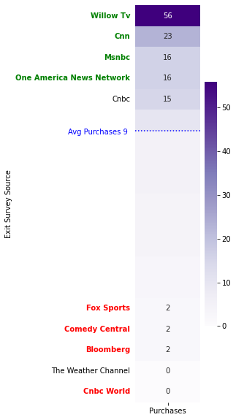
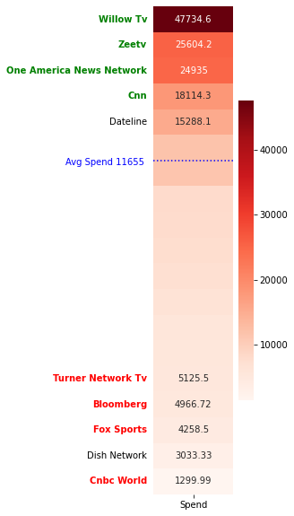
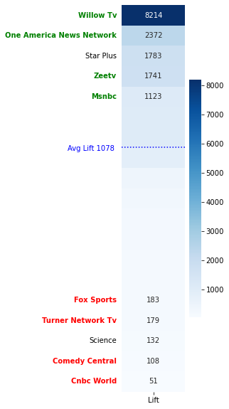
Purchases, Spend, and Lift – Top and Bottom 5 Channels – Recurring Characters
At the top, we see the following channels in all three categories:
Willow TV
One America News
With the following in two out of three categories
ZeeTV
CNN
MSNBC
At the bottom, we see the following channels in all three categories:
Fox Sports
With the following in two out of three categories
Comedy Central
Bloomberg
CNBC World
Turner Network TV (TNT)

Slide 5
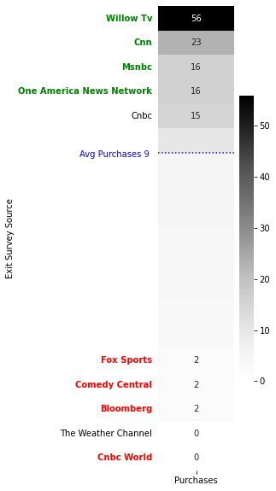
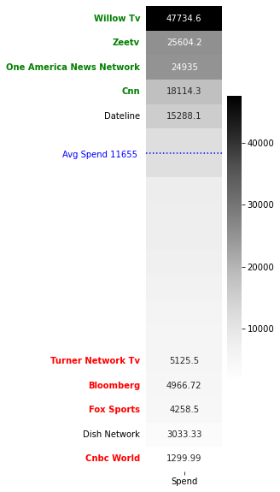
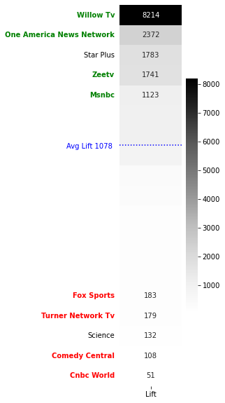
Purchases, Spend, and Lift – Top and Bottom 5 Channels – Recurring Characters
At the top, we see the following channels in all three categories:
Willow TV
One America News
With the following in two out of three categories
ZeeTV
CNN
MSNBC
At the bottom, we see the following channels in all three categories:
Fox Sports
With the following in two out of three categories
Comedy Central
Bloomberg
CNBC World
Turner Network TV (TNT)

Slide 6
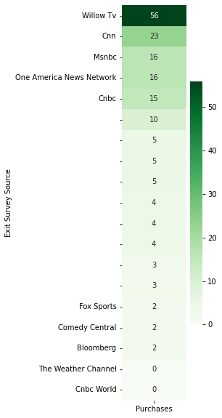
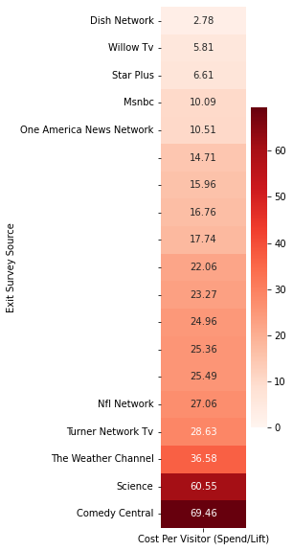
Cost efficiency – Cost Per Visitor Per Network (Spend/Lift)
At the top:
WillowTV, MSNBC, and One America News Network are among the top 5 in terms of Cost Per Visitor and are in the top 5 in terms of purchases.
Key Benchmark: Overall Cost Per Visitor (Total Spend / Total Lift): $10.81
Only the top 5 companies (pictured left) outperformed this metric.
At the bottom:
Comedy Central and The Weather Channel have very few purchases and are among the costliest in terms of generating Lift

Slide 7
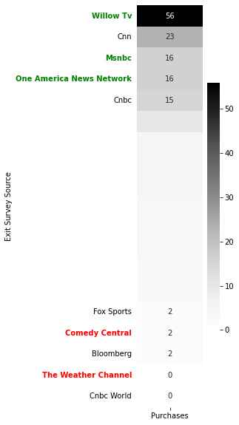
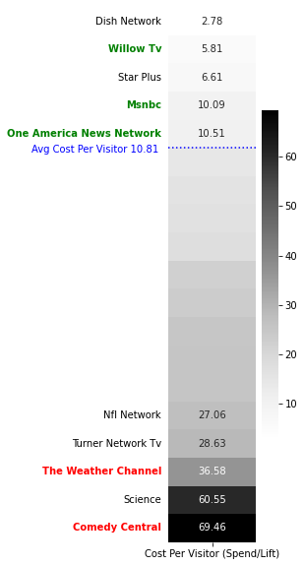
Cost efficiency – Cost Per Visitor Per Network (Spend/Lift)
At the top:
WillowTV, MSNBC, and One America News Network are among the top 5 in terms of Cost Per Visitor and are in the top 5 in terms of purchases.
Key Benchmark: Overall Cost Per Visitor (Total Spend / Total Lift): $10.81
Only the top 5 companies (pictured left) outperformed this metric.
At the bottom:
Comedy Central and The Weather Channel have very few purchases and are among the costliest in terms of generating Lift

Slide 8
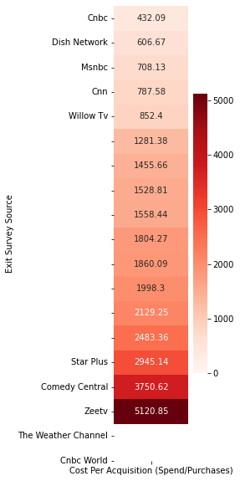
Cost efficiency – Cost Per Acquisition (CPA) Per Network (Spend/Purchases)
At the top:
WillowTV, CNN, MSNBC, and CNBC are among the top 5 in terms of Cost Per Acquisition and are in the top 5 in terms of purchases.
Key Benchmark: Overall Cost Per Acquisition (Total Spend / Total Purchases): $1265.35
Only the top 5 companies (pictured left) outperformed this metric.
At the bottom:
Comedy Central, The Weather Channel, and CNBC World have very few, or no purchases, and are among the costliest in terms of generating purchases.
Note: Weather Channel and CNBC World had zero purchases and calculating CPA isn’t possible.

Slide 9
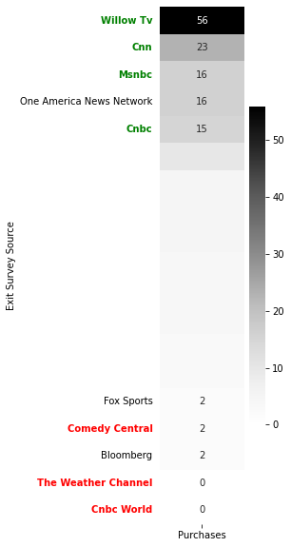
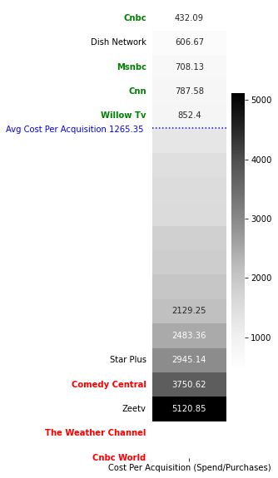
Cost efficiency – Cost Per Acquisition (CPA) Per Network (Spend/Purchases)
At the top:
WillowTV, CNN, MSNBC, and CNBC are among the top 5 in terms of Cost Per Acquisition and are in the top 5 in terms of purchases.
Key Benchmark: Overall Cost Per Acquisition (Total Spend / Total Purchases): $1265.35
Only the top 5 companies (pictured left) outperformed this metric.
At the bottom:
Comedy Central, The Weather Channel, and CNBC World have very few, or no purchases, and are among the costliest in terms of generating purchases.
Note: Weather Channel and CNBC World had zero purchases and calculating CPA isn’t possible.

Slide 10
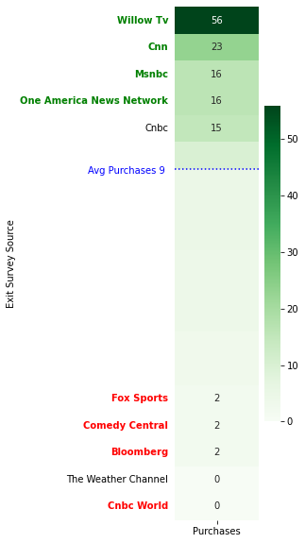
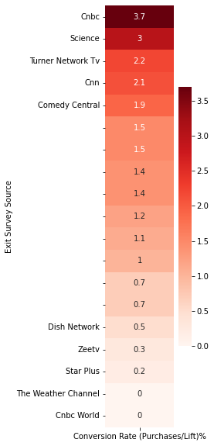
Conversion Rate Per Network (Purchases/Lift)%
At the top:
CNN and CNBC are among the top 5 in terms of Conversion Rate and are in the top 5 in terms of purchases.
Key Benchmark: Overall Conversion Rate (Total Purchases / Total Total): 0.9%
Most companies outperformed this metric.
At the bottom:
The Weather Channel and CNBC World have no purchases and thus have a conversion rate of 0%.
Of note: Comedy Central has low purchases but high conversion rate
Note: Weather Channel and CNBC World are dead last in Conversion Rate because both had zero purchases.

Slide 11
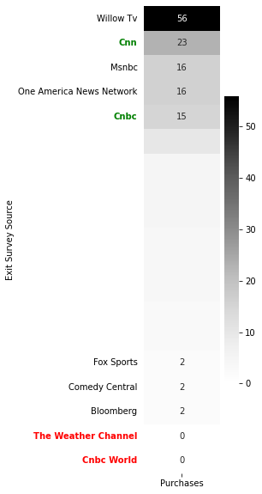
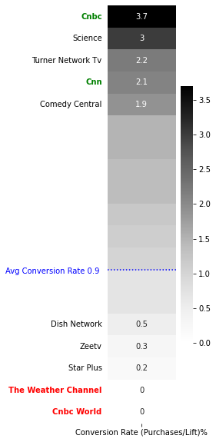
Conversion Rate Per Network (Purchases/Lift)%
At the top:
CNN and CNBC are among the top 5 in terms of Conversion Rate and are in the top 5 in terms of purchases.
Key Benchmark: Overall Conversion Rate (Total Purchases / Total Total): 0.9%
Most companies outperformed this metric.
At the bottom:
The Weather Channel and CNBC World have no purchases and thus have a conversion rate of 0%.
Of note: Comedy Central has low purchases but high conversion rate
Note: Weather Channel and CNBC World are dead last in Conversion Rate because both had zero purchases.

Slide 12
What have we learned so far?
The good
In the top 5 for 2/3 of your metrics:
WillowTV (+2/3 metrics)
Highest Spend Overall
Highest Lift Overall
Highest Purchases Overall
MSNBC (+2/3 metrics)
Third Highest Purchases
Fourth Highest Lift
CNN (+2/3 metrics)
Second highest purchases
CNBC (+2/3 metrics)
Fourth Highest purchases
The bad
In the bottom 5 for 2/3 of your metrics:
Comedy Central (-2/3 metrics)
Costliest in generating lift
Second costliest in generating purchases
Low purchases, but high conversion rate
CNBC World (-2/3 metrics)
Zero Purchases
CPA can’t be calculated
In the bottom 5 for all three of your metrics:
The Weather Channel (-3/3 metrics)
Zero Purchases
CPA can’t be calculated
Third Costliest in generating lift

Slide 13
What else can we learn?

Slide 14
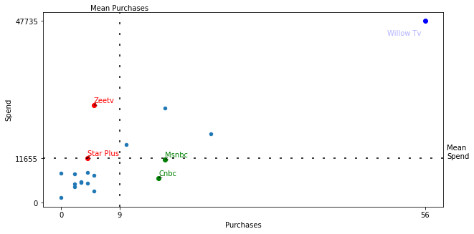
Purchases vs. Spend
Below average purchases, above average spend:
You’re spending more and getting less purchases, that’s bad!
Above average purchases, below average spend:
You’re spending less and getting more purchases, that’s good!
Note: the graph is divided into four quadrants, sectioned off by Average Purchases (x) and Average Spend (y).

Slide 15
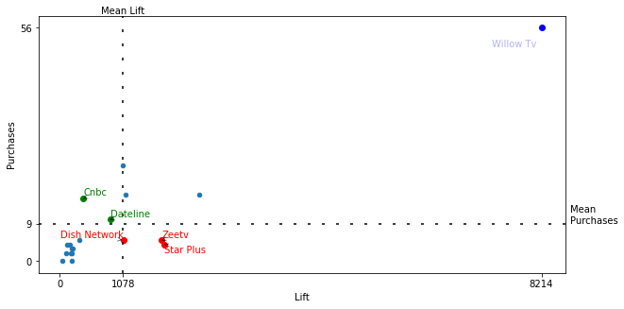
Lift vs. Purchases
Below average lift, yet above average purchases:
You’re getting less lift, but more purchases despite it, that’s good!
Above average lift, below average purchases:
Despite increased traffic, these customers don’t seem to want your product, that’s bad!
Note: the graph is divided into four quadrants, sectioned off by Average Lift (x) and Average Purchases (y)

Slide 16
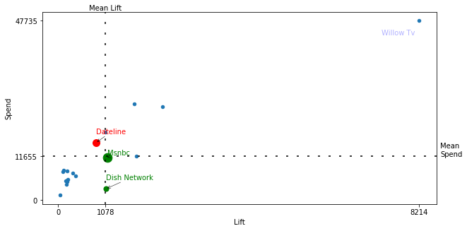
Lift vs. Spend
Below average lift, above average spend:
You’re getting less lift for your buck, that’s bad!
Above average lift, below average spend:
You’re getting more lift for your buck, that’s good!
Note: the graph is divided into four quadrants, sectioned off by Average Lift (x) and Average Spend (y). The size of each colored point corresponds to number of purchases made there.

Slide 17
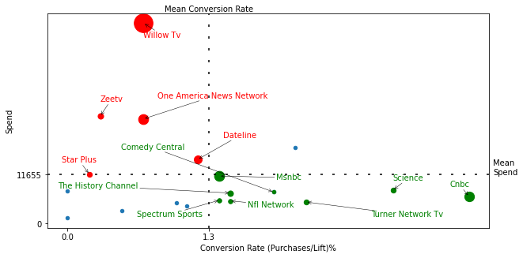
Conversion Rate vs. Spend
Low conversion rate, high spend:
These channels have a low likelihood of a sale and are more expensive to advertise on, that’s bad!
High conversion rate, low spend:
These channels have a higher likelihood of a sale and are cheaper to advertise on, that’s good!
Note: the graph is divided into four quadrants, sectioned off by Average Conversion Rate (x) and Average Spend (y).
The size of each colored point corresponds to number of purchases made there.

Slide 18
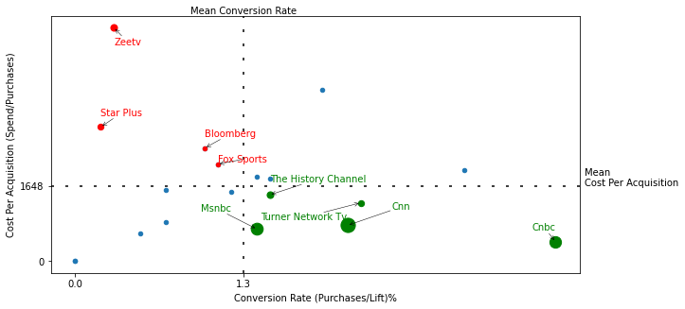
Conversion Rate vs. Cost Per Acquisition (CPA)
Low conversion rate, high cost per acquisition
These channels have a low likelihood of a sale and it’s costly to acquire a customer, that’s bad!
High conversion rate, low cost per acquisition
These channels have a high likelihood of a sale and it’s cheaper to acquire a customer, that’s good!
Note: the graph is divided into four quadrants, sectioned off by Average Conversion Rate (x) and Average CPA (y).
The size of each colored point corresponds to number of purchases made there.

Slide 19
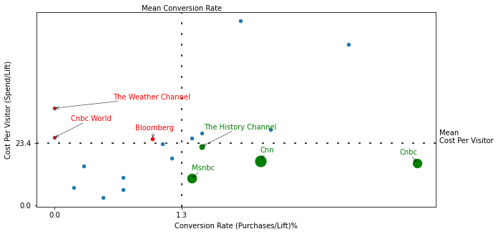
Conversion Rate vs. Cost Per Visitor
Low conversion rate, high cost per visitor:
These channels have a lower likelihood of acquiring a customer and a higher cost to get them to your website, that’s bad!
High conversion rate, low cost per visitor:
These channels have a higher likelihood of acquiring a customer and a lower cost to get them to your website, that’s good!
Note: the graph is divided into four quadrants, sectioned off by Average Conversion Rate (x) and Average Cost Per Visitor (y).
The size of each colored point corresponds to number of purchases made there.

Slide 20
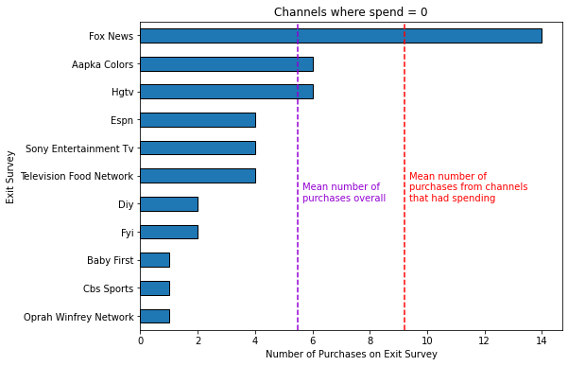
Some Channels have no spend, but high purchases
Despite having no spending on advertising, Fox News was way ahead in terms of mean number of purchases, when considering only channels where money was spent on ads (19 channels).
Other channels, like Aapka Colors and HGTV, performed better than average, if we look average over any channel from the exit survey (30 channels).

Slide 21
What new information have we gained?
The good
CNBC (+5)
Performed well in 5/6 of the previous graphs
MSNBC (+4)
Performed well in 4/6 of the previous graphs
The History Channel (+3)
Performed well in 3/6 of the previous graphs
CNN (+2)
Performed well in 2/6 of the previous graphs
Turner Network TV (+2)
Performed well in 2/6 of the previous graphs
NFL Network (+2)
Performed well in 2/6 of the previous graphs
The bad
ZeeTV (-4)
Performed poorly in 4/6 of the previous graphs
Star Plus (-4)
Performed poorly in 4/6 of the previous graphs
Bloomberg (-2)
Performed poorly in 2/6 of the previous graphs

Slide 22
Recommendation: Which networks to spend more money?
MSNBC
Third highest purchases
Fourth highest lift
In top 5 of 2/3 of your metrics
Performed well in 4/6 of the scatter plots
CNN
Second highest purchases
In top 5 of 2/3 of your metrics
Performed well in 2/6 of the scatter plots
CNBC
Fourth highest purchases
In top 5 of 2/3 of your metrics
Performed well in 5/6 of the scatter plots
Honorable Mentions
Weren’t in top 5 of any of your metrics, but performed well in at least 2 of the scatter plots:
The History Channel
Turner Network TV
Was in bottom 5 in terms of spending, perhaps more exposure would lead to even stronger performance
NFL Network
No money spent on advertising, yet customers attributed their purchase to these channels, which accounted for a sizeable chunk of all 236 purchases:
Fox News (5.9%)
Aapka Colors (2.5%)
HGTV (2.5%)

Slide 23
Recommendation: Which networks to cut spending?
CNBC World
Zero Purchases
Ranked in bottom 5 for 2/3 of your metrics
The Weather Channel
Zero Purchases
Third costliest in generating lift
Ranked in bottom 5 for 3/3 of your metrics
ZeeTV
Performed poorly in 4/6 of the scatter plots
Star Plus
Performed poorly in 4/6 of the scatter plots
Comedy Central
Costliest for generating lift
Second costliest in generating purchases
Ranked in bottom 5 for 2/3 of your metrics
Honorable mentions
Bloomberg
Performed poorly in 2/6 of the scatter plots

Slide 24
How can the exit survey be improved?
Remove channels that you haven’t spent money on
CBS Sports
DIY
ESPN
Fox News
FYI
HGTV
Oprah Winfrey Network
Remove Other:______
When a customer marks Other, it gives us just as much information as if they had left this question blank. It’s unnecessary to have two different choices that yield the same information.
Include a few more questions on demographics, such as age or gender.

