Slide 1
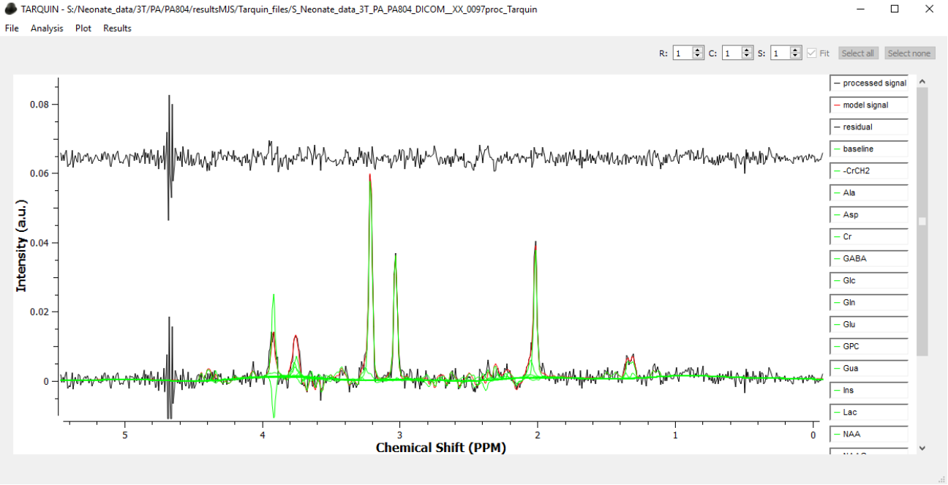
Tarquin after fitting:

Slide 2
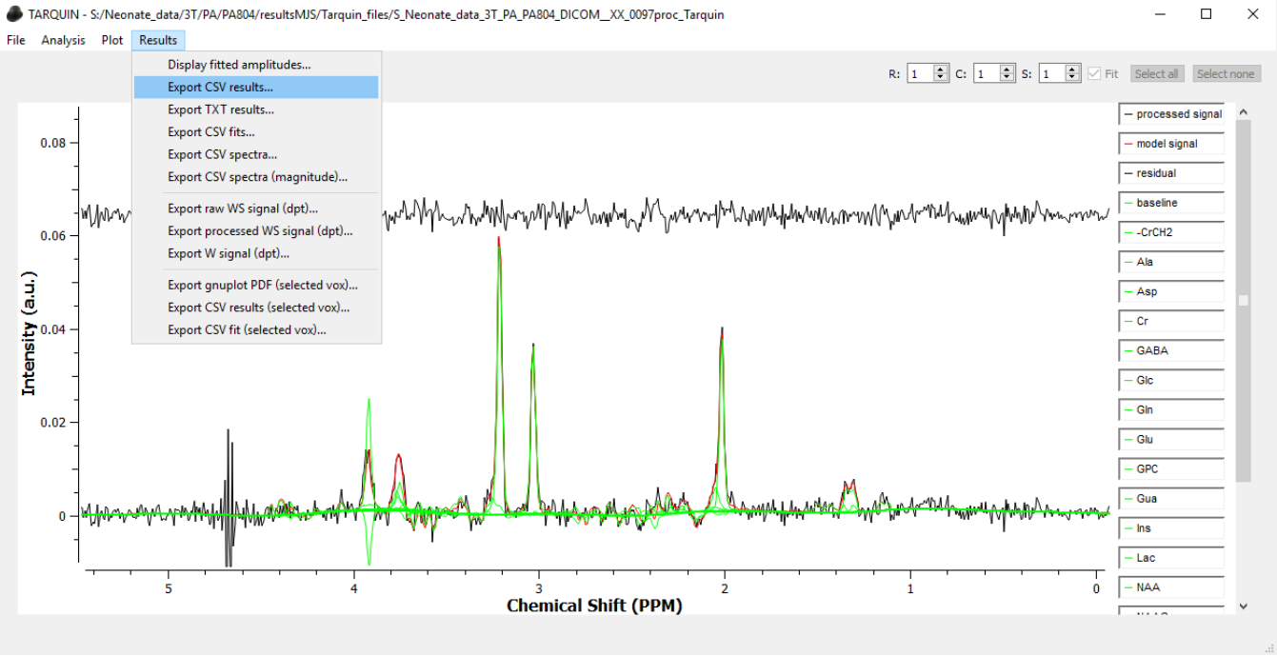
Select Export CSV Results

Slide 3
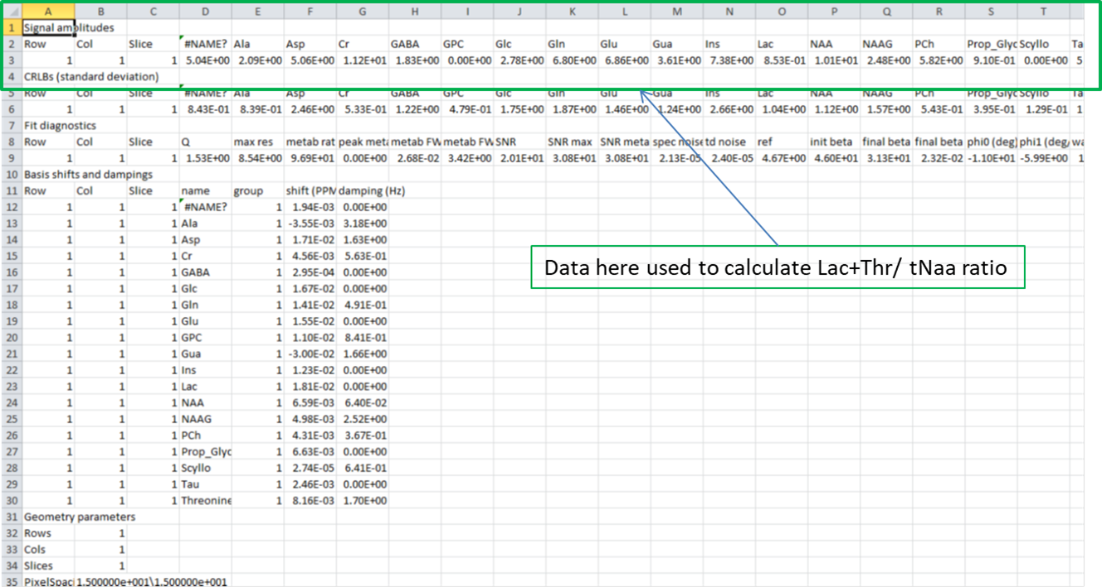
Save CSV file and open:

Slide 4
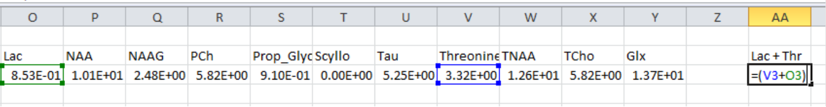
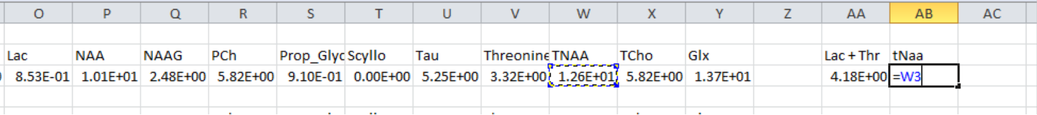
Compute ratio:
1: Calculate Lac + Thr
2: Copy tNaa
3: Calculate ratio

