Slide 1
WELCOME

Slide 2
Course Title:
Software Development Project-II
Course No: CSE 3200

Slide 3
Project Name:
Implementation of Mobile Notice Board
Project Supervisor:
Dr. Pintu Chandra Shill
Associate Professor
Department of Compute
Science and Engineering.
Devoloped By:
Priyabrota Sen
Roll:1207024
Tanmoy Ghosh
Roll:1207028

Slide 4
Project Objectives
Faster broadcast of notices regarding education, technical events, cultural events.
Any lost/found going out in university.
Easy way to broadcast your message.
Helps you to be updated with what’s going on in your campus.

Slide 5
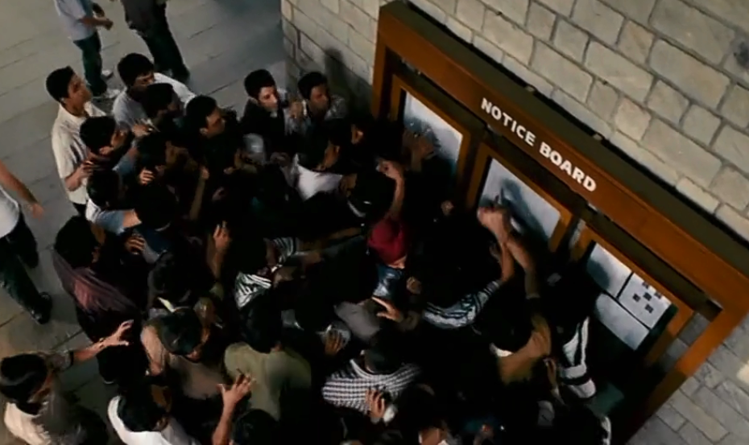
Present System
Every sort of work is done on mush paper and clipped to the notice board
For any notice student have to look for on the notice board
A huge crowd before the notice board
.

Slide 6
Problem in Present System
Sometimes the notice is not posted due time.
After a few days the notice may be damaged.
Previous notice may not be found.
On holiday student doesn’t get the notice.
Due to huge crowd every student doesn’t get access the notice board.

Slide 7
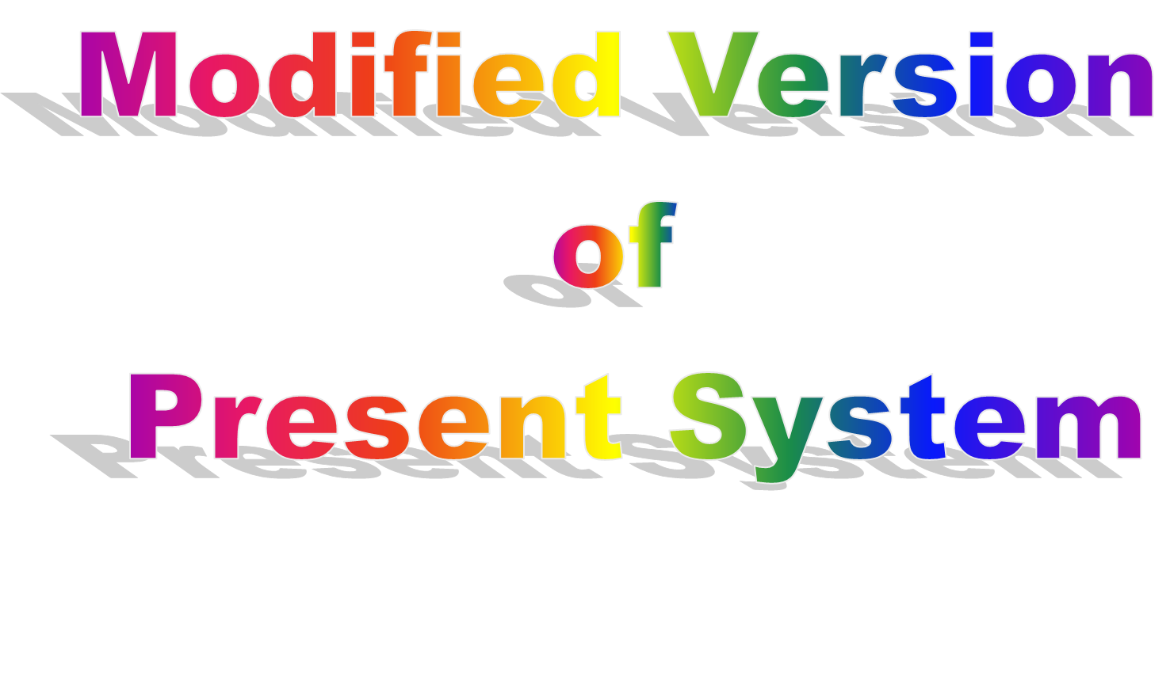

Slide 8
Proposed System
Notice will be published via mobile using this application.
Anyone can share the important message.
If a notice for only the teachers then the students will not access the notice.
Every group has access to his own domain.
A published notice can be modified.

Slide 9
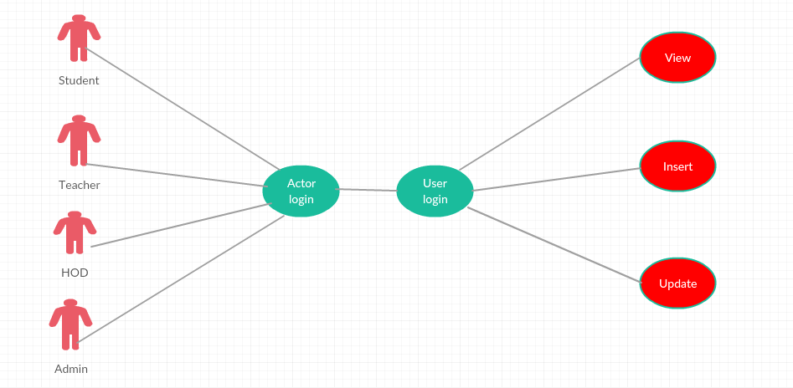
Use Case Diagram

Slide 10
Project Modules
User Interface
Communication with web server
Parsing JSON response

Slide 11
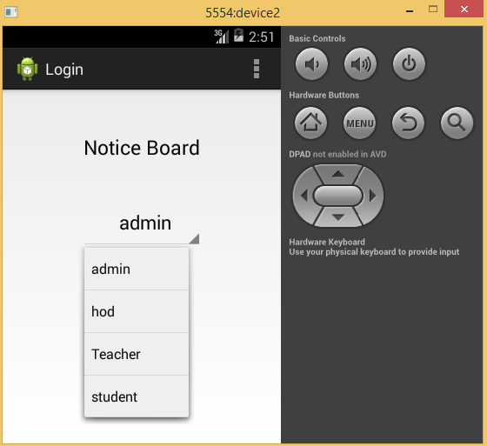
Actor Login

Slide 12
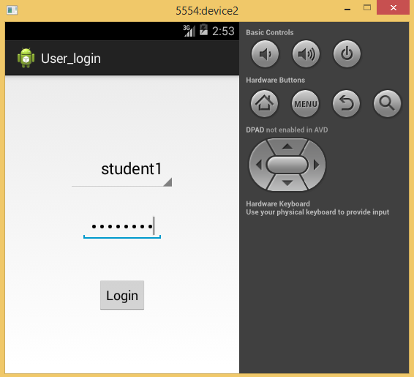
User Login

Slide 13
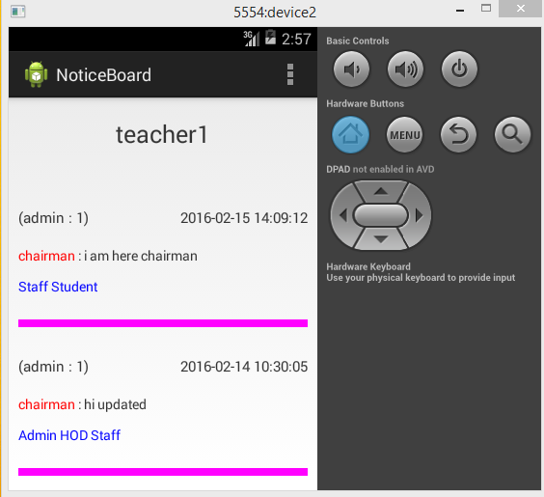
Notice Board

Slide 14
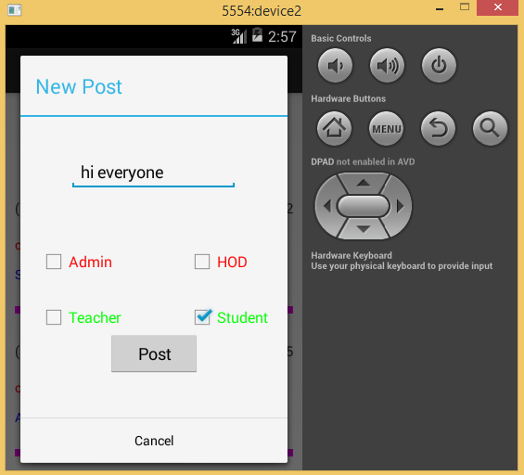
Post Notice

Slide 15
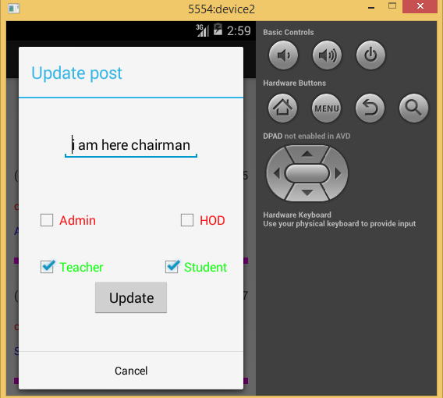
Update Notice

Slide 16
Communication With Web Server
Communicate with web server
000webhost server is used to host the database
Fatches notice form the server and show the notice in the notice board
Free server is used so the server is very slow

Slide 17
JSON parsing
JASON stands for Java Script Object Notation
It is independent data exchange format
All the web server responses are JSON encode.
Application needs to parse the JSON in order to get the actual response or message from the server

Slide 18
Technologies Used
XML
Java
PHP
MySQL

Slide 19
Advantages
Eliminate wastage of time and energy
Avoid duplication and overlapping
Remove crowd on the notice board
Notice can be published and show from anywhere and anytime
Keeping notice at one place
Notice will not be damaged or spoilt

Slide 20
Limitations
Sometimes the server is down and the application doesn’t work properly
As we use the free server so the server does not work properly
When the database size is big then it takes some times to upload the notice

Slide 21
Future Scope
Upload documents and PDF file
Include notification alert in the application icon
Feedback on any notice

Slide 22
Conclusion
Getting update with University
Everyone will be aware of all on going events and activities in the campus
Make every person well informed about the University

Slide 23
Thank You to All

