Slide 1
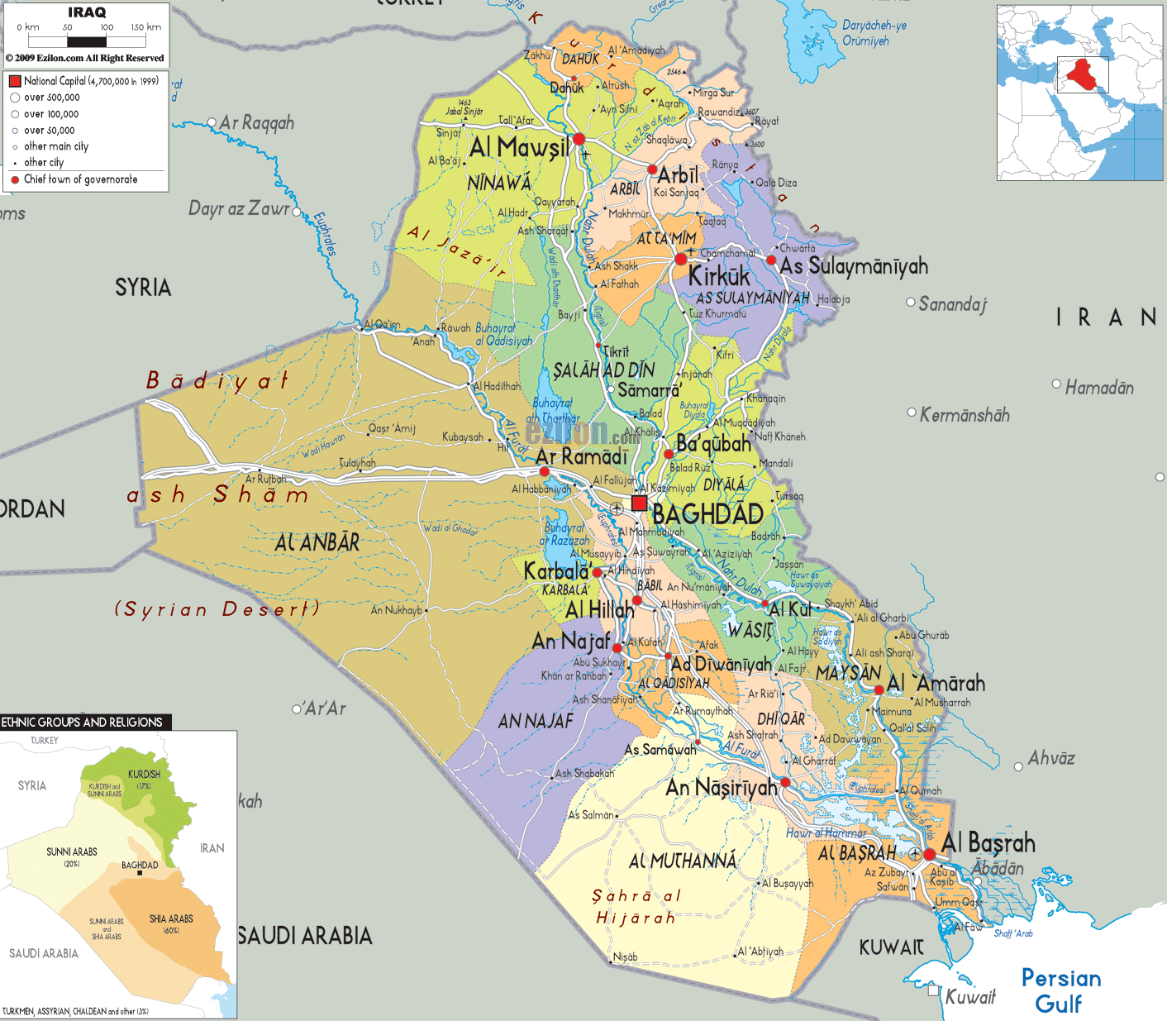
IRAQ ACTION 2009-2015
FACTS
Total Area 438.317 km2
Population 37 millions
UNIVERSITIES
5 (Baghdad region)
15 (rest of Iraq)
18 (Kurdistan)
    9 (Erbil)
    7 (Sulaimania)
    2 (Dohuk)
24 (private Intitutions)
RECENT HISTORY
Republic (1958-1969)
Ba'athist Iraq (1968-2003)
    Iran War (9/80 – 8/88)
    First Gulf War (8/90-2/91)
Republic (2003-
    Invasion (20/3/03)
    Elections (2005)
    ISIS crisis (June 2014)
Francesco PAPPALARDI
(Università Roma TRE)

Slide 2




IRAQ UNIVERSITIES
Baghdad University
Established in 1957
(80,000 students)
5 Campuses
25 Colleges
University of Basrah
Established in 1964
(100,000 students)
4 Campuses
15 Colleges
Salahaddin University
Erbil (Kurdistan)
Established in 1968
(27,000 students)
Academic (Full Time) 1750
Academic (Contract) 120
University of Mosul
Established in 1967
(30,000 students)
19 Colleges
under ISIS control

Slide 3

Early Actions in Iraq (before 2003)
2000 Adil Naoum (Iraqi Science Academy) requests support
2000 First mission to Iraq
(Michel Jambu, D. Robert, G. Oppenheim, Michel Waldschmidt)
2001 Second mission (MJ, MW)
2001 & 2002, Workshops on the use of computers in teaching mathematics at the University, Baghdad supported by CIMPA
2002 Third mission (MJ,MW) funds for travel of Iraqi students

Slide 4
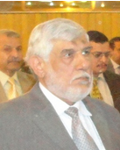
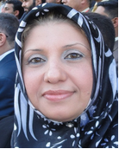
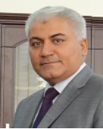
Consequences of the 2000 mission the work of Michel Jambu
10.000€ grant to CIMPA in support Iraqi mathematics
2003 visit to CIMPA of Prof. Dr. Abid Ali H. Al Taai, later counselor of the Ministry of Higher Education and Scientific Research in Iraq
2008 visit of Prof. Dr. Hana M. Ali to Nice to work with MJ
2009 visit of Prof. Dr. Raad S. Mahdi to Nice to work with MJ
Abid Ali H. Al Taai
Hana M. Ali
Raad S. Mahdi

Slide 5


Actions in Iraq (after 2003)
2008 Mission Iraqi Kurdistan (Mohammad Eftekhari, MW)
2009 (November 14 – 18)
The First Iraqi-French Mathematics Conference
Salahaddin University-Erbil
2010- The French Embassy in Bagdad support starts

Slide 6

Actions in Iraq
December 14 - 16, 2010, (MJ & MW)
International Conference on Revitalizing Research in Kurdistan.
October 23 - 24, 2013, (MJ, MW, JJ, FP)
Second International Conference of Mathematics and its Applications, Basrah
May 5-14 2014,
CIMPA-KURDISTAN-IRAQ Inverse problems: Theory and applications

Slide 7
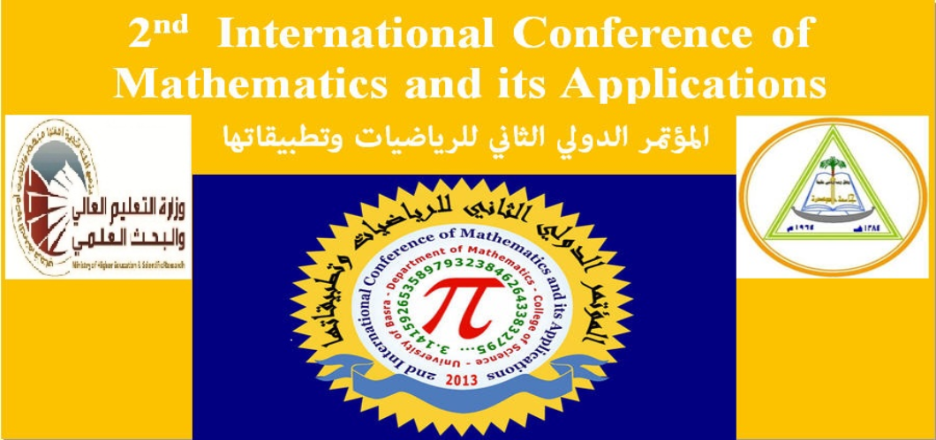
October 23 - 24, 2013
Organizers:
Raad S. Mahdi
Abdulsattar J. Ali
Hana M. Ali
...
Among the Participants:
Michel Jambu
Michel Waldschmidt
Jorge Jimenez Urroz
FP

Slide 8


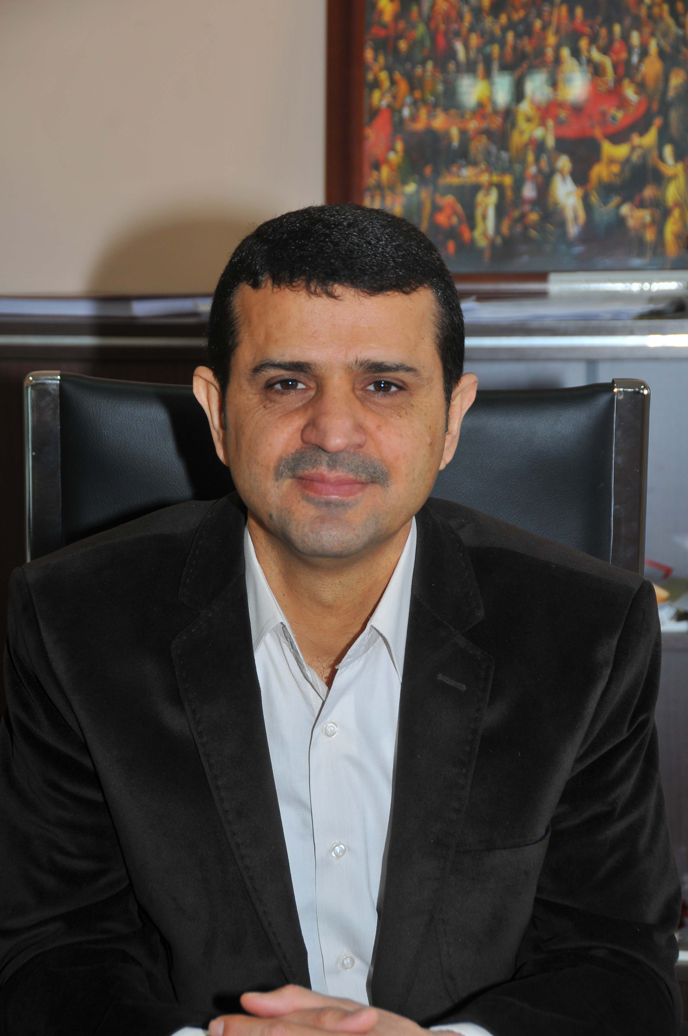
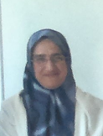
Kurdistan Workshops Project
2010 (25/11–9/12) Algebraic Geometry - Caucher Birkar (Sal)
2011 (3–11/1) A Mini Course on Commutative Algebra-Reza Sazeedeh (Sal)
2011 (10-16–16/2) Some Topics in Topology - Michel Jambu (D)
2011 (4-11/4) Number Theory - Alain Faisant (Sal)
2011 (5/9 – 11/9) Topics of Numerical Methods for Partial Differential Equations
Abdeljalil Nachaoui (Sal)
2011 (17-21/12) Commutative Algebra - Kamran Divaani
2012 (8-14 /5) Free Boundary problem : theory and practice
Abdeljalil Nachaoui (Sal+Sul)
2013 (14-30/4) Statistics with Application – Badih Ghattas (Sal+Sul)
2013 (30/3 - 8/4) Geometry and Computational Topology - Michel Jambu
2013 (20-29/8) Application of Matlab in Mathematics - Adnane Azzouzi
2013 (25-31/10) Inverse Problems - Abdeljalil Nachaoui (Sal+Sul)
2014 (1/12 – 9/12) Number Theory and Cryptography – FP (Sal)
Fatima Aboud
Herish Omar

Slide 9
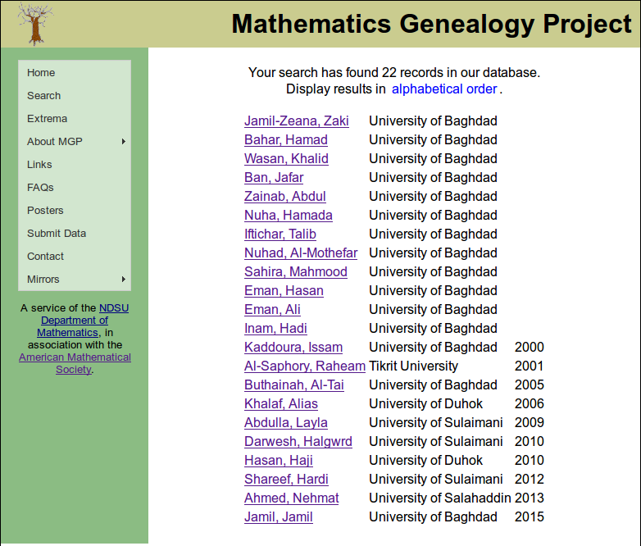
Some PhD's from Iraq
Most of them are
scientifically related to
Naoum Adil G.
(College of Sciences,
University of Baghdad)

Slide 10

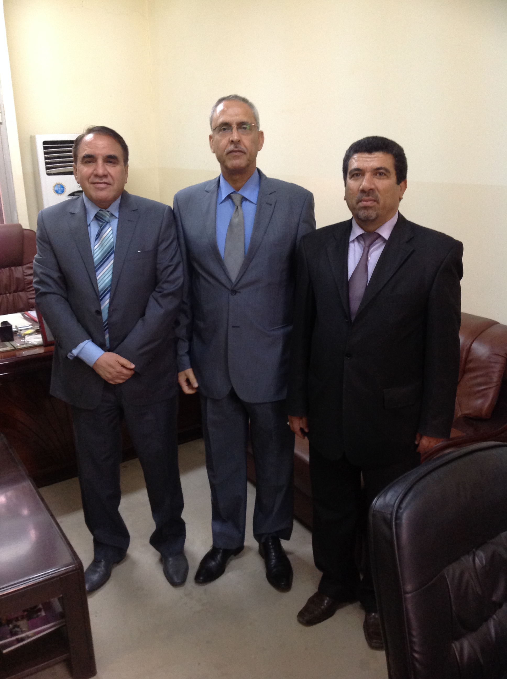
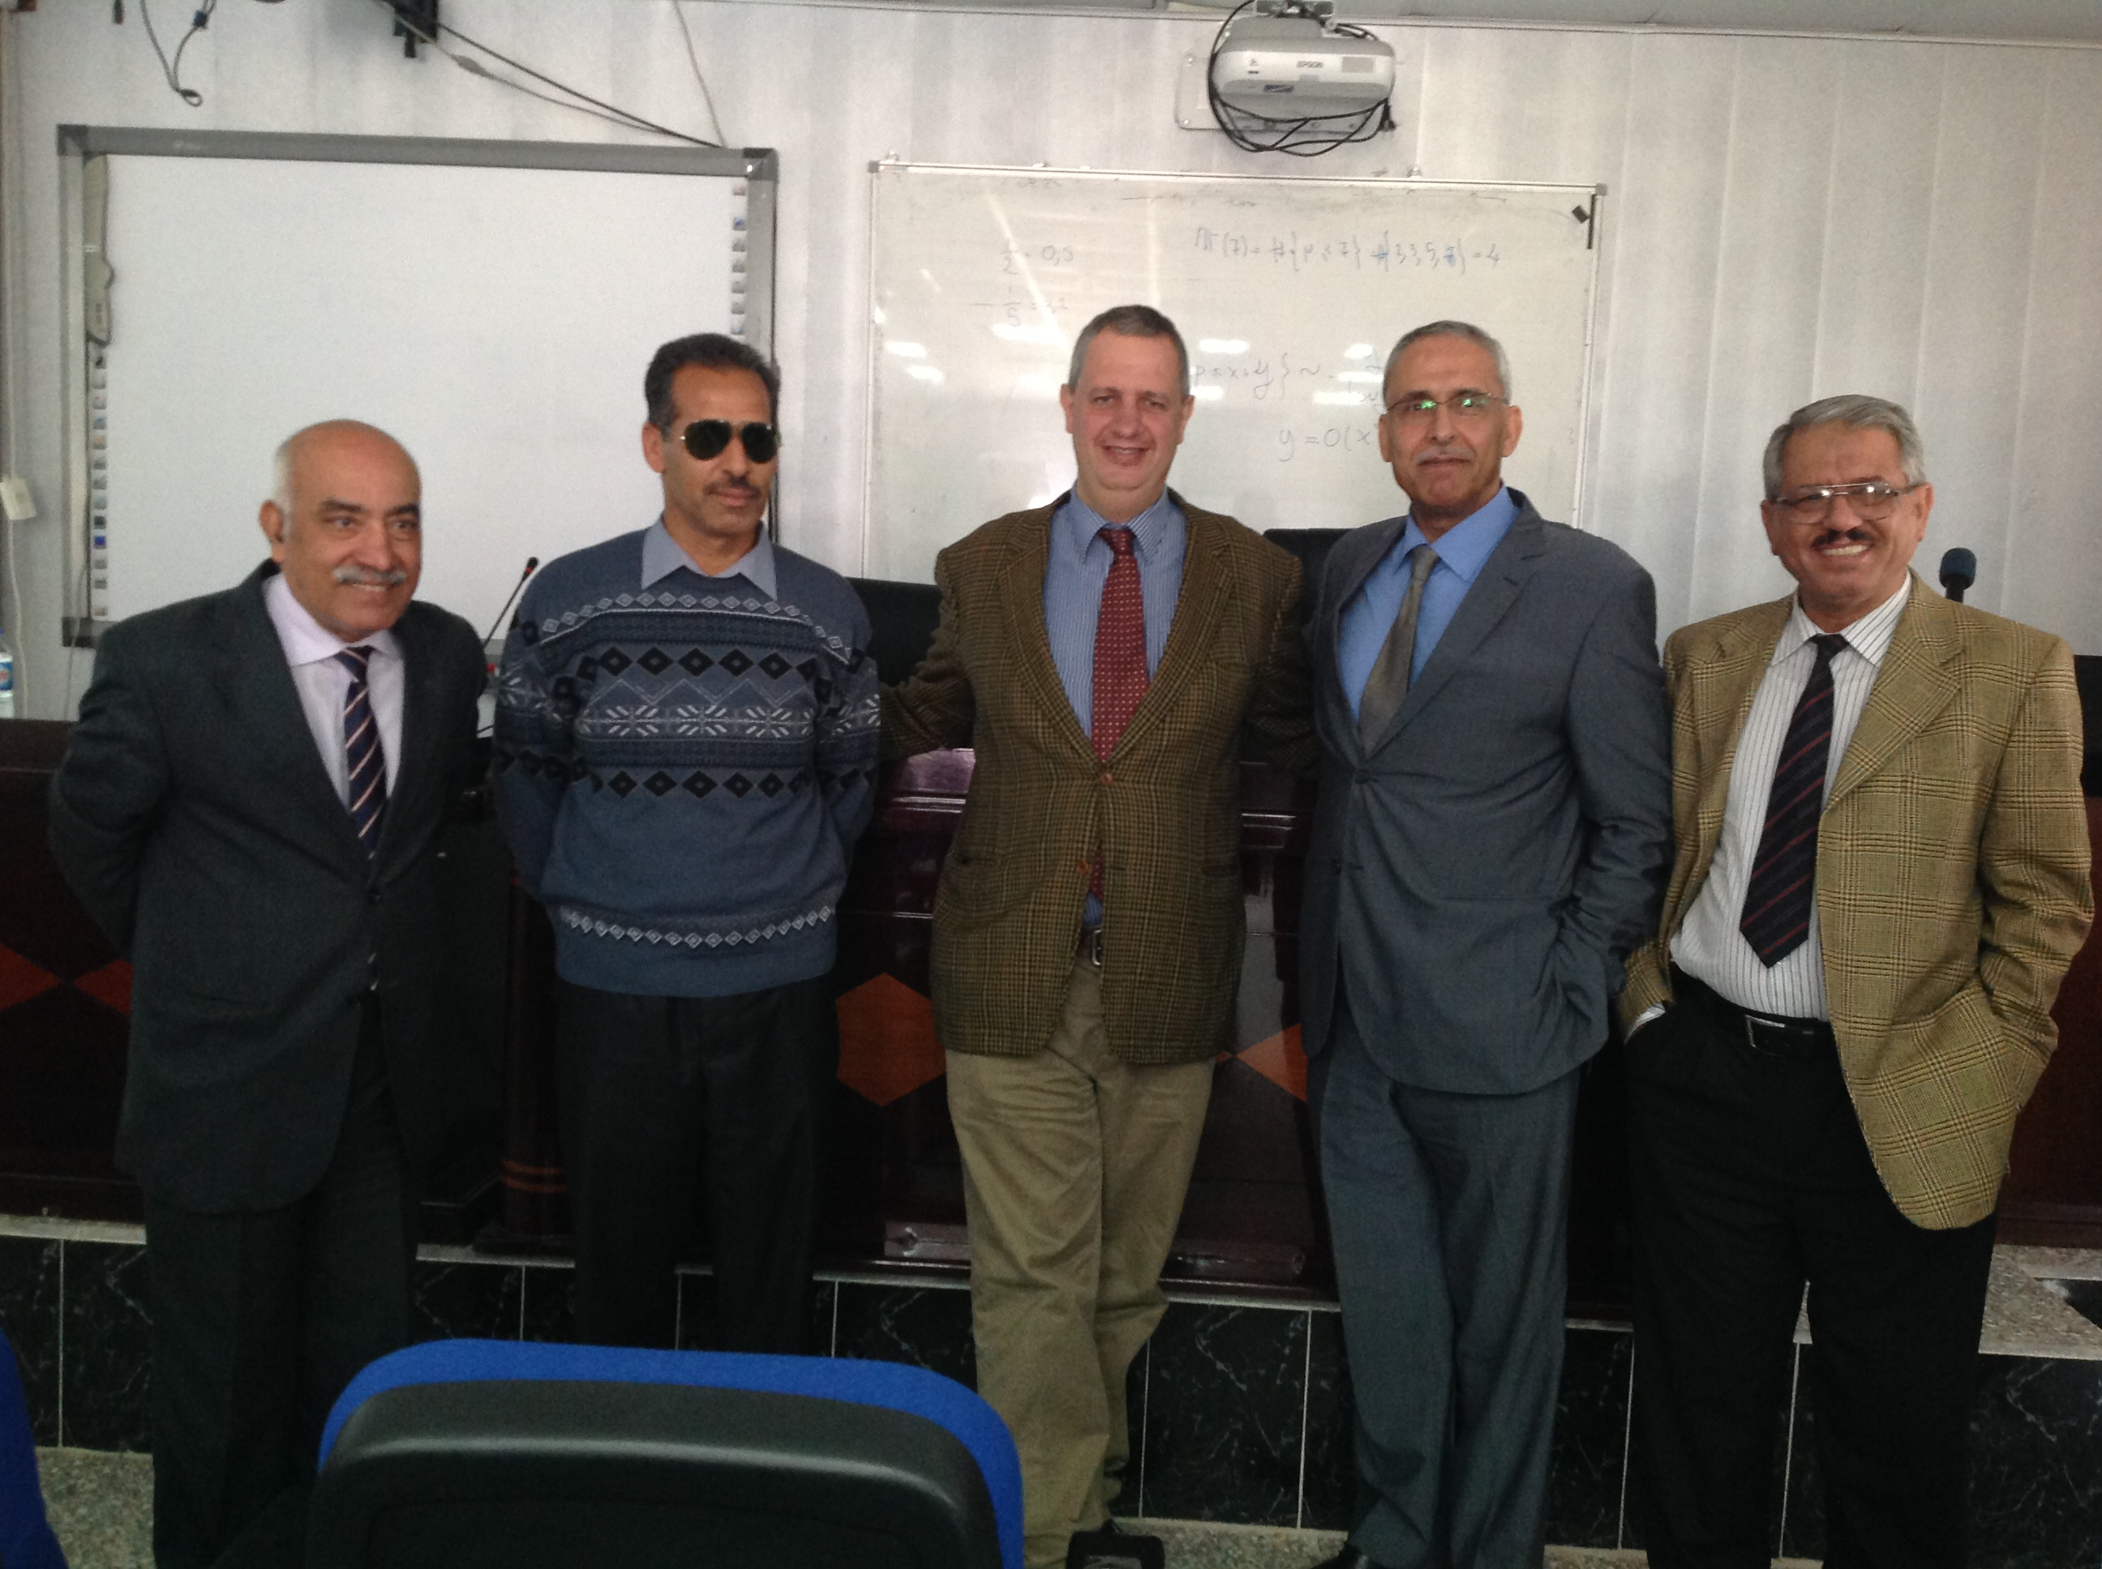
March 29 - April 1, 2014
College of Science for Women
University of Baghdad
MISSION'S TASKS
Number Theory Seminars
Presentation on Mathematics Programs in Italian University
Reviewing local programs in Mathematics
Meeting with possible future Iraqi Doctoral Students in Italy
Iden Hasan Al-Kinany, Na'mh Abdulla Abid, Hussain Ali Mohamad
Radhi Ibrahim Mohammed Ali, Saad Naji Al-Azzawiy, FP, Na'mh Abdulla Abid, Saad Abbod Badday

Slide 11
Future Actions
Security Issues
Iraqi Government Doctoral Fellowships (ME,MJ,MW)
Kurdish Government Doctoral Fellowships (ME,MJ,MW)
Update the accredited Universities list of the Ministry of Higher Education
Short Travel Grants for Iraqi Mathematicians
Continuing CIMPA-Kurdistan Workshops Projects
Future CIMPA school in Erbil or elsewhere

Slide 12
Webography of Iraq Mathematics
http://www.uobaghdad.edu.iq/ (Baghdad University)
http://www.uobasrah.edu.iq/ (Basrah University)
http://su.edu.iq/ (Salahaddin University)
http://www.iraqacademy.iq/ (Iraq Academy of Siences)
http://www.uomosul.edu.iq/ (University of Mosul)
http://www.basconmath.org/ (2nd Conf. Int. Math. & Appl.)
http://univsul.edu.iq/ (University of Sulaimani)
http://www.mhe-krg.org/ (Ministery of Higher Educ.
Erbil)
http://ww1.moheiraq.org/ (Ministery of Higher Educ.
Baghdad)

Slide 13
Reportography of Iraq Missions
2000 CIMPA Mission Iraq (MJ)
2002 Mission Iraq (MJ, MW)
2008 Mission au Kurdistan Iraqien
2009 First Iraqi-French Mathematics Conference (MW)
2012 Topics in Cryptography (JJU)
2013 2nd ICMA International Conference of Mathematics and its Applications University of Basrah (MJ&MW), (FP)
2014 Academic visit at College of Science of Women, University of Baghdad (FP)
2014 CIMPA School: Inverse problems: Theory and Applications
(JJU), (Abdeljalil Nachaoui & Fatima Aboud)
2014 University of Baghdad (FP)

