Slide 1
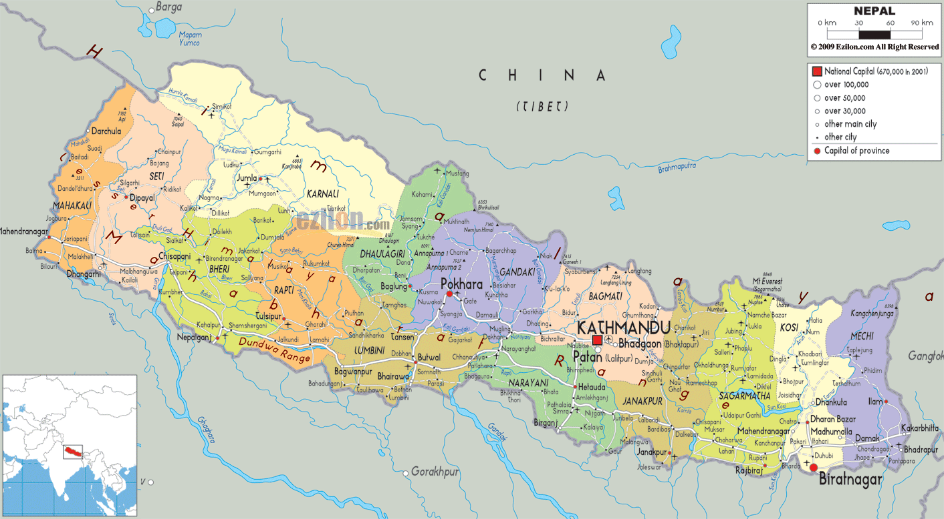
NEPAL ACTION 2010-2015
Francesco PAPPALARDI
(Università Roma TRE)
Kingdom 1768-2007
Republic 2008-
Total Area 147,181 km2
Population 27 millions

Slide 2




NEPAL UNIVERSITIES
Tribuvan University
Established in 1959
(604,000 students)
more than 600 affiliated colleges
located in Kirtipur
7000 perm faculties
+ 5000 temp facultird
Kathmandu University
Established in 1991
(40,000 students)
more than 200 affiliated colleges
located in Dhulikel
Private Intitution
Purbanchal University
Established in 1993
(22,000 students)
located in Biratnagar (far east)
Pokara University
Established in 1996
(25,000 students)
located in Pokara
There are five more smaller universities in Nepal

Slide 3


CIMPA-ICTP actions NEPAL
2009 National School in Number Theory and Cryptography NSNTC
2010 CIMPA-ICTP research school Number Theory in Cryptography and Its Applications
2014 CIMPA-NEPAL research school Aspects of Dynamical Systems

Slide 4
Mathematics Programs in Nepal
(at TU & KU)
    Kathmandu
    University:
School of Science
  M.Phil.(Math)
  Ph.D. in Mathematics
School of Education
  Post-Graduate Diploma of Education in Math
  Master of Education in Math
    Tribhuvan
    University:
Central Department of Mathematics
  Bachlour (Math)
  Master (Math)
  Ph.D. in Mathematics (3studs)
Department of Mathematics Education
  Master of Education in Math

Slide 5


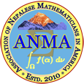
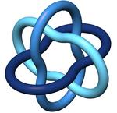



Who is Who in Nepal Mathematics
Nepal Mathematical Society (NMS) 1979-
Council for Mathematics Education of Nepal (MEC) 1991-
Association of Nepalese Mathematicians in America (ANMA) 2010-
NMS is an associate IMU member 2010
MEC is an associate ICMI member since 2010
Nepal is an affiliate member of SEAMS since 2013

Slide 6
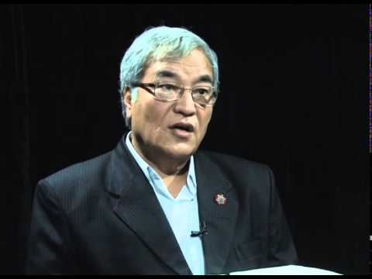
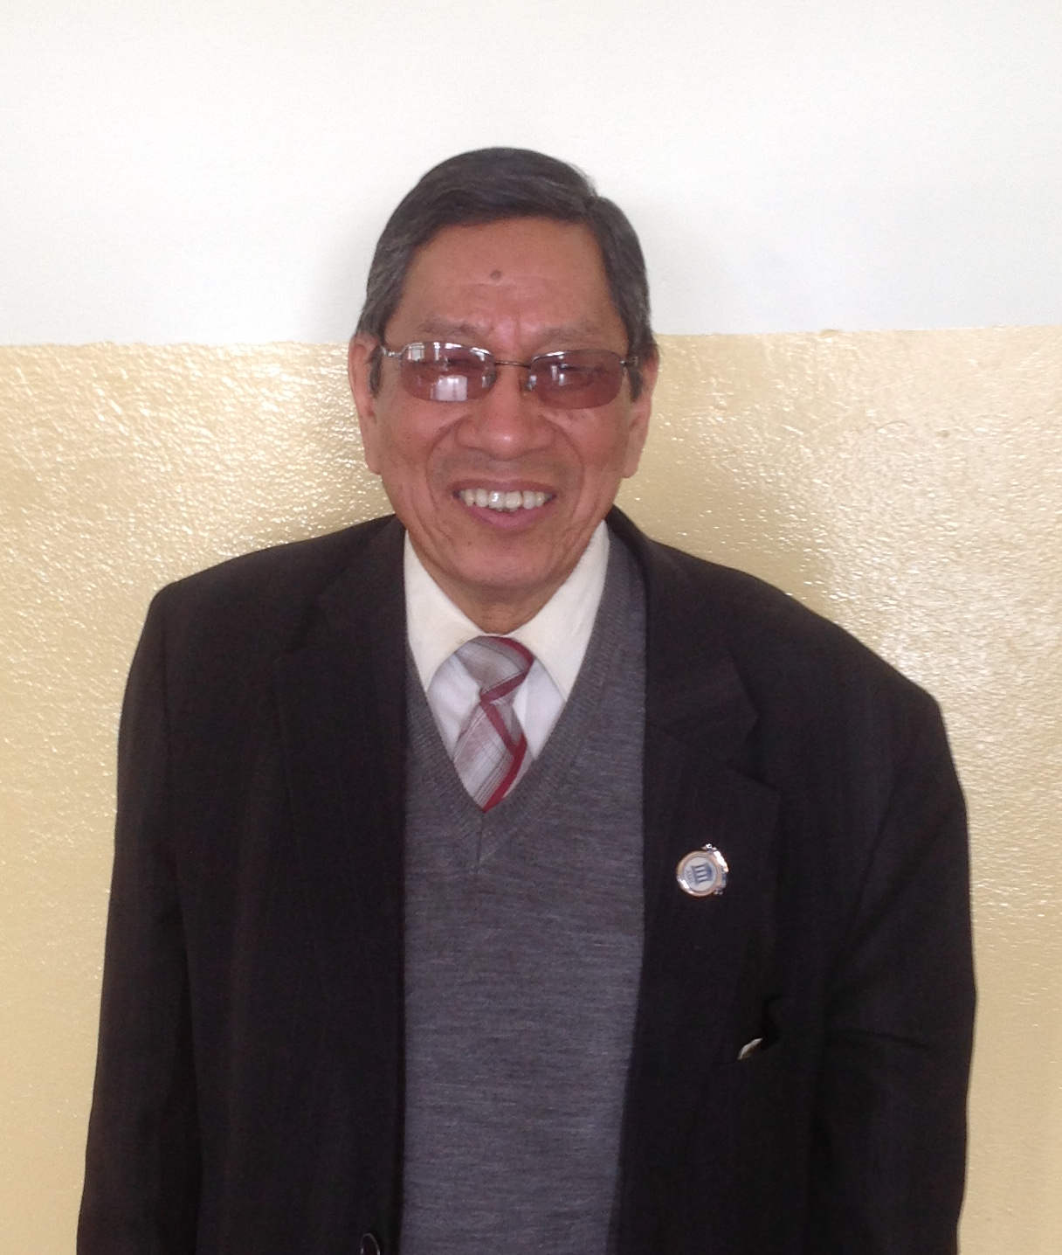
Who is Who in Nepal Mathematics
Prof. Dr. Bhadraman Tuladhar (Founder and former Registrar of KU, President of NMS,)
Prof. Dr. Hira Bahadur Maharjan (Vice-Chancellor TU)

Slide 7
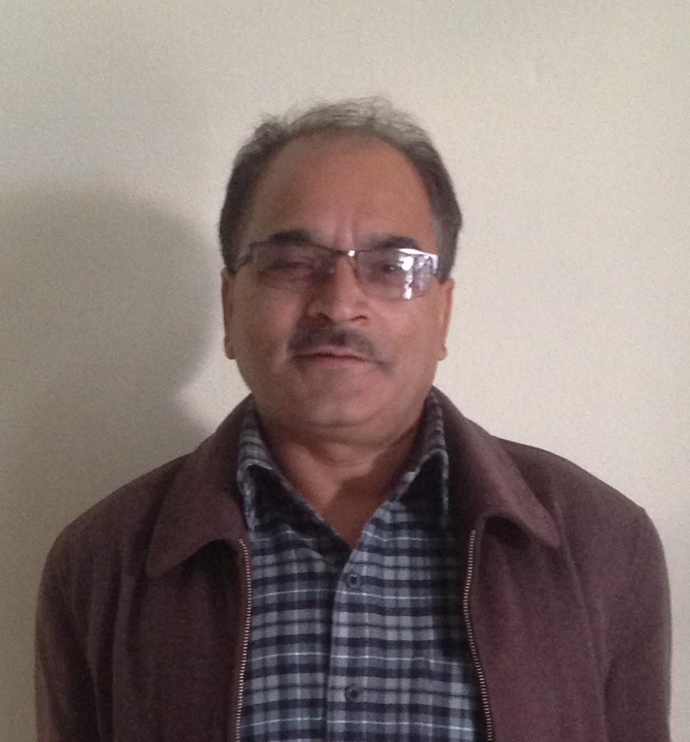
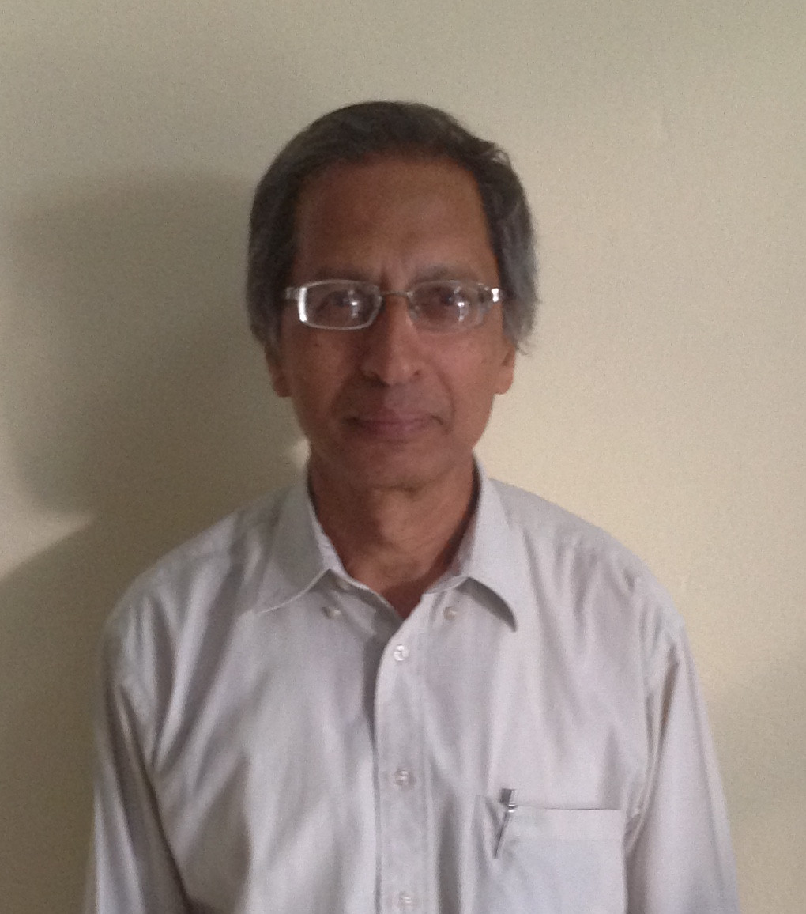
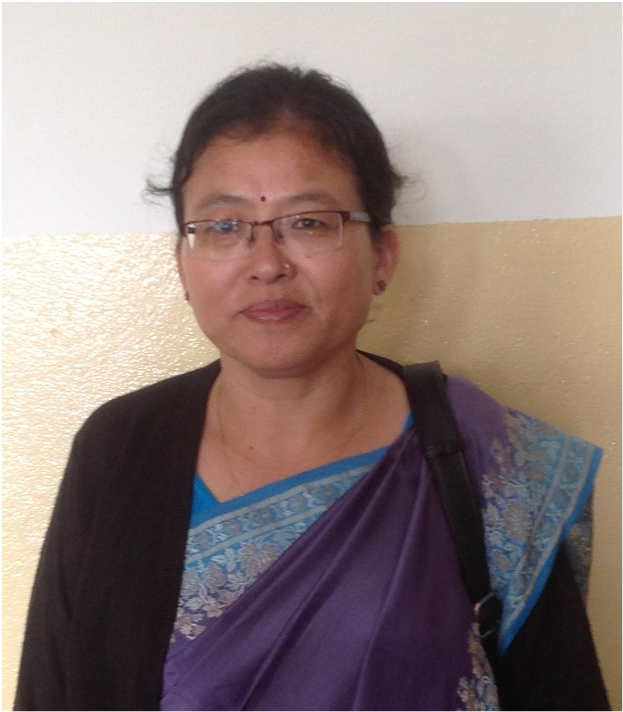
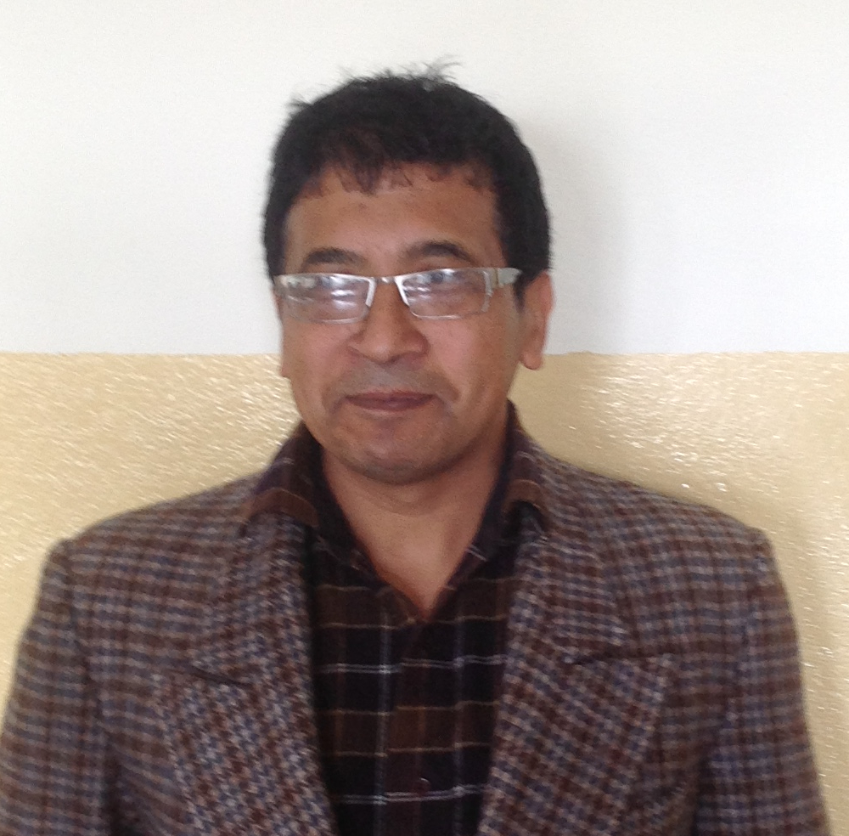
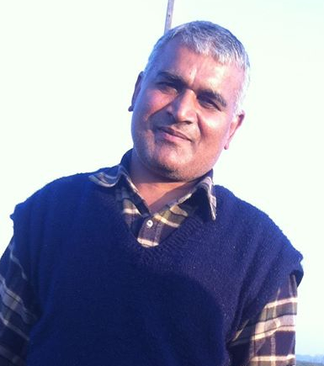
Who is Who in Nepal Mathematics
Prof. Dr. Kedar Nath Upreti
(Department Head)
Prof. Dr. Gajendra Bahadur Thapa
(Former Department Head)
Prof. Dr. Kanhaiya Jha
(organizer of NSNTC 2009 & CIMPA 2010)
Prof. Dhan Kumari Thapa
(Tresurer of NMS)
Prof. Dr. Ajaya Singh
(organizer of CIMPA 2014)

Slide 8
Other actions
2005 first visit (FP)
2009 NSNTC 1 (Kanhaya Jha)
2010 first contact with TU (Michel Waldschmidt)
CIMPA Number Theory (Kanhaya Jha)
Wolfram Mathematica School (Corrado Falcolini)
2011 “SIX hands” course in Number Theory (FP, MW & J. Jimenez Urroz)
2012 Course on Continued Fractions (MW)
2013 first contact with CIT (Affiliated to Purbanchal University)
2014 CIMPA-ICTP Dynamical Systems (Ayaja Singh & Renaud Leplaideur)
Course of Algebraic Number Theory (FP)
2015 Wolfram Mathematica Training Project (Corrado Falcolini)

Slide 9
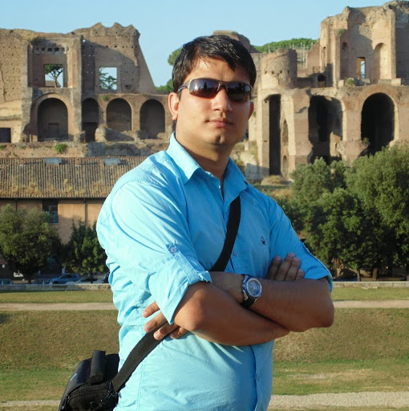
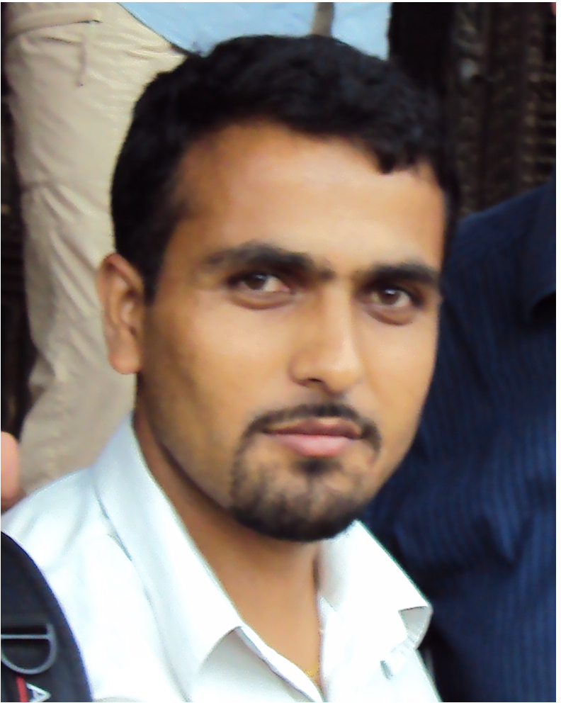

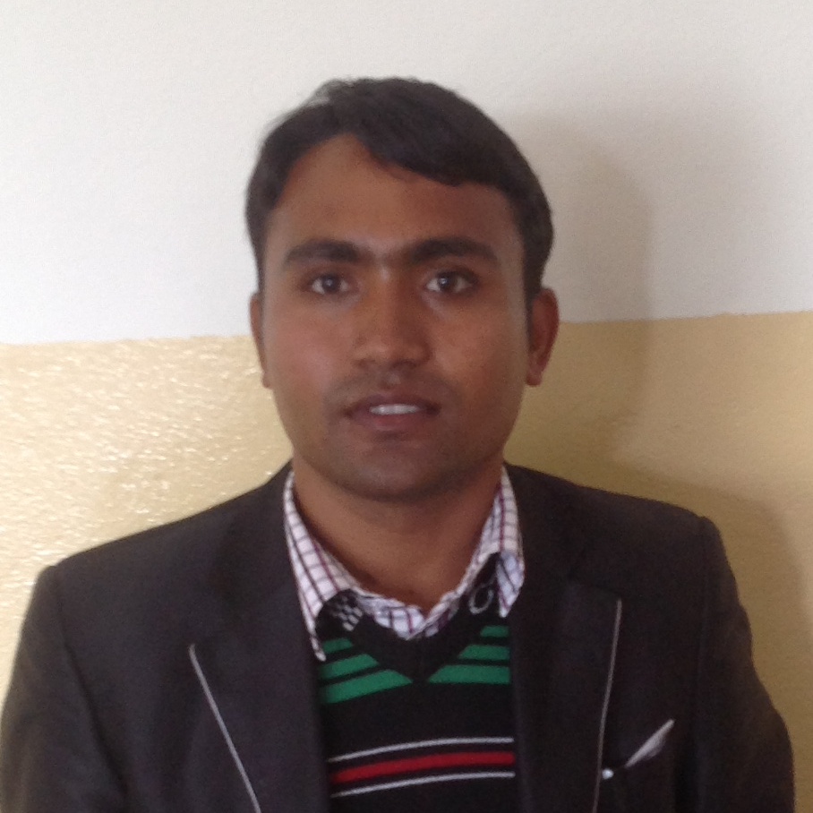


Projects on single
Nepalese students
Nilakanta Paudel
PhD Student 2013-
Università Roma Tre
Chudamani Poudyal
PhD Student 2011-
University of Wisconsin Milwaukee
Manoj Gyawali
Master 2012
Université Pierre et Marie Curie

Slide 10

Possible Future Actions in Nepal
Help to organize a new CIMPA school in 2018
Wolfram Mathematica Instructional programme
Doctoral Fellowships for Nepalese Exceptional Student
Algebra Teaching Project
Help to organize NSNTC 2 in 2017
Interaction with the SPIM program from HRI (Allahabad)
New contacts with
Department of Mathematical Education TU
Purbanchal University
Pokara University

Slide 11
Webography of Nepal Mathematics
UNIVERSITIES
http://tribhuvan-university.edu.np/ (Tribhuvan University)
http://www.ku.edu.np/ (Kathmandu University)
http://pu.edu.np/ (Pokhara University)
http://puexam.edu.np/ (Purbanchal University)
ASSOCIATIONS
http://www.nms.org.np/ (Nepal Mathematical Society)
http://mathcouncilnepal.org.np/ (Council for Math. Education)
http://www.anmaweb.org/ (Association of Nepalese
Mathematicians in America)
http://www.nepalimath.com/ (Nepali Mathematicians
Abroad)

Slide 12
Reportography of Nepal Missions
February 2013 (MW)
July 2010 – CIMPA SCHOOL (MW)
July 2010 - CIMPA SCHOOL (Kanhaiya Jha)
July 2010 - CIMPA SCHOOL (FP)
December 2013 (FP)
November 2014 - CIMPA SCHOOL (Renaud Leplaideur)

