Slide 1

Doctorate Program in Mathematics
at
Roma Tre University
Notes:
1

Slide 2
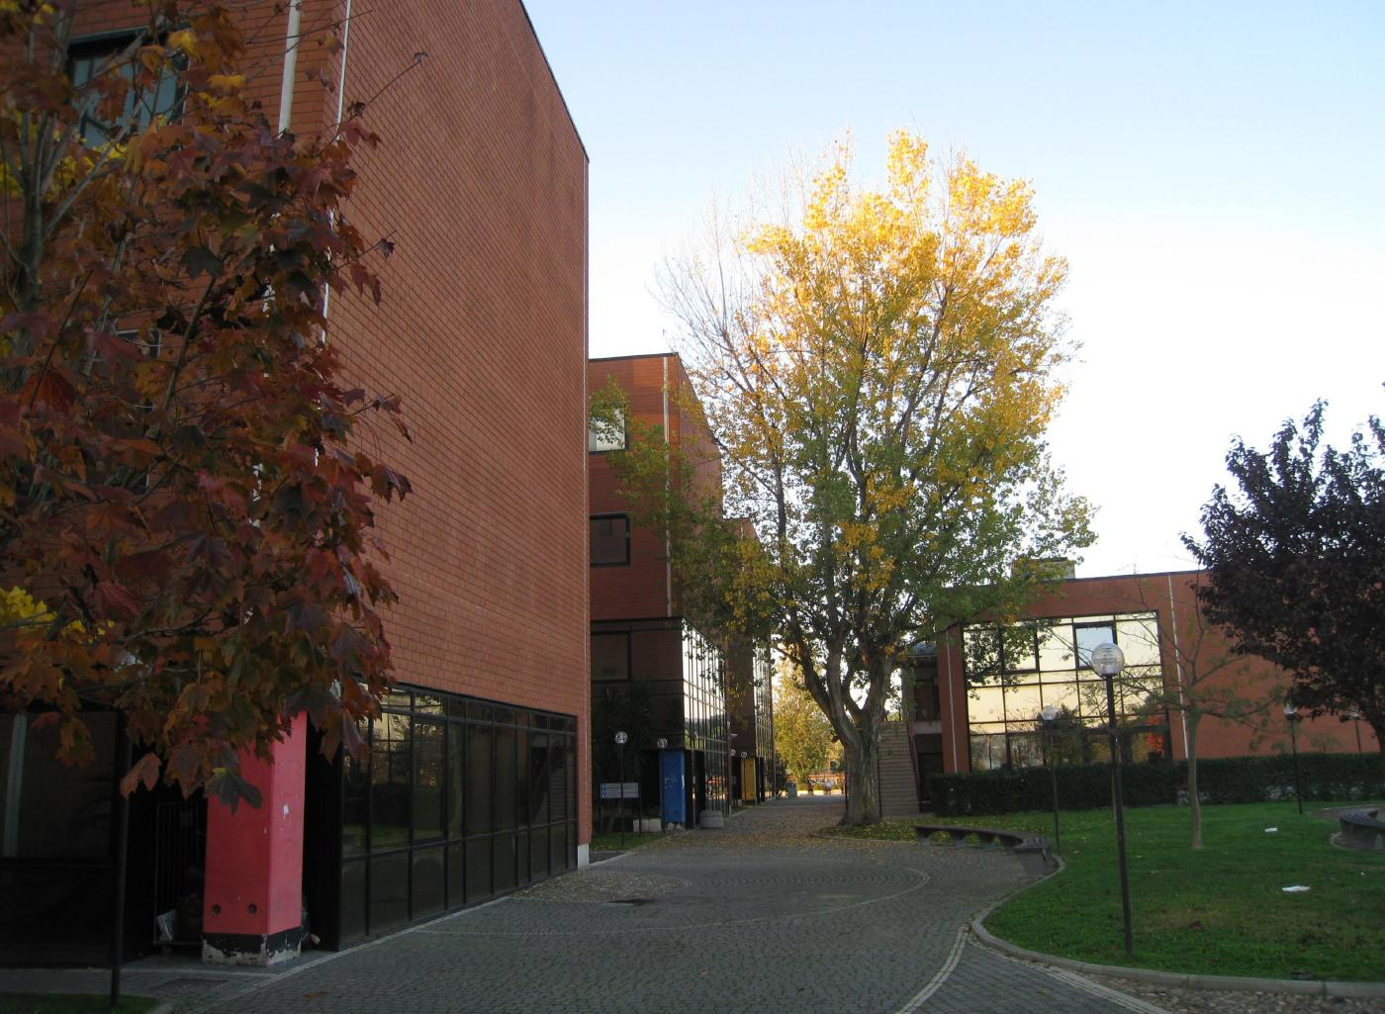
DEPARTMENT OF MATHEMATICS AND PHYSICS
Section of Mathematics
Notes:
2

Slide 3
MATHEMATICS at Roma Tre:
Fact Sheet
Director of Department Lucia Caporaso
President of Section Pierpaolo Esposito
Coordinatore del Dottorato di Ricerca Luigi Chierchia
Largo San Leonardo Murialdo, 1 00146, Roma. tel. +39 06 5733 8212 fax +39 06 5733 8080
http://www.mat.uniroma3.it
Notes:
3

Slide 4
Mathematics Section: fact Sheet
41 faculty Staff
23 temporary teaching Staff
9 Administration Staff
7 Post Docs
29 PhD Students
40 (approx) Master Students

Slide 5
The Doctorate Program
Officially in english starting this year
3 + 1 years program
Application between July and September (keep an eye open)
At least one fellowship reserved for international students
Selection done through an informal Skype Interview
First year with courses and marks – Then thesis
http://ricerca.mat.uniroma3.it/dottorato/
Email: dottric@mat.uniroma3.it

Slide 6
Main Research Topics for PhD Thesis
Algebraic Geometry
Arithmetic Geometry
Commutative Algebra
Computer Science
Differential Equations and Dynamical Systems
Mathematical Physics
Non linear Analysis and Dynamical Systems
Probability Theory and Mechanical Statistics
Numerical Analysis of PDE
Number Theory
Applied Mathematical Physics
Logic

Slide 7
Thank you!
Francesco Pappalardi
pappa@mat.uniroma3.it
http://www.mat.uniroma3.it/users/pappa

