Slide 1

Doctorate Program in Mathematics
at
Roma Tre University
Notes:
1

Slide 2
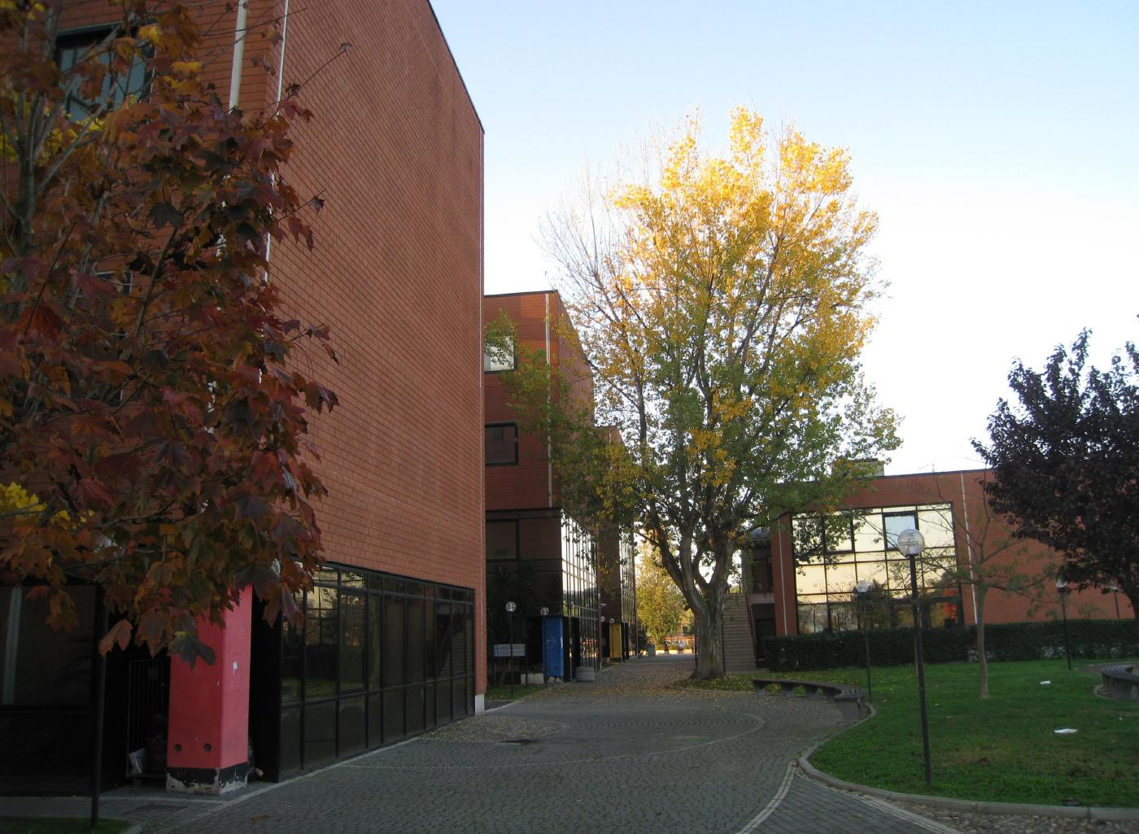
DEPARTMENT OF MATHEMATICS AND PHYSICS
Section of Mathematics
Notes:
2

Slide 3
MATHEMATICS at Roma Tre:
Fact Sheet
Director of Department Lucia Caporaso
President of Section Elisabetta Scoppola
Coordinator of the Ph.D. program Angelo Felice Lopez
Largo San Leonardo Murialdo, 1 00146, Roma. tel. +39 06 5733 8212 fax +39 06 5733 8080
http://www.matfis.uniroma3.it/index_eng.php
Notes:
3

Slide 4
Mathematics Section: fact Sheet
38 faculty Staff
13 temporary teaching Staff
9 Administration Staff
8 Post Docs
20 PhD Students (7 international)
40 (approx) Master Students

Slide 5
The Doctorate Program
Officially in english
3 years program
Application between June and July (keep an eye open)
5 new students admitted every year
Selection done through an informal Skype Interview, usually in September
First year with courses and marks – Then thesis
http://www.matfis.uniroma3.it/dottorato/dottorato.php?dottorato=matematica
Email: dottric@mat.uniroma3.it

Slide 6
New fellowships for foreign students (in addition to the usual ones)
Financed by INDAM Ph.D. Program DP-COFUND
Deadline: May 31, 2017
Info:
https://cofund.altamatematica.it/dp-2015/main/website

Slide 7
Main Research Topics for Ph.D. Thesis
Algebraic Geometry
Arithmetic Geometry
Commutative Algebra
Computer Science
Differential Equations and Dynamical Systems
Mathematical Physics
Non linear Analysis and Dynamical Systems
Probability Theory and Mechanical Statistics
Numerical Analysis of PDE
Number Theory
Applied Mathematical Physics
Logic

Slide 8
Thank you!
Francesco Pappalardi
pappa@mat.uniroma3.it
http://www.mat.uniroma3.it/users/pappa

