Slide 1

Doctorate Program in Mathematics
at
Roma Tre University
Notes:
<numero>
<numero>

Slide 2
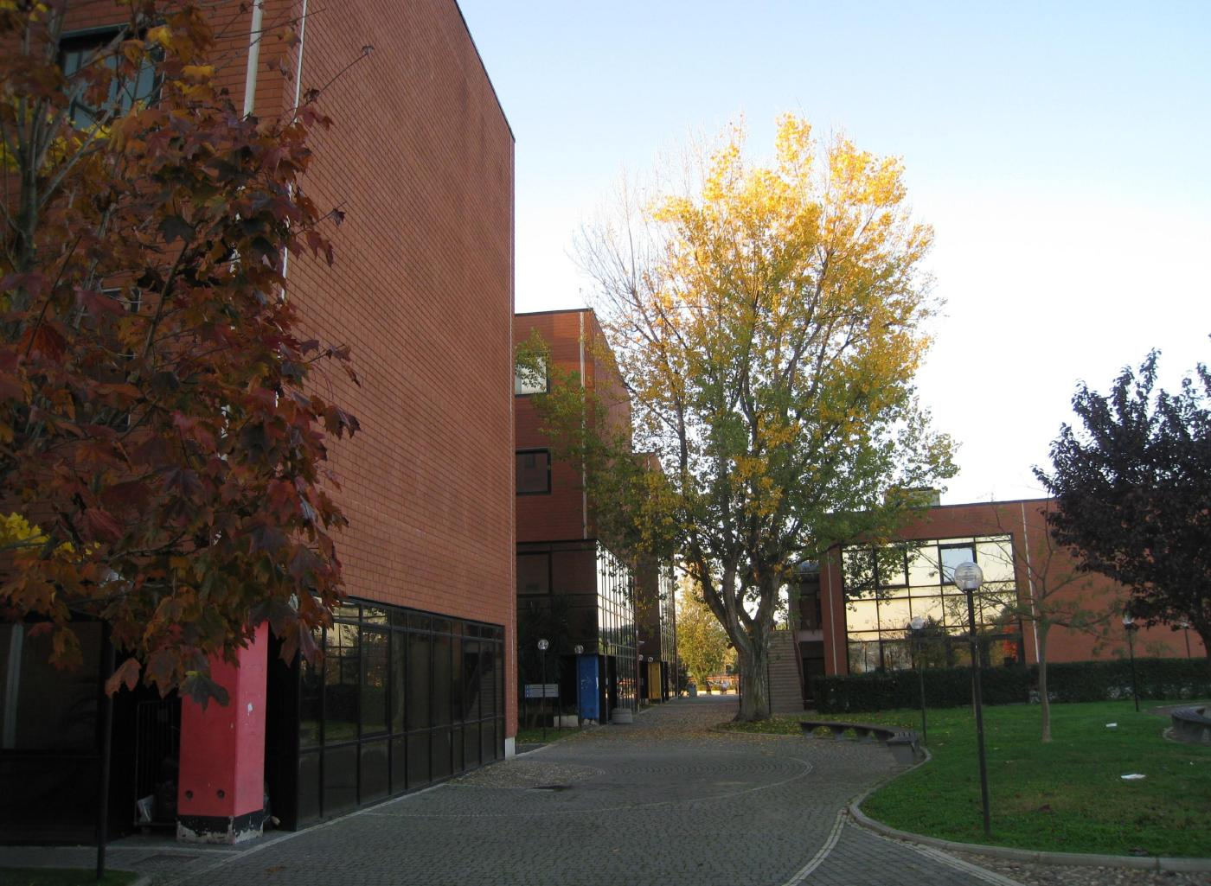
DEPARTMENT OF MATHEMATICS AND PHYSICS
Section of Mathematics
Notes:
<numero>
<numero>

Slide 3
MATHEMATICS at Roma Tre:
Fact Sheet
Director of Department Lucia Caporaso
President of Section Pierpaolo Esposito
Doctorate Program Coordinator Luigi Chierchia
Largo San Leonardo Murialdo, 1
00146, Roma.
tel. +39 06 5733 8212
fax +39 06 5733 8080
http://www.mat.uniroma3.it
Notes:
<numero>
<numero>

Slide 4
Mathematics Section:
fact Sheet
41 faculty Staff
23 temporary teaching Staff
9 Administration Staff
7 Post Docs
29 PhD Students
40 (approx) Master Students

Slide 5
The Doctorate Program
Officially in English starting this year
3 + 1 years program
Application at the end of July
Three fellowships reserved for international students
Selection done through an informal Skype Interview
First year with courses and marks – Then thesis
Deadline 3/9/14
http://ricerca.mat.uniroma3.it/dottorato/
Email: dottric@mat.uniroma3.it

Slide 6
Main Research Topics for PhD Thesis
Algebraic Geometry
Arithmetic Geometry
Commutative Algebra
Computer Science & Cryptography
Differential Equations and Dynamical Systems
Mathematical Physics
Non linear Analysis and Dynamical Systems
Probability Theory and Mechanical Statistics
Numerical Analysis of PDE
Number Theory
Applied Mathematical Physics
Logic

Slide 7
Thank you!
Francesco Pappalardi
pappa@mat.uniroma3.it
http://www.mat.uniroma3.it/users/pappa

Slide 8
PICTURES FOR THE
2014 CIMPA SCHOOL
ARE IN http://www.mat.uniroma3.it/users/pappa/missions/Cimpa_benin_portraits/

