Slide 1


Opportunities for Iraqi Students at UniRoma3:
Notes:
1

Slide 2
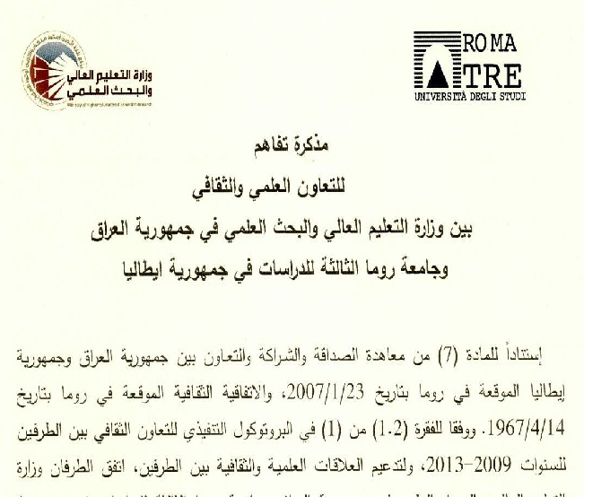
Collaboration Agreement signed between
Università RomaTre
&
Ministry of Higher Education and Scientific Research of The Republic of Iraq

Slide 3
Collaboration Agreement signed between
Università RomaTre
&
Ministry of Higher Education and Scientific Research of The Republic of Iraq
Still being finalized
Mobility for PhD Students
Training for Faculty Staff
Sabbatical Years
Short time visits for Faculties and for Master Students
It involves several disciplines:
Ecomonics
Law
Archeology
Arts
Architecture
Mathematics & Physics
Engineering
Management

Slide 4
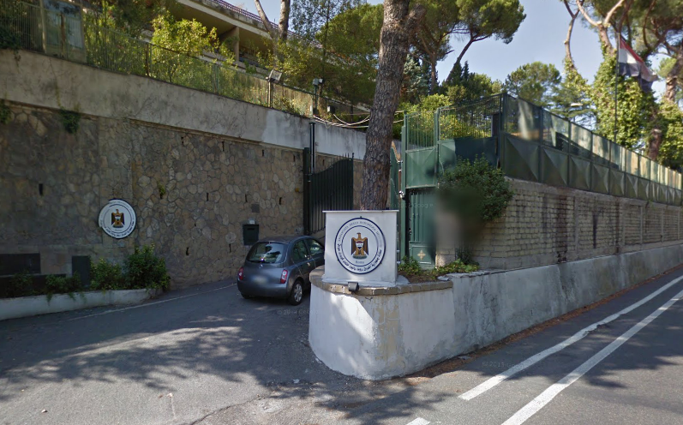
Embassy of the Republic of Iraq
Via Della Camilluccia,355 , 00135 Roma

Slide 5
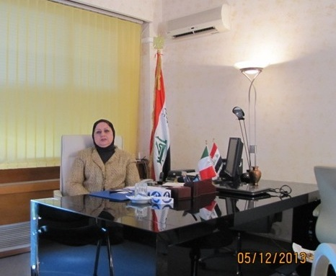
The Cultural Councellor of Iraq in Rome
Professor Manahil Ahmed Ali AL-Nawas
http://www.iraqcultural-roma.it/

Slide 6
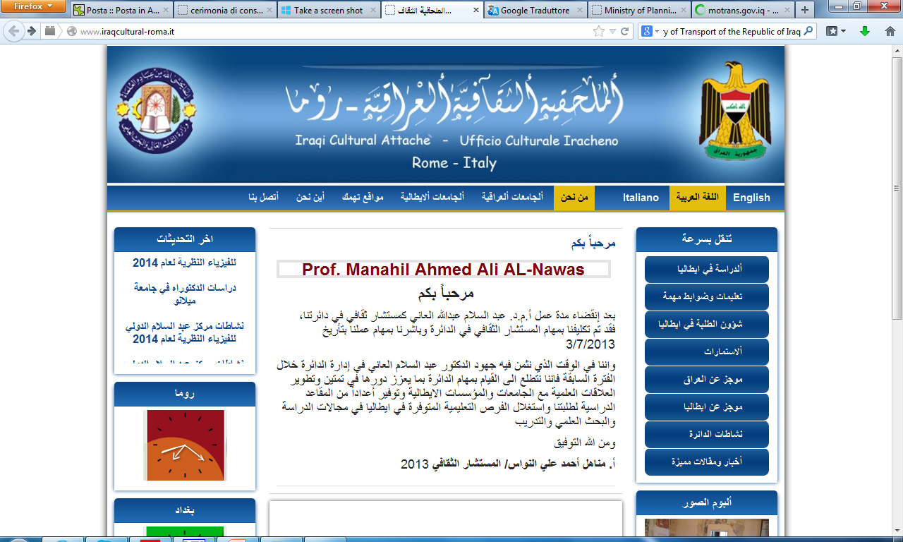
http://www.iraqcultural-roma.it/

Slide 7
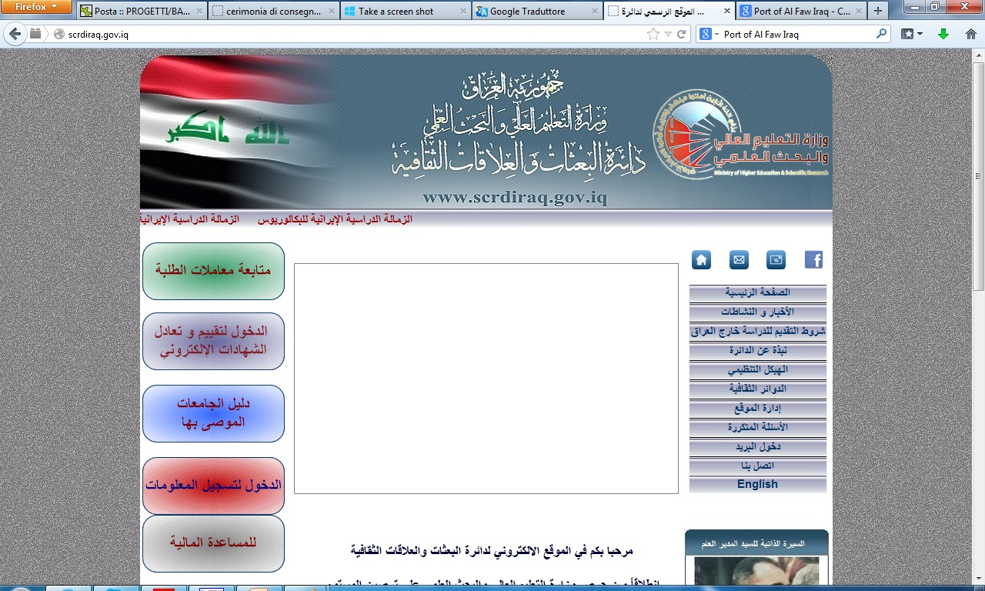
The Starting Point for more Information:
http://scrdiraq.gov.iq

Slide 8
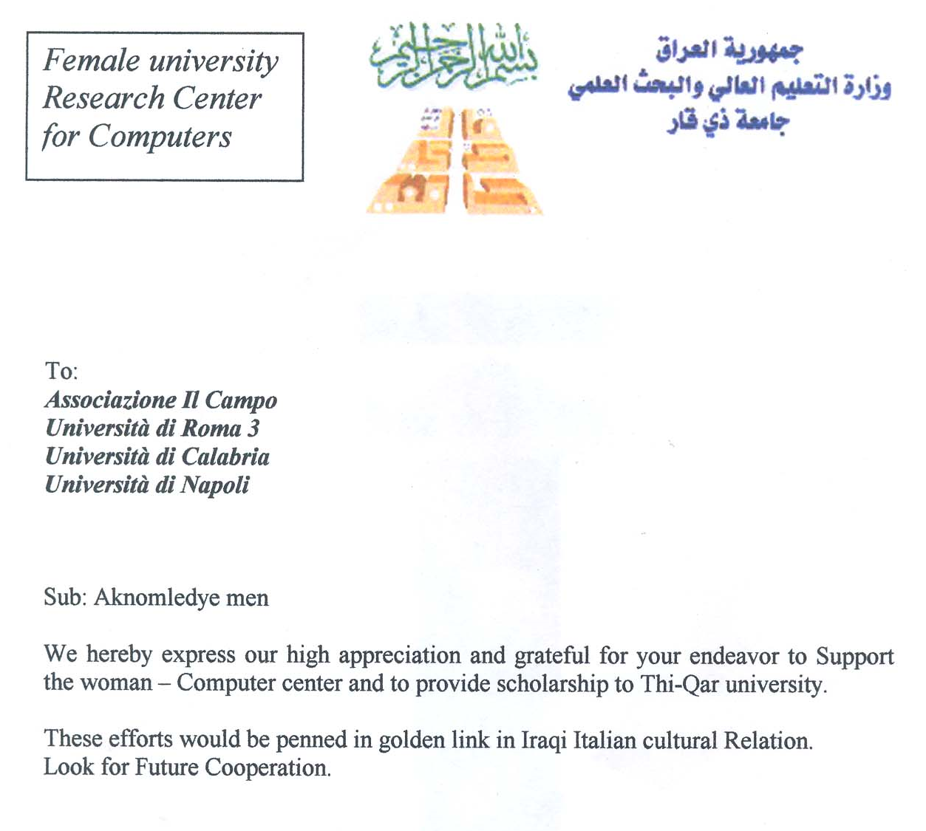
Previous Collaborations of
Università Roma Tre in Iraq: 2005

Slide 9


Previous Collaborations of
Università Roma Tre in Iraq 2007:
Diploma in Harbour Engineers at the Università Roma Tre:
awarded to 20 Iraqi Engineers from the Port of AL-Faw

Slide 10
For more, contact:
International Relation Office:
ir@uniroma3.it
http://internationalrelations.uniroma3.it/
Notes:
10

