Slide 1
Ready Player One
Eric Arthur, Chris Whimpenny, Rui Huang, Praneeth Appikatla, Joseph Yuen
Notes:
Joe
THE WORLD OF READY PLAYER ONE COULD BE OUR WORLD
Due to the advances in technology, the current societal issues with technology will increase in effect
Realistic Technology – ready player one accurately depicts current technology 27years in the future
Security – current security issues will become worse in a more connected world
Disassociation from Real World – as the real world enters more into the digital world, people will become more disassociated

Slide 2
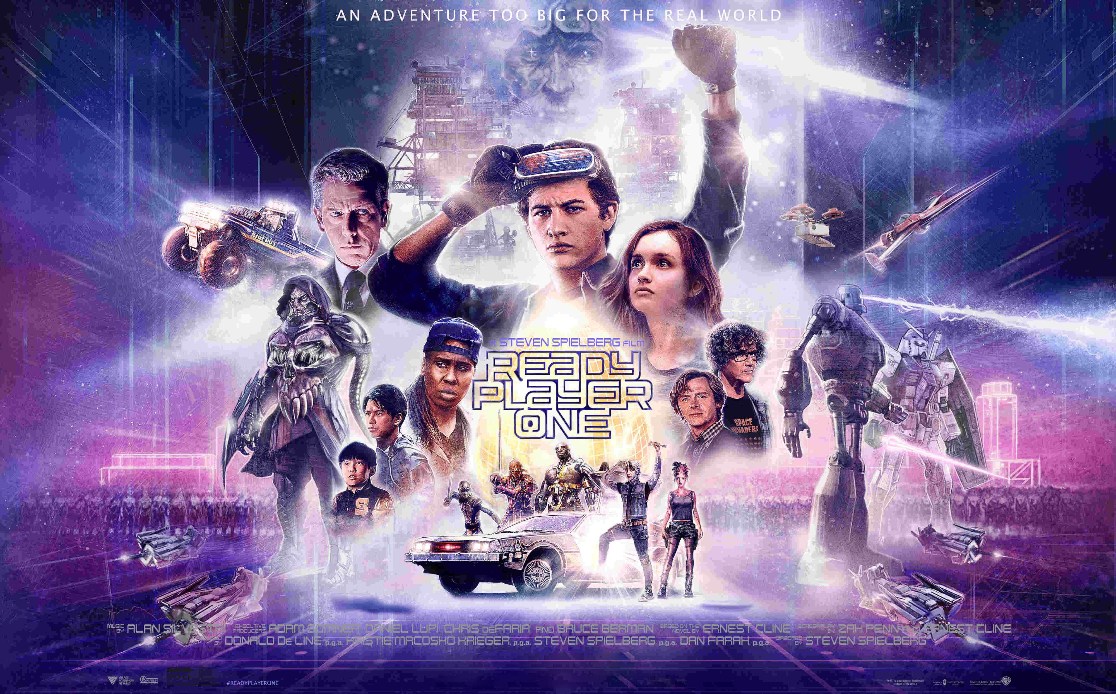
Background
OASIS
Massively Multiplayer Online Simulation Game
James Halliday and Ogden Marrow
Easter Egg
Death of Halliday
3 Keys -> Control of OASIS
Wade Watts
Parzival
Innovative Online Industries (IOI)
Nolan Sorrento - CEO
Tech corporation in search of keys
[12]
Notes:
Joe
1st Key – Race
High Five grabs the attention of the world
2nd Key – The Shining
Watts learns Halliday's story
Art3mis Abducted
High Five infiltrate IOI
Big Battle
Everyone dies except Watts
3rd Key – Easter Egg
Watts passes the final test and gains control of the OASIS
Aftermath
Watts shuts down the OASIS for 2 days of the week

Slide 3
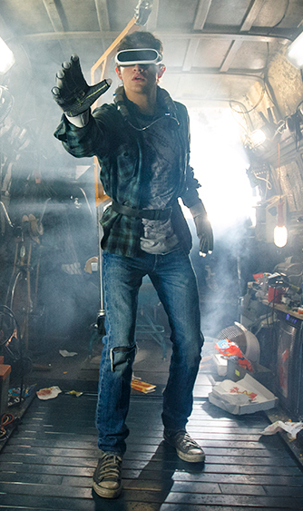
Realistic Technology in Ready Player One
Portable VR Technology
Interface Devices
[11]
Notes:
Eric and Chris
Ready Player One presents a realistic depiction of technology 27 years in the future. Technology discussed will be mobile VR technology that Wade is wearing, interface devices such as haptic gloves and omnidirectional treadmills and technology with VR external impacts such as cryptocurrency and transferring ones subconsciousness.

Slide 4
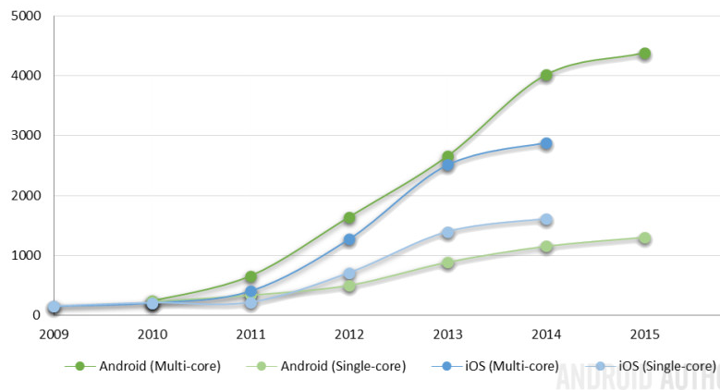
Mobile VR technology not far off
Increased growth of
mobile processing
Current smartphone
specs not far off
from VR requirements
[1][2][3]
[1][2][3][4]
Notes:
Eric
Current VR technology requires a pretty nice desktop to run, but in the movie VR is presented as a technology with computational power self contained in the headset, therefore comparing specs
The base clock speed for the gtx 970 is around 1050MHz
The base clock speed for the i5-4950 is 3.3GHz
8 GBs of RAM needed
Current phones have around 1.8-2Ghz processor speed
Many phones have 4GBs of RAM
Currently smart phones don’t use dedicated graphics cards and instead use on board chips such as the Adreno 530 found in many high end android phones, and it has a processing clock speed around 650 MHz.
Using graph on right side we can see that mobile technology has been growing at a strong rate that shows that in 27 years we will definitely have VR headsets with computers in them.

Slide 5
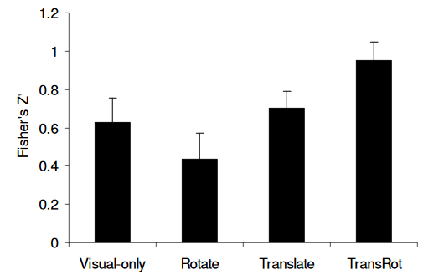
Interface devices are In the works
Haptic Feedback gloves currently cost around $250 [5]
Omnidirectional treadmills require harnesses for safety [6]
OT cost around $600 [7]
Improve immersion in VR
[5][6][7]
Notes:
Interface devices meaning Haptic Feedback gloves and omnidirectional treadmills (OT). Haptic Feedback gloves in an early stage of development, currently very chunky and have wires all over them. Developer kits for haptic gloves cost around $250 dollars there are no consumer grade products available at this time.
Omnidirectional treadmills are progressing really fast with prototypes going back to the early 2010s. Currently omnidirectional treadmills are either really large 4m by 4m like the one used in this graph, or really small around 2 feet by 2 feet, the smaller ones require a harness or bar to support to the user from falling, and even larger ones use harnesses to prevent injury. Cost around $600 for a small consumer grade version some larger ones used for research cost around $2,000. Omnidirectional treadmills, and interface devices in general, improve immersion in VR. Study on right is a chart about participants ability to walk a straight line in VR, the last group transrot used a large omnidirectional treadmill and it was linked to a direct increase in cognitive ability to remember what a straight path was.

Slide 6
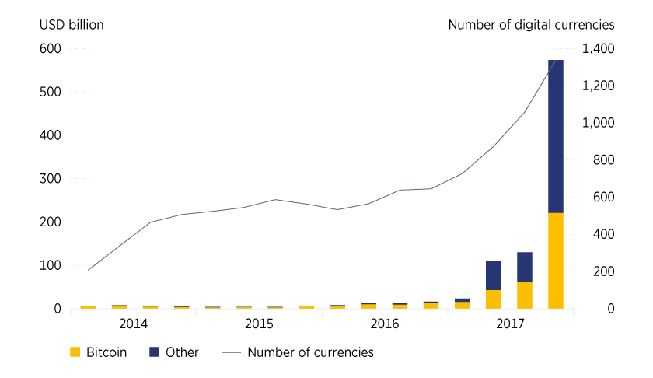
Technology With External Impacts
Online Currency
If popularity trend continues, there will be a market
Technological hurdles that need to be addressed first
Copying Over Subconscious
Today's $97 million-dollar super computers are close
Resources availible 27 years from now will be able to handle the memory load
[20][21][22]
Notes:
Online Cryptocurrencys areon the rise and trends show a full adoption ni the next 30 years. The amount of transactions these forms can currently handle is much too low to be able to support this rise however (7 tps compared to avg of 2000 and max of 56000). While this may cause issues, new innovations in this field and compared to the progress already made will have a good chance of overcoming these hurdles.
There are over 100 trillion connections in the brain and if each one is modeled and a computer is created of this magnitude, it would need ~100 Terabytes of Fast Data. Super computers are close to this number however they cost 97 million dollars. Taking into account the amount of wealth halliday has as well as the combined computing power of the oasis (Brain estimated = 10^18 FLOPS, Computing power of world currently = 10^23 FLOPS), it is very fathomable that the technology is able to support the transfer of his consciousness

Slide 7

SECURITY Risks set to worsen
Consequences
Privacy
Corporations
Notes:
Praneeth and Rui
The movie depicts common security concerns people have today and goes further to show that with the development of technology going forward the risks associated with using it become greater.

Slide 8
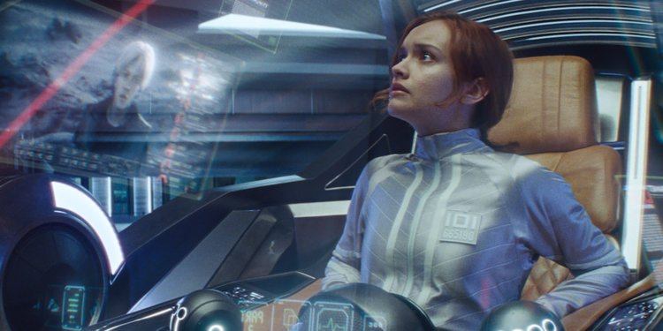
Security consequences
Players have a lot at stake
OASIS has a major security flaw
Plot hinges on Sorrento writing down his password
[15]
Notes:
Praneeth -
In the world of RPO, players are heavily invested into the OASIS. Their character progression, their money, and private information can all be lost if someone were to hack the game.
While this is not shown in the movie, they do show a major security flaw with the OASIS. The protagonists use an exploit to prevent Sorrento from logging off, but are able to simulate to him that he is. A breach of security this critical should warrant taking the game down to fix it and the consequences of not catching it are shown in the film. Another breach of security is shown when Samantha is able to get into Sorrento's rig as shown in this picture. This is only possible because Sorrento writes his password down inside of it. He faces the consequences for not taking proper security precautions.
Picture link:
https://www.thisisinsider.com/ready-player-one-movie-vs-book-2018-3

Slide 9

Oasis lacks secure privacy measures
Aliases protect the identity
Privacy issues when reveal the identity
Watt speaks out his first name
Sorrento hacked by Watt's team
[13][17]
Notes:
Rui
The OASIS protect the privacy of users through using aliases. No one can know the real identity of a player in OASIS through just aliase.
But in case the player reveal their personal information, that can cause serious issues:
1. Just after Watt speak out his first name to Cook(Art3mis), IOI managed to get all personal information about Watt through just a first name. They know his full name, address, appearance by just a first name without any government resources. This also put his family in danger.
2. One other example is Watt’s team hacked Sorrento’s account with just a line of password. This is also a severe problem OASIS has, which could lead to leak of personal identity and loss of wealth. And this shows the single password is unsafe especially in such large system like OASIS. An article [17] also suggests that a two-factor authentication can be much safer.
These two examples shows OASIS has more serious privacy issues than we have now.

Slide 10

corporations as governments
IOI act as a "government"
IOI loyalty center
IOI surveillance drones
[14]
Notes:
Rui
In the movie, there are no government directly invovled; however the IOI’s loyalty center seems to be another form of government in the movie.
1. They imprison people in the loyalty center and force them to work for the company. In both real world and OASIS, they have people to monitor them all the time, which means people will not have any privacy in the loyalty center.
2. The omnipresent surveillance drones from IOI also makes people have almost no privacy in the real world as long as IOI know one’s identity. Watt was tracked all the time by the drones after he let them know his name.
Right now, large cooperations like google already have large amount of personal inforamtion. In a more connected world, large cooperations like IOI can control more resources and get more detailed personal inforamtion, therefore lead to more serious security and privacy issues.

Slide 11
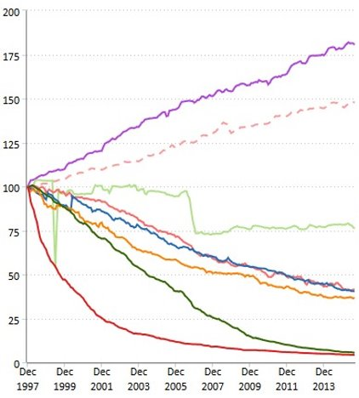
COST OF VR will Decrease over time
<Your Name>
99% of computers in 2016 couldn’t run VR[8]
Current VR setup cost: $1700-$2700 USD [9]
Cost of Computer technology cheapens over time
Consumer Price Index
[8][9][10]
Notes:
Eric
Include y axis in graph
Nvidia states that 99% of computers in 2016 can't run VR, therefore a majority of people cannot use VR. A VR setup including desktop cost and sensors/headset cost around 1700-2700 making this technology currently too expensive for a majority of people to afford. But using graph on the right where y axis is CPI Consumer Price Index, the red line represents computer technology and peripherals, obvious that VR will be affordable in only a few years. This means that the digital divide will go away and now everyone has access to VR technology, this means all the problems stated prior will affect a larger amount of people.

Slide 12
DISASSOCIATION FROM THE REAL WORLD
Virtual Globalization
Internet Addiction
Breakdown of Traditional Communication
Notes:
Joe and Praneeth
Cost of VR discussed on previous slide -> Low cost of VR
Depletion of fossil fuels, global warming, and rampant overpopulation -> the world is not a great live in
With the current state of our world that is currently struggling with environmental issues regarding fossil fuels and global warming in combination with our growing population and limited resources, the world of Ready Player One could become our world. The low cost of VR and the current state of the Ready Player One world which could be our world makes the OASIS a great place to be with virtually unlimited resources.
You can go anywhere, do anything, and be anyone.
The consequences of everyone using VR are virtual globalization, the expansion of a global economy all in one platform, internet addiction, using a network application for an "unhealthy" amount of time, and the breakdown of traditional communication.

Slide 13
VIRTUAL GLOBALIZATION of oasis
Global Reach
In-game vendors
Players and corporations buy and sell items
One platform
Notes:
The OASIS is a game that has players from all around the world who are not only playing the game but living in it. Since there are so many people, it seems natural that there would be a great deal of trading and e-commerce, and that is the reality in Ready Player One. We see many in-game vendors where players and corporations can make goods and sell them using online virtual currency. And since almost everybody plays the game, a serious amount of capital can be made from this virtual world. While not explicitly stated in the movie, given the backstory and environment, I think it's fair to say that the OASIS is a hub for international commerce which is just another reason for people to be disassociated from reality. When a person can just stay in the game world and buy what they need for the real world, there's not much of a reason to switch platforms. Today, we have applications like Amazon that are a hub for ecommerce which is big but small in comparison to the behemouth that is the OASIS. But as more and more people have access to the internet, while history may not play out exactly as in Ready Player One, the digital economy will expand, and great corporations may rise that become an e-commerce hub like the OASIS.

Slide 14
Oasis enables Internet ADDICTION
"I think in the future VR is going to be the super drug... Do you want to spend it with real people in a real world, which is often harder than spending it in a virtual world where you can be the person you always wanted to be — where the id becomes the self? Is that a world you really want to live in for the rest of your life?"
- Steven Spielberg Director of Ready Player One
[18] [19]
Notes:
Joe and Praneeth
Internet addiction is a very prominent and relevant issue in modern society because of the new generations that are consuming technology at an early age.
According to the director of the movie, Steven Spielberg, he calls the future VR to be a super drug.
In the movie, the moral of the story is that people should put down their technology and interact in the real world as seen by the actions of Wade Watts who shuts down the OASIS for 2 days out of the week for people to do so.
The OASIS has potetnially billions of players that live, work, and play in it. In our society, this would be considered internet addiction, but in the world of Ready Player One, this is a socially acceptable activity which is not an addiction but rather a lifestyle. There could be an arguemnt that the OASIS promotes association with the real world because the real world is online. Spielberg's quote suggests that the choice is society's to make and talks about the consequences of a digital world. But regardless, the mentality allows for a disassociation from the real physical world that could be unhealthy to society where the "id becomes the self." Because we already see internet addiction in teenagers and prominent enough in South Korea for their government to pass laws to combat internet addiction, a global game that everybody plays for for hours on end is still a big jump but certainly an obtainable one. In a study on Tawainese High Schools regarding internet addiction, the researchers found that 17.4% of Taiwanese High School students were addicted to the internet*. While many European youth had considerably lower results around 1-5%, many asian countries such as Korea and China had higher results at about 8-13%. The numbers are still low in comparison to the world of Ready Player One, but the data suggests that the percentage of those who have internet addiction will increase as more people gain access and use the internet.
*The study used the Chen Internet Addiction Scale, the short form of the impulsivity scale, a series of questionaires, Ko's depression inventory, the Rosenberg Self-Esteem scale, the Toronto Alexithyma Scale, Chinese Happiness Inventory, Internet Assecibility Test, and series of internet scales.

Slide 15
Technology Breaks down traditional communication
Winner Take-All Society
OASIS connects everyone on one network
The allure of communicating from behind a screen
Notes:
The contest in the movie plays into the idea of a winner take-all society where the game draws people into the socially unproductive work of playing video games for the majority of their time. This is only fueled by the contest for the egg. When nearly the entire world is participating in the virtual reality, it becomes the normal way of communication. The movie shows VR gear available to nearly everyone. As mentioned earlier, with VR equipment becoming more affordable there will be less of a digital divide meaning that online communication can be well on its way to how it is shown in the movie. Lastly, going back to the idea of addiction, the OASIS offers people the chance to become anyone they want and the idea of communicating online is very enticing. This is present today as people spend more time on their phones communicating through messages and less time interacting in person. One of the main ideas of the movie is that this behavior is dangerous because it causes society to invest their time and effort into a game and ignoring the harsh conditions of the world around them that they are capable of changing.

Slide 16
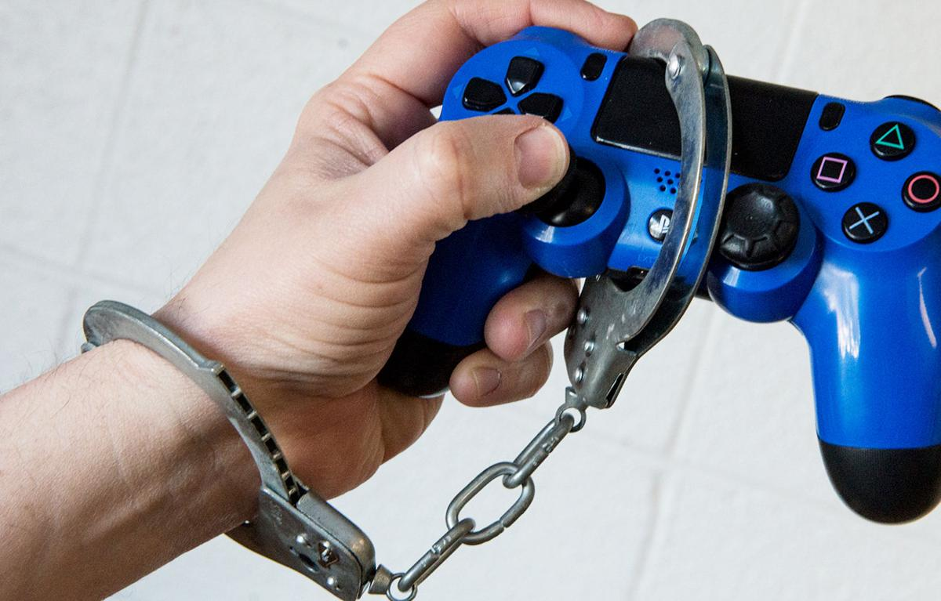
Conclusions
Realistic Technology
Increased Security Issues
Dissociation from Real World
[16]
Notes:
Picture link:
Overall conclusion is that the movie shows that advances in technology result in a future where current issues with technology have not gone away but instead become widespread.

Slide 17
References
1. Nvidia. (n.d.). GeForce GTX 970 Specifications. Retrieved September 25, 2018, from https://www.geforce.com/hardware/desktop-gpus/geforce-gtx-970/specifications
2. Intel. (n.d.). Intel Core i5-4950 Processor. Retrieved September 25, 2018, from https://ark.intel.com/products/80815/Intel-Core-i5-4590-Processor-6M-Cache-up-to-3_70-GHz
3. Understanding Smartphones Specs. (2017, December 28). Retrieved September 25, 2018, from http://androiddeveloper.galileo.edu/2017/12/28/understanding-smartphones-specs/
4. https://www.androidauthority.com/smartphone-performance-improvements-timeline-626109/
5. Hayden, S. (2018, July 3). Plexus is a VR Glove With Finger Haptics & Multiple Tracking Standards, $250 Dev Kits Coming Soon. Retrieved September 25, 2018, from https://www.roadtovr.com/plexus-vr-glove-finger-haptics-multiple-tracking-standards-250-dev-kit-pre-orders-now-available/
6. Ruddle, R., Volkova, E., & Bulthoff, H. (2011). Walking improves your cognitive map in environments that are large-scale and large in extent. Retrieved from http://eprints.whiterose.ac.uk/74327/6/ruddler2.pdf
7. Horwitz. (2018, April 5). Kat Walk Mini promises a compact, affordable VR treadmill for in-game movement. Retrieved October 1, 2018, from https://venturebeat.com/2018/04/05/kat-walk-mini-promises-a-compact-affordable-vr-treadmill-for-in-game-movement/
8. Neiger, C. (2016, September 8). Virtual reality is too expensive for most people — but that's about to change. Retrieved September 25, 2018, from https://www.businessinsider.com/why-is-virtual-reality-so-expensive-2016-9
9. Ackerman, D. (2016, June 25). The real cost of virtual reality. Retrieved September 25, 2018, from https://www.cnet.com/news/the-real-cost-of-virtual-reality/
10. Bureau of Labor Statistics. (2015, October 13). Long-term prices trends for computers, TVs, and related items. Retrieved September 25, 2018, from https://www.bls.gov/opub/ted/2015/long-term-price-trends-for-computers-tvs-and-related-items.htm
11. https://variety.com/2018/digital/news/ready-player-one-vr-tech-1202739419/
12. http://readyplayeronemovie.com
13. http://www.brhs.com.au/privacy-information/
14. https://www.eff.org/issues/surveillance-drones
15. https://www.thisisinsider.com/ready-player-one-movie-vs-book-2018-3
16. http://www.joplinglobe.com/news/local_news/ready-player-shun-video-game-players-skeptical-about-future-classification/article_5cd170e2-5544-5d9b-9215-eb67402b98a2.htmlHe
17. Doug Barney, Single Password = Security Failure: How Two-Factor Authentication Saves the Day, (26 Sep. 2018) https://www.kaseya.com/blog/2016/10/14/single-password-security-failure-how-two-factor-authentication-saves-the-day/
18. Josh Rottenberg, March 23, 2018, 'Ready Player One's' Steven Spielberg and Ernest Cline on pooling their nostalgia to tell a new story, http://www.latimes.com/entertainment/movies/la-ca-mn-ready-player-one-spielberg-cline-20180323-htmlstory.html [10/1/18]
19. Lin, M., Wu, J., You, J., Hu, W., & Yen, C. (n.d.). Prevalence of internet addiction and its risk and protective factors in a representative sample of senior high school students in Taiwan.(Report). Journal of Adolescence, 62, 38–46. doi:10.1016/j.adolescence.2017.11.004 [10/1/18]
20.Dixon, P. (2018, February). Digital currencies: Assessing the possibilities. Retrieved September 24, 2018, from Thinking Ahead Magazine Web Site: https://www.thinking-ahead-magazine.com/2018/issue-102/editorial/digital-currencies-assessing-the-possibilities/
21. Hayworth, K. (2016). Mind uploading: an argument for the scientific and technical plausibility of preserving thoughts indefinitely. Retrieved September 24, 2018, from Gale Group Web Site: http://go.galegroup.com/ps/i.do?id=GALE%7CA456275895&v=2.1&u=mlin_c_worpoly&it=r&p=AONE&sw=w
22. Woo, W. (2017, March 12). Using Google Trends to Estimate Bitcoin's User Growth. Retrieved September 23, 2018, from Coin Desk Web Site: https://www.coindesk.com/using-google-trends-estimate-bitcoins-user-growth/

