Slide 1
Case Study on Swiggy Dataset
Using SQL
- By Pappu Kumar

Slide 2


Query : /* Find customers who have never ordered ? */
Output :

Slide 3

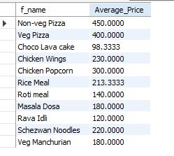
Query : /* Find average price of food/dish ?*/
Output :

Slide 4
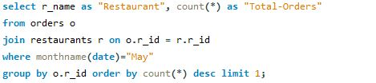

Query : /* Find top restaurant in term of number of orders for a given month ? Let say given month is May*/
Output :

Slide 5
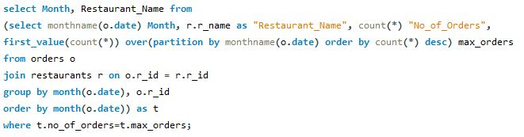

Query : /* Find top restaurant in term of number of orders for each month ? */
Output :

Slide 6
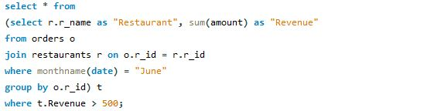

Query : /* Find restaurants with monthly sale greater than x rupees ? Let say given month is June */
Output :

Slide 7
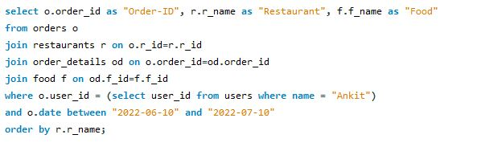
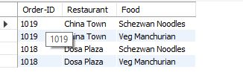
Query : /* Show all orders with order details for a particular customer in a particular date range. Let say given customer is "Ankit" and given date range is 10th June,2022 and 10th July,2022*/
Output :

Slide 8
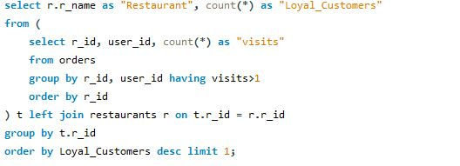

Query : /* Find restaurant with maximum number of repeated customers or loyal customers ?*/
Output :

Slide 9
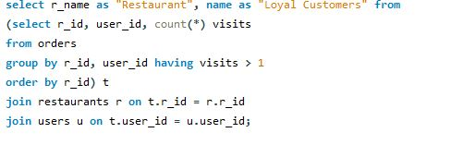
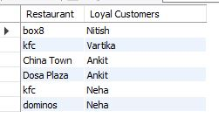
Query : /* Find loyal customers for all restaurants ?*/
Output :

Slide 10
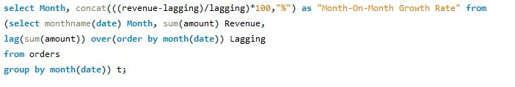

Query : /* Find Month over Month revenue growth of Swiggy ?*/
Output :

Slide 11
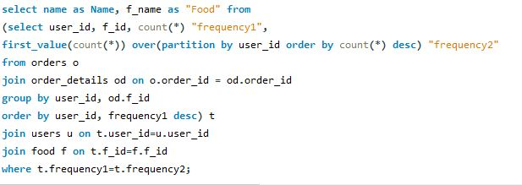
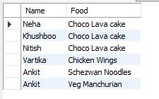
Query : /* Find favourite food/dish of each customer ?*/
Output :

