Slide 1

Database System Engineering and
Distributed Backend Development
WarehouseIQ
Smart Warehouse & Inventory Management System
DBMS Project
Student 1 — YASHAS KASULA / 2520030401
Student 2 — GNANESHWAR REDDY / 2520030552
Student 3 — VENKATESH ADDANKI / 2520030404
TEAM NUMBER- 4 SECTION-9

Slide 2

ProblemStatement
1
Traditional
Manual records · Scattered spreadsheets · Difficult stock tracking
2
Result
Stock inaccuracies · Missed low-stock items · Slow, unreliable reporting
Fragmented data across people and files causes slow decisions and operational risk.

Slide 3
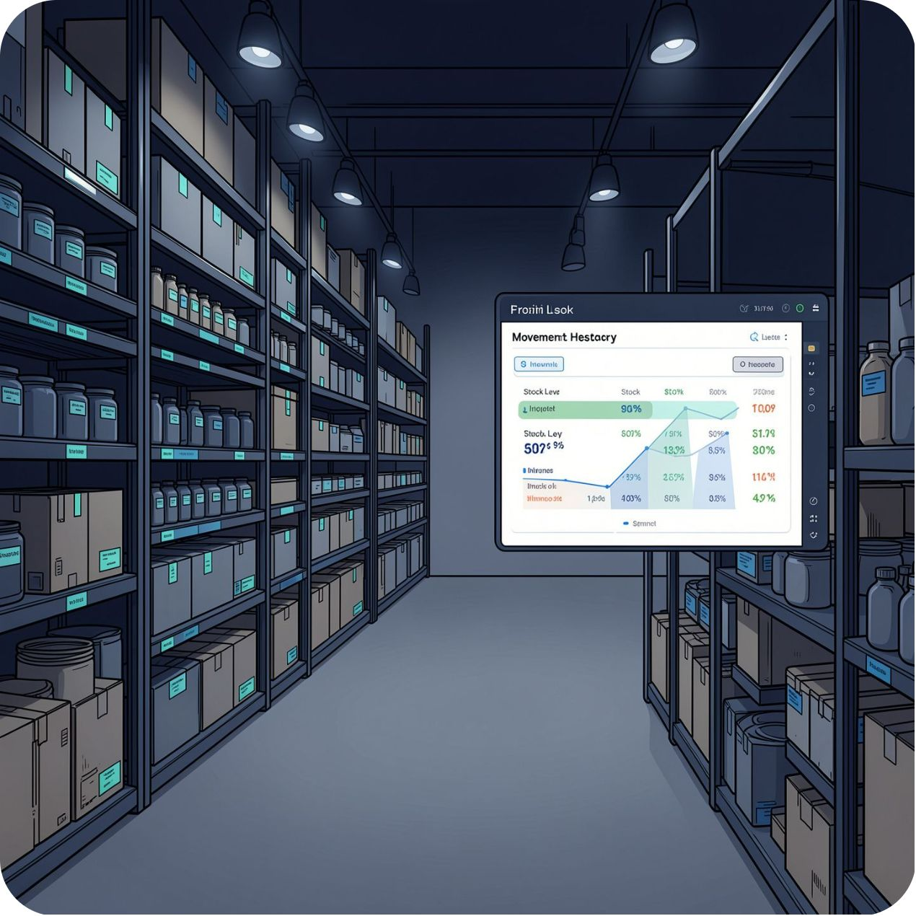

Everything your warehouse needs, in one place.
WarehouseIQ provides a centralized system for managing products, suppliers, warehouse information, inventory, and stock movements. It records stock entering and leaving the warehouse, maintains movement history, highlights low-stock products, and provides simple reports for better inventory visibility.
Products • Inventory • Suppliers • Stock Movements • Reports

Slide 4








Core Modules
01 Login
02 Product Management
03 Supplier Management
04 Warehouse Management
Secure, role-based access and single sign-on readiness.
Canonical product records, SKU attributes and catalog control.
Vendor profiles, lead times and contact history.
Location maps, bin assignments and capacity overview.
05 Inventory Management
06 Stock In / Stock Out
07 Movement History
08 Dashboard & Reports
Live stock counts, reserved vs available and valuation.
Structured receiving and dispatch workflows with checks.
Immutable movement logs for traceability and audits.
Concise operational dashboards and exportable reports.

Slide 5
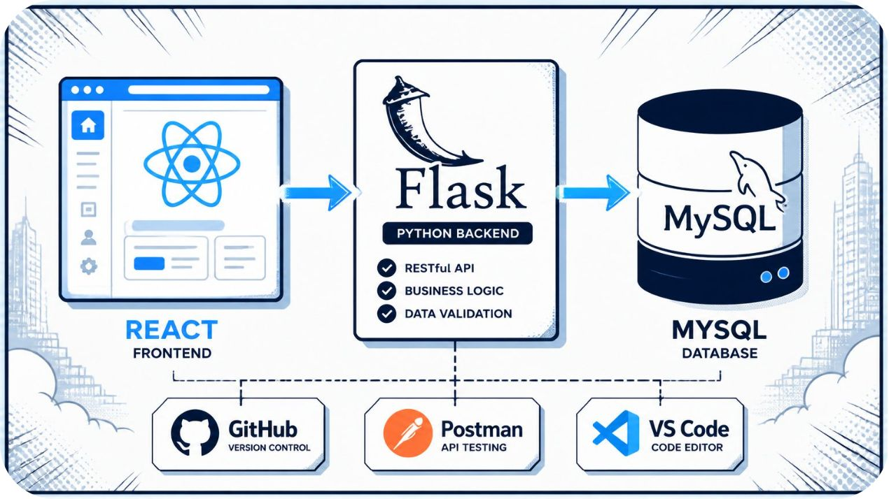
Built With
An intentionally simple, maintainable stack:
Frontend
Backend
React + modern CSS for a responsive, accessible UI.
Flask (Python) serving a RESTful API and business logic.
Database
MySQL: normalized DB schema with transaction-safe operations.
Supporting tools: GitHub · Postman · VS Code

Slide 6

Thank You
WarehouseIQ — Smart Warehouse & Inventory Management System

