Slide 1
STUDENT DETAILS
Name : Varalakshmi Pappula
Skills Build Email ID : 23h41f0082@bvcits.edu.in
College Name : BVC Institute of Technology & science
College State : Andhra Pradesh
Internship Domain : Artificial Intelligence
Internship Start Date : 3rd June
Internship End Date : 12th July

Slide 2
PROJECT TOPIC
A Machine Learning Model to check a Employee_Burnout_Analysis

Slide 3
AGENDA
Project overview
Who are the End Users
Your solution and its Value Proposition
How did you customize the project and make it your own?
Modelling
Results
Links

Slide 4
Project overview
In the introduction of an employee burnout analysis, you should provide a brief overview of the concept of burnout, its significance in the workplace, and the purpose of your analysis. Here's a structured approach:
Define Burnout : Start by defining what employee burnout is. Explain it as a state of chronic stress that leads to physical and emotional exhaustion, detachment, and decreased performance.
Importance of the Issue : Discuss why burnout is a critical issue in the workplace. Highlight its impacts on employees' health, productivity, and overall organizational effectiveness.
Contextual Background : Provide context for the analysis. Mention if there have been specific incidents or trends within the organization or industry that have raised concerns about burnout.
Purpose of the Analysis : Clearly state the goals of your analysis. This might include identifying the causes of burnout, assessing its impact on employees and the organization, and proposing solutions or interventions.
Scope and Methodology : Briefly outline the scope of your analysis and the methods used to gather data or insights.

Slide 5
Who are the End Users
IBM's skills and characteristics include a focus on advanced technology, innovation, and a strong emphasis on research and development.
characteristics of IBM include:
Technical Expertise: IBM has deep technical knowledge and experience in various high-tech domains.
Innovation: They are known for their continuous innovation and development of cutting-edge technologies.
Global Presence: IBM operates globally, requiring solutions that can be scaled and adapted to different markets and regulations
Needs:
Advanced Tools and Solutions: IBM needs tools that can integrate with their existing technologies and enhance their capabilities in areas like AI, cloud services, and quantum computing.
Scalability: Solutions must be scalable to meet the demands of their large, global customer base.
Security: High levels of security are crucial to protect sensitive data and maintain trust.
Benefits from Your Solution:
Enhanced Capabilities: Your solution could provide IBM with advanced features or technologies that complement their existing offerings and strengthen their technological edge.
Increased Efficiency : By addressing specific needs or gaps in their current setup, your solution could improve operational efficiency and reduce time spent on problem-solving.
Competitive Advantage: Integrating your solution could enhance IBM's ability to offer cutting-edge solutions to their clients, reinforcing their position as a leader in technology

Slide 6
Your solution and its proposition
Addressing employee burnout involves a multi-faceted approach to identify, analyze, and mitigate the factors contributing to burnout. Here's a structured solution and proposition for tackling employee burnout:
Assessment and Diagnosis:
A. Employee Surveys and Feedback : Conduct regular, anonymous surveys to gauge employees' stress levels, job satisfaction, and work-life balance
B. Performance Metrics : Analyze performance metrics and absenteeism rates to identify patterns that may indicate burnout.
C. One-on-One Interviews : Hold interviews or focus groups to gather qualitative insights into employee experiences and challenges.
Analysis:
A. Identify Stressors :
Work load : Examine if employees have excessive workloads or unrealistic deadlines.
Job Role Clarity : Check if employees have clear job roles and responsibilities.
Work Environment : Assess if the work environment is supportive and free of toxic elements.
B. Analyze Trends:
Look for common themes in survey responses and interviews. For example, high stress might correlate with certain departments or roles.
C. Benchmarking:
Compare your findings with industry standards to understand if your burnout rates are higher than average.

Slide 7
How did you customize the project and make it your own?
Customizing an employee burnout analysis project to make it your own involves several steps. Here’s a structured approach:
Define Objectives and Scope:
Understand the Purpose: Clearly define what you want to achieve with the burnout analysis. Are you aiming to identify risk factors, improve employee well-being, or develop interventions?
Scope: Determine the extent of your analysis. Will it cover the entire organization, specific departments, or particular job roles?
Gather and Analyze Data:
Relevant Metrics : Identify specific metrics that are relevant to your organization, such as employee satisfaction, workload, work-life balance, absenteeism rates, and turnover rates.
Benchmarking : Compare findings against industry standards or historical data within your organization to provide context.
Develop Relevant Indicators :
Burnout Indicators : Customize burnout indicators to align with your organizational culture and job roles. For instance, you might focus on job-specific stressors or organizational factors unique to your company.
Create Custom Metrics : Develop metrics specific to your organization, such as stress levels related to particular projects or departmental workload.
Design and Implement Interventions :
Implementation Plan: Create a clear plan for implementing changes, including timelines, responsible parties, and measurement of effectiveness.
Feedback Loop : Incorporate feedback from

Slide 8
Modelling
Modeling employee burnout involves several steps and can be approached using various methods depending on the data available and the goals of the analysis. Here's a general framework for modeling employee burnout:
1. Define Burnout : Burnout typically involves three components:-
*Emotional Exhaustion*: Feeling drained and overwhelmed.-
*Depersonalization*: Developing a detached or negative attitude towards work and people.-
*Reduced Personal Accomplishment*: Feeling ineffective and lacking achievement.
2. Data Collection Gather data through various means:-
*Surveys and Questionnaires*: Use validated tools such as the Maslach Burnout Inventory (MBI) or the Copenhagen Burnout Inventory (CBI).-
*HR Data*: Employee demographics, job roles, performance metrics, and turnover rates.-
*Workplace Metrics*: Workload, hours worked, job satisfaction, and workplace environment.###
3. Data Preparation:-
*Data Cleaning*: Handle missing values and outliers.-
*Feature Selection*: Choose relevant features that impact burnout (e.g., workload, job satisfaction).-
*Normalization/Standardization*: Ensure features are on comparable scales.

Slide 9
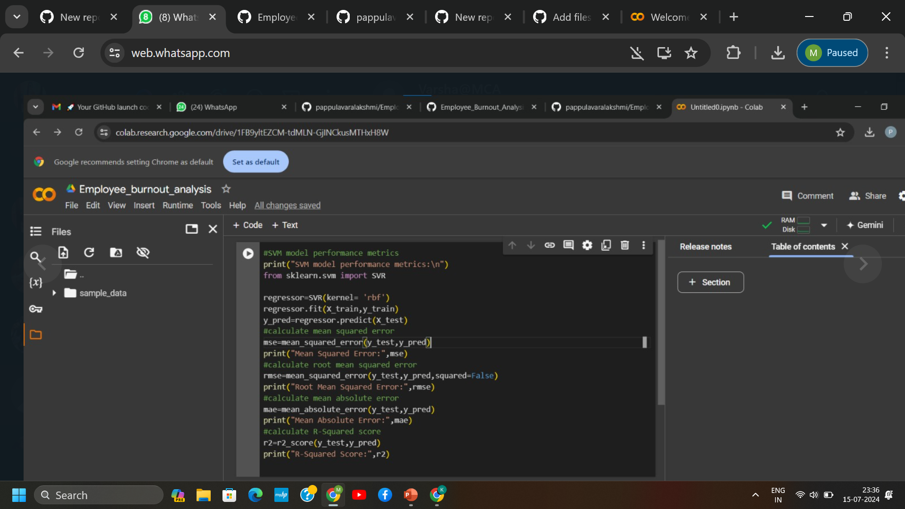
Results

Slide 10
LINKS
https://github.com/pappulavaralakshmi/Employee_Burnout_Analysis.ipynb

