Slide 1
PRACTICAL EMBEDDED SYSTEMS DEVELOPMENT USING C++

Slide 2
What will you learn?
Use of C++ to develop libraries for interfacing external components with an STM32 microcontroller.
Use of STM32 HAL drivers for application development on an STM32 microcontroller.
Designing and development of embedded software (from algorithm to working code).
Embedded software development using a project-oriented approach.

Slide 3
PROJECTS
Bluetooth controlled servo
Tic Tac Toe game
Self-driving car

Slide 4
Components
STM32 dev board (F401RE Nucleo board)
Connectors (male-male, male-female, female-female)
20x4 LCD
HC05 Bluetooth module
SG90 servo
4x4 Keypad
HCSR04 ultrasonic sensor (x3)
L298N motor driver
4 wheel car chassis, wheels and TT gear motor (For Arduino UNO R3 Robot 4WD Cars RC Remote Control L98N Robotics Learning Kit Educational Stem Toys DIY enthusiasts|Integrated Circuits| - AliExpress)
Li-ion battery (x3)
3-cell Li-ion battery case
10k potentiometer

Slide 5
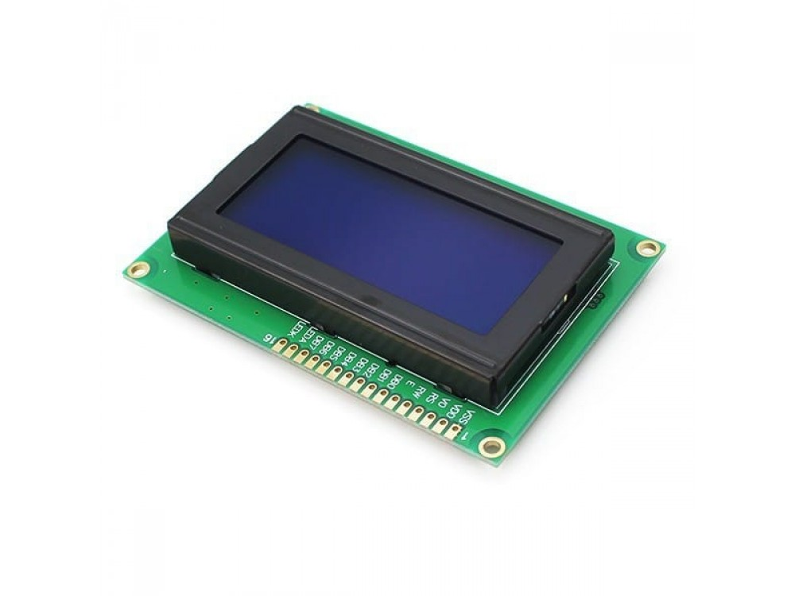
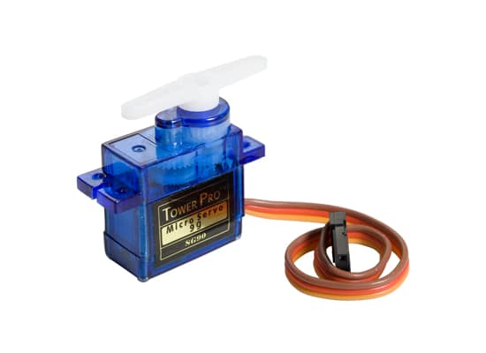
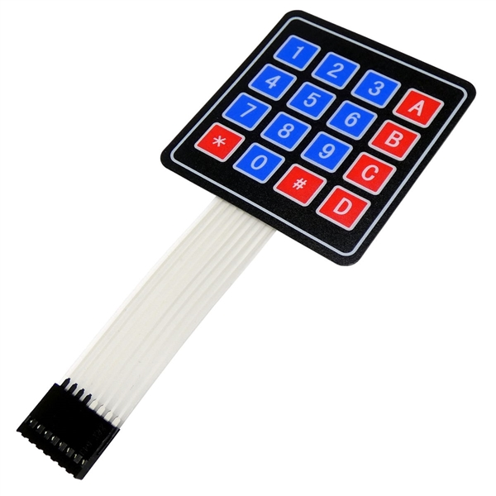
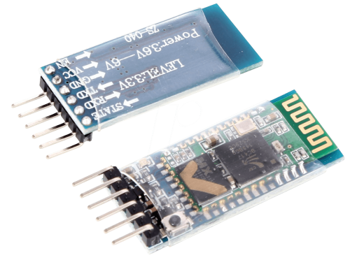
Components con’t

Slide 6
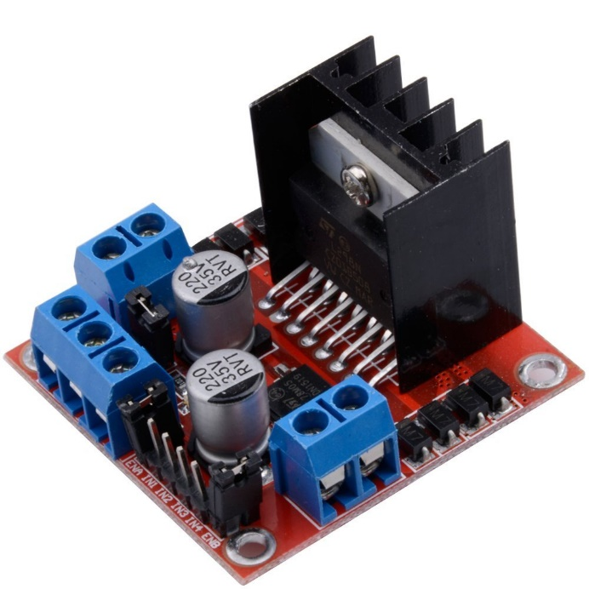
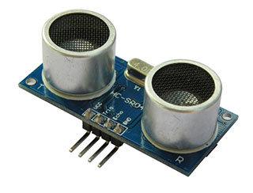
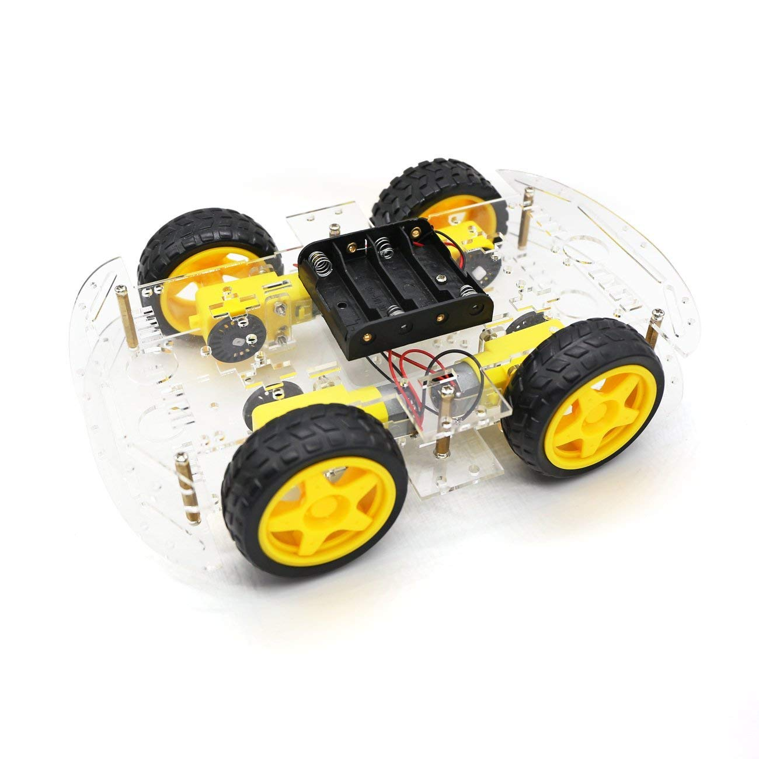
Components con’t

