Slide 1
PRACTICAL EMBEDDED SYSTEMS DEVELOPMENT USING C++

Slide 2
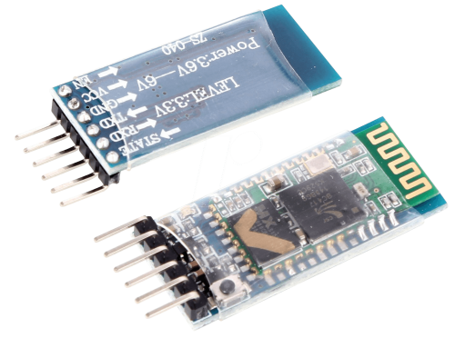
HC05 Bluetooth module
Uses the UART communication protocol
Can be operated in transmit and/or receive mode
5v power supply

