Slide 1
PRACTICAL EMBEDDED SYSTEMS DEVELOPMENT USING C++

Slide 2
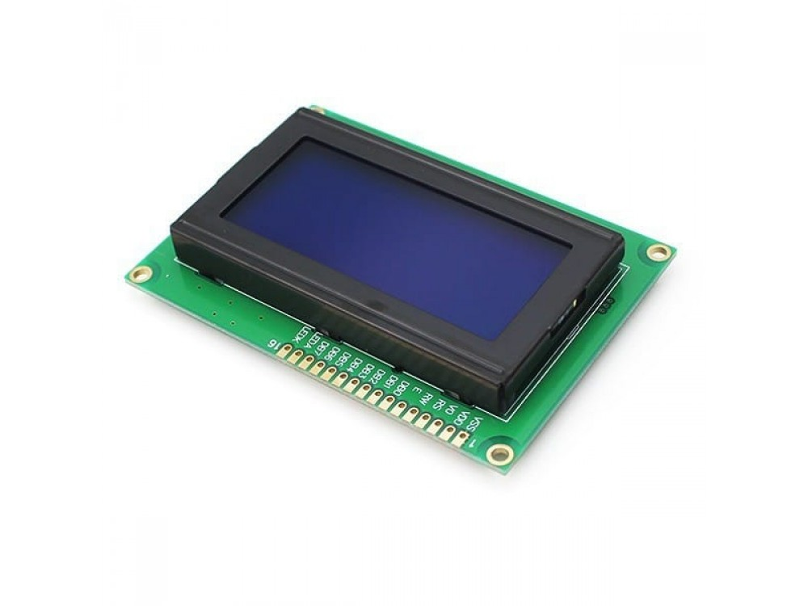
LCD (20x4)
It has 20 columns and 4 rows
Same pin numbering as 16x2 LCD
16 pins
5v supply

Slide 3
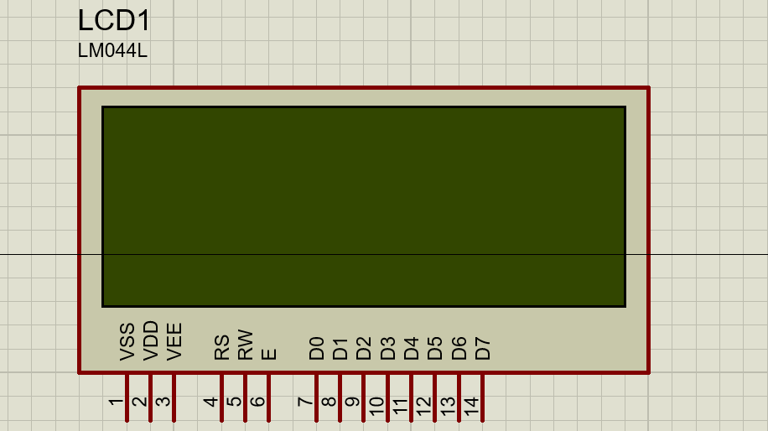
Pinout

Slide 4
Pinout con’t
Vss: ground
Vdd: 5v
Vo or Vee: Contrast
RS: Register Select
RW: Read/Write
E: Enable
D0-D7: Data pins
A: Backlight anode
K: Backlight cathode

