Slide 1
PRACTICAL EMBEDDED SYSTEMS DEVELOPMENT USING C++

Slide 2
Preamble
The 20x4 LCD and 16x2 LCD are based on the same controller (HD44780).
This controller has a data register and an instruction register.
The instruction register stores instruction codes e.g. display clear.
The data register stores data written into the DDRAM or CGRAM.
We’d write data into the DDRAM.
Data stored in a particular DDRAM address determines the location where the data will be displayed on the LCD.

Slide 3
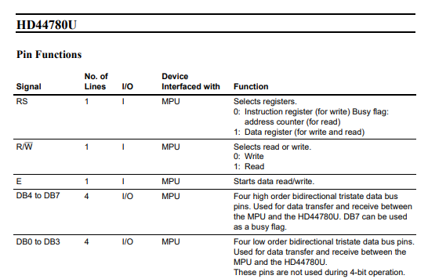
Some pin functions

Slide 4
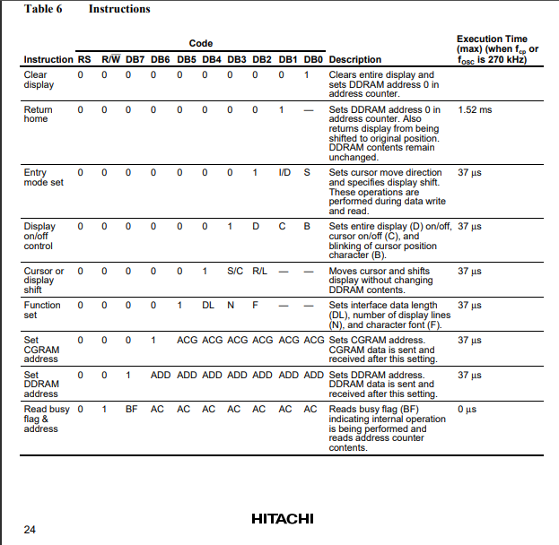
Instruction table

Slide 5
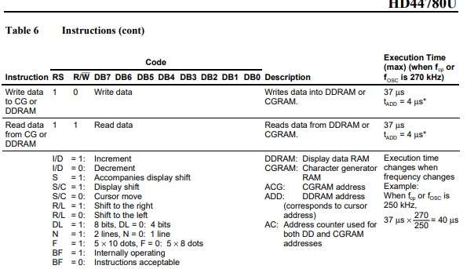
Instruction table con’t

Slide 6
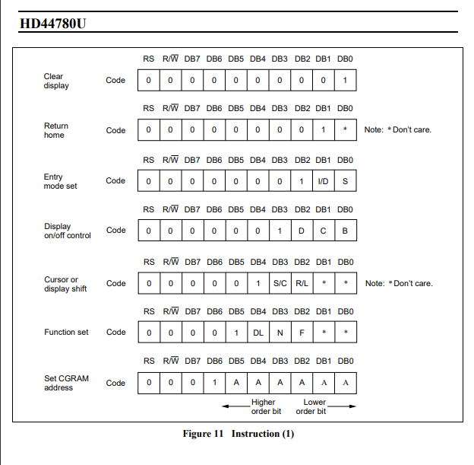
Instructions con’t

Slide 7
Some instruction codes based on 4-bit mode
Function set (8-bit) = 0x03,
Function set (4-bit) = 0x02,
Clear display = 0x01,
Display on, cursor on = 0x0E,
Display on, cursor off = 0x0C,
Entry mode, increment cursor = 0x06

Slide 8
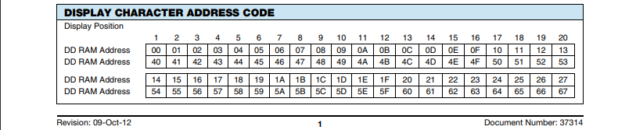
DDRAM address codes

Slide 9
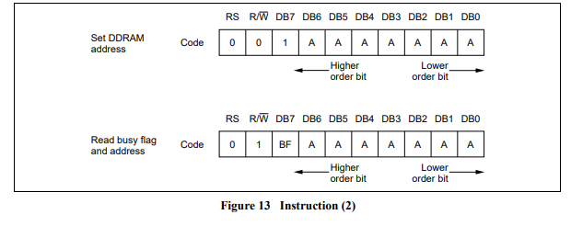
Setting the DDRAM address

Slide 10
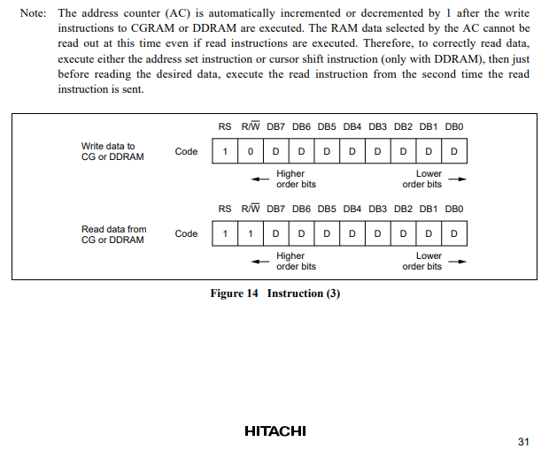
Data transfer with the DDRAM

Slide 11
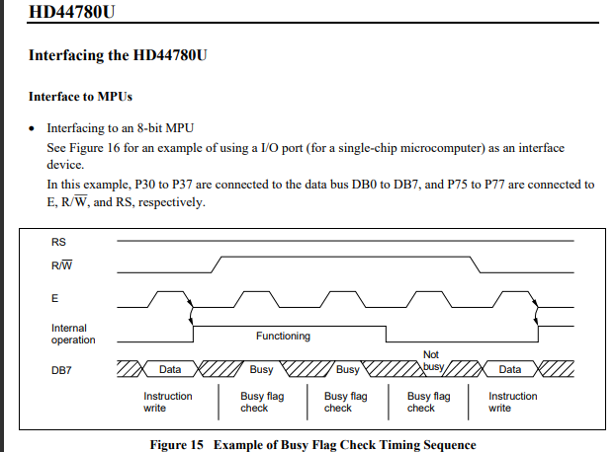
The Enable pulse

Slide 12
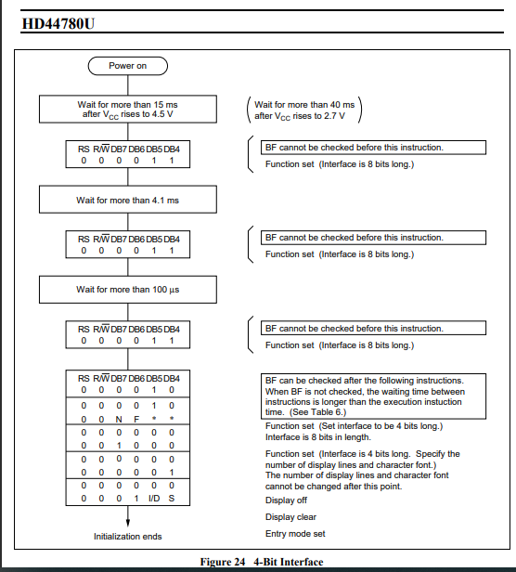
Initialization sequence for 4-bit mode

Slide 13
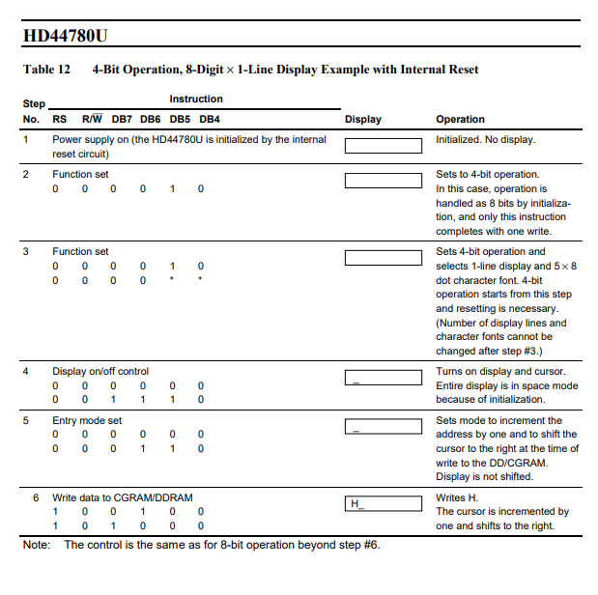
Sample procedure for 4-bit operation

