Slide 1
PGDS TSW IIT Roorkee
Capstone Project
Telecom Customer Churn
Prasanna H Patil

Slide 2
Agenda
Problem Statement
Business Outcome
Solution Approach
Build and Test Hypothesis
Data Analysis and Insights
Feature Engineering and Selection
Model Building and Evaluation
Conclusion

Slide 3
Problem Statement
Every Business grows only with customer satisfaction and thus it becomes of perennial importance to make sure customer is receiving best of services. While every organization make efforts towards this there are always other factors which lead to customer churn. Telecom sector in India is a living example of same in recent times. Apart from service-related issues due to large subscriber base and old ageing Infra, highly competitive market space, stream of subscriber friendly offers and VAS (value added services) all leading to high customer churn rates for all Operators.
That is why it is of utmost importance to the Operators to identify the customers with high probability to churn so they can resolve grievances, extend customized offers or implement recommendations by the data science team who is tasked with predicting the churn and suggesting root cause and remediations from the provided dataset of customer service desk. Idea is to be proactive to the churn then to be reactive based on past knowledge.

Slide 4
Business Outcome
Data Shared for telecom domain shows a 26.5% churn rate for sample population.
For any telco it is quite economical and beneficial to retain a customer than acquiring a customer at a cost of 1000 rs per customer acquired.
Business wants to bring down the churn rate to 15% for starters keeping a margin for 11% improvement while management takes additional steps.

Slide 5
Solution Approach
Acquire Data
Data Cleaning
Exploratory Data Analysis
Feature Eng. and Selection
Deploy Models
Evaluate Models
Re-Eng. Features & Selection
Hyperparameter Tuning
Model Selection
Model Deployment
Note: - A Separate Solution Approach Document is provided along with Submission.

Slide 6
Build and Test Hypothesis
Duration/tenure of contract of customer lower is the churn rate probability.
Lesser the no of subscriptions for additional services higher the possibility of churn.
Customer with extended family (wife and children) lower the probability of churn.
Tenure and Additional services are important features for churn prediction.
High Charges leads to higher churn rate as customer are attracted to counter offers from competitors.
Senior citizens are less probable to churn.
High Tenure = Lower Churn
Tenure & Add Services are Imp features
Less Services = High Churn
High Charges = High Churn
Extended Family = Low Churn
Senior Citizen = Low Churn

Slide 7
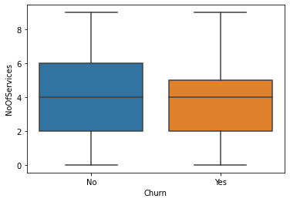
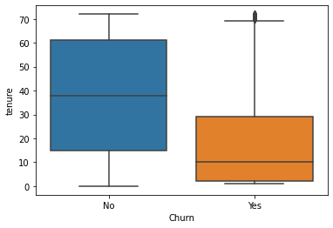
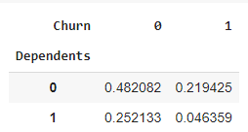
Build and Test Hypothesis
Longer the duration/tenure of contract of customer lower is the churn rate probability → Accepted(It is evident from the box plot on right)
Lesser the no of subscriptions for additional services higher the possibility of churn → Rejected (It is evidently clear from box plot on right)
Customer with extended family (wife and children) lower the probability of churn → Accepted (as evidently clear from crosstab on right 25% Customer with Dependents of total population only 4% have Churned)
2
1
3

Slide 8
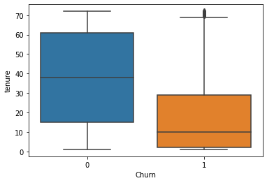
Build and Test Hypothesis
Tenure important features for churn prediction → Accepted (as evident from box plot on right)
Additional services are important features for churn prediction → Rejected (from the correlation heatmap these variable are more than 80% correlated to other variables and can be ignored)
1

Slide 9
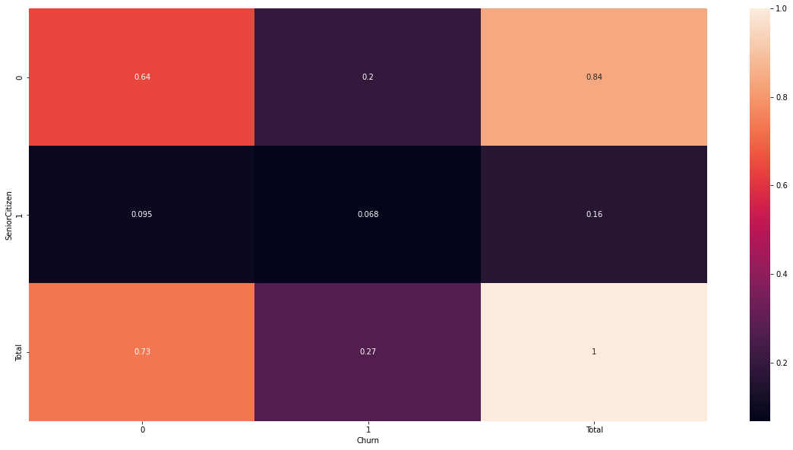
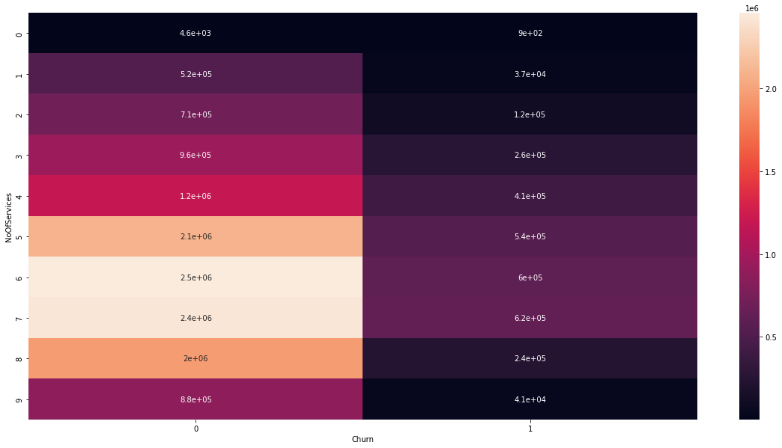
Build and Test Hypothesis
2
High Charges leads to higher churn rate as customer are attracted to counter offers from competitors → Rejected (From heatmap it is evidently clear that highest of the values are from No churn side. Higher values have led to churn but there is lack of evidence)
Senior citizens are less probable to churn → Rejected (as we can see 59% of Senior Citizen have not churned but 41% have churned from below heatmap)
1

Slide 10
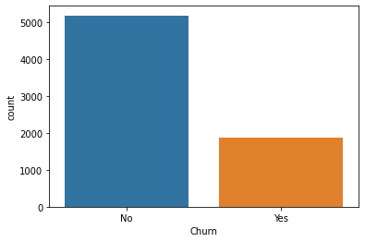
Data Analysis and Insights
Data is Highly Imbalanced as data seems to be more biased towards records for No Churn.
Data needs to be balanced by using Up sampling technique like SMOTE to balance Churn Yes and No data.
SMOTE was applied after deploying all possible classification models. Pre-SMOTE application the Accuracy and F1 Scores of Top performing model was ~ 81 % and Post-SMOTE the Accuracy and F1 score improved to ~ 87 % for same model.

Slide 11
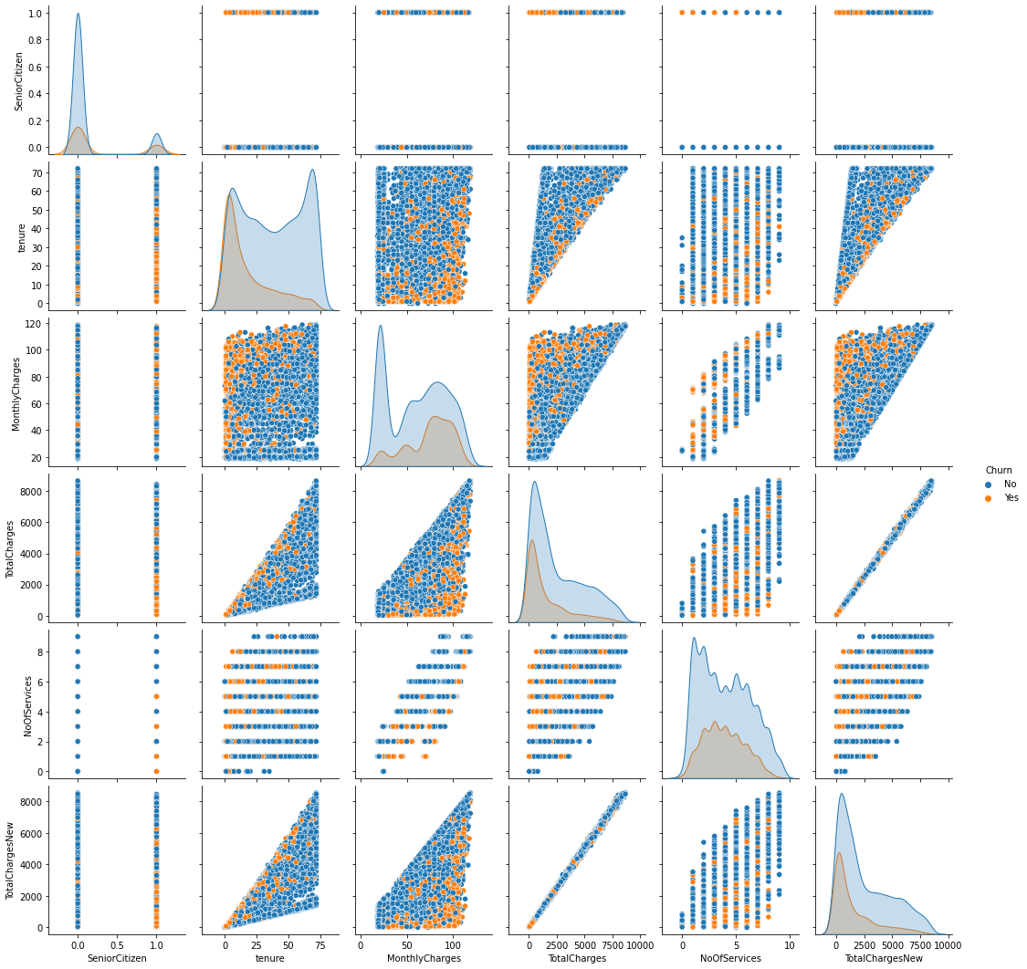
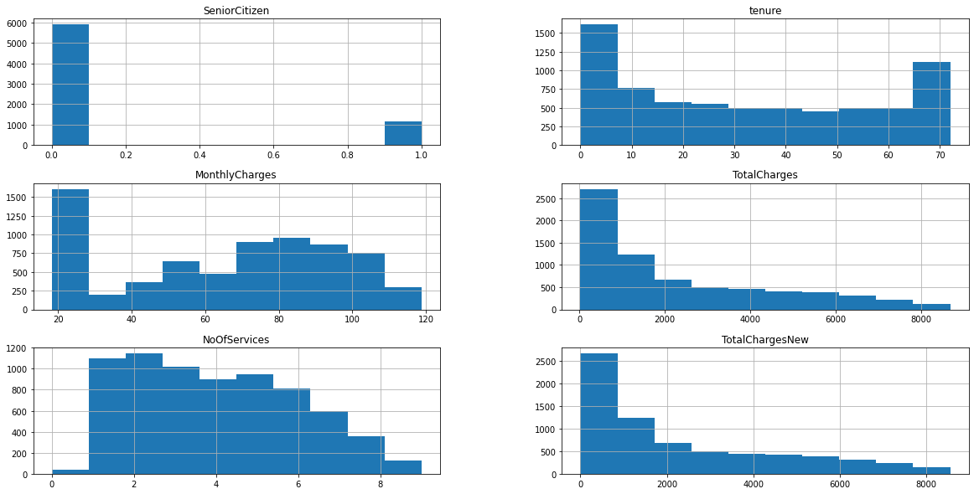
Data Analysis and Insights
Total Charges and Monthly Charges are left skewed.
Tenure overall seems to be evenly distributed but when observed with respect to Churn it is observed that tenure is left skewed.
No of Services which is a derived feature it seems evenly distributed and does not have any significant impact on the Churn.
Tenure vs Total Charges and Total Charges vs Monthly Charges are linearly correlated to each other.
Total Charges New is a derived field after recalculating as Tenure * Monthly Charges but it does not seem to have much of a differentiated impact when compared to Total Charges.

Slide 12
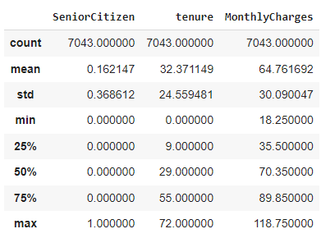
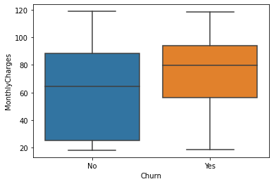
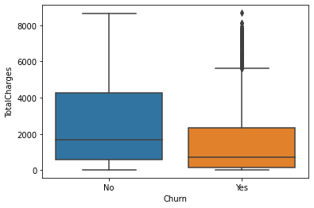
Data Analysis and Insights
Total charges seems to have a natural distribution and no outliers. But on closer look it seems there are outliers with respect to Churn which suggests that High Total Charges lead to Higher Churn possibility.
Tenure too seems to be properly distributed when looked closely at lower Tenure seems to lead to Higher Churn Possibility.

Slide 13
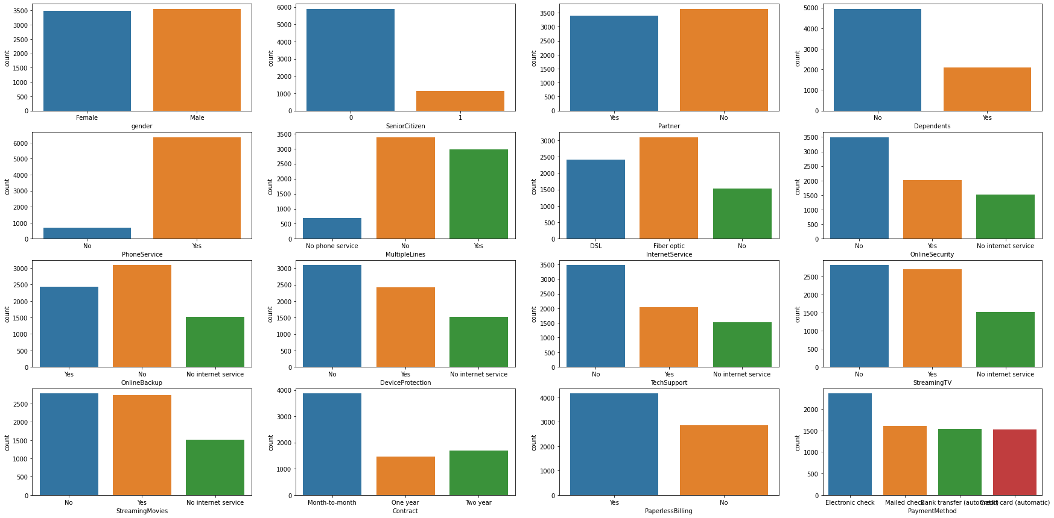
Data Analysis and Insights
Distribution of gender (Male/Female) is even.
No of Senior Citizens are very less in population.
People without partners is slightly higher than ones with partners.
No of People with dependents less than half of ones without dependents in population.
People with phone service are more than ones without phone service.
Multiple lines is evenly distributed.

Slide 14
Data Analysis and Insights
No of Fiber Optic Connections are more compared to DSL and No connection for Internet Service.
Most of the people have no Online Security Service.
Online Backup service is widely preferred.
Device Protection and Tech Support are mostly not preferred.
Streaming TV and Movies is evenly distributed.
Most people prefer Paperless Billing with Electronic check option.

Slide 15
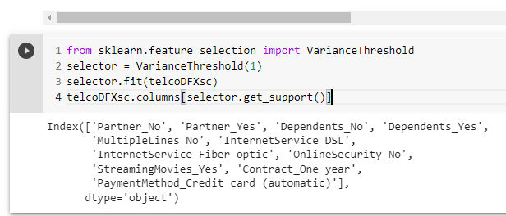
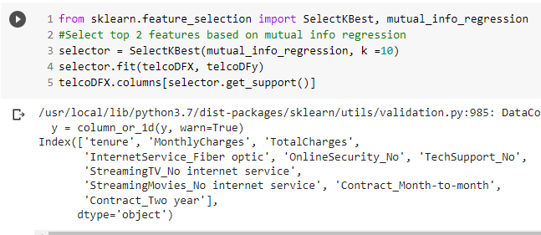
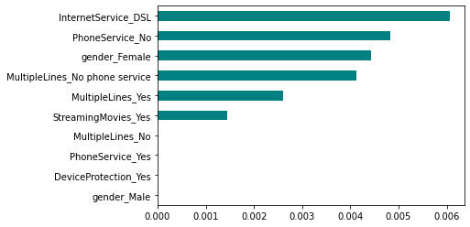
Feature Engineering and Selection
Using Variance Threshold method to identify top features results in 11 features with variance threshold set to 1. Variance Threshold is calculated after applying one hot encoding to data set which is done before splitting data in train and test to avoid information leakage.
We also used SelectKBest method to identify features setting k to 10 after applying one hot encoding gives similar features to variance threshold method.
We used Information gain method to identify top 10 features which again resulted in similar set of features as other 2 methods described above.

Slide 16
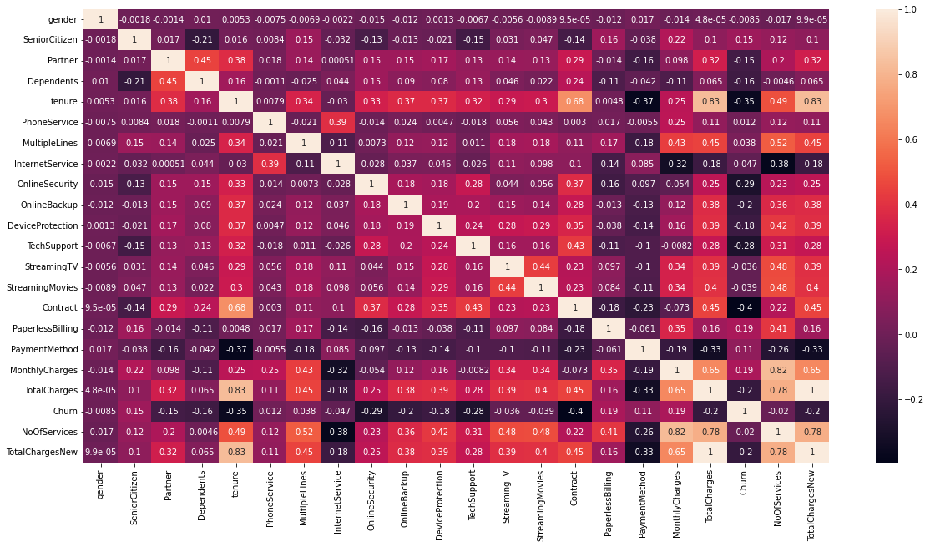
Feature Engineering and Selection
Correlation heatmap shows that new features created no of services is highly correlated to Total and Monthly charges and thus has no significant impact and can be dropped or code reverted.
Correlation heatmap shows that new features created Total Charges New is highly correlated to Tenure and thus has no significant impact and can be dropped or code reverted.
Similarly total charges and tenure are highly correlated and thus either of the column can be kept for model building.
It is observed that all the features provide good variation and there are less to none correlated variables which can be dropped.

Slide 17
Model Building and Evaluation
Classification Algo | Accuracy | Precision | Recall | F1-score | Support
Logistic Regression | 0.87 | 0.87 | 0.87 | 0.87 | 2582
Naïve Bayes | 0.79 | 0.8 | 0.79 | 0.79 | 2582
Stochastic Gradient Descent | 0.84 | 0.84 | 0.84 | 0.84 | 2582
KNN | 0.85 | 0.85 | 0.85 | 0.85 | 2582
Random Forest | 0.86 | 0.86 | 0.86 | 0.86 | 2582
SVC - Linear Kernel | 0.86 | 0.86 | 0.86 | 0.86 | 2582
SVC - rbf Kernel | 0.84 | 0.84 | 0.84 | 0.84 | 2582
Gradient Boosting | 0.86 | 0.86 | 0.86 | 0.86 | 2582
AdaBoost | 0.72 | 0.73 | 0.71 | 0.71 | 2582
XG Boost | 0.87 | 0.87 | 0.87 | 0.87 | 2582
Cat Boost | 0.86 | 0.87 | 0.86 | 0.86 | 2582
We Build and Evaluated 11 Classification Models with mentioned feature selections, data preprocessing, Standardization and Normalization mentioned in slides above.
Best performing model is XG boost with accuracy of around 87.45 % while Linear Regression performed accuracy of 86.9 %.

Slide 18
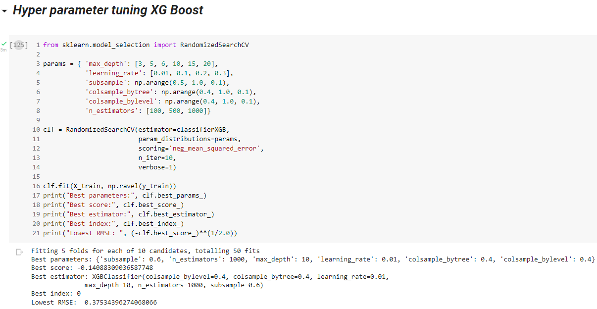
Model Building and Evaluation
Applied RandomSearchCV to best performing model XG Boost after trying multiple iterations and hyper parameter combinations it was observed that the default values used initially provided the best results.
Simlary RandomSearchCV was applied to 2nd best performing model Logistic Regression after trying multiple iterations and hyper parameter combinations it was observed that the default values used initially provided the best results.

Slide 19
Conclusion
Data is highly imbalanced applicate of Up sampling using SMOTE technique helped improve the prediction by ~ 6%
2 Derived Features No of services and Total Charges New have no +ve impact on the outcome hence excluded from final model.
We can accurately predict 87% cases where churn is probable i.e., out of 100 future cases of we will be able to predict 87 probable cases proactively in time to act thus a 14% cases still will be unavoidable which is within acceptable limit of 15% as decided in Business Outcome.

Slide 20
Thank You

