Slide 1
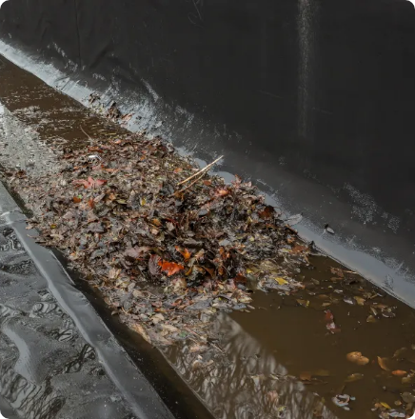
1M1B AI FOR SUSTAINABILITY
IBM SKILLSBUILD • AICTE
DrainGuard
Drainage Risk Screening &
Maintenance Prioritization Prototype
Papri Das
B.Tech – Electronics & Communication Engineering
Supreme Knowledge Foundation Group of Institutions
Mankundu, West Bengal
INTERNSHIP ID • INTERNSHIP_17828984086a44dee80acf6
SDG 11
SDG 13
Sustainable Cities & Communities • Climate Action
DrainGuard AI • 1M1B AI for Sustainability
1

Slide 2
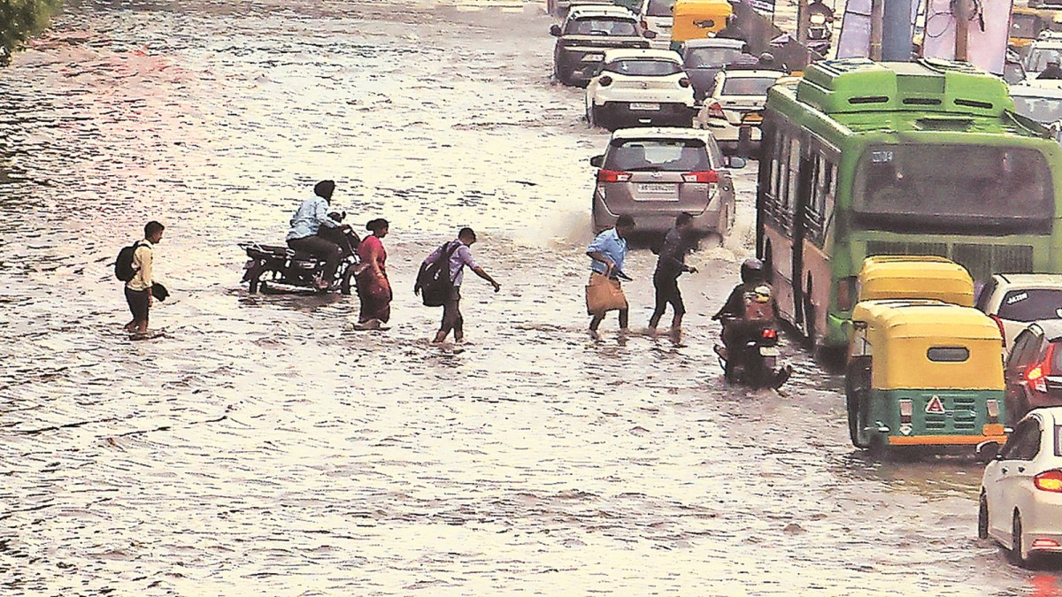
The Real-World Drainage Challenge
A practical infrastructure problem involving visible inlet conditions, field workload and fragmented context.
01
INLET BLOCKAGE
02
PATROL BOTTLENECKS
• Plastic waste
• Street sediment
• Leaves & organic debris
• Mud / silt
• Dispersed drainage locations
• Repeated inspection needs
• Limited field resources
03
FRAGMENTED FIELD DATA
04
CIVIC & INFRASTRUCTURE IMPACT
• Drainage photographs
• Rainfall observations
• Waterlogging history
• Surface water ponding
• Mobility disruption
• Maintenance burden
• Local environmental & health concerns
SDG 11
SDG 13
No unsupported scale or performance statistics are used.
DrainGuard AI • 1M1B AI for Sustainability
2

Slide 3
Current Gaps & Automation Opportunity
The current prototype is an offline decision-support workflow; AI automation can be added as a future layer.
CONVENTIONAL MANUAL APPROACH
DRAINGUARD AI
• Reactive inspection scheduling
• Manual photograph review
• Subjective qualitative notes
• No consistent priority scoring
• Rainfall and historical information reviewed separately
• Repeated inspection workload
• Structured screening of visible drainage conditions
• Manual condition selection in the current prototype
• Transparent 0–100 inspection priority indicator
• Combines visual cues + rainfall + historical context
• Local knowledge-base retrieval + rule-based guidance
• Human-in-the-loop inspection prioritization
The prototype standardizes assessment, scoring and field guidance; future vision models can automate condition recognition.
DrainGuard AI • 1M1B AI for Sustainability
3

Slide 4
Design Thinking & Problem Framing
EMPATHIZE
DEFINE
IDEATE
PROTOTYPE
TEST
HOW MIGHT WE?
How might we use AI to synthesize visual drainage-condition cues with localized rainfall and historical data, so that municipal maintenance teams can systematically prioritize field inspections during periods of elevated waterlogging risk?
TARGET STAKEHOLDERS
Municipal Ward Engineers
Sanitation Crew Leaders
Urban Communities
Need multi-source information synthesis for maintenance planning.
Need concise and transparent inspection guidance.
Benefit from safer and more resilient urban environments.
DrainGuard AI • 1M1B AI for Sustainability
4

Slide 5
Why Structured Assessment Instead of Only Manual Notes?
A structured workflow makes observations, context, scoring and field guidance more consistent.
TRADITIONAL RULE-BASED
Rainfall = High
History = Frequent
→ Assign priority
IMAGE
CONDITION
SELECTION
RAIN + HISTORY
CONTEXT
PRIORITY
INDICATOR
SOP-BASED GUIDANCE
HUMAN
VERIFICATION
WHY THIS HELPS
A structured form reduces variation in how visible conditions, rainfall and history are recorded and scored across drainage observations.
The system recommends — humans verify and decide
DrainGuard AI • 1M1B AI for Sustainability
5

Slide 6
DrainGuard AI – Proposed Prototype
A software-based decision-support prototype that works without external API calls.
LOCAL KNOWLEDGE –BASED RETRIVAL
RETRIEVED SOP GUIDANCE + RULE-BASED CHECKLIST
FIELD
OBSERVATION
IMAGE
REFERENCE
CONTEXT
SELECTION
PRIORITY
CALCULATION
HUMAN
VERIFICATION
• Accepts a drainage photograph
• User selects the visible drainage condition
• Combines visual cues with rainfall context
• User selects historical waterlogging frequency
• Calculates a transparent 0–100 priority indicator
• Uses LOCAL SOP GUIDANCE for grounded guidance
• Recommends human physical inspection
Offline prototype • No external API request • Human physical inspection remains final verification.
DrainGuard AI • 1M1B AI for Sustainability
6

Slide 7
Visible Condition Assessment
The current prototype uses manual selection of visible surface indicators; this does not confirm subsurface blockage or pipe condition.
Indicator
Visible Pattern
Prototype Points
Initial Focus
Clear Flow
Unimpeded visible inlet / runoff
0
Routine monitoring
Organic Debris
Leaves, branches, loose vegetation
+15
Surface sweep / rake
Mud & Sediment
Visible silt accumulation
+20
Manual desilting
Solid Waste / Plastic
Wrappers, bottles, polythene bags
+25
Manual litter removal
Standing Water
Visible water pooling around inlet
+30
Inspect inlet & downstream flow
Heavy Visible Occlusion
Large visible surface obstruction
+40
Priority physical inspection
LIMITATION • Visual screening evaluates visible surface conditions only. It cannot confirm underground blockage, pipe integrity or subsurface flow.
DrainGuard AI • 1M1B AI for Sustainability
7

Slide 8
Context-Aware Priority Assessment
Transparent Heuristic Priority Index (0–100)
Priority Index
= S_visual + S_rainfall + S_history
VISUAL SCORE
RAINFALL
HISTORY
0–40
0–30
0–30
RAINFALL
HISTORY
PRIORITY TIERS
• Low / Nil = 0
• Moderate = 10
• Heavy = 20
• Very Heavy = 30
• None = 0
• Occasional = 15
• Frequent Recurring = 30
0–30
LOW PRIORITY
31–60
MEDIUM PRIORITY
61–100
HIGH INSPECTION PRIORITY
PROTOTYPE ASSUMPTION • Weights are demonstration assumptions and require empirical calibration using real municipal field datasets.
DrainGuard AI • 1M1B AI for Sustainability
8

Slide 9
Local SOP Guidance Engine
A predefined local SOP knowledge base provides concise, consistent field guidance without external API calls.
Detected Visual Cues
+ Rainfall + History
SAMPLE INPUT • ASSET DR-001
Local SOP
RAG
Condition: Standing Water
Rainfall: Heavy
History: Frequent Recurring
LOCAL SOP
LOOKUP
Predefined Drainage /
Stormwater SOP
Local Knowledge-Base Retrieval
RULE-BASED FIELD GUIDANCE
“Observed standing water combined with heavy rainfall indicates elevated risk of street ponding. Field inspection is recommended to verify grate clearance, clear perimeter debris, and confirm downstream drainage flow.”
Field Guidance
Human Inspection
DrainGuard AI • 1M1B AI for Sustainability
9

Slide 10
AI ELEMENTS & TECHNOLOGIES USED
CURRENT PROTOTYPE
LOCAL KNOWLEDGE-BASE RETRIEVAL
RAG retrieval searches relevant .txt/.md drainage guidance based on condition and priority.
RULE-BASED PRIORITY ENGINE
Combines visible condition, rainfall and history into a transparent 0–100 indicator.
RULE-BASED GUIDANCE ENGINE
Uses predefined offline templates to produce field checklists.
HUMAN-IN-THE-LOOP
Human personnel physically verify the drainage condition before maintenance.
FUTURE AI ENHANCEMENT
Computer Vision → Automatic visible-condition recognition
LLM + RAG → Generative grounded guidance
📷 DRAINAGE IMAGE
↓
👤 VISIBLE CONDITION SELECTION
↓
🌧️ RAINFALL + WATERLOGGING HISTORY
↓
🧮 PRIORITY INDEX (0–100)
↓
🔎 LOCAL KNOWLEDGE-BASE RETRIEVAL
(RAG RETRIEVAL)
↓
📚 RELEVANT SOP GUIDANCE
↓
⚙️ RULE-BASED GUIDANCE ENGINE
↓
📋 FIELD CHECKLIST
↓
👷 HUMAN PHYSICAL VERIFICATION

Slide 11
Prototype Interface & Workflow Validation
Python + Streamlit • Prototype / Demonstration Data
DRAINGUARD AI / SCREENING DASHBOARD
INTERFACE COMPONENTS
Asset ID
Rainfall
History
• Upload drainage image
• Asset ID
• Rainfall condition
• Historical waterlogging frequency
• Analyze button
• Priority assessment
• Priority score
• Explanation
• Recommended inspection action
DR-001
Heavy
Frequent
ANALYZE
PRIORITY ASSESSMENT
RECOMMENDATION
HIGH
Physical verification
recommended.
80 / 100
Upload image → enter context → analyze → review → physically verify
PROTOTYPE / DEMONSTRATION DATA
DrainGuard AI • 1M1B AI for Sustainability
10

Slide 12
Prototype Verification & Testing
Deterministic score generation is verified; real-world performance requires representative field data.
ID
Scenario Inputs
Expected Tier
Calculated Output
Result
TC-01
Clear Grate (0) + Low Rain (0) + No History (0)
Low
Low (0/100)
PASS
TC-02
Organic Debris (15) + Moderate Rain (10) + No History (0)
Low / Med Border
Low (25/100)
PASS
TC-03
Solid Waste (25) + High Rain (20) + Occasional History (15)
Medium
Medium (60/100)
PASS
TC-04
Standing Water (30) + Heavy Rain (20) + Frequent History (30)
High
High (80/100)
PASS
DEMONSTRATION TEST CASES • Unit testing validates predictable priority-index calculation. Field performance still requires representative data.
DrainGuard AI • 1M1B AI for Sustainability
11

Slide 13
Responsible AI Considerations
Design safeguards keep the prototype transparent, bounded and human-supervised.
FAIRNESS
TRANSPARENCY
ETHICS
Apply consistent screening criteria across locations and datasets.
Show the selected factors and score contribution.
Avoid misleading claims and do not present indicators as certainty.
PRIVACY
HUMAN OVERSIGHT
Avoid unnecessary personal or sensitive data.
People physically verify conditions before maintenance action.
AI recommends. Humans verify and decide.
DrainGuard AI • 1M1B AI for Sustainability
12

Slide 14
Expected Impact
Potential value areas — not measured performance claims.
1
2
3
4
OPERATIONAL
ENVIRONMENTAL
SOCIAL
RESOURCE
Faster initial screening of drainage observations.
Supports preparedness for rainfall-related drainage issues.
Supports safer and more resilient urban communities.
Helps organize limited inspection and maintenance effort.
SDG 11
SDG 13
No percentage improvement, accuracy or user-count claims are made without actual experiments.
DrainGuard AI • 1M1B AI for Sustainability
13

Slide 15
Future Roadmap
Future scope only — these capabilities are not currently implemented.
01
Larger locally representative drainage image dataset
02
Empirical calibration of priority weights
03
GIS-based ward mapping
04
Live weather integration
05
Mobile / offline field application
06
Bengali and multilingual support
07
Continuous AI evaluation
08
Optional future IoT integration
FUTURE SCOPE • Validate before deployment
DrainGuard AI • 1M1B AI for Sustainability
14

Slide 16
CONCLUSION
From fragmented observations to structured inspection priorities.
“DrainGuard AI demonstrates how responsible AI can transform fragmented drainage observations into structured inspection priorities and grounded maintenance guidance.”
AI supports the decision — human inspection remains the final verification step.
Papri Das • B.Tech – ECE
Supreme Knowledge Foundation Group of Institutions
THANK YOU
1M1B AI for Sustainability Virtual Internship
DrainGuard
DrainGuard AI • 1M1B AI for Sustainability
15

