Slide 1
Ajax Testing Tool Review
when to test, what to test, how to test Ajax applications
Monday, September 29th, 3:00 - 4:30p
Ted Husted
In this session, we explore
  when to test, what to test and how to test Ajax components.
  creating automatic tests with various tools, including YUI Test, OpenQA Selenium, and TIBCO Test Automation Kit
  how to use Ajax testing tools with IDEs and continuous integration systems.

Slide 2

Ajax Testing Tool Review when to test, what to test, how to test Ajax applications
Square One University Series

Slide 3

Ajax Testing Tool Review
For the latest version of this presentation,
visit http://slideshare.com/ted.husted
For the latest version of source code,
visit http://code.google.com/p/yazaar/

Slide 4

Abstract
Not long ago, testing Ajax components meant play-testing a page by hand.
Today, there are a growing number of tools we can use to simplify and automate Ajax testing.
During the session, we will cover
  when, what, and how to test Ajax applications
  creating automatic tests with various tools
  testing with IDEs and continuous Integration systems

Slide 5
Ajax Testing Tool Review
Tool Review
  JsUnit and YUI Test
  Selenium
  Cruise Control
Ajax Testing in Action
  Live Coding Demonstration
    YUI Test + Selenium + Cruise Control
    Added value: MyEclipse and IDEA

Slide 6

JsUnit
JsUnit is a Unit Testing framework for client-side (in-browser) JavaScript.
Essentially a port of JUnit to JavaScript.
Platform for automating the execution of tests on multiple browsers and multiple machines running different OSs.
Development began in January 2001.

Slide 7
JsUnit – Key Features
Create test cases with JavaScript code.
Tracing modes - warn, info, and debug.
Group related cases using test suites.
Server component
  provide integration with other test platforms,
  test logging, and
  running tests on multiple target platforms.

Slide 8
JsUnit – Key Features
Browser Support - Internet Explorer 5.0+, Firefox or Mozilla 0.9+, Netscape 6.0+, and Konqueror 5+.
Release - 2.2 (Alpha, 2006 March)
  2.2.0 (tagged 2008 Jan)
  Since 2001
License - GPL, LGPL, MPL
One team member

Slide 9
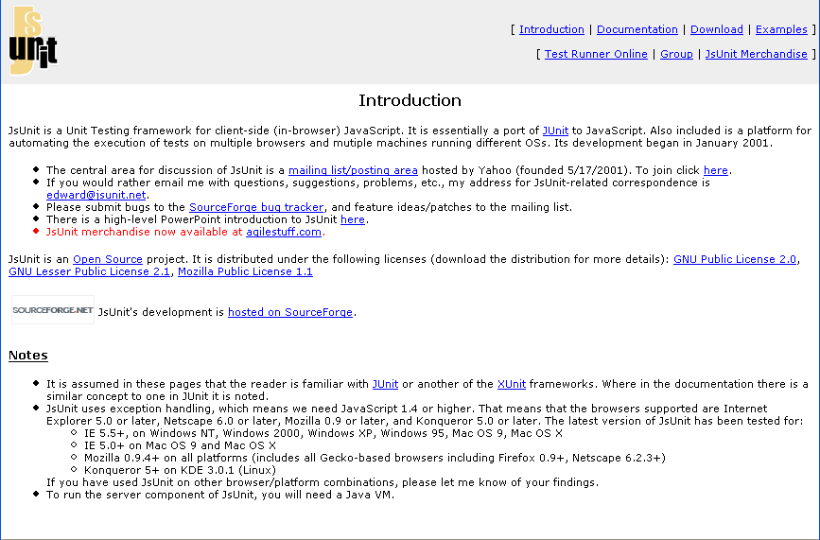
http://jsunit.net/

Slide 10
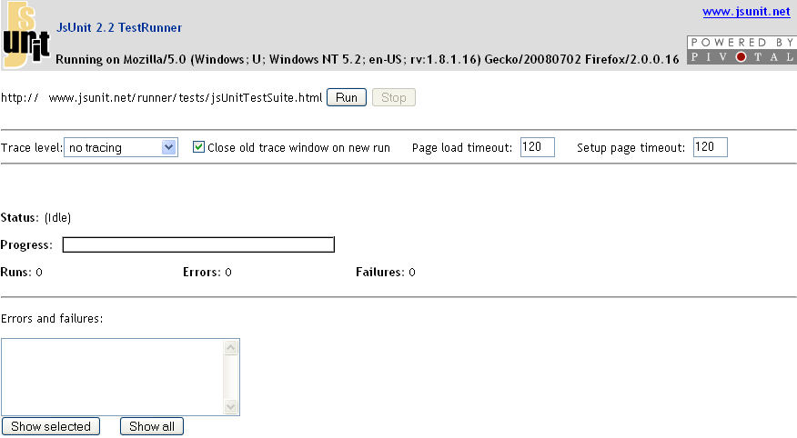
http://www.jsunit.net/runner/testRunner.html?testpage=/runner/tests/jsUnitTestSuite.html

Slide 11
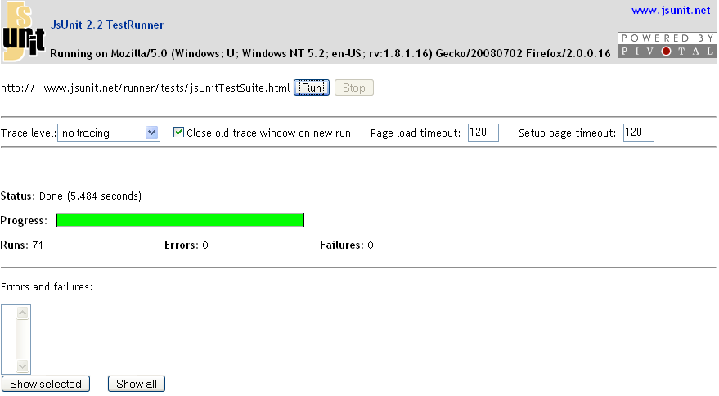
http://www.jsunit.net/runner/testRunner.html?testpage=/runner/tests/jsUnitTestSuite.html

Slide 12
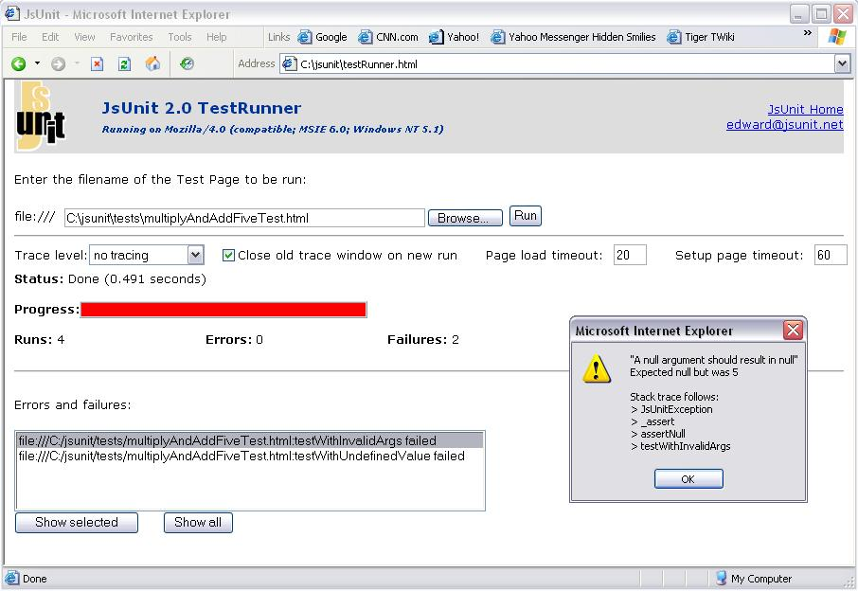
http://www.jsunit.net/documentation/runnerExample.html

Slide 13
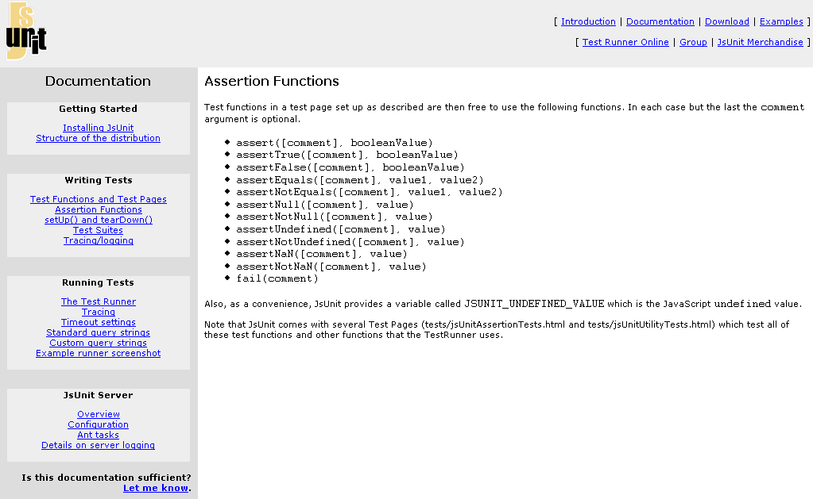
http://jsunit.net/documentation/

Slide 14
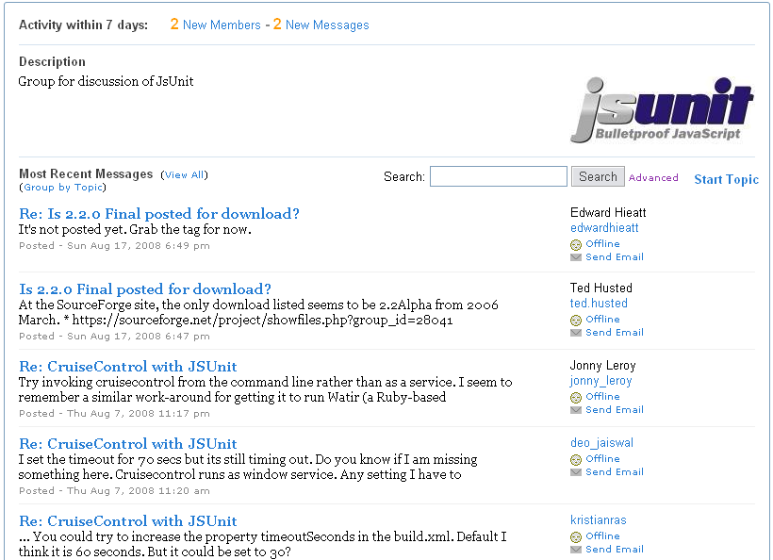
http://tech.groups.yahoo.com/group/jsunit/

Slide 15

http://www.cafepress.com/agilestuff

Slide 16
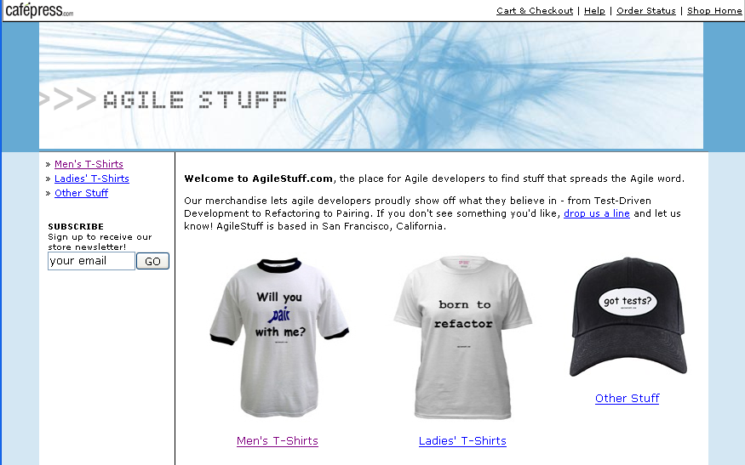
http://www.cafepress.com/agilestuff

Slide 17
JsUnit
No Form Support
No Asynchronous Support
Server Support - Java
IDE Support - Eclipse, IDEA
CruiseControl Support

Slide 18
JsUnit
Strengths
  Established,
  xUnit model,
  Active community.
Weaknesses
  Sole Developer,
  Conservative License,
  Irregular release schedule,
  Several known limitations.

Slide 19
JsUnit
Bottom Line
  Use when team members are already experienced with jsUnit
    (and licensing is not an issue)
  Consider YUI Test to test asynchronous code if starting fresh
    (or willing to try something new).
  For acceptance tests, add Selenium to the mix

Slide 20
JsUnit
Resources
  AJAX and Unit Testing - it's time to mingle, Jim Plush (2006 Feb)
    http://www.litfuel.net/plush/?postid=117
  Ajax and Unit Testing Part Two, The Wrath of Mock, Jim Plush (2006 Nov)
    http://www.litfuel.net/plush/?postid=154

Slide 21

YUI Test
Testing framework for browser-based JavaScript solutions.
Add unit testing to JavaScript solutions.
Derives characteristics from nUnit and Junit.

Slide 22
YUI Test – Key Features
Create test cases through simple syntax.
Failure detection for methods that throw errors.
Group related cases using test suites.
Asynchronous tests for testing events and Ajax communication.
Cross-browser DOM Event simulation.

Slide 23
YUI Test – Key Features
Support for “A-Grade” Browsers
Release 2.5.2 (2008 May)
  Since 2005
License – BSD
~16 Team Members
  Yahoo! employees and contributors

Slide 24
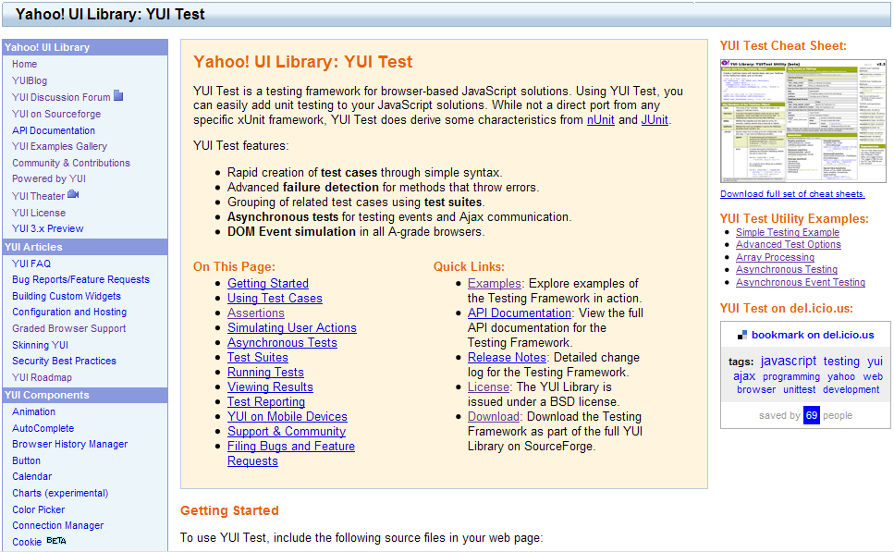
http://developer.yahoo.com/yui/yuitest/

Slide 25
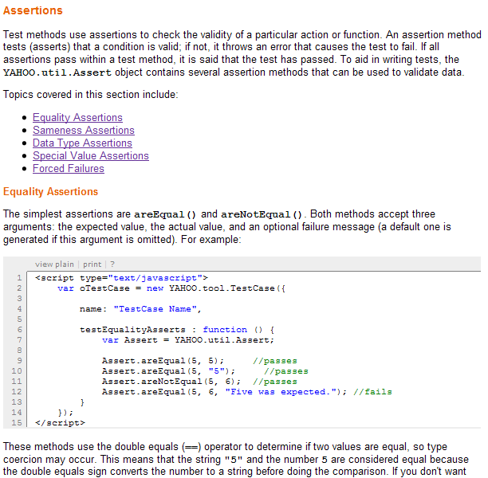
http://developer.yahoo.com/yui/yuitest/#start

Slide 26
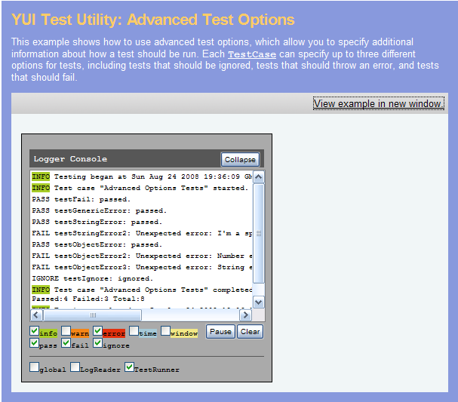
http://developer.yahoo.com/yui/examples/yuitest/yt-advanced-test-options.html

Slide 27
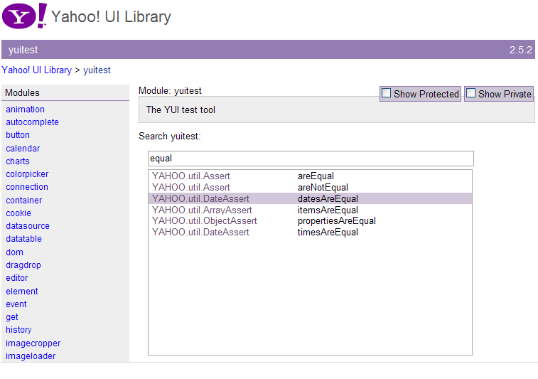
http://developer.yahoo.com/yui/docs/module_yuitest.html

Slide 28
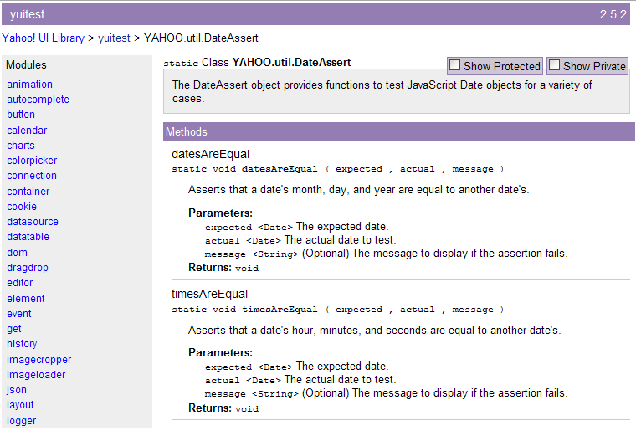
http://developer.yahoo.com/yui/docs/YAHOO.util.DateAssert.html#method_datesAreEqual

Slide 29
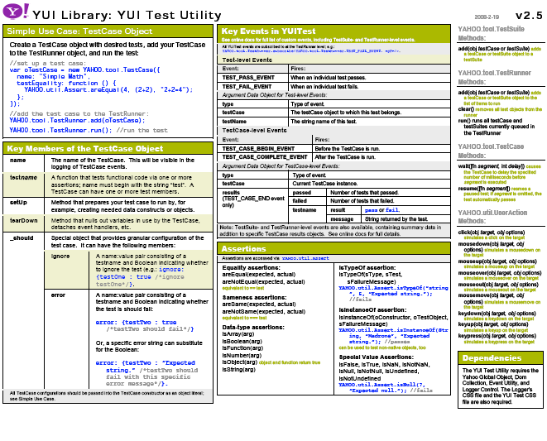
http://yuiblog.com/assets/pdf/cheatsheets/yuitest.pdf

Slide 30
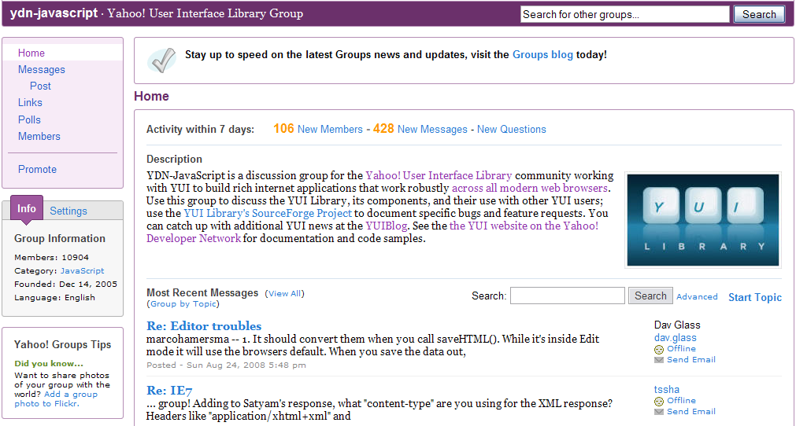
http://tech.groups.yahoo.com/group/ydn-javascript/

Slide 31
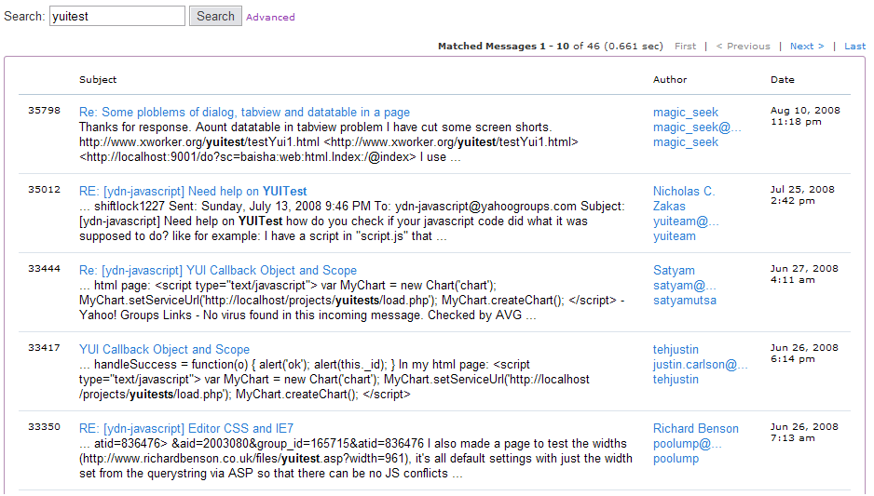
http://tech.groups.yahoo.com/group/ydn-javascript/msearch?query=yuitest

Slide 32
YUI Test
Form Support
Asynchronous Support
No Server Support
No IDE Support
No CI Support

Slide 33
YUI Test
Strengths
  Bundled with YUI Library
  Large, well-funded team
  Regular releases
  Active community
  Well documented
Weaknesses
  Bundled with YUI Library

Slide 34
YUI Test
Bottom Line:
  Use when coding JavaScript or Ajax applications
  Good for simple event/form tests
  For true acceptance tests, add Selenium to the mix

Slide 35
YUI Test
Resources
  Writing Your First YUI Application, Eric Miraglia (2008 May)
    http://www.insideria.com/2008/05/writing-your-first-yui-applica.html

Slide 36

Open QA Selenium
Selenium is a suite of tools to automate web app testing across many platforms
Selenium IDE records and runs tests as a Firefox Plugin.
Selenium Remote Control runs tests across multiple platforms
Selenium Grid distributes
test running across multiple
machines

Slide 37
Selenium – Key Features
Create test scripts using Selenium Commands.
Run tests in against live applications.
Compile test scripts in native languages, such as Java, C#, Ruby.
Integrate scripts with other test suites and continuous integrations systems.

Slide 38
Selenium – Key Features
Support for Firefox 2+, (RC and Core) IE7, Safari 2+, Opera 8+, Windows, OS X, Linus, Solaris.
Release 1.0-beta (2008 March)
  Since 2005
License – Apache
~11 Team Members
  Originated as ThoughWorks project

Slide 39
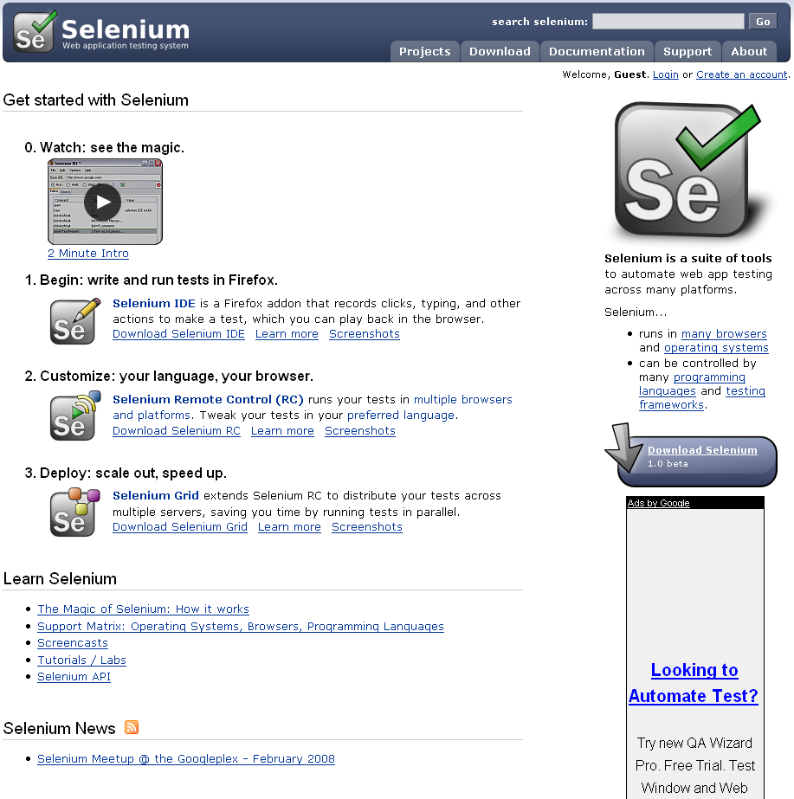
http://selenium.openqa.org/

Slide 40
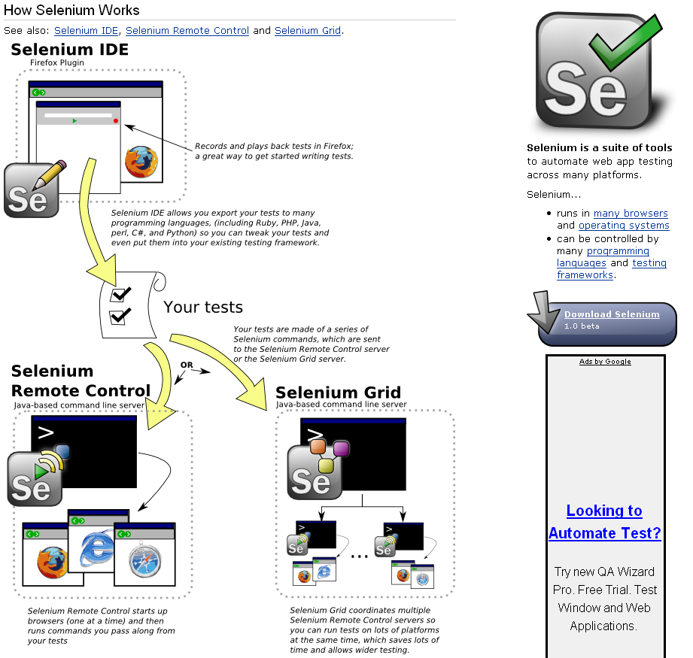
http://selenium.openqa.org/documentation/

Slide 41
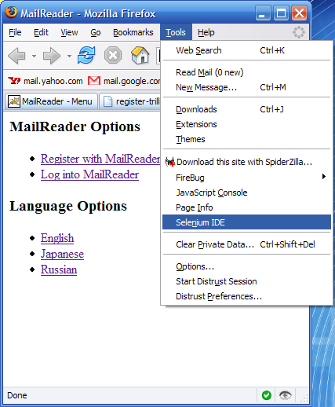

Slide 42
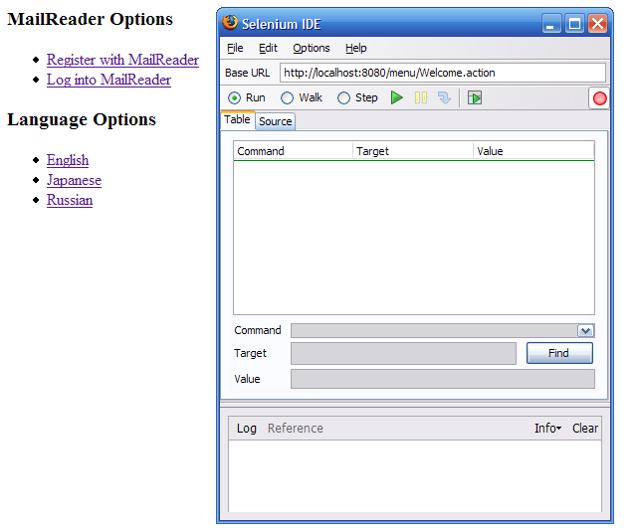

Slide 43
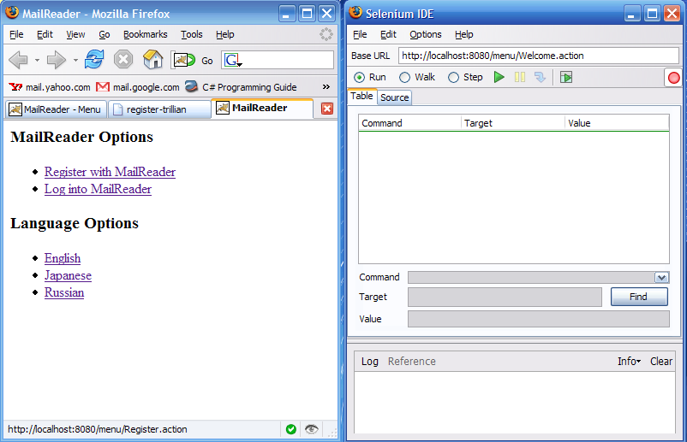

Slide 44
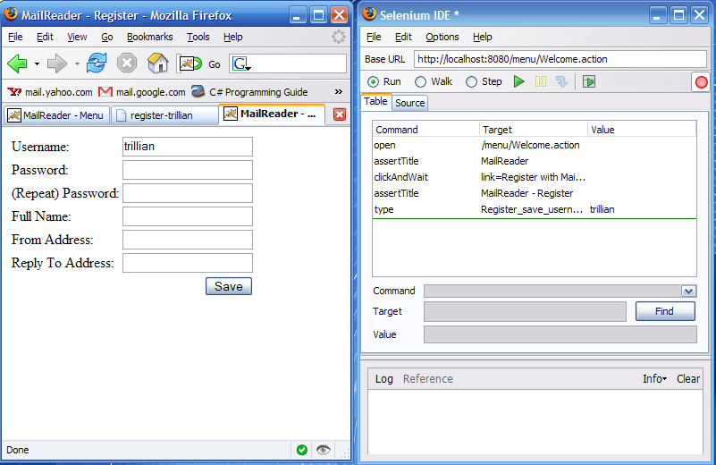

Slide 45
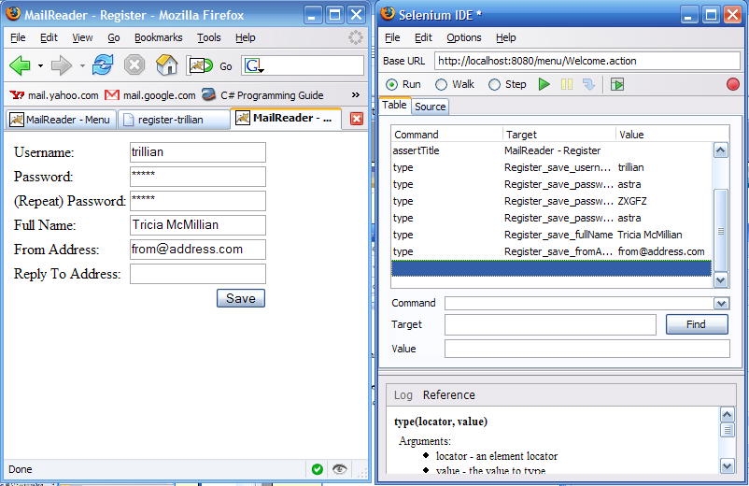

Slide 46
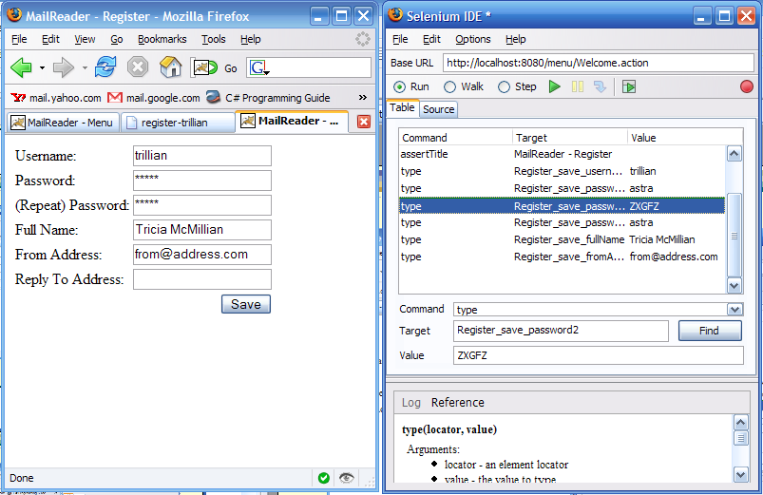

Slide 47
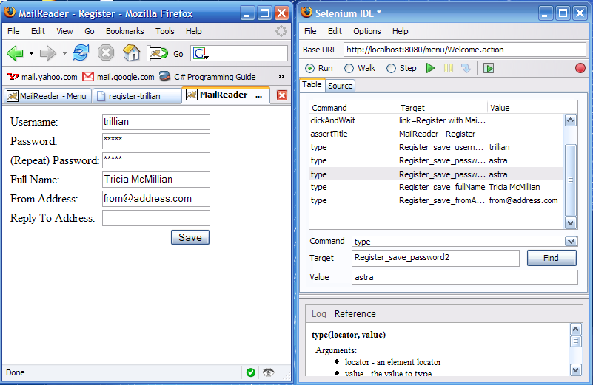

Slide 48
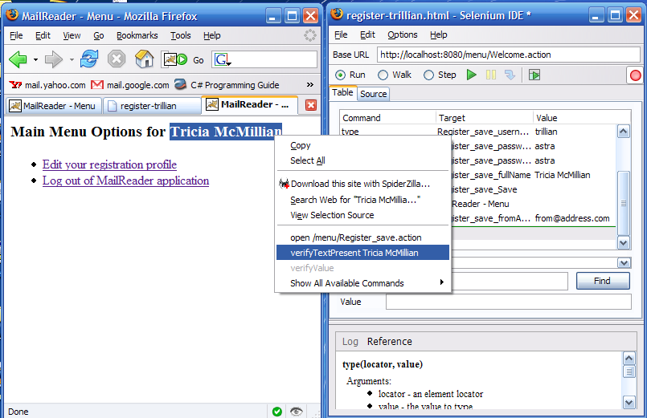

Slide 49
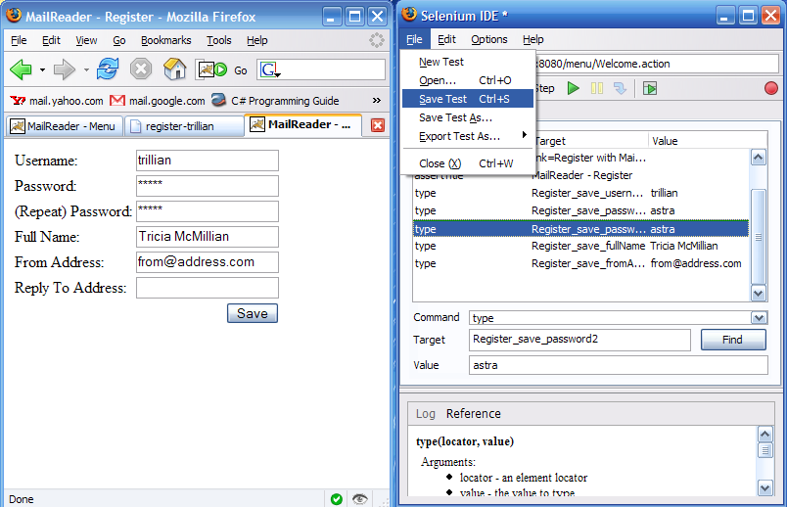

Slide 50
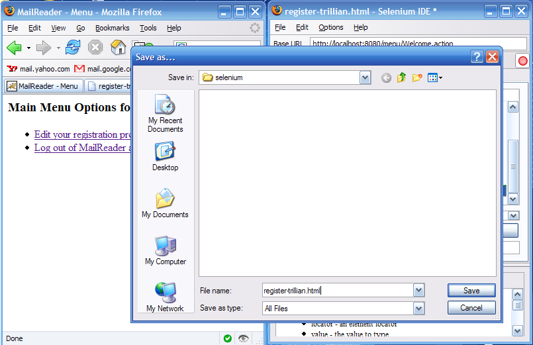

Slide 51
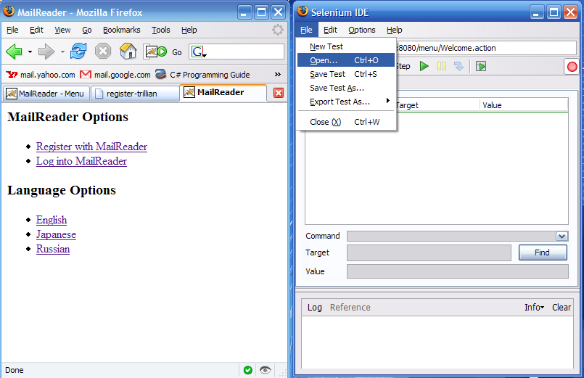

Slide 52
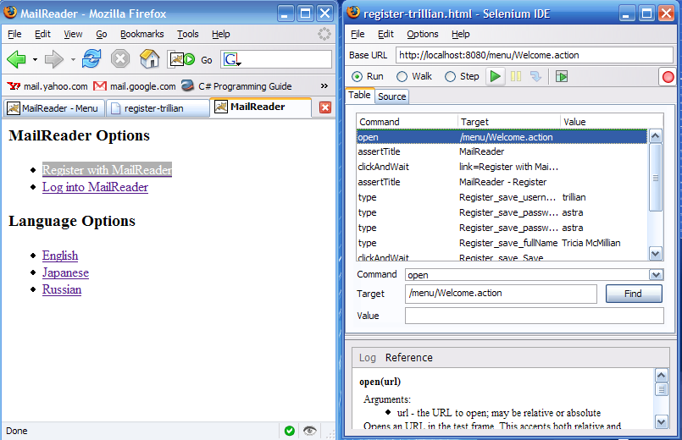

Slide 53
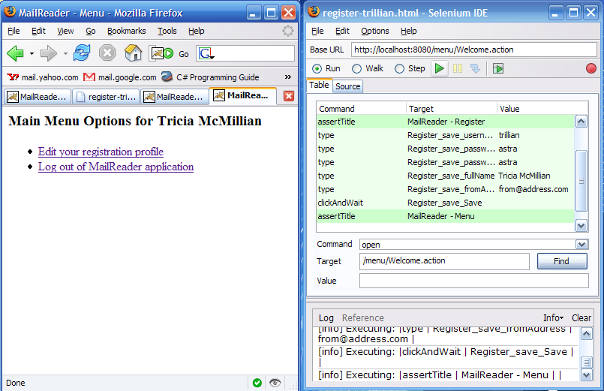

Slide 54
<tr><td>open</td><td>Welcome.action</td><td></td></tr>
<tr><td>assertTitle</td><td>MailReader</td><td></td></tr>
<tr><td>clickAndWait</td><td>link=Register with MailReader</td><td></td>
<tr><td>assertTitle</td><td>MailReader - Register</td><td></td></tr>
<tr><td>type</td><td>Register_save_username</td><td>trillian</td></tr>
<tr><td>type</td><td>Register_save_password</td><td>astra</td></tr>
<tr><td>type</td><td>Register_save_password2</td><td>astra</td></tr>
<tr><td>type</td><td>Register_save_fullName</td><td>Tricia McMillian</t
<tr><td>type</td><td>Register_save_fromAddress</td><td>tricia@magrathea.
<tr><td>clickAndWait</td><td>Register_save_Save</td><td></td></tr>
<tr><td>assertTitle</td><td>MailReader - Menu</td><td></td></tr>
<tr><td>assertTextPresent</td><td>Tricia McMillian</td><td></td></tr>

Slide 55
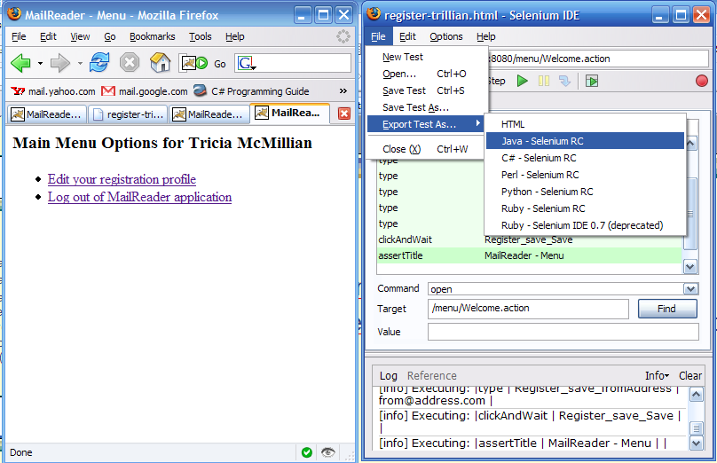

Slide 56
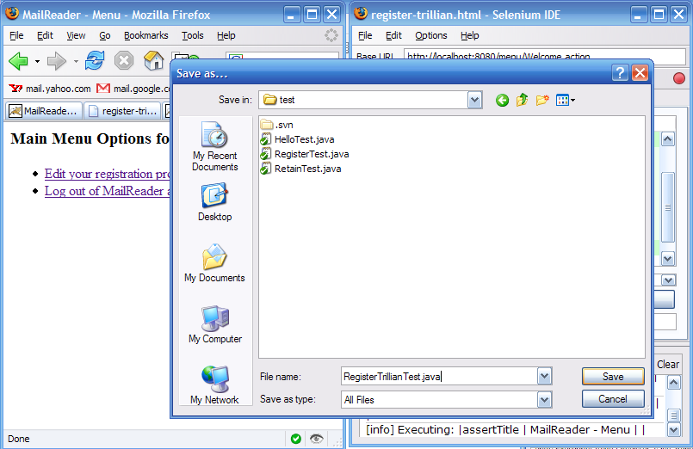

Slide 57
RegisterTrillianTest.java
public class RegisterTrillianTest extends SeleneseTestCase {
public void testRegisterTrillian() throws Exception {
selenium.open("/menu/Welcome.action");
assertEquals("MailReader", selenium.getTitle());
selenium.click("link=Register with MailReader");
selenium.waitForPageToLoad("30000");
assertEquals("MailReader - Register", selenium.getTitle());
selenium.type("Register_save_username", "trillian");
selenium.type("Register_save_password", "astra");
selenium.type("Register_save_password2", "astra");
selenium.type("Register_save_fullName", "Tricia McMillian");
selenium.type("Register_save_fromAddress", "from@address.com");
selenium.click("Register_save_Save");
selenium.waitForPageToLoad("30000");
assertEquals("MailReader - Menu", selenium.getTitle());
checkForVerificationErrors();
}

Slide 58
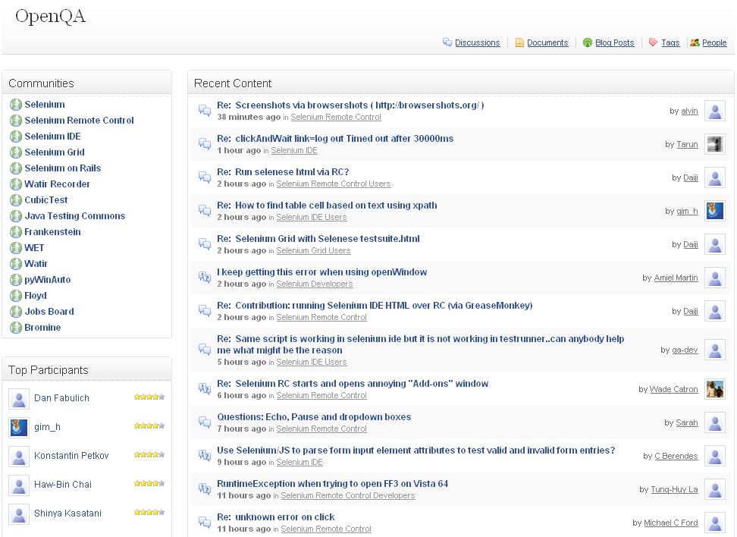
http://clearspace.openqa.org/index.jspa

Slide 59
OpenQA Selenium
Form Support
Asynchronous Support
Server Support
IDE Support
CI Support

Slide 60
OpenQA Selenium
Strengths
  Granual toolset
  Large, dedicated team
  Steady releases
  Active community
Weaknesses
  Complex setup
  Superficial suite support
  Choppy documentation
  Slow releases

Slide 61
OpenQA Selenium
Bottom Line
  Use to create acceptance tests
  Complements unit tests

Slide 62

CruiseControl
Continuous build process framework
Plugins for email notification, Ant, and source control tools.
Web interface to view build details

Slide 63
CruiseControl – Key Features
Build loop – On trigger event, runs tasks, notifies listeners
Legacy reporting - Browse results of build loop and access artifacts
Dashboard - Visual representation of project status

Slide 64
CruiseControl – Key Features
Java, Ruby, and .NET projects
Several third-party tools and plugins
Java Release 2.7.3 (2008 July)
  Since 2001
License – BSD Style
~8 Team Members

Slide 65
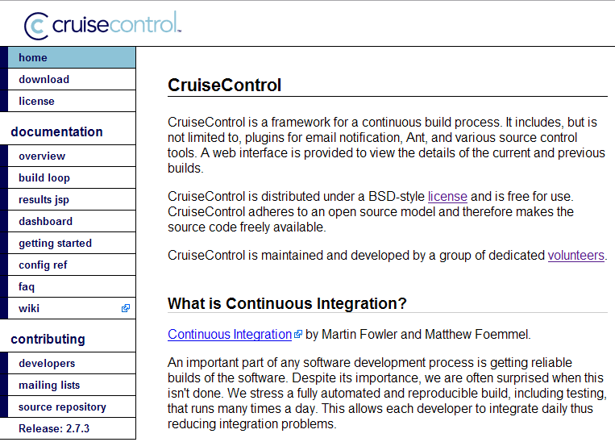
http://cruisecontrol.sourceforge.net/

Slide 66
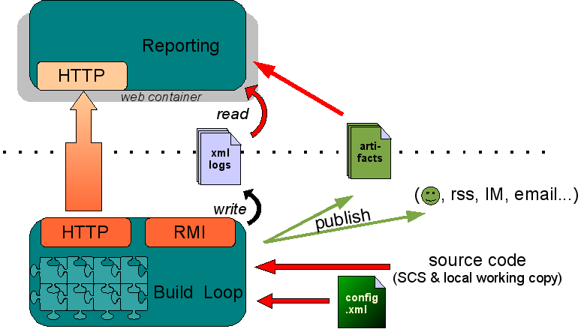
http://cruisecontrol.sourceforge.net/overview.html

Slide 67
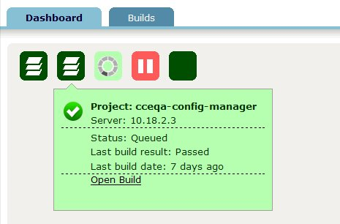
http://cruisecontrol.sourceforge.net/dashboard.html

Slide 68
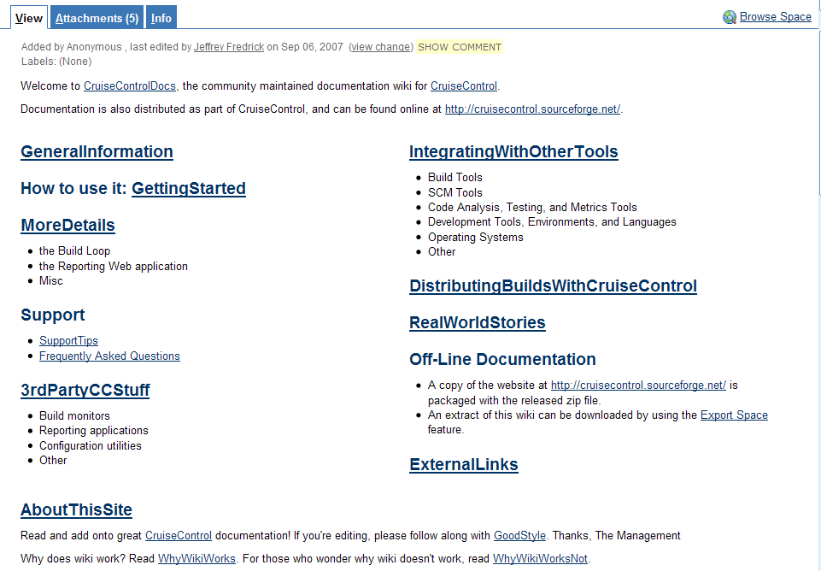
http://confluence.public.thoughtworks.org/display/CC/Home

Slide 69
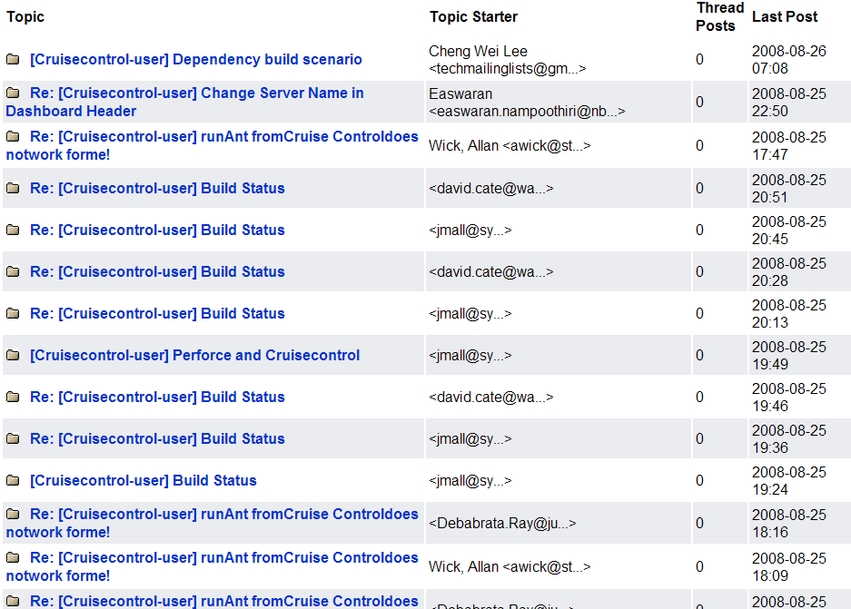
http://sourceforge.net/mailarchive/forum.php?forum_name=cruisecontrol-user

Slide 70

Let's Code It!

Slide 71
Ajax Testing Tool Review
During the session, we covered
  when, what, and how to test Ajax applications
  creating automatic tests with various tools
  testing with IDEs and continuous Integration systems

Slide 72
Square One University Series

