Slide 1

Testing Ajax Applications when to test, what to test, how to test Ajax applications
Square One University Series

Slide 2

Testing Ajax Applications
For the latest version of this presentation,
visit http://slideshare.com/ted.husted
For the latest version of source code,
visit http://code.google.com/p/yazaar/

Slide 3
Abstract
Not long ago, testing Ajax meant play-testing by hand.
Today, there tools to simplify and automate Ajax testing.
In this session, we explore:
How Ajax works, and why it complicates testing;
When, where, and how to test Ajax components;
How to test with continuous integration systems.

Slide 4

Testing Ajax Applications
Ajax 101
  How Ajax works
  Why it complicate testing
Tool Review
  Selenium IDE and Remote Control
  Hudson Continuous Integration Server
Ajax Testing in Action
  Live Coding Demonstration
    Eclipse + Selenium + Subversion + Hudson

Slide 5

Ajax 101
Marketing term coined in 2005
Set of technologies

Slide 6
Ajax 101
Marketing term coined in 2005
Set of technologies
In use since 1999 (even 1996)

Slide 7
Ajax 101
Marketing term coined in 2005
Set of technologies
In use since 1999 (even 1996)
An acronym made the difference
Would you buy a
pre-owned technology
from this man?

Slide 8
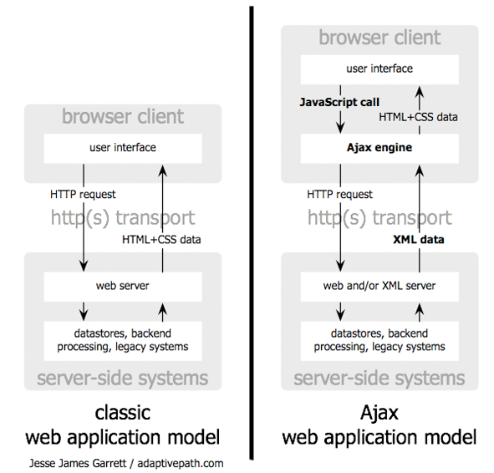
http://www.adaptivepath.com/ideas/essays/archives/000385.php

Slide 9
“It was [the] desire to look,
act and feel like Outlook
that caused us to move
web applications forward
in a new evolutionary path.”
http://msexchangeteam.com/archive/2005/06/21/406646.aspx

Slide 10
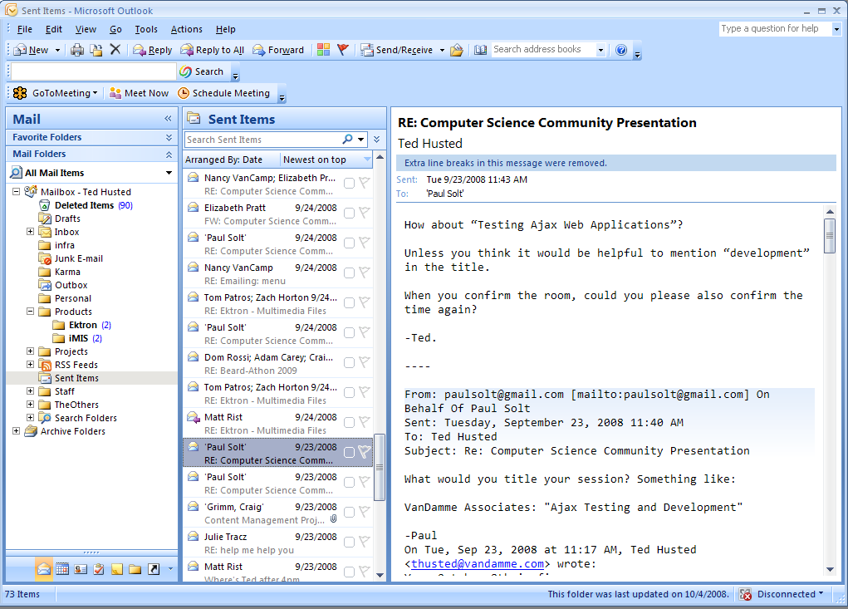

Slide 11
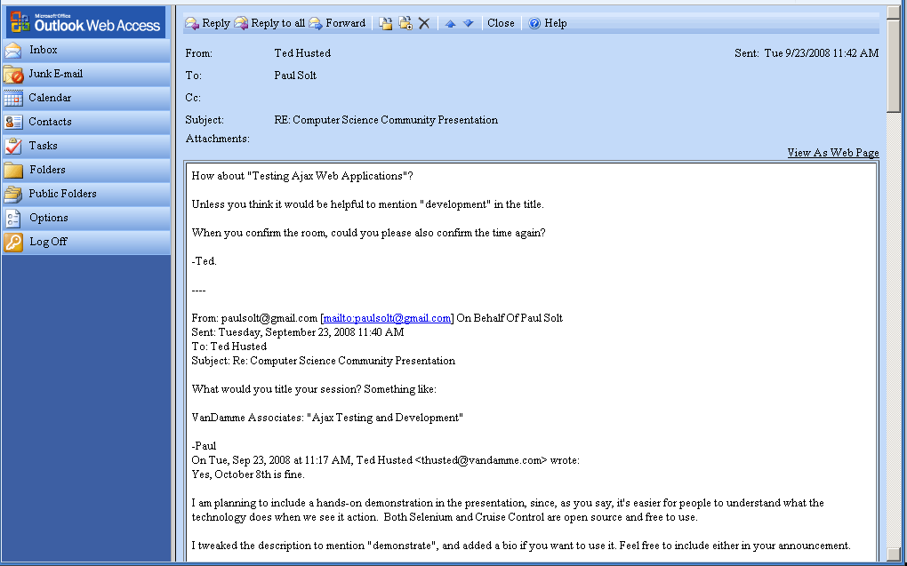

Slide 12
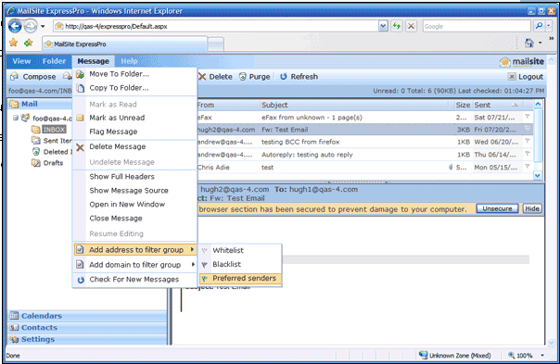
http://www.mailsite.com/Products/express-pro-ajax-web-email-calendar-client.asp

Slide 13
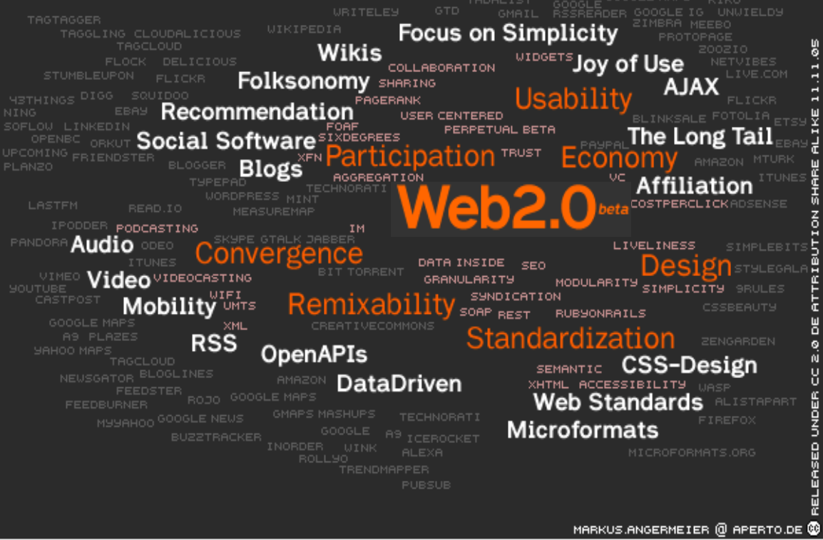
http://www.slideshare.net/satyajeet_02/web-20-5316/
http://-x-web-email-calenda-

Slide 14
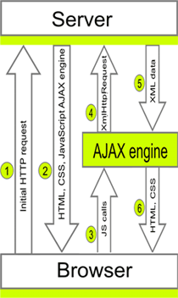
http://www.mailsite.com/Products/express-pro-ajax-web-email-calendar-client.asp

Slide 15
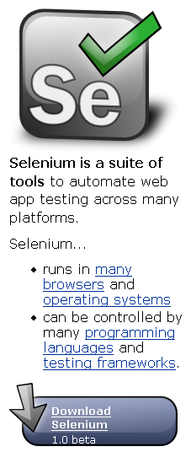
Open QA Selenium
Selenium is a suite of tools
Selenium IDE
  records and runs tests
Selenium Remote Control
  runs across multiple platforms
Selenium Grid
  runs across multiple machines
http://selenium.openqa.org/documentation/

Slide 16
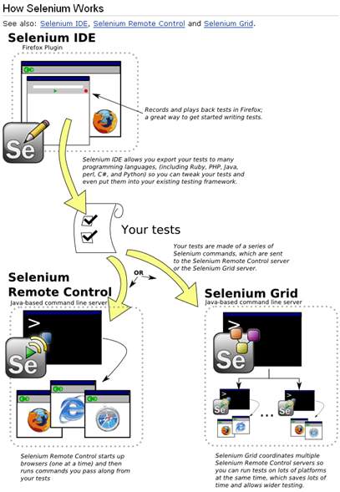

Slide 17
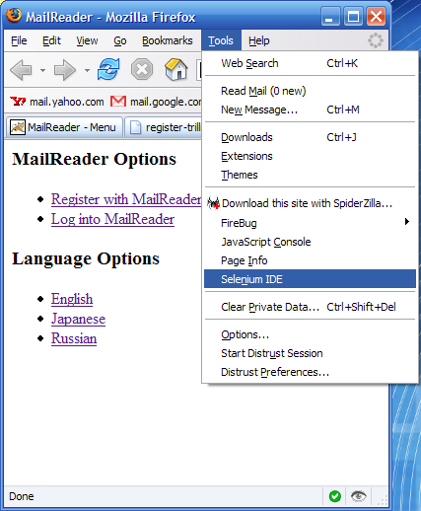

Slide 18
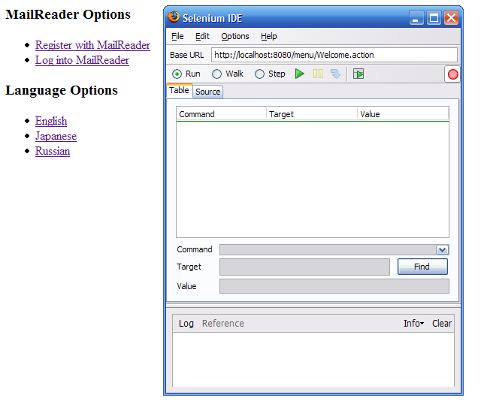

Slide 19
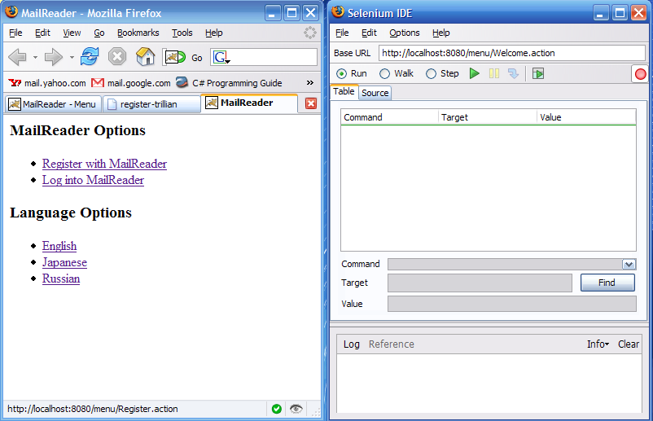

Slide 20
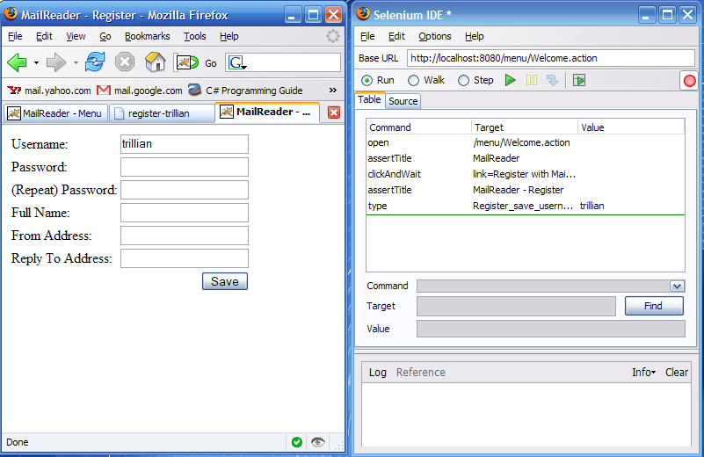

Slide 21
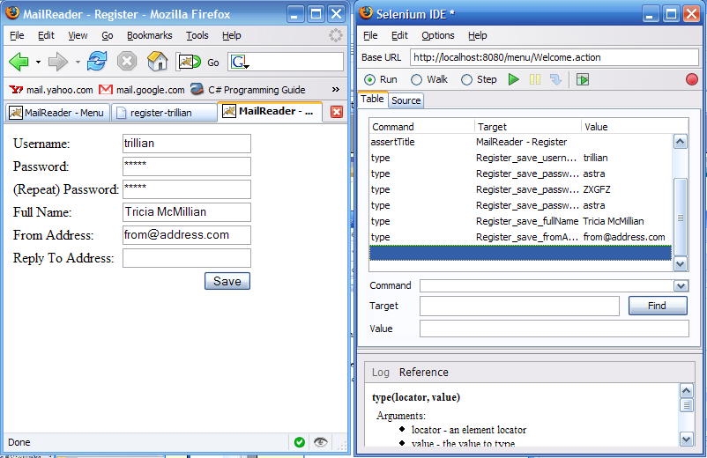

Slide 22
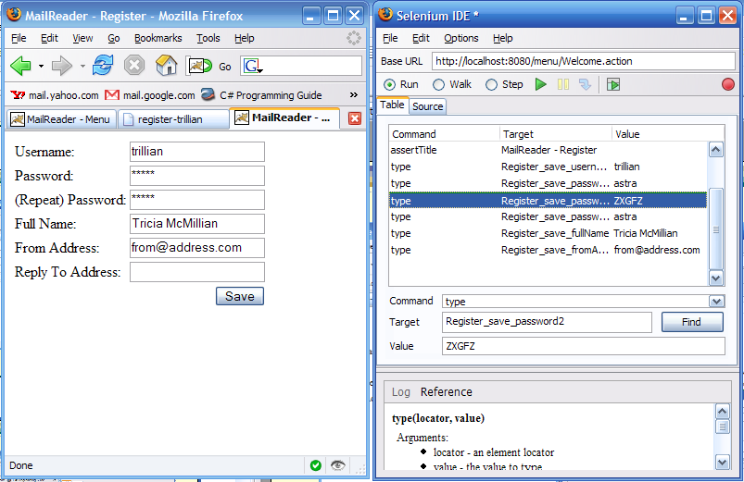

Slide 23
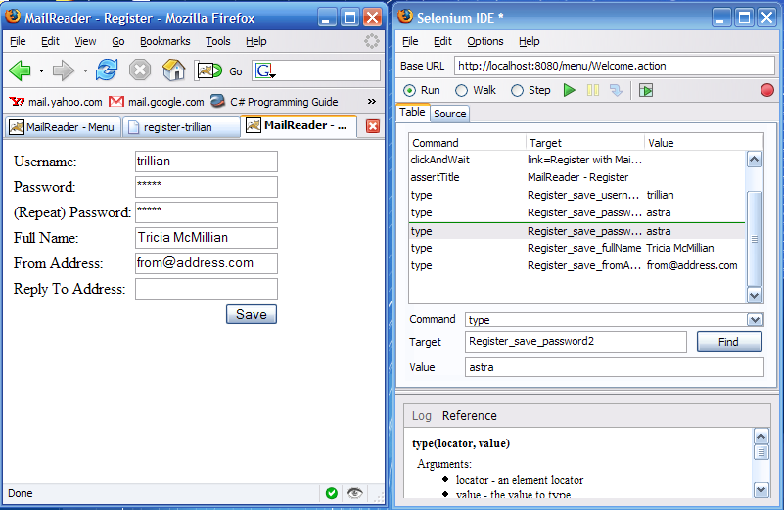

Slide 24
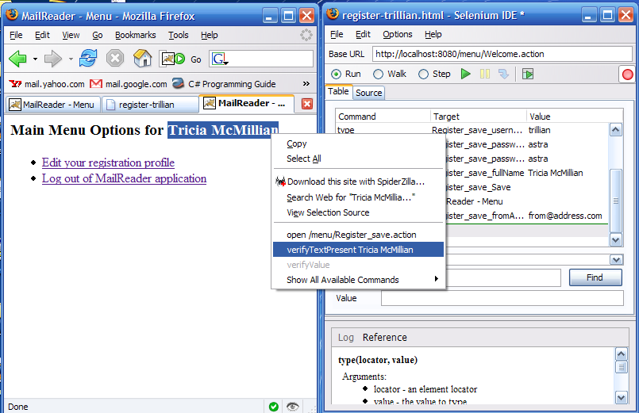

Slide 25
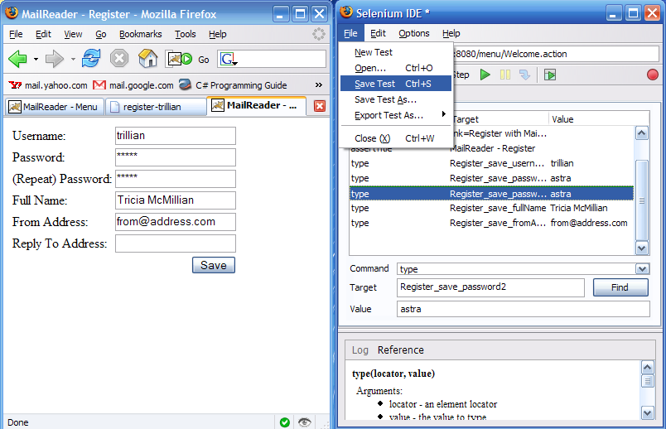

Slide 26
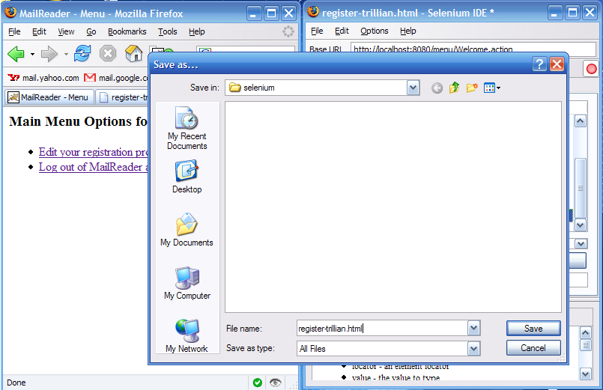

Slide 27
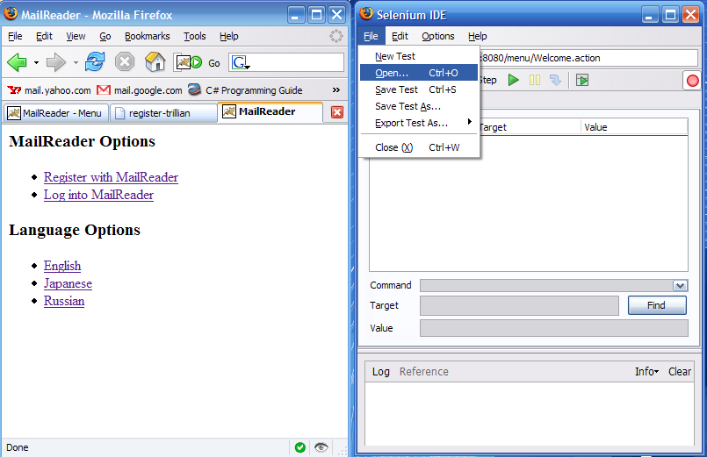

Slide 28
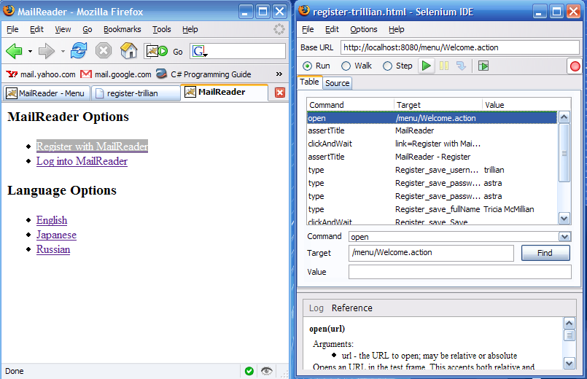

Slide 29
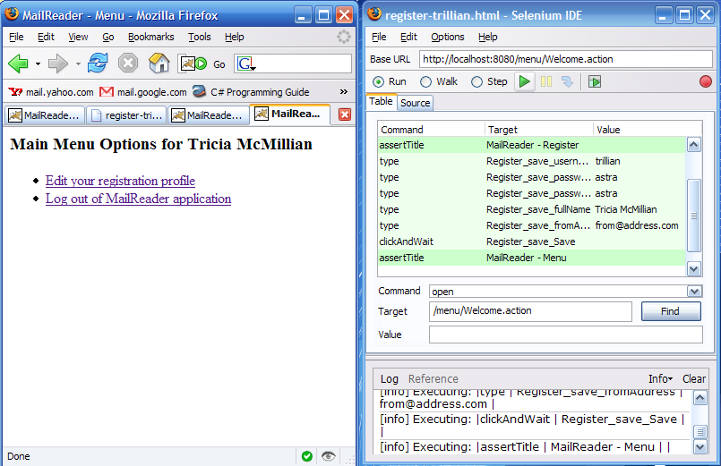

Slide 30
<tr><td>open</td><td>Welcome.action</td><td></td></tr>
<tr><td>assertTitle</td><td>MailReader</td><td></td></tr>
<tr><td>clickAndWait</td><td>link=Register with MailReader</td><td></td>
<tr><td>assertTitle</td><td>MailReader - Register</td><td></td></tr>
<tr><td>type</td><td>Register_save_username</td><td>trillian</td></tr>
<tr><td>type</td><td>Register_save_password</td><td>astra</td></tr>
<tr><td>type</td><td>Register_save_password2</td><td>astra</td></tr>
<tr><td>type</td><td>Register_save_fullName</td><td>Tricia McMillian</t
<tr><td>type</td><td>Register_save_fromAddress</td><td>tricia@magrathea.
<tr><td>clickAndWait</td><td>Register_save_Save</td><td></td></tr>
<tr><td>assertTitle</td><td>MailReader - Menu</td><td></td></tr>
<tr><td>assertTextPresent</td><td>Tricia McMillian</td><td></td></tr>

Slide 31
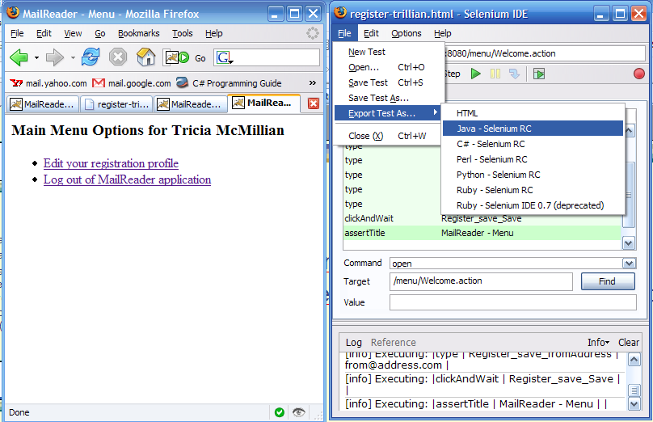

Slide 32
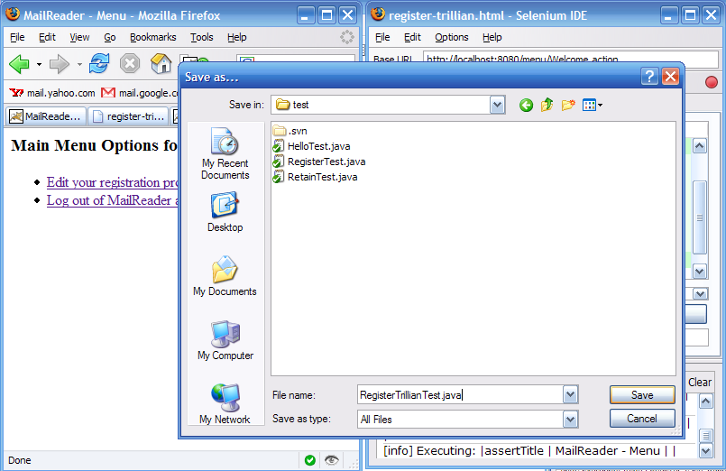

Slide 33
RegisterTrillianTest.java
public class RegisterTrillianTest extends SeleneseTestCase {
public void testRegisterTrillian() throws Exception {
selenium.open("/menu/Welcome.action");
assertEquals("MailReader", selenium.getTitle());
selenium.click("link=Register with MailReader");
selenium.waitForPageToLoad("30000");
assertEquals("MailReader - Register", selenium.getTitle());
selenium.type("Register_save_username", "trillian");
selenium.type("Register_save_password", "astra");
selenium.type("Register_save_password2", "astra");
selenium.type("Register_save_fullName", "Tricia McMillian");
selenium.type("Register_save_fromAddress", "from@address.com");
selenium.click("Register_save_Save");
selenium.waitForPageToLoad("30000");
assertEquals("MailReader - Menu", selenium.getTitle());
checkForVerificationErrors();
}

Slide 34
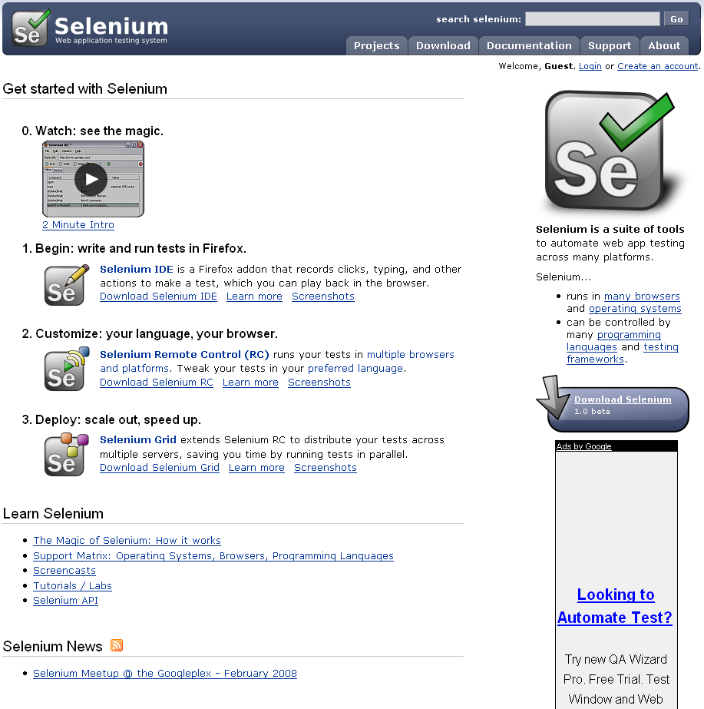
http://selenium.openqa.org/

Slide 35
Selenium – Key Features
Create test scripts using Selenium Commands.
Run tests in against live applications.
Compile test scripts in native languages, such as Java, C#, Ruby.
Integrate scripts with other test suites and continuous integrations systems.

Slide 36
Selenium – Key Features
Support for major browsers
  Firefox 2+, (RC and Core) IE7, Safari 2+, Opera 8+, Windows, OS X, Linus, Solaris.
Current Releases
  IDE, RC, Grid, 2008; Core: 2007
  Since 2005
License – Apache
~11 Team Members
  Originated as ThoughtWorks project

Slide 37
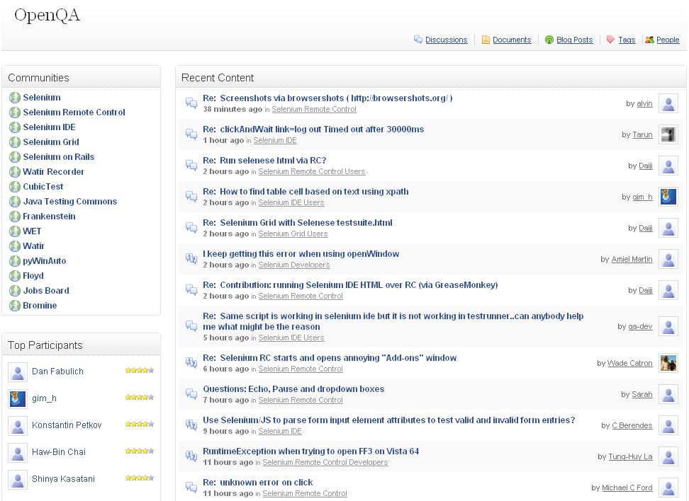
http://clearspace.openqa.org/index.jspa

Slide 38
OpenQA Selenium
Form Support
Asynchronous Support
Server Support
IDE Support
CI Support

Slide 39
Firefox 3 and Selenium RC
The current Remote Control beta release (2007) is not compatible with FF3
Minor configuration issue with version numbering in FF3
Hot patch available
Best Advice: Install FF2 in default location, and FF3 in an alternate spot.

Slide 40
OpenQA Selenium
Strengths
  Granual toolset
  Large, dedicated team
  Steady releases
  Active community
Weaknesses
  Complex setup
  Superficial suite support
  Choppy documentation
  Perpetual beta

Slide 41
OpenQA Selenium
Bottom Line
  Use to create acceptance tests
  Complements unit tests
    jsUnit, YUI Test, qUnit

Slide 42
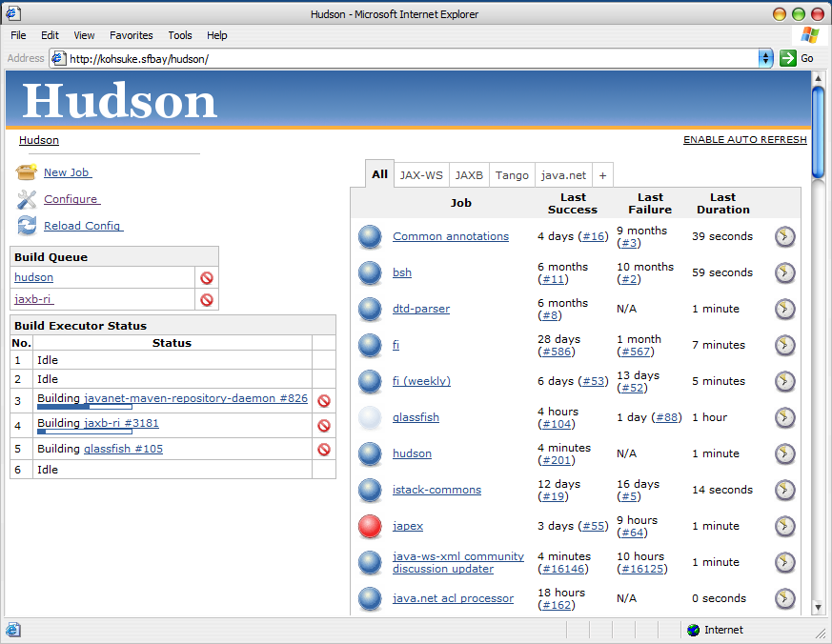

Hudson
Continuous build process framework
Runs as a Java web application
BYO Container or standalone mode

Slide 43
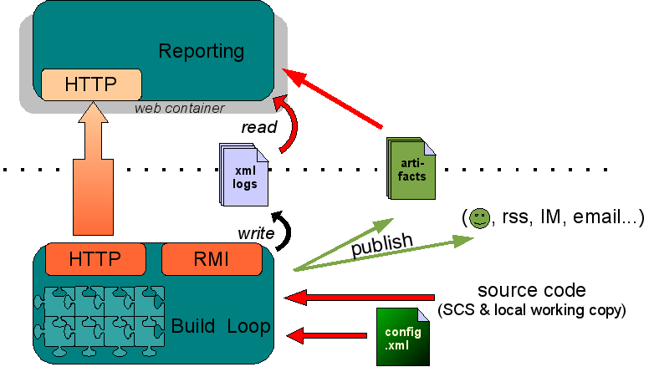
http://cruisecontrol.sourceforge.net/overview.html

Slide 44
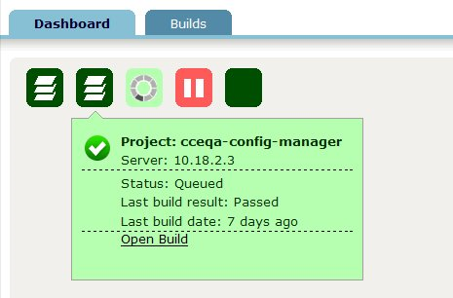
http://cruisecontrol.sourceforge.net/dashboard.html

Slide 45
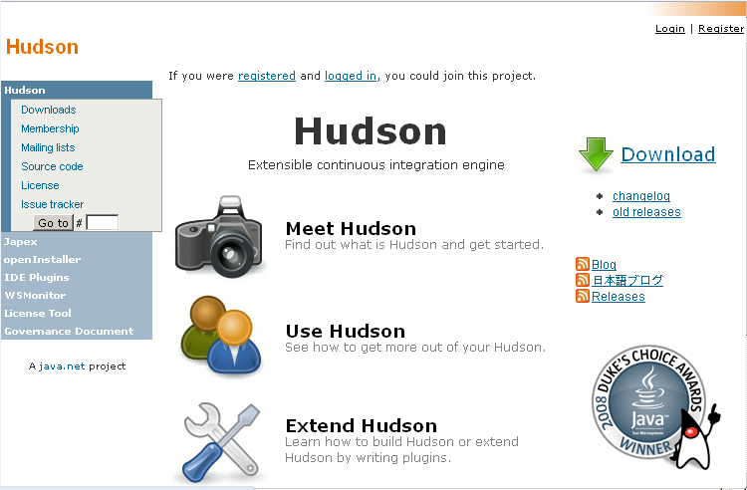
http://cruisecontrol.sourceforge.net/

Slide 46
http://cruisecontrol.sourceforge.net/dashboard.html

Slide 47
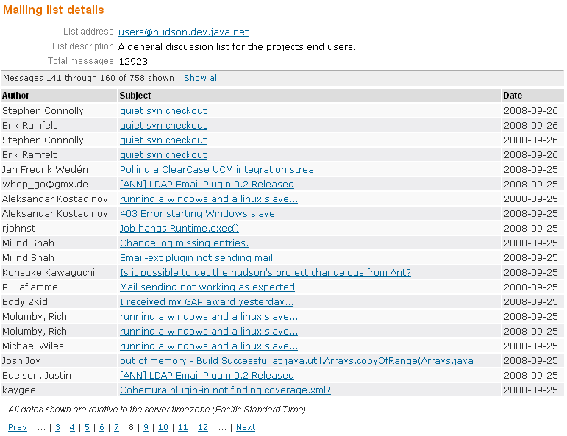

Slide 48
Hudson – Key Features
RSS/E-mail/IM Integration
JUnit/TestNG test reporting
Permanent links
Change set support
After-the-fact tagging
History trend, Distributed builds, File fingerprinting, Plugins.

Slide 49
Hudson – Key Features
Quick Install, Free style setup – Runs standalone, instant project checkout, automatic build configuration.
Visual Configuration – No XML required.
Friendly Dashboard - Project status at a glance.

Slide 50
Hudson – Key Features
Regular releases (daily/weekly milestones)
License -- MIT / Creative Community

Slide 51
Hudson
Strengths
  Simple setup
  Slick UI
  Well documented
  Regular releases
  Active community
Weaknesses
  Java container
  Committers?

Slide 52





http://cruisecontrol.sourceforge.net/overview.html

Slide 53

Let's Code It!

Slide 54
Ajax Testing Tool Review
During the session, we covered
  when, what, and how to test Ajax applications
  creating automatic tests with various tools
  testing with IDEs and continuous Integration systems

Slide 55
Square One University Series

