Slide 1
Determining the best place for housing in sanfrancisco

Slide 2
Optimal housing conditions
Low crime rate
Easy access to facilities for food, leisure and shops
Not much noise
Low price

Slide 3
Data
San Francisco locational and crime data from the government
https://cocl.us/sanfran_crime_dataset
https://cocl.us/datascience_survey_data
Popular food, shopping and leisure places from FourSquare API
The data was collected a cleaned to prevent duplicates and fakes.

Slide 4
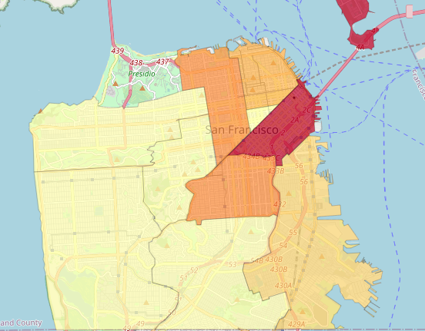
Visualising the crime rate in san francisco
As expected the crime rate increases as we get closer to town center, apart for the tenderloin (triangle area).

Slide 5
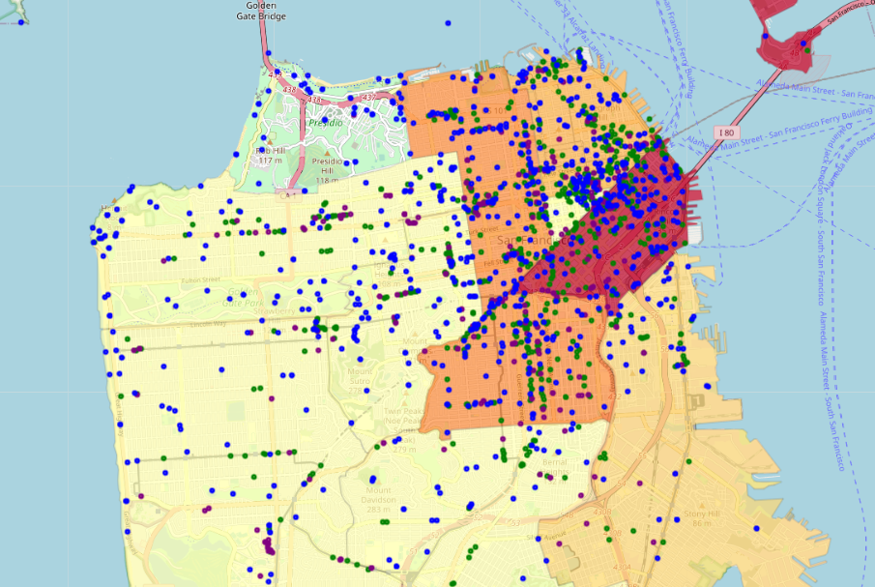
Visualising crime rate and facilities in San Francisco

Slide 6
Findings

Slide 7
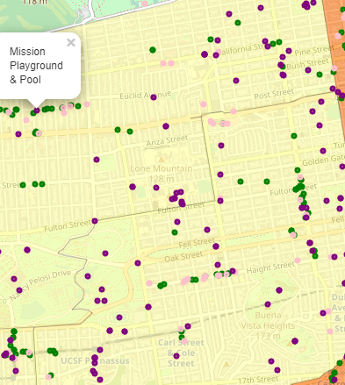
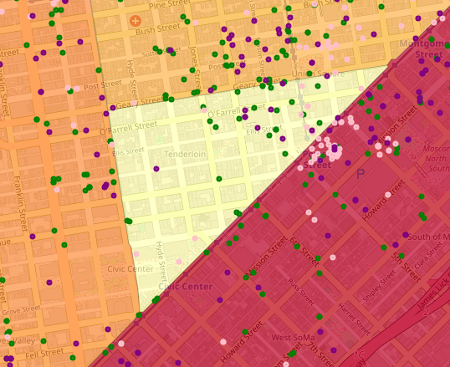
Best places to buy/build a house

Slide 8
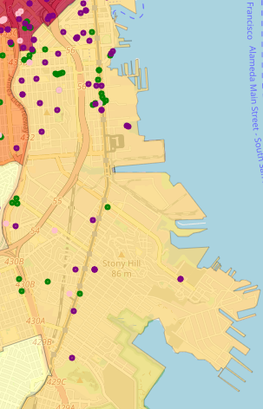
Worst place to build/buy house

