Slide 1




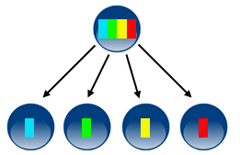


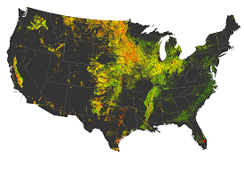
Commander.R
1
Raster Input of my region
4
Lookup table maker
2
Run APSIM
Raster to poly
REALM
Weather maker
Output aggregation
Mask by suitability
3
Simulation units
Soil maker
Output maps
Dissolve

