Slide 1
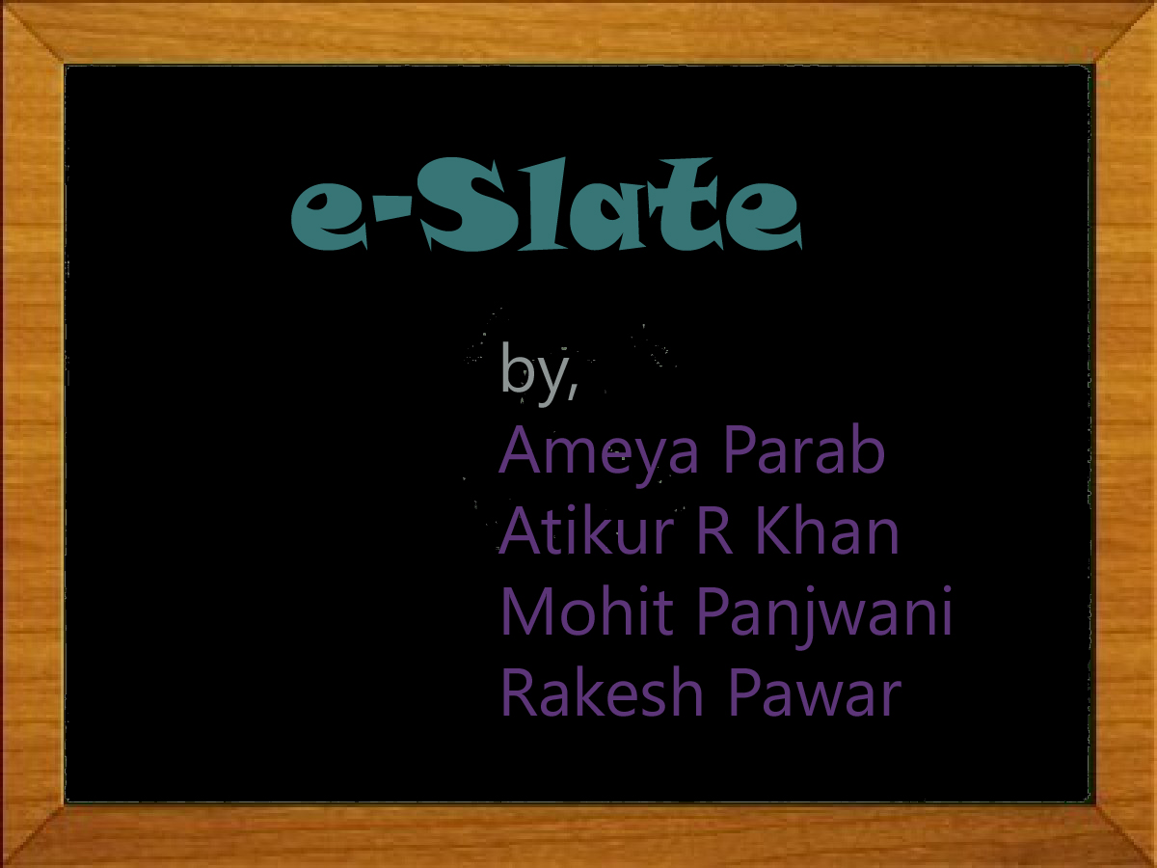

Slide 2
Abstract
A small kid is more attracted towards a mobile phone rather than a book. So if we develop an application through which we help the kids of age group 3-5 to learn the Alphabets, Numbers, Comparisons, Colors and objects it would be fun for the kid to learn .Also the children will get use to the new evolving technology and would help for the fundamental development of a child.

Slide 3
Learning Theories
Learning theories are conceptual frameworks that describe how information is absorbed, processed, and retained during learning.

Slide 4
3 main perspectives to learning:
Behaviorism
Cognitivism
Constructivism

Slide 5
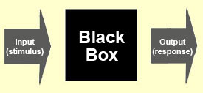
Key Principles: Behaviorism
Mind as Black Box
Learning is regular, expected responses
Reward and Punish in order to reinforce behavior

Slide 6
Key Principles: Cognitivism
Learning happens as a result of brain processes
Initially brain processes to acquire knowledge
Recall to store knowledge
What we must do in the application?

Slide 7
Key Principles: Constructivism
Learning as a process in which the learner actively constructs or builds new ideas or concepts.
Actively engage the learners

Slide 8
Some learning theories
Piaget
Piaget believed that cognitive development occurs through a sequence of successive qualitative changes in cognitive structures.

Slide 9
Piaget’s Four Stages:
Sensorimotor Stage (birth - 2 yrs):
actions is used as interaction medium, there is an increased awareness of self and surroundings.
Preoperational Thought Stage (2 - 7yrs):
development of language and conceptual thought occurs.
Concrete Operations Stage (7-11yrs):
increased ability to apply logical thought to concrete problems, thinking is still primarily related to immediate experience.
Formal Operations Stage (11yrs on):
ability to apply logic to a variety of problems; higher order thinking occurs.

Slide 10
Assimilation Theory
Principles:
1. The most general ideas of a subject should be presented first and then progressively differentiated in terms of detail and specificity.
2. Instructional materials should attempt to integrate new materials with previously learned material by comparing new and old ideas and concepts.

Slide 11
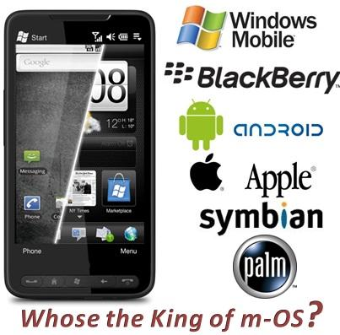

Slide 12
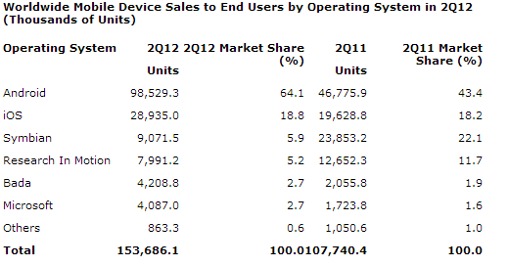
Platform Analysis

Slide 13

Advantages of Android over ios
Android's app store has over 5,00,000 apps and has registered over 20 billion downloads.
The survey showed that 36% of the respondents trust Google as a brand.
Google's services seem to be quite important for many buyers today, as 26% of the respondents said that they preferred Android phones over Apple iPhone .
In the battle for smartphone supremacy, companies introduce new technologies very frequently. Apple has just the iPhone 4S to speak of, which has only a few advancements as compared to the iPhone 4.

Slide 14


Slide 15

Existing Application Analysis

Slide 16
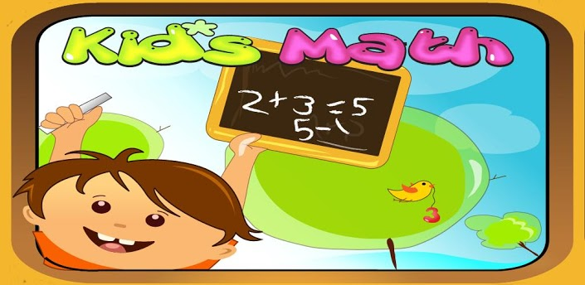
It helps kids to learn quickly to add, subtract, multiply and divide
iOS

Slide 17

Advantages
The application is dynamic.
There are 8 levels in “All Operations”
Disadvantages
No Report or Analysis of the Game.
Time Restriction.

Slide 18
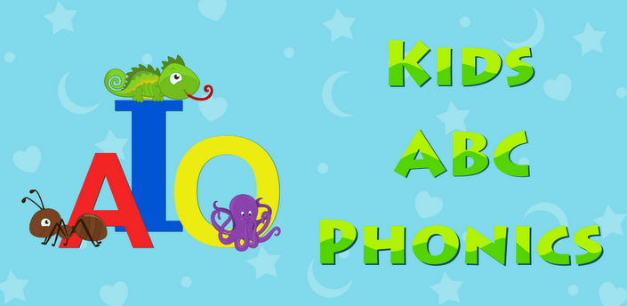
It plays phonics of the alphabets and also displays common words.( i.e A – Apple)
iOS

Slide 19

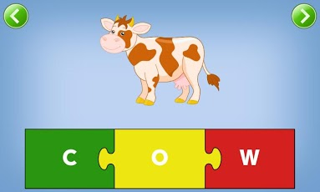
Advantages
Picture-filled letter block.
Building blocks

Slide 20
Disadvantages
Pronunciations in American accent.
GUI is difficult for kids.

Slide 21

Learning Colors For Kids
Identification of common colors.
Asks to press a particular color.
Android

Slide 22

Advantages
Identification is easier.
Simple GUI
Easy Functionality
Disadvantages
Only the simple colors are used.
Color mixing not available i.e
(RED + GREEN = YELLOW)

Slide 23
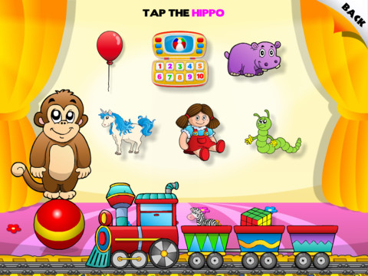
Abby - Interactive Games for Children
iOS

Slide 24
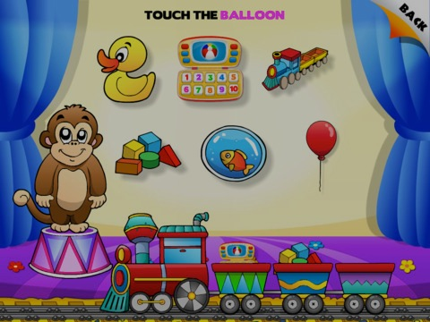
Advantages
Helps to distinguish various objects
Various puzzles of shapes and object are available
Smart and attractive GUI
Disadvantages
Only object name is mentioned and description is not given.

Slide 25
Overcoming Disadvantages
Full-featured app
Report and analysis
Description of objects
Simple GUI

Slide 26
Content
Alphabets
-Introduction to alphabets.
-Phonics introduction.
-Drawing
-alphabet song.
Numbers
-Introduction to numbers
- Phonics introduction.
-Drawing
-number song
-adding numbers
-subtracting numbers

Slide 27
General Awareness
-Colours
-Animals
-Vegetables
-Fruits
-Shape
Games
Alphabetic Games
-Arrange in order
-Match capital with lower case alphabets
-Learn to spell
Numeric Games
-Arrange in order
-Find the largest number
-Count the objects
-Fill in the blanks

Slide 28
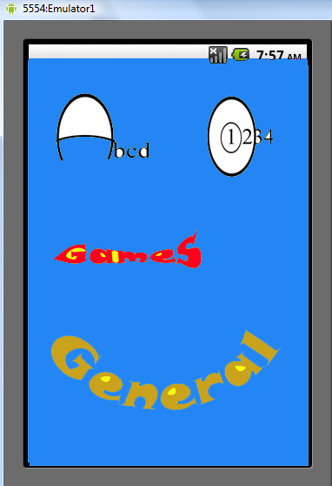
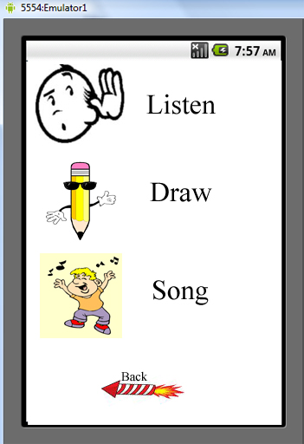
Alphabets & Numbers
Observable change
In behavior
Behaviorism

Slide 29
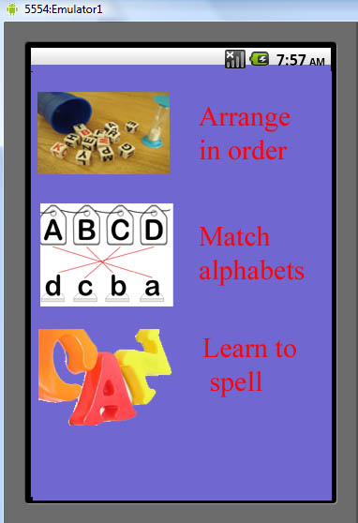
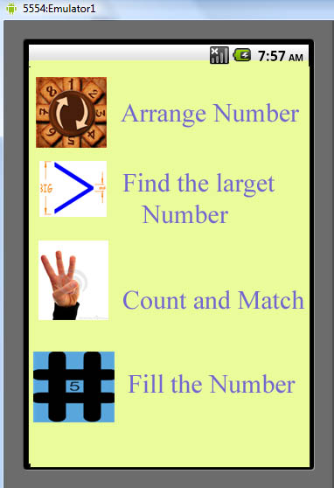
Alphabet Games
Number Games
Gaining Attention
Rehearsal and visuals
used
Cognitivism

Slide 30
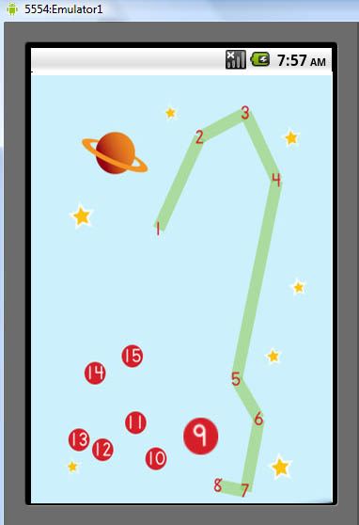
Learning
Retrieving prior knowledge
Acquire new Knowledge
Constructivism

Slide 31
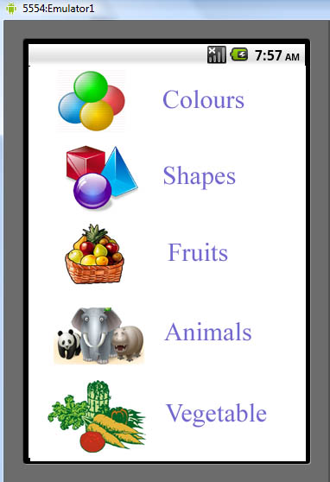
Classification of Objects
-try to classify objects
using single feature

Slide 32
Conclusion
Learning is self organizing system ,hence Mobile apps can be a great learning tool in the hands of children.

Slide 33
Thank You

