Slide 1
KAP 140 Autopilot
A self-study tool for pilots who fly with the Bendix/King KAP 140 Autopilot System
This presentation is provided free of charge
to everyone who desires to use it.
This presentation is available for download at:
www.JimPitman.US
Revised: 03-22-2005

Slide 2
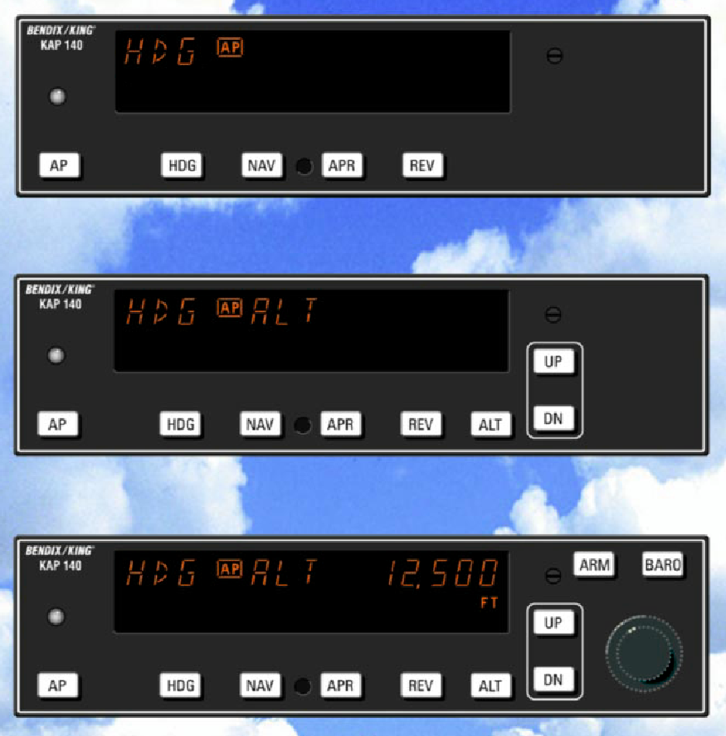
Three Different KAP 140 Autopilots
The KAP 140 Single Axis system is
an entry level digital panel-mount
autopilot, offering lateral modes only
with an electric trim option.
The KAP 140 Two Axis system provides
both lateral and vertical modes.
The KAP 140 Two Axis system provides
both lateral and vertical modes
with altitude preselect.

Slide 3
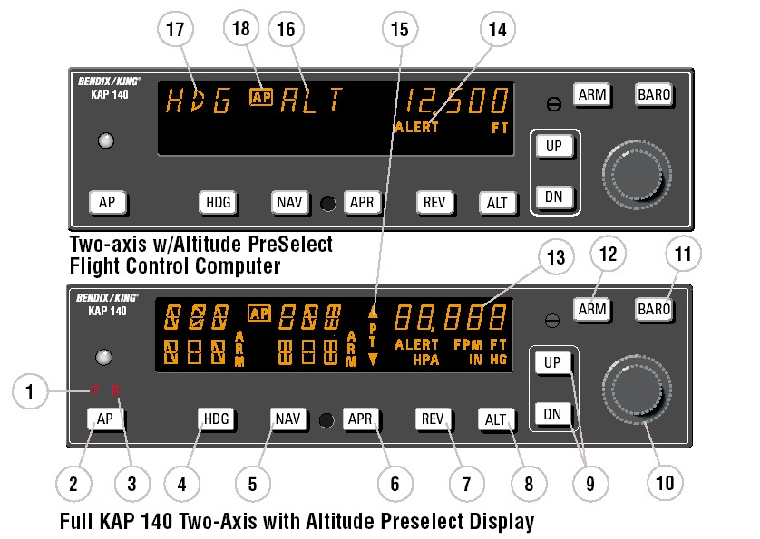
Learning the Two Axis/Altitude Preselect KAP 140
1. PITCH AXIS, (P) ANNUNCIATOR
2. AUTOPILOT ENGAGE/DISENGAGE (AP) BUTTON
3. ROLL AXIS (R) ANNUNCIATOR
4. HEADING (HDG) MODE SELECTOR BUTTON
5. NAVIGATION (NAV) MODE SELECTOR BUTTON
6. APPROACH (APR) MODE SELECTOR BUTTON
7. BACK COURSE APPROACH (REV) MODE SELECTOR BUTTON
8. ALTITUDE HOLD (ALT) MODE SELECT BUTTON
9. VERTICAL TRIM (UP/DN) BUTTONS
10. ROTARY KNOBS
11. BARO SET (BARO) BUTTON
12. ALTITUDE ARM (ARM) BUTTON
13. ALTITUDE ALERTER/VERTICAL SPEED/BARO SETTING DISPLAY
14. ALTITUDE ALERT (ALERT) ANNUNCIATION
15. PITCH TRIM (PT) ANNUNCIATION
16. PITCH MODE DISPLAY
17. ROLL MODE DISPLAY
18. AUTOPILOT ENGAGED (AP) ANNUNCIATION

Slide 4
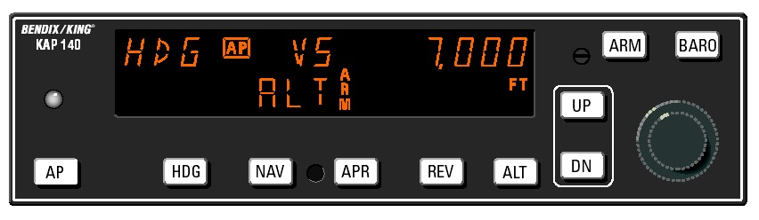
Reading the Display
When reading the autopilot display, it is important to differentiate between the information on the top versus the bottom of the screen. The information on the top shows the modes that are currently active. The information on the bottom shows what is going to happen in the future. In this example, the autopilot is in HDG and VS modes and the ALT mode is armed to capture 7,000 feet. If the ALT mode is not armed, the autopilot will not capture the selected altitude.

Slide 5
Scenario Index
1. Takeoff and Climb to Assigned Altitude
2. GPS Capture
3. Procedure Turn to ILS Approach
4. Front Course ILS Approach
5. Outbound on GPS Approach
6. Inbound on GPS Approach

Slide 6
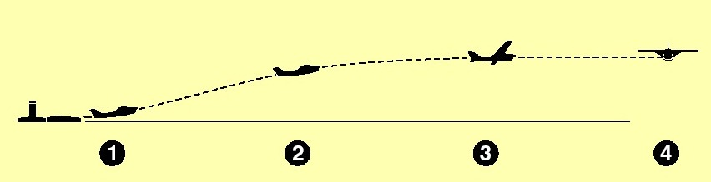
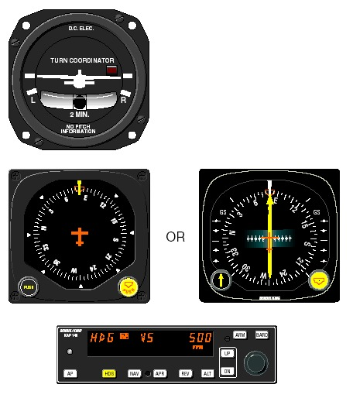
Scenario 1 - Takeoff and Climb to Assigned Altitude (1)
1. The aircraft is well off the ground and established
at a safe climb rate.
The heading bug on the DG or HSI is turned to
the desired heading of 080° (runway heading).
By depressing the HDG button on the KAP 140,
the autopilot engages into the heading and vertical
speed modes and maintains the selected
heading of 080° and current rate of climb.
Note: On newer models, you must press and hold the
AP button for 0.25 seconds to engage the autopilot.
Click HERE to return to the scenario index

Slide 7
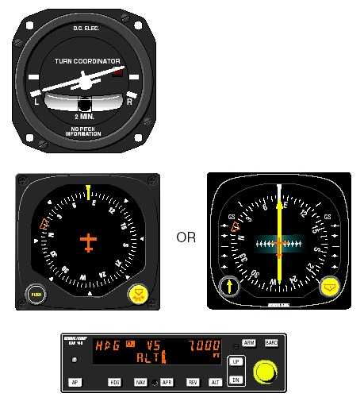
Scenario 1 - Takeoff and Climb to Assigned Altitude (2)
2. The heading bug on the DG or HSI is turned to
the new desired heading of 010° and the aircraft
begins to respond with an immediate left turn. A
cruise altitude of 7,000 feet is entered using the
rotary knobs. The ARM button must be pressed to
manually engage the altitude capture function. The
altitude ARM annunciation is displayed at the bottom
of the screen. ALT will automatically arm for
subsequent altitude changes.
Click HERE to return to the scenario index

Slide 8
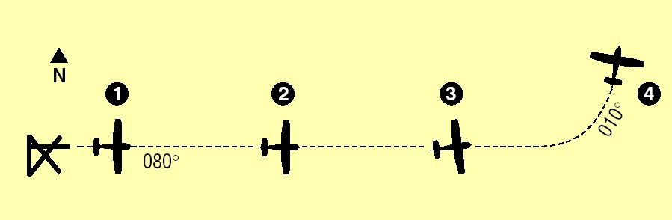
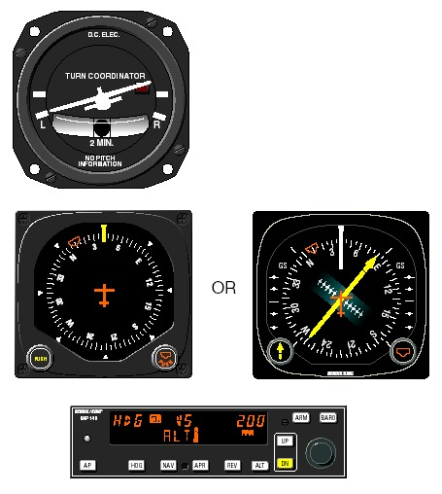
Scenario 1 - Takeoff and Climb to Assigned Altitude (3)
3. The autopilot is responding to the heading select
mode with a left bank. The climb rate has been
decreased, using the DN button, in preparation
for level out. The vertical speed value will be
displayed upon selection of the DN button and
will remain for three seconds.
Click HERE to return to the scenario index

Slide 9
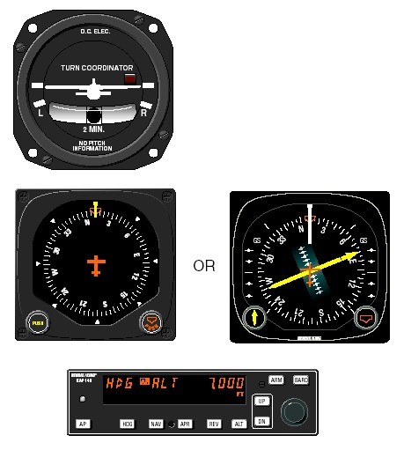
Scenario 1 - Takeoff and Climb to Assigned Altitude (4)
4. Desired altitude has been reached and automatic
altitude capture occurs. The autopilot has
completed the turn and is now established on a
010° heading.
Click HERE to return to the scenario index

Slide 10
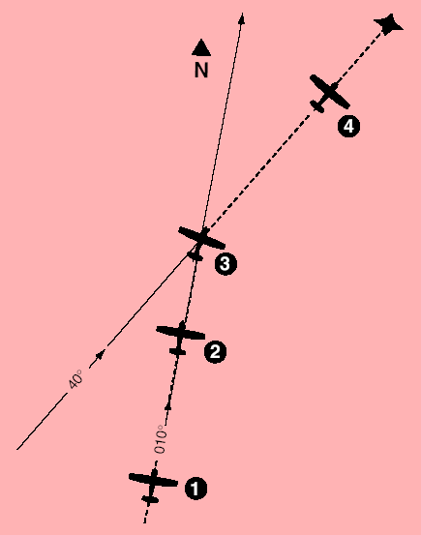
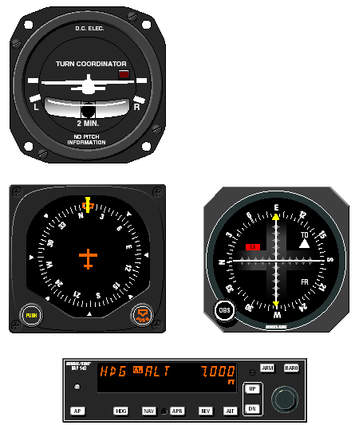
Scenario 2 - GPS Capture (1)
1. Continuing on heading 010°, a GPS waypoint is
established. A 30° intercept is desired.
Click HERE to return to the scenario index

Slide 11
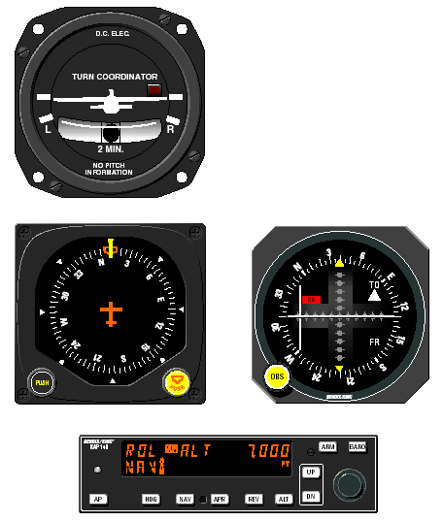
Scenario 2 - GPS Capture (2)
2. The HDG button is depressed to select ROL
mode which will allow an “all angle intercept”.
GPS data is selected for the CDI and the OBS is
set to 040°. The NAV button is depressed and
NAV ARM is annunciated. ROL will change to
HDG and flash for five seconds. ROL will then
be redisplayed. While the HDG annunciation is
flashing, move the heading bug to the desired
course of 040°. The aircraft will remain wings
level until the capture point.
Click HERE to return to the scenario index

Slide 12
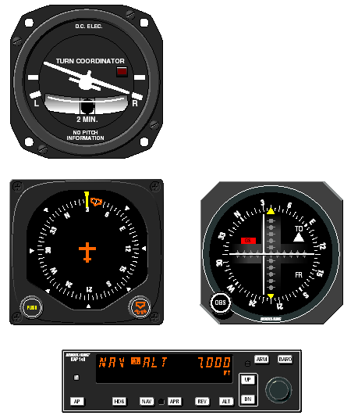
Scenario 2 - GPS Capture (3)
3. When the computed capture point is reached,
the ROL annunciation changes to NAV and a
right turn is initiated by the autopilot.
Click HERE to return to the scenario index

Slide 13
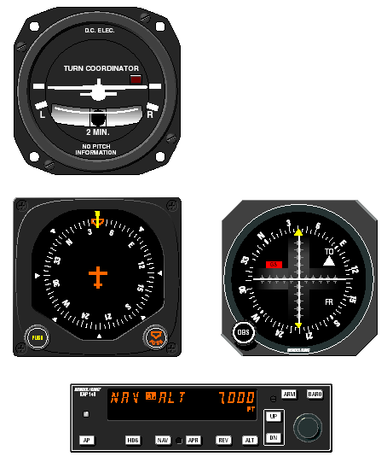
Scenario 2 - GPS Capture (4)
4. The turn is complete and the autopilot is tracking
the GPS course.
Click HERE to return to the scenario index

Slide 14
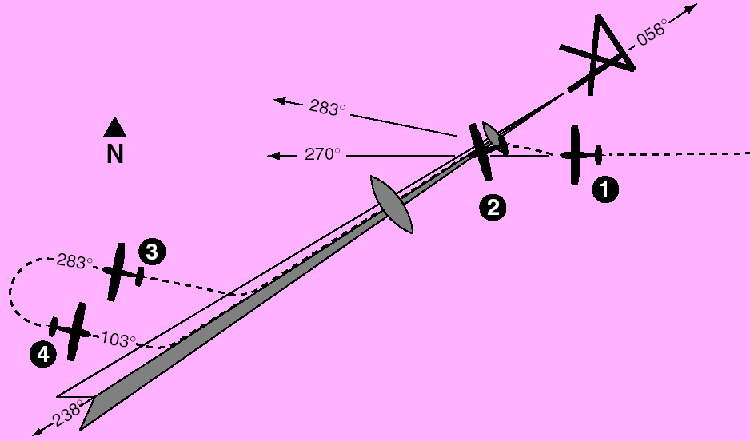
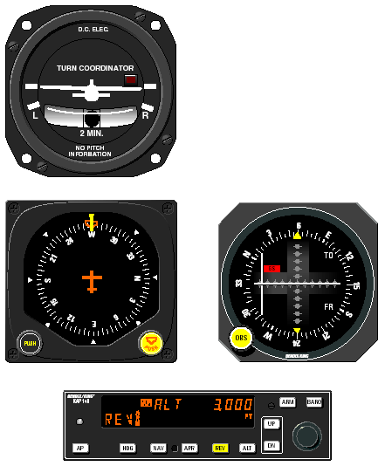
Scenario 3
Procedure Turn to ILS Approach (1)
1. The aircraft is heading 270° with heading and
altitude hold engaged. To intercept and fly the
ILS front course outbound, set the front course
on the OBS and depress the reverse course
(REV) button. The HDG annunciation will flash
for five seconds then extinguish. While the
HDG annunciation is flashing, move the heading
bug to the front course 058°. Since HDG
was active upon selection of REV the autopilot
will initiate a 45° intercept to the localizer signal.
In this case, the aircraft will turn to 283°.
Click HERE to return to the scenario index

Slide 15
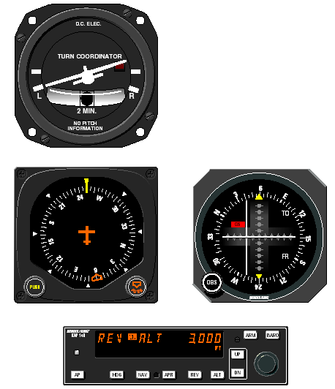
Scenario 3
Procedure Turn to ILS Approach (2)
2. When the computed capture point is reached,
auto intercept mode is cancelled and reverse
localizer mode is automatically activated and a
left turn outbound on the localizer is initiated by
the autopilot.
Note: The left-right deviations of the CDI course
deviation needle are reversed (you must turn right
to center a deviation of the index to the left). This
needle reversing takes place because you are flying
outbound on a front course.
Click HERE to return to the scenario index

Slide 16
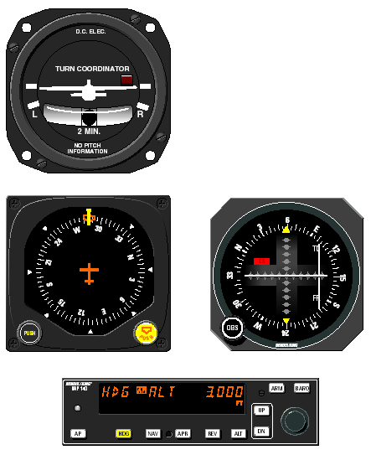
Scenario 3
Procedure Turn to ILS Approach (3)
3. At the desired point, HDG mode is used to initiate
the procedure turn. Select HDG and set the
heading bug to 283°. During the procedure turn
outbound, the CDI course index goes off scale
to the right. The aircraft is flying away from the
localizer centerline at a 45° angle on a selected
heading of 283°.
Check the heading displayed on the DG against
the magnetic compass and reset if necessary.
Click HERE to return to the scenario index

Slide 17
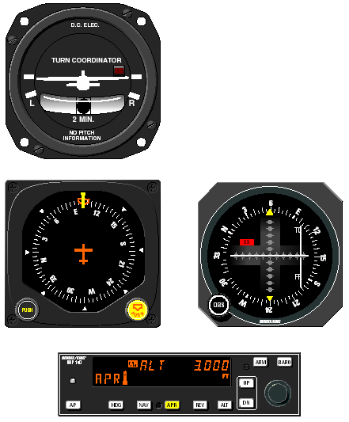
Scenario 3
Procedure Turn to ILS Approach (4)
4. Now you have reset the heading bug to 103°
and made a 180° turn to this heading. This
103° heading will intercept the front course of
058°. You must now select the approach mode
by depressing the APR button on the KAP 140.
* The HDG annunciation will flash for five seconds
then extinguish. While the HDG annunciator
is flashing, move the heading bug to the
front course 058°. Since the 45° intercept is
103°, the aircraft will not turn until the front
course is captured.
Click HERE to return to the scenario index

Slide 18
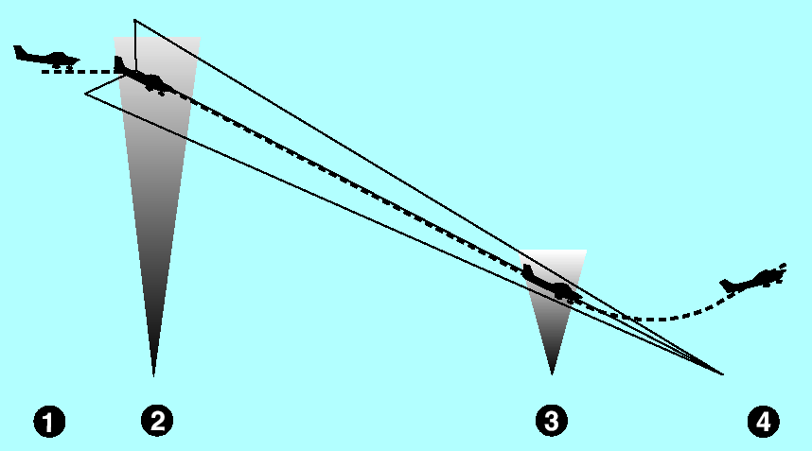
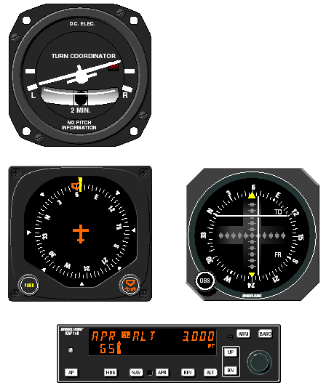
Scenario 4
Front Course
ILS Approach (1)
1. Continuing the maneuver from scenario 3, APR
coupling occurs (HDG annunciation changes to
APR), and the glideslope mode is automatically
armed. The autopilot will capture the localizer
and the CDI course index will center.
Click HERE to return to the scenario index

Slide 19
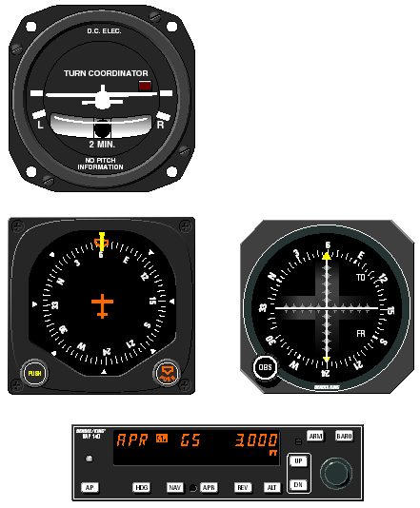
Scenario 4
Front Course
ILS Approach (2)
2. The autopilot is following the localizer. At the
outer marker, the glideslope deviation needle is
at midscale. Altitude hold is automatically disengaged
when the glideslope is captured. The ALT
annunciator extinguishes and GS is displayed.
The autopilot will make pitch and bank changes
as necessary to maintain localizer and glideslope.
Click HERE to return to the scenario index

Slide 20
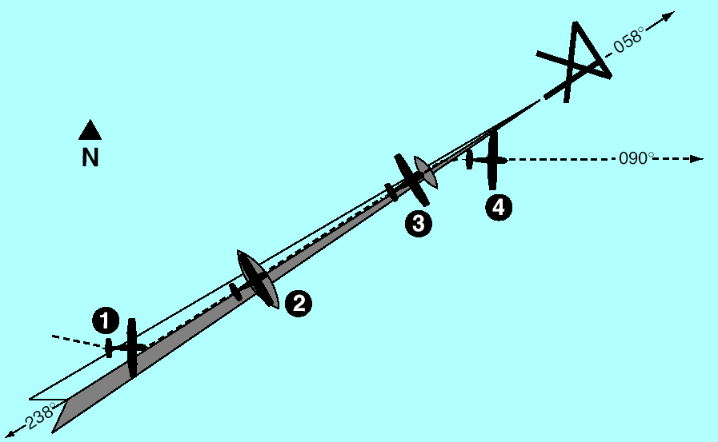
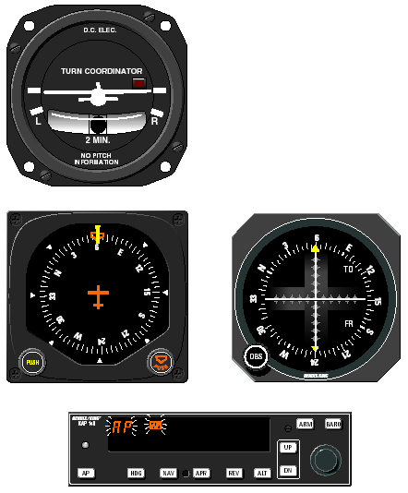
Scenario 4
Front Course
ILS Approach (3)
3. At the middle marker, the pilot disengages the
autopilot with the button on the control wheel.
This cancels all operating modes. The flashing
AP annunciations are displayed and a disconnect
tone will sound.
Click HERE to return to the scenario index

Slide 21
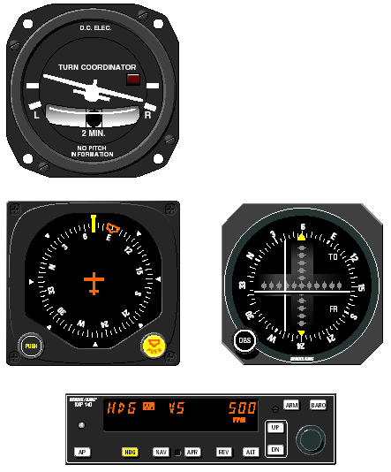
Scenario 4
Front Course
ILS Approach (4)
4. The pilot initiates the missed approach and sta-
bilizes the aircraft in the climb. The heading
bug is set to the missed approach heading of
090°. By depressing the HDG button on the
KAP 140, the autopilot engages into the heading
and vertical speed modes, commencing a
right turn to a heading of 090° and maintaining
the rate of climb existing at engagement.
Note: On newer models, you must press and hold the
AP button for 0.25 seconds to engage the autopilot.
Click HERE to return to the scenario index

Slide 22
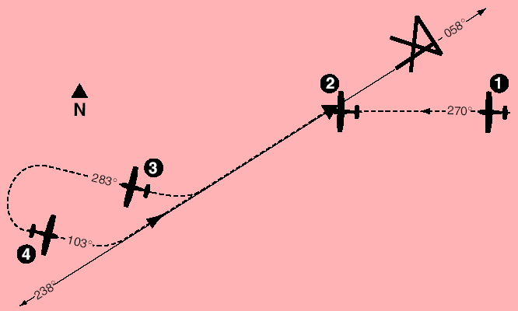
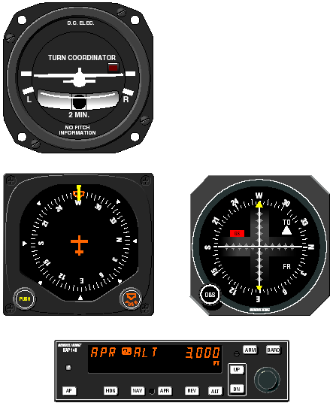
Scenario 5
Outbound on GPS Approach (1)
1. The aircraft is in APR mode approaching the
IAF. Approach arm is indicated on the GPS
annunciator.
Click HERE to return to the scenario index

Slide 23
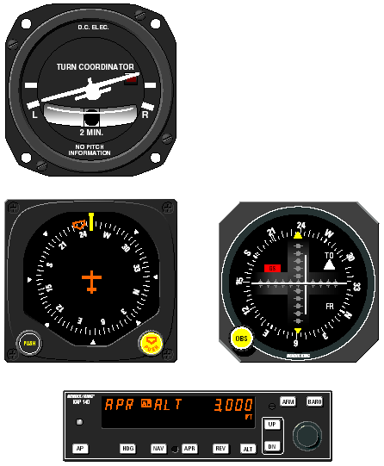
Scenario 5
Outbound on GPS Approach (2)
2. Upon waypoint alerting at the IAF, the heading
bug is set to 238°, the GPS’s Leg/OBS mode
switching is set to OBS mode and the OBS is
set to 238°. The autopilot initiates a left turn to
track the 238° GPS course.
Click HERE to return to the scenario index

Slide 24
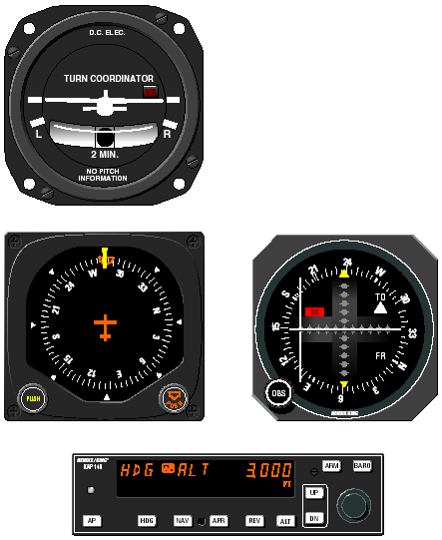
Scenario 5
Outbound on GPS Approach (3)
3. At the desired point, heading mode is used to
initiate the procedure turn. During the procedure
turn outbound, the deviation bar shows that the
aircraft is flying away from the GPS course at a
45° angle on a selected heading of 283°.
Check the heading displayed on the DG against
the magnetic compass and reset if necessary.
Click HERE to return to the scenario index

Slide 25
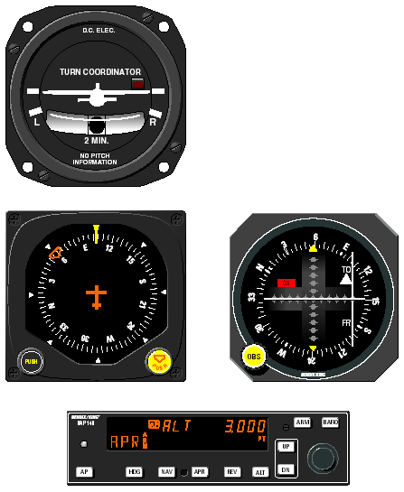
Scenario 5
Outbound on GPS Approach (4)
4. The heading bug has been set to 103° and the
aircraft has made a left turn to this heading.
The GPS’s Leg/OBS mode switching is set to
Leg mode and the OBS is set to 058°. Select
approach mode by depressing the APR button.
The HDG annunciation will flash for five seconds
then extinguish. While the HDG annunciation
is flashing, move the heading bug to 058°.
Since the 45° intercept is 103°, the aircraft will
not turn until the course is captured.
Click HERE to return to the scenario index

Slide 26
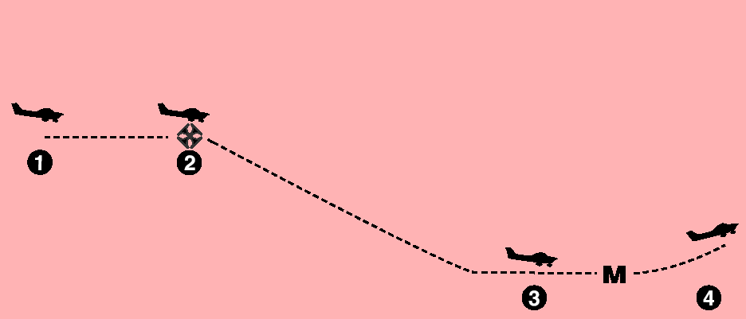
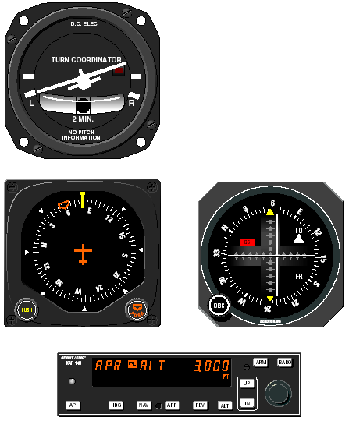
Scenario 6
Inbound on GPS Approach (1)
1. Continuing the approach from scenario 5,
APR mode capture occurs. The autopilot initiates
a left turn to track the 058° GPS course.
Approach active is indicated on the GPS
annunciator.
Click HERE to return to the scenario index

Slide 27
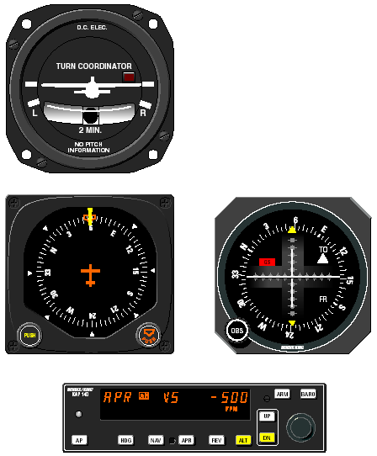
Scenario 6
Inbound on GPS Approach (2)
2. At the FAF, ALT is depressed to activate vertical
speed mode. The desired descent rate is
obtained using the DN button.
Remember, speed needs to be controlled with
the throttle.
Click HERE to return to the scenario index

Slide 28
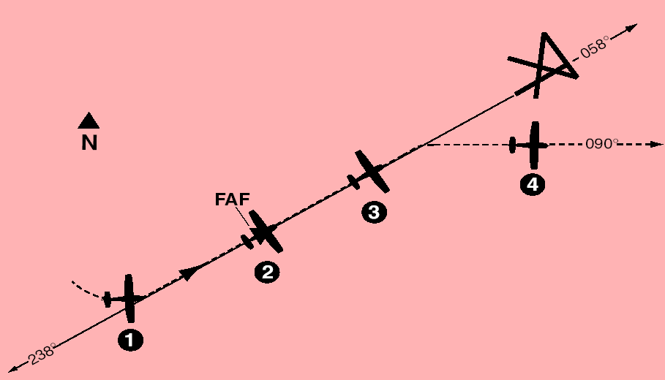
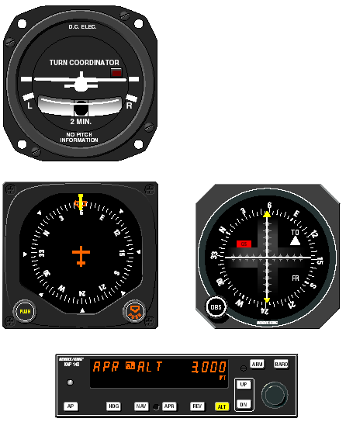
Scenario 6
Inbound on GPS Approach (3)
3. At the MDA, the ALT button is depressed causing
the autopilot to level off and maintain a constant
altitude. At the MAP the pilot disengages
the autopilot with the button on the control
wheel. A flashing AP annunciation is displayed
and a distinctive tone will sound.
Click HERE to return to the scenario index

Slide 29
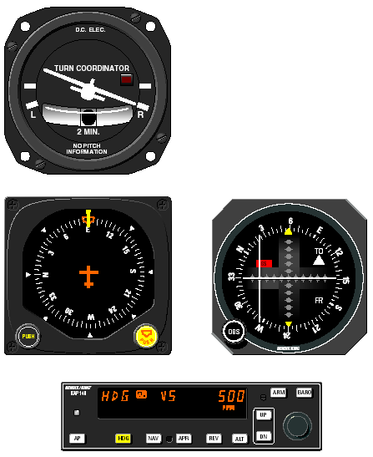
Scenario 6
Inbound on GPS Approach (4)
4. The pilot initiates the missed approach and
stabilizes the aircraft in the climb. The heading
bug is set to the missed approach heading of
090°. By depressing the HDG button on the
KAP 140, the autopilot engages into the heading
and vertical speed modes, commencing a
right turn to a heading of 090° and maintaining
the rate of climb existing at engagement.
Note: On newer models, you must press and hold the
AP button for 0.25 seconds to engage the autopilot.
Click HERE to return to the scenario index

Slide 30
The End
Click HERE to return to the scenario index
Click HERE to return to the first slide
This presentation is available for download at:
www.JimPitman.US

