Slide 1

Name : Viraj Vilas Parab Roll no : 8 College name : B.K.Birla College, Kalyan Topic name : Amazon Top 50 Bestselling Books 2009 -2019 Kaggle link : https://www.kaggle.com/raquelilarri/amazon-top-50-bestselling-books-2009-2019

Slide 2
Aim & Problem Statement :
This Slide includes “Amazon Top 50 Bestselling Books 2009 -2019 " dataset. The aim of this project is to find out and visualize the data's main characteristics and trends using data visualization techniques.
We have got a data about Authors and the information about there books in this dataset.
By analyzing this dataset, we can get to know the most interesting and trending books whichever the readers loves the most, and we can also find out some other useful information using data visualization.

Slide 3
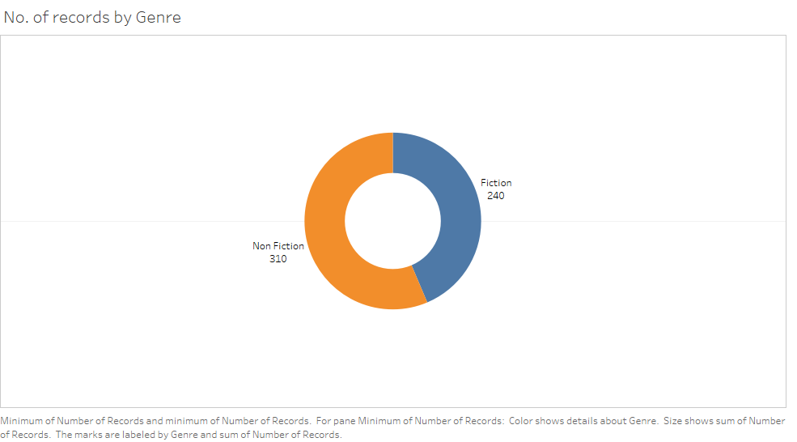

Slide 4
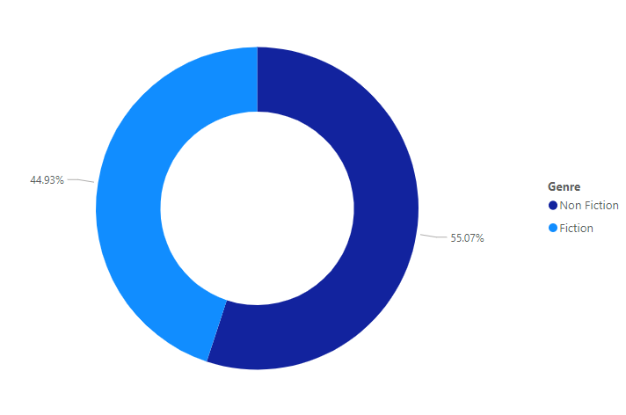

Slide 5
Insights :
In this graph we can see that number of records of Non-fiction books is more than the number of records of Fiction books.
Notice that 310 records of Non-fiction books have been recorded and 240 records of Fiction books have been recorded.
So, about 55.07% of books recorded are non-fiction and about 44.93% of books recorded are fiction.

Slide 6
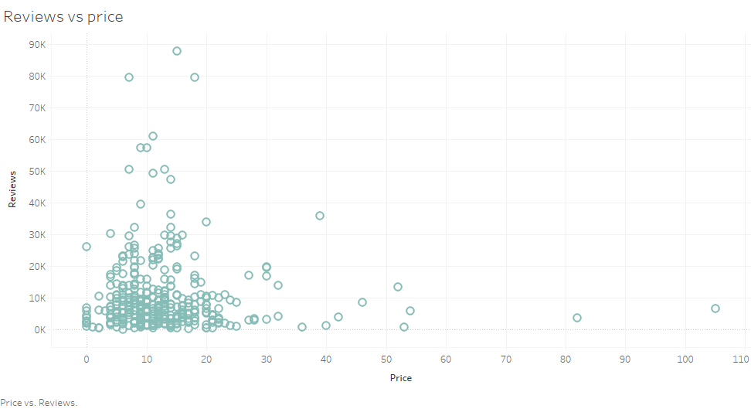

Slide 7
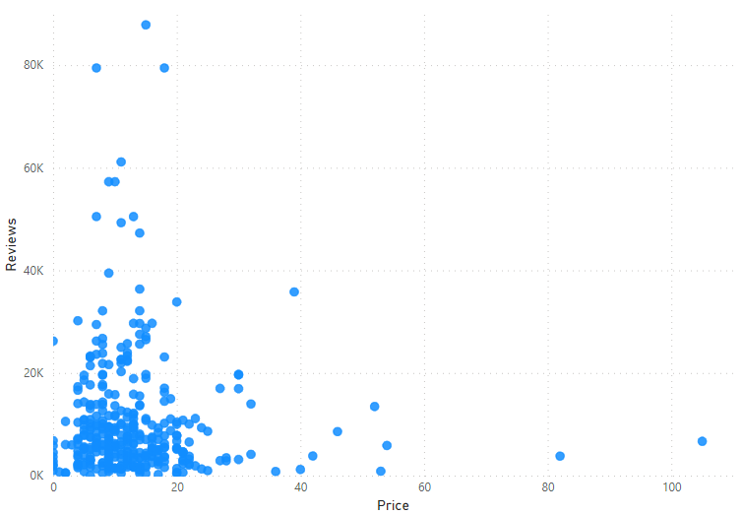

Slide 8
Insights :
Here we can see that the price of most of the books are below 25,and they have similar number of reviews.
Also, the books having lower price have better reviews as compared to the higher price segment.
As we move forward with the price, no. of reviews getting down .
So, we can conclude that the readers prefer the cheaper books and loving the content too.

Slide 9
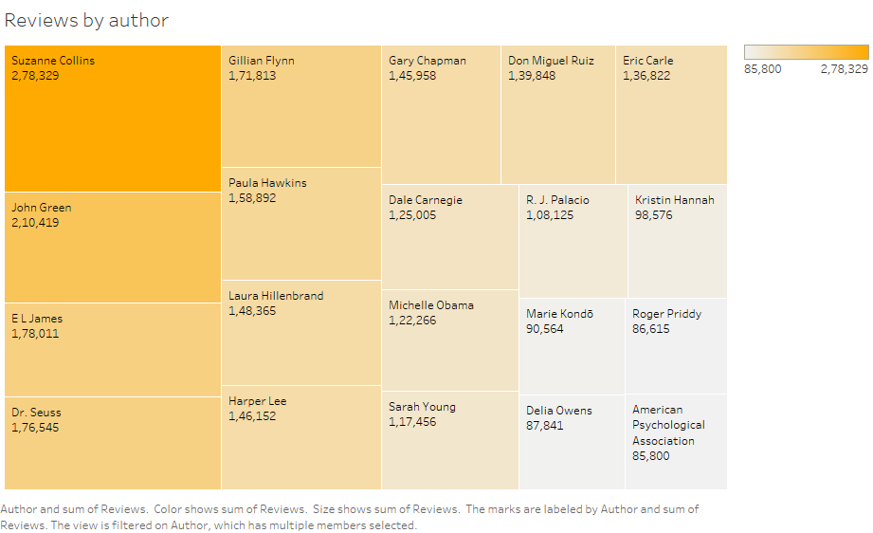

Slide 10
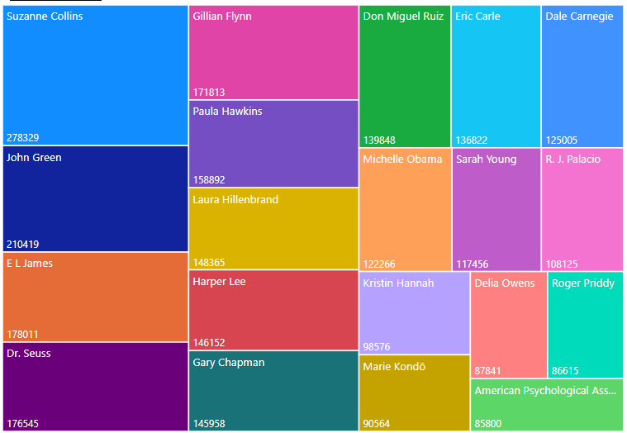

Slide 11
Insights :
So, first we talk about the most famous author “Mr. Suzanne Collins”, who has maximum number of reviews.
From this graph we can have a look on famous authors by reviews.
In the first view, we can see there are 20 author’s name shortlisted as the first 20 famous authors.
So, with the help of this graph we can prefer the books written by the famous authors.

Slide 12
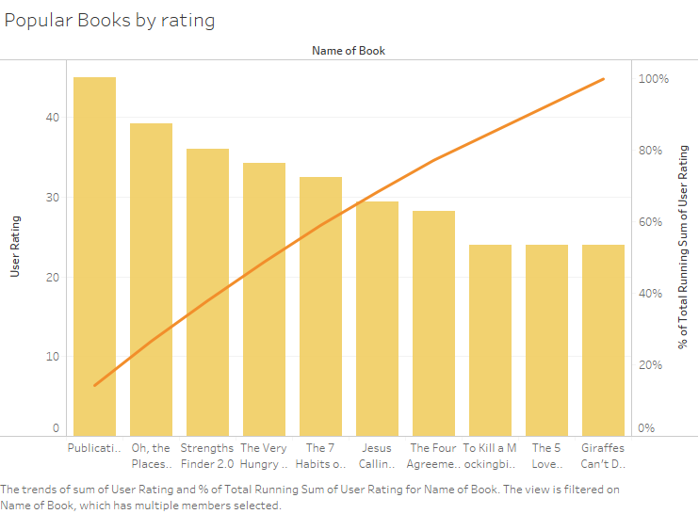

Slide 13
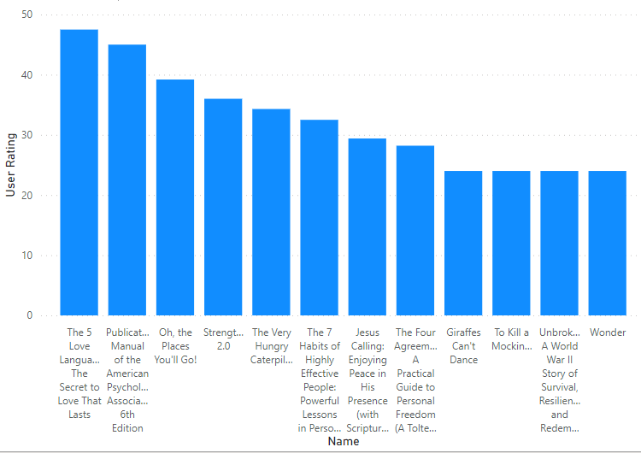

Slide 14
Insights :
As the title indicates, from this graph we can focus on the popular books by the total sum of their ratings.
Higher the sum indicates higher the ratings a book get.
About 50% of the total ratings is captured by the first 4 books namely, “Publication Manual of the American Psychological Association, 6th Edition”, “Oh, the Places You'll Go”, “StrengthsFinder2.0”, “The Very Hungry Caterpillar”.

Slide 15
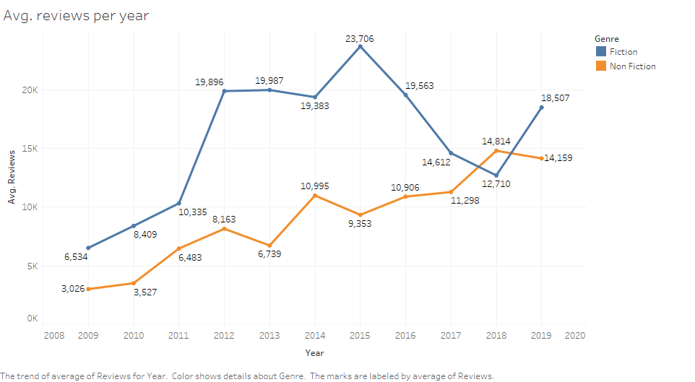

Slide 16
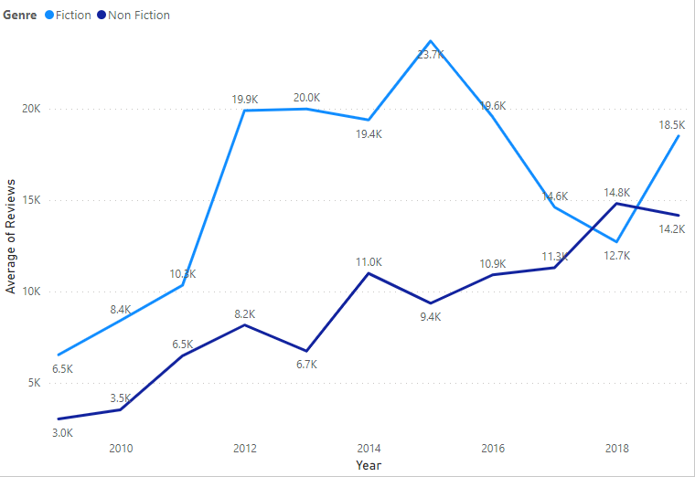

Slide 17
Insights :
From this graph we get to know about Average reviews of Fiction and Non-fiction books respect to years.
Here we can notice that the graph is positive enough to show the success of books irrespective of there genres.
Specifically saying then fiction genre had higher progress rate than the non-fiction genre.
But as the years passed, they both becomes competitors of each other.
So, there is up and down in both genres in present.
But the positive thing is there is drastic change in the reviews as we can say that the readers are ultimately increasing.

Slide 18
Conclusion and business decision :
The purpose of this analysis is to get particular insights regarding Authors and their books.
From this project we get to know the most famous authors and their books.
Though we can now move forward in correct direction to select the best book as per our need.
Also, there is a need to reduce the price segment as we saw the readers prefer cheaper books with better contents.
Also, the books mentioned in the 14th slide should have more quantity of stock as they have more love from the readers.

Slide 19
Thank You !!

