Slide 1
Women's Tennis Insights
Deck 2: Project Plan
Jul 24,2025
Presented by:
Yondong Xiang
Kan Zhou
Yuqi Gu

Slide 2

TABLE OF CONTENTS
01
02
03
Project Overview
Project Code Management
Project Timeline

Slide 3


Project Scope & Objectives
Web-Based Presentation
Data Visualization
Match Outcome Prediction
Visualize trends in player rankings, match outcomes, and performance metrics
Identify breakout players based on unexpected wins
Construct a network graph to illustrate head-to-head matchups and rivalry intensity
Develop an interactive website to present visual analytics
Provide live dashboards and predictive insights
Build machine learning models to forecast match outcomes or player performance

Slide 4
WTA Insights——Dataset Overview
Repository——tennis_wta
Limitations
Key Features
https://github.com/JeffSackmann/tennis_wta
Published by Jeff Sackmann
No real-time data
Last updated at 2024
No injury
No live status info
No weather info
Need to add 2025 data manually
Free and open-source
Clean, structured CSV format
Historical WTA singles match data (1968–2024)

Slide 5
Women Tennis Match Prediction Model Design
Model Structure
Feature Engineering
Objective
To predict future matches outcome between any two players.
XGBoost
Captures nonlinear patterns and feature interactions
Logistic Regression
Interpretable and suitable for initial baseline modeling
Category | Example Features
Difference | Ranking difference, points diff, aces diff
Recent Form ( Last n Weeks) | Number of matches played, wins, losses, total games
Head-to-Head Features | Overall win rate vs opponent, surface-specific win rate
Surface Info | One-hot encoded: clay, hard, grass
Elo Ratings | Dynamic ratings updated after each match, used as key input signal

Slide 6

Working Together
Git & Team Progress
02
https://github.com/paracide/women-tennis-insights
https://github.com/paracide/women-tennis-insights
Yongdong Xiang

Slide 7
Git Repository
🤝 Team Collaboration Enables multiple members to work in parallel and review each other's changes
📁 Organized File & Code Management Tracks all versions and changes to documents, code, and data
💼 Portfolio-Ready Public repository can be shared on résumés, GitHub profiles, etc.
🛡️ Long-Term Preservation Ensures the project is safely stored and accessible in the future

Slide 8
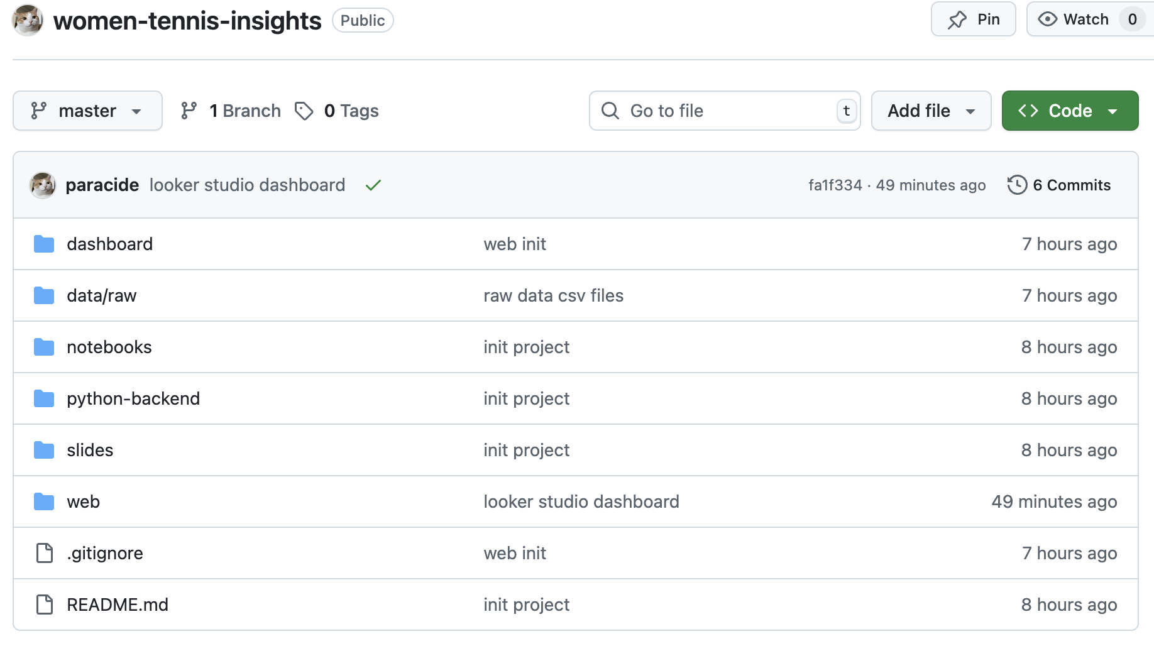

Git Repository
https://github.com/paracide/women-tennis-insights

Slide 9
WTA Insights——Dataset Overview
Main Files
Sample Columns
wta_matches_YYYY.csv
Yearly match data
Each row = 1 singles match
WTA main matches (2024): 2,600
Other matches (2024): 38,000
wta_players.csv
Player info: name,handedness, Date of birth, country
70,000 players
wta_rankings_YYYY.csv
Weekly WTA rankings per year
Top 1000
wta_matches_YYYY.csv
Tournament name
Tournament start date
Court surface (Hard, Clay, Grass)
Match round (1R, QF, SF, etc.)
Match winner
Match score
wta_rankings_YYYY.csv
Ranking_date
Rank
Player_id
Ranking_points

Slide 10
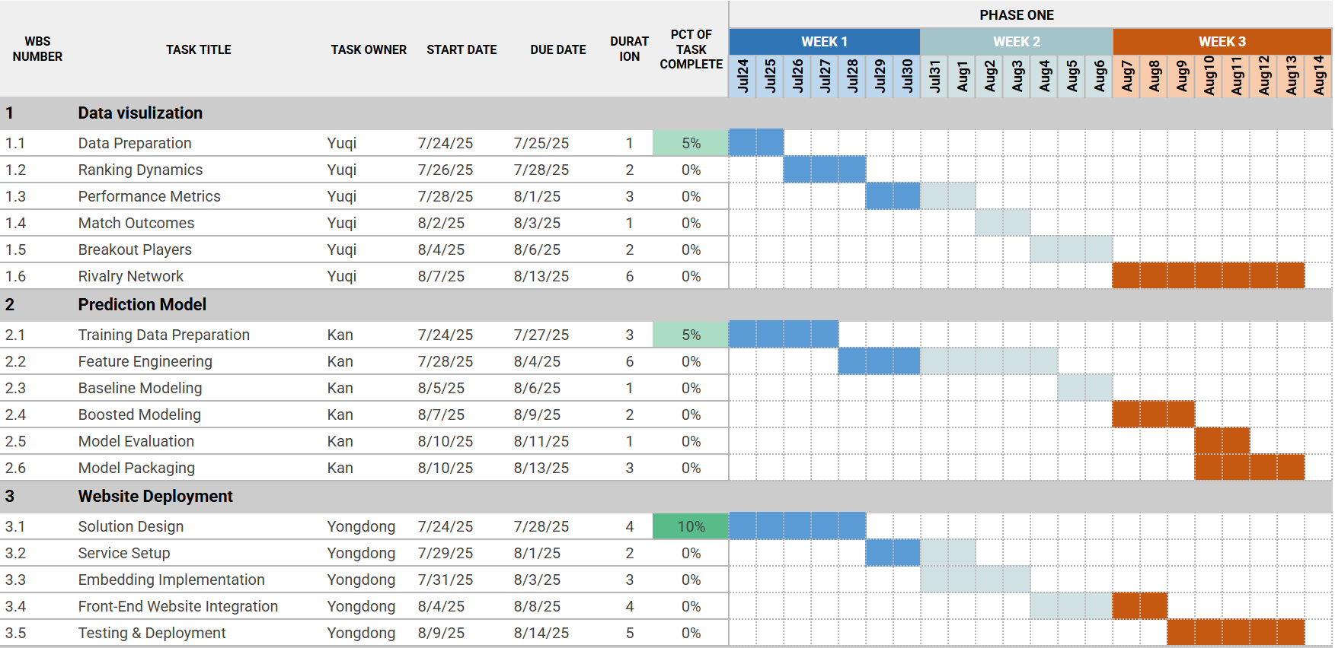
Gantt Chart with Task Breakdown
*subject to change

Slide 11
Project Structure
03

Slide 12

Project Structure - Visualization
1. WTA Tour-level match data
Coverage: The main events of the official WTA Tour.
Tournament levels: High-level tournaments, including Grand Slams, WTA 1000, etc.
Player level: Top professional players, higher world rankings.
2. ITF and WTA Qualifying match data
Coverage: Qualifying rounds before the WTA main events, as well as ITF.
Tournament level: Below the main tour level, serving as entry-level.
Player level: Newly turned professional players, lower-ranked players.

Slide 13
Project Structure - Visualization
tourney_id | tourney_name | surface | draw_size | tourney_level | tourney_date | match_num | winner_id | winner_seed | winner_entry
2024-9900 | United Cup | Hard | 18 | I | 20240101 | 299 | 216347
winner_name | winner_hand | winner_ht | winner_ioc | winner_age | loser_id | loser_seed | loser_entry | loser_name | loser_hand
Iga Swiatek | R | 176 | POL | 22.5 | 201493 |  |  | Angelique Kerber | L
loser_ht | loser_ioc | loser_age | score | best_of | round | minutes | w_ace | w_df | w_svpt
173 | GER | 35.9 | 6-3 6-0 | 3 | F | 70 | 1 | 3 | 59
w_1stIn | w_1stWon | w_2ndWon | w_SvGms | w_bpSaved | w_bpFaced | l_ace | l_df | l_svpt | l_1stIn
43 | 31 | 9 | 8 | 5 | 5 | 0 | 0 | 42 | 27
l_1stWon | l_2ndWon | l_SvGms | l_bpSaved | l_bpFaced | winner_rank | winner_rank_points | loser_rank | loser_rank_points
13 | 7 | 7 | 4 | 8 | 1 | 9505

Slide 14

Project Structure - Visualization
General viewing and reporting
tourney_id | Tournament identifier
winner_seed, loser_seed | Seed number (contextual)
winner_name, loser_name | Player names
winner_ioc, loser_ioc | Country code
winner_ht, loser_ht | Height
winner_hand, loser_hand | Playing hand (R/L)
winner_entry, loser_entry | Entry type (e.g., Q, WC)
tourney_name | Tournament name
tourney_date | Date of tournament
score | Match score (formatted text)
round | Match round (e.g., R32, SF)
minutes | Match duration

Slide 15

Project Structure - Visualization
Analytical player ability
winner_rank_points, loser_rank_points | WTA ranking points
winner_rank, loser_rank | Current WTA rankings
winner_id, loser_id | Unique player IDs
winner_age, loser_age | Player age
w_svpt, l_svpt | Total service points played
w_SvGms, l_SvGms | Service games played
w_df, l_df | Double faults
w_ace, l_ace | Aces
w_2ndWon, l_2ndWon | Second-serve points won
w_1stWon, l_1stWon | First-serve points won
w_1stIn, l_1stIn | First serves in
surface | Surface type (influences playing style)

Slide 16
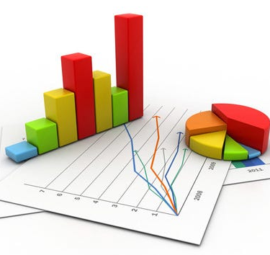
Project Structure - Visualization
1. Player Win Rate Leaderboard Chart Type: Bar chart, ranked table (with player icons)
2. ACE / Double Fault Leaderboards Chart Type: Bar chart, TOP 10 leaderboard
3. First Serve Percentage & Win Rate Comparison Chart Type: Scatter plot, grouped column chart
4. Wins and Participation by Country Chart Type: Map, donut chart Purpose: Analyze which countries have the most active players and highest win rates
5. Match Duration Trends Chart Type: Line chart, box plot (by round)
6. Key Stats vs. Match Outcomes Chart Type: Heatmap, radar chart

Slide 17
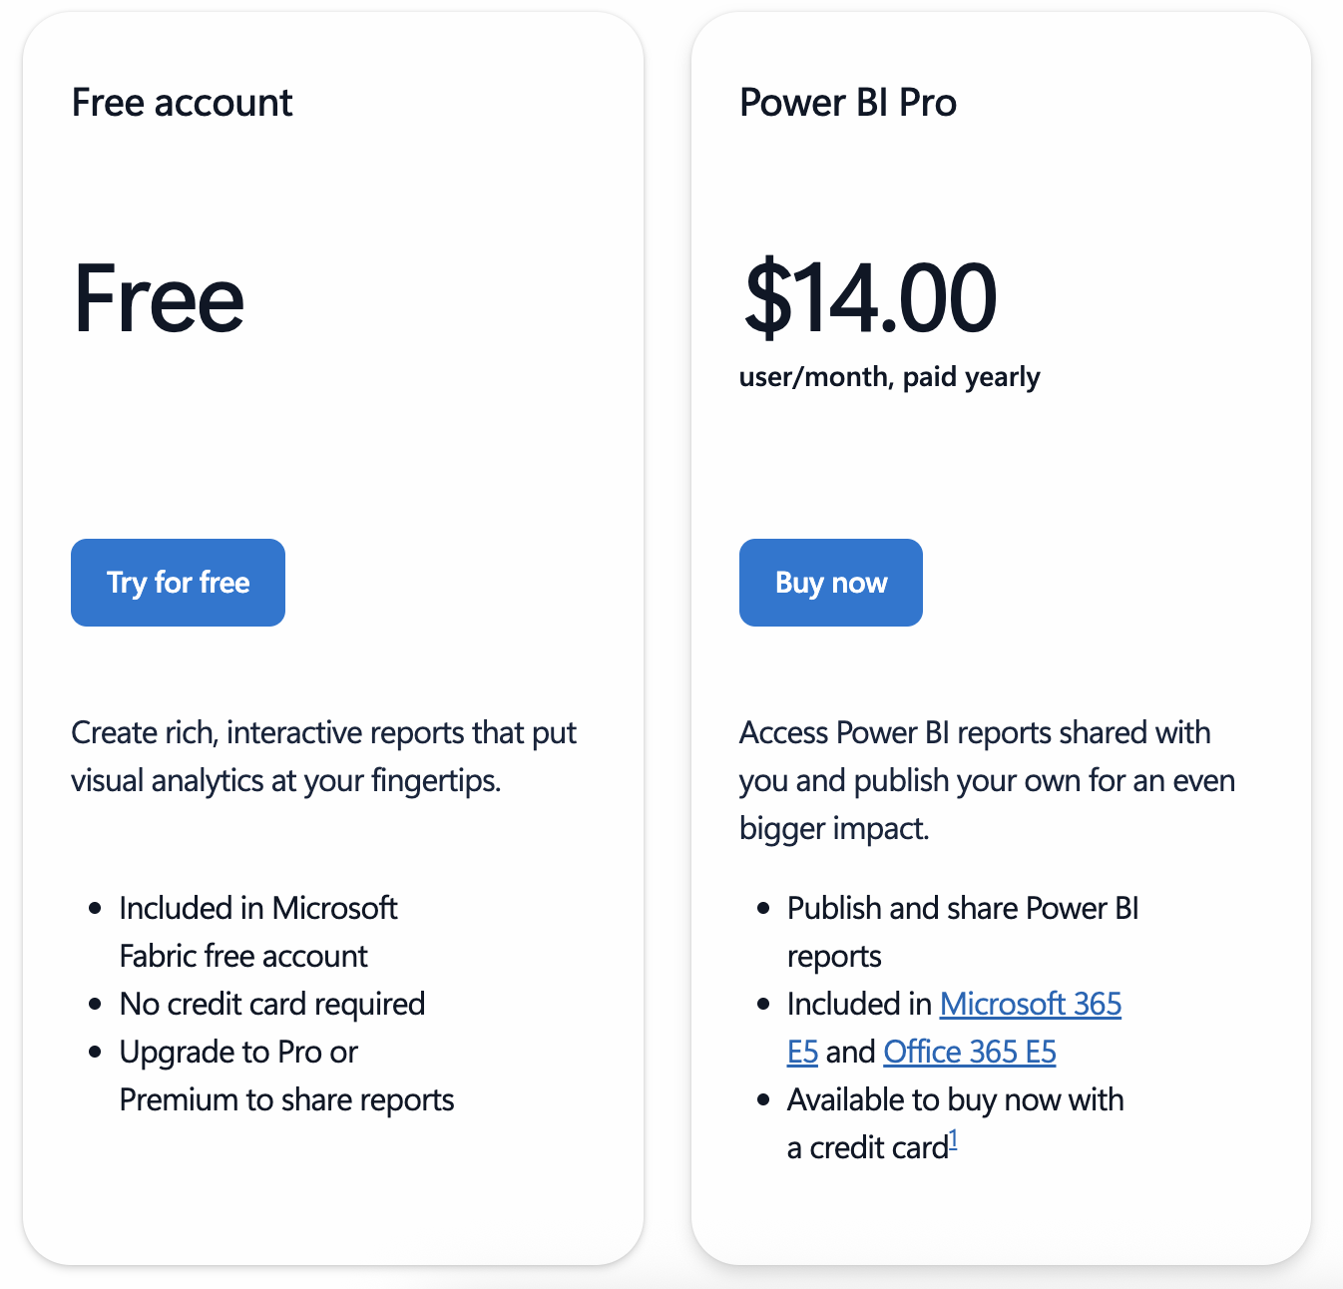
Project Structure - Website with Power Bi
Login required even when embedded
Users without Power BI accounts cannot view reports
University account cannot publish to web
Requires admin to enable
Contradicts our goal of public access for all users
Personal account needs Power BI Pro

Slide 18






Project Structure - Website with Open Source
Visualization
Database & Cloud
Front-End
metabase.nightfae.com

Slide 19
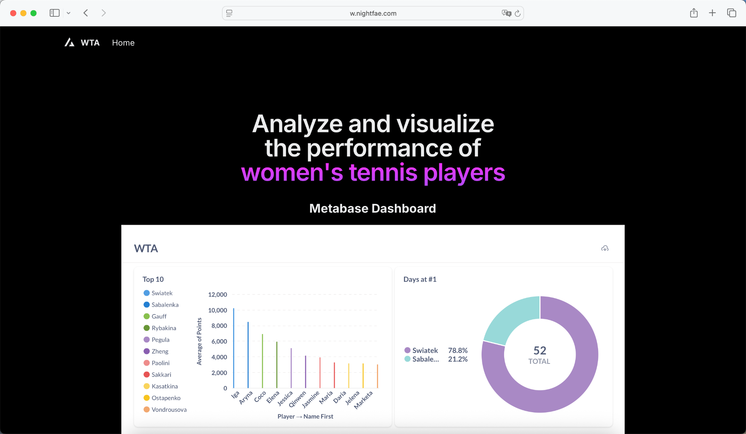
Project Structure - Website
https://w.nightfae.com/

Slide 20
THANKS
Do you have any questions?

