Slide 1
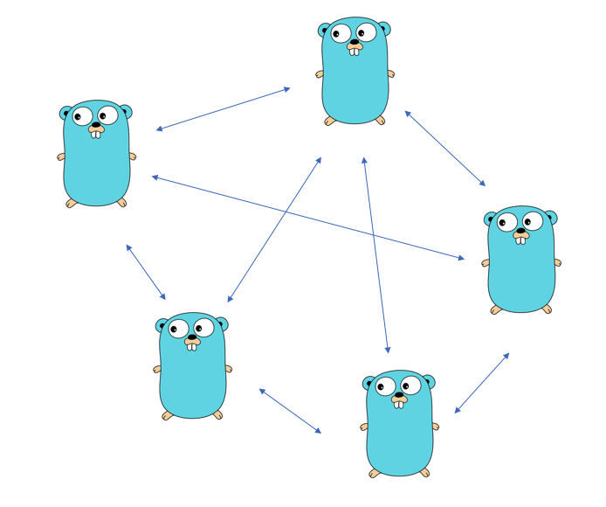
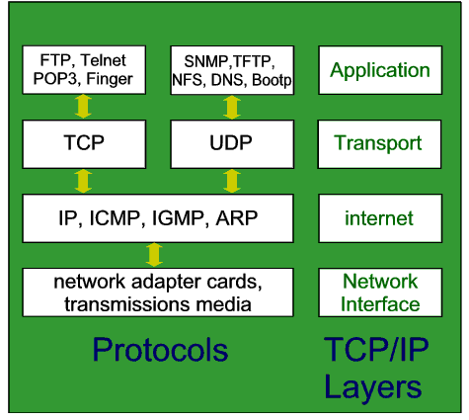
Go networking
Peter Borovanský, KAI, I-18,
borovan(a)ii.fmph.uniba.sk
Prejdeme si v Go tri úrovne tzv. TCP Stacku, a naprogramujeme
klient/server aplikáciu cez TCP/IP sockety, príklad chat
sntp udp klient (time server klient)
malý Webcrawler
Zdroje:
Writing Web Applications
  http://golang.org/doc/articles/wiki/
Network programming with Go
  http://jan.newmarch.name/go

Slide 2
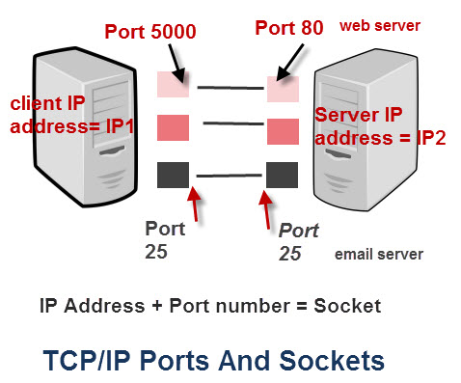
TCP/IP Ports&Sockets
Socket = IP Address + Port Number
IP Address 255⁴
Port 0..65536, ale
  0..1023 (0-0x3FF) - vyhradené pre rôzne serverovské servisy (IANA)
  1024..49151 (0x400-0xBFFF) - môžu byť vyhradené
  49152..65535 (0xC000-0xFFFF) – voľné pre klientské programy
TCP/IP spojenie je spojenie dvoch socketov
  klientského, vaše IP+dynamicky vygenerovaný port, napr. 61234
  Serverovského, jeho IP+port serverovskej služby, napr. 80 pre web server
TCP/IP protokol poskytuje
  TCP Port – overenie doručenia (acknowledge), opätovné vyslanie packetu
  UDP Port – bez overenie, bez znovu vyslania nedoručeného packetu
http://www.steves-internet-guide.com/tcpip-ports-sockets/

Slide 3
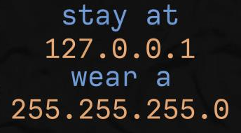
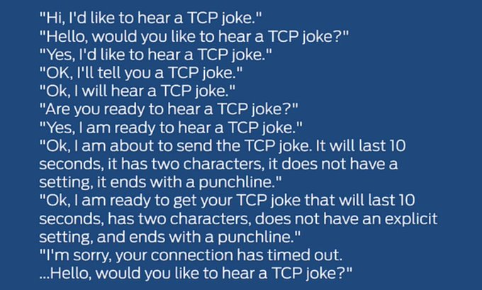

Slide 4
TCP Klient socket
(pripája sa cez TCP klient socket na google.com:80)
import ( "bufio" "fmt" "io" "net" )
func main() { // vytvorenie spojenia client-socket
conn, err := net.Dial("tcp", "google.com:80")
if err != nil {
fmt.Println("connection error: " + err.Error())
} else { // písanie do conn : net.Conn
fmt.Fprintf(conn, "HEAD/ HTTP/1.0\r\n\r\n")
r := bufio.NewReader(conn) // bufio wrapper
for {
line, _, err := r.ReadLine() // čítanie z conn
if err == io.EOF {
break
}
fmt.Printf("%s\n", line)
}
}
}
HTTP/1.1 status codes
1xx Informational responses
2xx Success
3xx Redirection
4xx Client errors
5xx Server errors
tcpclient.go
Notes:
HEAD / HTTP/1.0

Slide 5
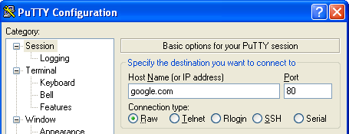
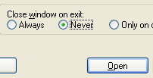
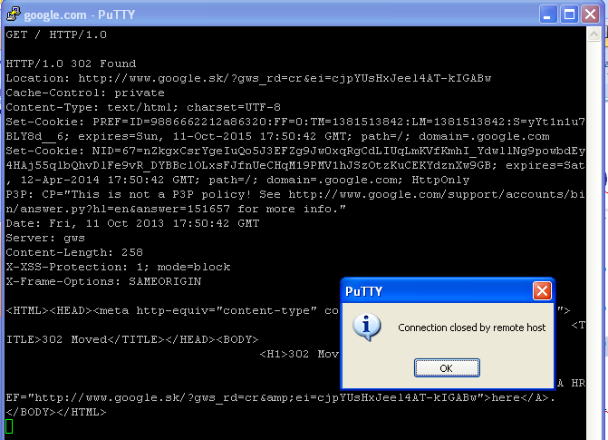
Putty/netcat
Notes:
HEAD/ HTTP/1.0

Slide 6
UDP Sntp klient
(pripája sa cez UDP na sntp server – Simple Network Time Protocol)
RFC 4330
http://tools.ietf.org/html/rfc4330
conn, err := net.Dial("udp","0.sk.pool.ntp.org:123")
if err != nil { return }
r := bufio.NewReader(conn)
w := bufio.NewWriter(conn)
data := make([]byte, 48)
data[0] = 3<<3 | 3
conn.SetDeadline(time.Now().Add(5 * time.Second))
defer conn.Close()
w.Write(data) // send request
w.Flush()
data, _, err = r.ReadLine() // read response
var sec, frac uint64
sec = uint64(data[43]) | uint64(data[42])<<8 | uint64(data[41])<<16 | uint64(data[40])<<24
frac = uint64(data[47]) | uint64(data[46])<<8 | uint64(data[45])<<16 | uint64(data[44])<<24
nsec := sec * 1e9
nsec += (frac * 1e9) >> 32
t := time.Date(1900, 1, 1, 0, 0, 0, 0,time.UTC).Add(time.Duration(nsec)).Local()
fmt.Printf("Network time: %v\n", t)
Udpclient2sntp.go

Slide 7
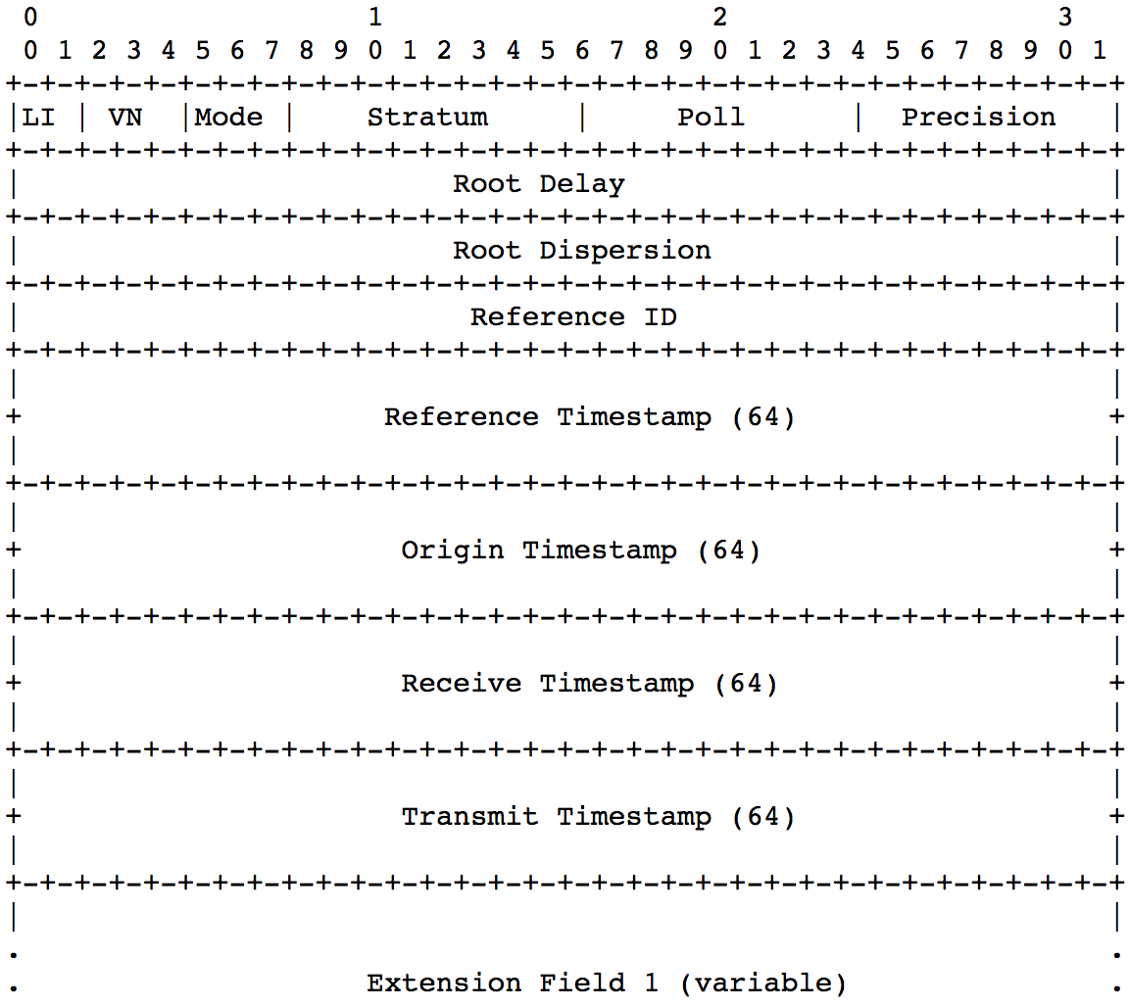
Sntp response
sec = uint64(data[43]) | uint64(data[42])<<8 | uint64(data[41])<<16 | uint64(data[40])<<24
frac = uint64(data[47]) | uint64(data[46])<<8 | uint64(data[45])<<16 | uint64(data[44])<<24
nsec := sec * 1e9
nsec += (frac * 1e9) >> 32
t := time.Date(1900, 1, 1, 0, 0, 0, 0,time.UTC).Add(time.Duration(nsec)).Local()
type packet struct {
Settings uint8 // 0: leap yr indicator, ver number, and mode
Stratum uint8 // 1: stratum of local clock
Poll int8 // 2: poll exponent
Precision int8 // 3: precision exponent
RootDelay uint32 // 4: root delay
RootDispersion uint32 // 8: root dispersion
ReferenceID uint32 // 12: reference id
RefTimeSec uint32 // 16: reference timestamp sec
RefTimeFrac uint32 // 20: reference timestamp fractional
OrigTimeSec uint32 // 24: origin time secs
OrigTimeFrac uint32 // 28: origin time fractional
RxTimeSec uint32 // 32: receive time secs
RxTimeFrac uint32 // 36: receive time frac
TxTimeSec uint32 // 40: transmit time secs
TxTimeFrac uint32 // 44: transmit time frac

Slide 8
Jednovláknový server
(počúva na porte localhost:8080)
import ( "bufio" "fmt" "io" "net" )
func main() { // porty <1024 majú špeciálne určenie
ln, err := net.Listen("tcp", ":8080") // server socket
if err != nil {
fmt.Println("connection error: " + err.Error())
} else {
conn, err := ln.Accept() // blokuje kým ja niekto
if err != nil { // nepokúsi o spojenie
fmt.Println("error: " + err.Error())
} else {
handleConnection(conn) // vieme vytvoriť len
} // jedno spojenie na “server”
}
}
server1thread.go

Slide 9
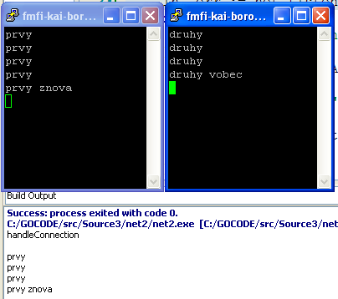
HandleConnection
(čítanie zo streamu nadviazanej konekcie)
func handleConnection(conn net.Conn) {
fmt.Println("handleConnection")
r := bufio.NewReader(conn)// wrapper na conn read stream
for {
line, _, err := r.ReadLine() // čítaj až do konca
if err == io.EOF {
break
} // a píš na konzolu
fmt.Printf("%s\n", line)
}
}
server1Thread.go

Slide 10
Viacvláknový server
(čo nadviazaná konekcia, to jedno vlákno = go rutina)
func main() {
ln, err := net.Listen("tcp", ":8080")
if err != nil {
fmt.Println("connection error: " + err.Error())
} else {
for {
conn, err := ln.Accept()
if err != nil { // server by mal prežiť !!!
fmt.Println("error: " + err.Error())
continue
} // obslúženie konekcie spustíme v nezávislej
go handleConnection(conn) // gorutine
}
}
}
serverMultiThread.go

Slide 11
ChatClient
Keď poznáme základy, skúsime vytvoriť jednoduchý chat-server umožnujúci:
viacero pripojení,
broadcastuje komunikáciu všetkým
type ChatClient struct {
clientID int // poradové číslo klienta
reader *bufio.Reader // reader a writer z/do konekcie
writer *bufio.Writer // klienta
}
func NewChatClient(clientID int, conn net.Conn) *ChatClient {
return &ChatClient{// konštruktor vytvorí z ID a konekcie
clientID: clientID, // jednoznačné ID ChatClient
reader: bufio.NewReader(conn), // input pipe stream
writer: bufio.NewWriter(conn), // output pipe stream
}
}
ID
reader
writer
chatroom.go

Slide 12
ChatRoom
ChatRoom
si pamätá všetkých ChatClientov
vie pridať ďalšieho, keď sa pripojí
type ChatRoom struct { // všetci ChatClienti
clients []*ChatClient
}
func NewChatRoom() *ChatRoom {// prázdny ChatRoom
chatRoom := &ChatRoom{
clients: make([]*ChatClient, 0),
}
return chatRoom
}
func (chr *ChatRoom) AddChatClient(conn net.Conn) *ChatClient {
chatclient := NewChatClient(len(chr.clients)+1, conn)
fmt.Printf("new client: %d\n", chatclient.clientID)
chr.clients = append(chr.clients, chatclient)
return chatclient
}
chatroom.go

Slide 13
ChatRoom
ChatRoom
echuje, čo jeden píše všetkým ostatným
func (chr *ChatRoom) handleConnection(conn net.Conn) {
chclient := chr.AddChatClient(conn)
for {
line, _, err := chclient.reader.ReadLine()
if err == io.EOF {
break
}
msg := fmt.Sprintf("%d>%s\r\n", chclient.clientID,line)
fmt.Print(msg) // výpis na konzolu chatroomu
for _, client := range chr.clients {
if client.clientID != chclient.clientID {
client.writer.WriteString(msg)
client.writer.Flush()
}
} } }
Hi!
Hi!
Hi!
chatroom.go

Slide 14
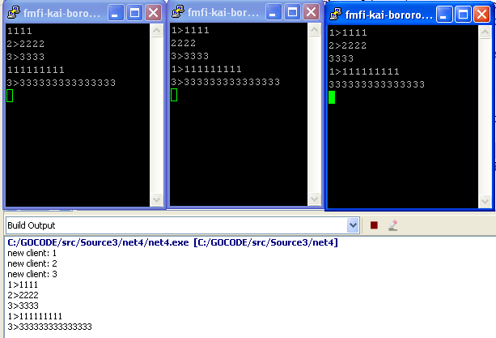

ChatRoom v akcii
chatroom.go

Slide 15
HTTP client
http klient je nadstavba TCP
zaobaľuje nízko-úrovňovú komunikáciu
GET Request-URI CRLF
[GET | HEAD | POST ] Request-URI HTTP-Version CRLF
GET http://google:80 HTTP/1.0
url := "http://google.com"
response, err := http.Head(url)
fmt.Println(response.Status) // 200 OK
for k, v := range response.Header { // Content-Type:
fmt.Println(k+":", v) } // [text/html; charset=ISO-8859-2]
response, err = http.Get(url)
fmt.Println("\nbody:")
reader := bufio.NewReader(response.Body) // čítame telo
for {
line, _, err := reader.ReadLine()
if err == io.EOF {
break
httpclient.go

Slide 16
Čo s telom ?
for {
line, _, err := reader.ReadLine()
if err == io.EOF { break }
strline := string(line)
var httpRef = regexp.MustCompile(
`(?i)href\s*=\s*(\"([^"]*\")|'[^']*'|([^'">\s]+))`)
matches := httpRef.FindAllString(strline, -1)
for _, match := range matches {
fmt.Println(match)
} }
body:
href="/search?"
href="http://www.google.sk/imghp?hl=sk&tab=wi"
href="http://maps.google.sk/maps?hl=sk&tab=wl"
href="http://www.youtube.com/?gl=SK&tab=w1"
href="https://mail.google.com/mail/?tab=wm"
href="https://drive.google.com/?tab=wo"
href="https://www.google.com/calendar?tab=wc"
...
httpclient.go

Slide 17
WebCrawler
Crawl uses fetcher to recursively crawl
pages starting with url, to a maximum of depth
TODO:
Fetch URLs in parallel.
Don't fetch the same URL twice.
func Crawl71(url string, depth int, fetcher Fetcher) {
if depth <= 0 {
return
}
body, urls, err := fetcher.Fetch(url)
if err != nil {
fmt.Println(err)
return
} // naivné prehľadávanie do hĺbky, bez kontroly
fmt.Printf("found: %s %q\n", url, body)
for _, u := range urls {
Crawl71(u, depth-1, fetcher)
}
return
}
https://tour.golang.org/concurrency/10

Slide 18
WebCrawling
golang.org
var fetcher = &fakeFetcher{
"http://golang.org/": &fakeResult{
"The Go Programming Language",
[]string{
"http://golang.org/pkg/",
"http://golang.org/cmd/",
},
},
"http://golang.org/pkg/": &fakeResult{
"Packages",
[]string{
"http://golang.org/",
"http://golang.org/cmd/",
"http://golang.org/pkg/fmt/",
"http://golang.org/pkg/os/",
},
},
"http://golang.org/pkg/fmt/": &fakeResult{
"Package fmt",
[]string{
"http://golang.org/",
"http://golang.org/pkg/",
},
},
"http://golang.org/pkg/os/": &fakeResult{
"Package os",
[]string{ "http://golang.org/",
"http://golang.org/pkg/",
},
},
}
golang.org/pkg
golang.org/os
golang.org/cmd
golang.org/pkg/fmt
webcrawler.go

Slide 19

WebCrawlerR
// HashMap navštívených linkov
var visited = make(map[string]bool)
func CrawlR(url string, depth int, maxDepth int) {
if depth <= maxDepth {// ak nie som príliš hlboko
visited[url] = true // ok, bol som tu ...
suburls := crawlPageR(url, depth) // získaj urls
for _, url := range suburls.suburls {// prejdi ich
if _, seen := visited[url]; seen {// ak si tam
continue // bol, preskoč
}
CrawlR(url, depth+1, maxDepth) // inak rekurzia
}
}
}
[0:http://golang.org/] "The Go Programming Language"
[1:http://golang.org/pkg/] "Packages"
not found: http://golang.org/cmd/
[2:http://golang.org/pkg/fmt/] "Package fmt"
[2:http://golang.org/pkg/os/] "Package os"
webcrawler.go

Slide 20
WebCrawlerR
type Urls struct {
depth int // hĺbka podstránky od koreňa
suburls []string // zoznam linkov na nej
}
func crawlPageR(url string, depth int) *Urls {
body, urls, err := fetcher.Fetch(url) // toto nemáme ☹
if err != nil {
fmt.Println(err)
} else {
fmt.Printf("found[%d:%s] %q\n", depth, url, body)
}
return &Urls{depth + 1, urls}
}
webcrawler.go

Slide 21

WebCrawler 2
var (
// akonáhle prejdeme stránku s adresou url, všetky jej vnorené Urls zapíšeme ho do kanálu
globalQueueOfUrls = make(chan Urls)
totalRuns = 0 // počet spustení crawlPage
// t.j. veľkosť fronty nespracovaných Urls
visited = make(map[string]bool) // navštívené urls
)
func crawlPage(url string, depth int) {
body, urls, err := fetcher.Fetch(url)
if err ...
fmt.Printf("[%d:%s] %q\n", depth, url, body)
globalQueueOfUrls <- Urls{depth + 1, urls}
}
webcrawler.go

Slide 22
WebCrawler 2
size: 287
7.6544378s
func Crawl(url string, depth int) {
totalRuns++ // spracuj hlavnú stránku
visited[url] = true // navštívili sme ju
go crawlPage(url, 0) // pridaj jej Urls do fronty
for totalRuns > 0 { // kým je niečo vo fronte
totalRuns-- // dekrementuj veľkosť fronty
next := <-globalQueueOfUrls // vyber z fronty
if next.depth > depth { continue } // prihlboko
for _, url := range next.suburls { // do hĺbky
if _, seen := visited[url]; seen { continue }
visited[url] = true
totalRuns++ // nerekurzívne spracuj
go crawlPage(url, next.depth) // podstránky
} } }
webcrawler.go

