Slide 1

Holiday Plans

Slide 2
Brighton & London
Don't want to stay in London as it's too expensive.
Brighton's only 30 minutes away by train.
Both have nice art galleries, and museums.
Brighton has the sea side.
London has posh knob ends 'working' in the parliament.

Slide 3
Brighton & London
Trains
Goes from Derby to London St Pancreas. Then to London Paddington – Brighton. Walk or get taxi for London change.
More sensible to get a bus like National Express or to fly, then go to London Paddington.
Train journey is supposed to take two hours.

Slide 4
Brighton & London
Hotel
Near the centre of Brighton. Sea view would be nice.
Must have a shower in the en-suite and a radio at least. Free wi-fi would be nice, and a desk.
Check in:
Check out:
Take 4 day holiday in April or May to avoid school kids and higher prices.

Slide 5
Brighton & London
To Do
Day 1: shop in book shops, view place & art galleries.
Day 2: Visit British Science Museum and wander past HP sauce place.
Day 3: Visit British Library and Vic & Albert. Walk through Hyde Park.
Day 4: Take pics in Brighton. Write, wander around finding interesting places. Go to the beach.

Slide 6
Day Trips
Bletchley Park or York
Matlock or Belper
Derby or Nottingham doesn't count
GCR or Butterly
Filey or Scarborough
Berlin or Paris
Old computer museums

Slide 7
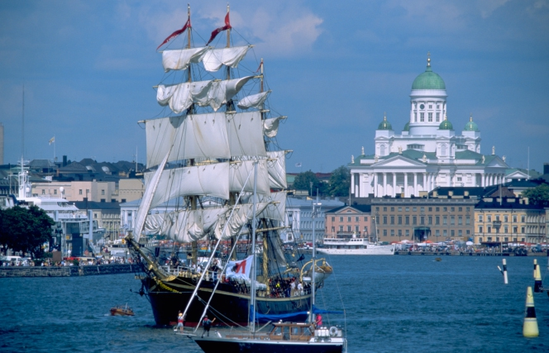
Finland Holiday

Slide 8
Finland Holiday
Get a ferry or plane to Helsinki.
A week long in May or June.
One day in Vaasa and Joensuu.
Visit countryside / scenery or cultural places.
Attend a metal show of some description.
Take a boat ride somewhere.

Slide 9
Finland Holiday
Eat reindeer or salmon.
Sight see Digia's headquarters.
Or the shop where Linus Torvalds brought his
First computer to program Linux on.
Visit the Sibelius museum, or see it performed by the Helsinki orchestra.

Slide 10
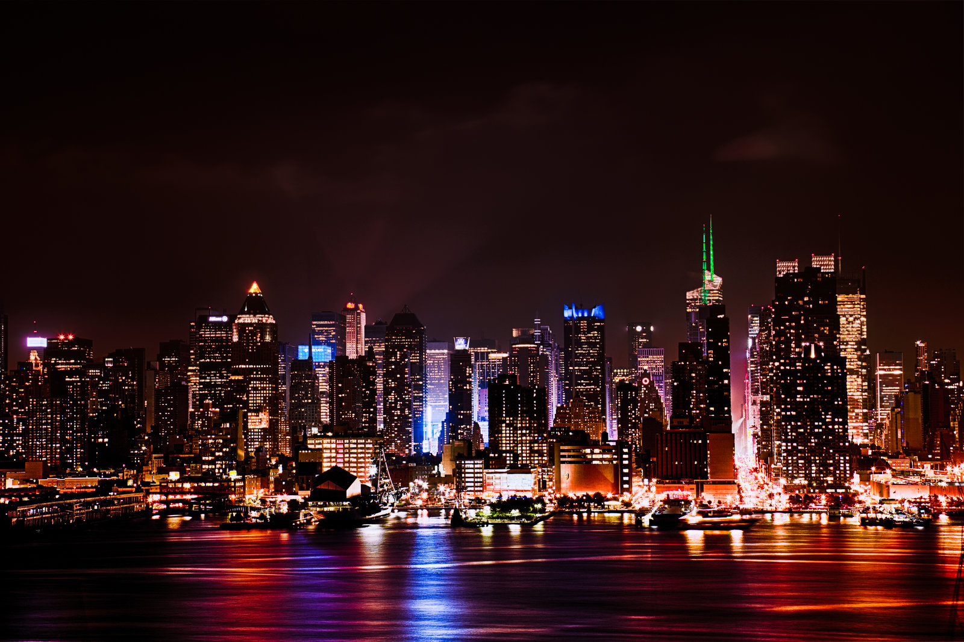
New York

Slide 11
New York
With sister
On plane
Both will need passports so get them 1 year
In advance.
Take camera and laptop.

Slide 12
New York
4 star hotel – sister can pay towards her room.
Live entertainment at hotel in evenings.
Don't go if there's a hurricane forecast.
Go in Oct – Nov. Before Xmas to get presents.
Take nicer clothes for attending nice restaurants.

Slide 13
New York
Get any shopping delivered internationally if it's large or technological.
Go to the top of one of those skyscrapers.
Visit the cities orchestra or ballet.
Go clothes shopping in main shopping street, that's if it hasn't closed down due to online shopping.

Slide 14
New York
Visit Harlem and a music club there if the USA has passed some sensible gun laws.
Otherwise visit the Statue of Liberty.
4 days, or 5 if I can get it cheap enough.

