Slide 1
CUSTOMER REPAYMENT BEHAVIOUR ANALYSIS

Slide 2
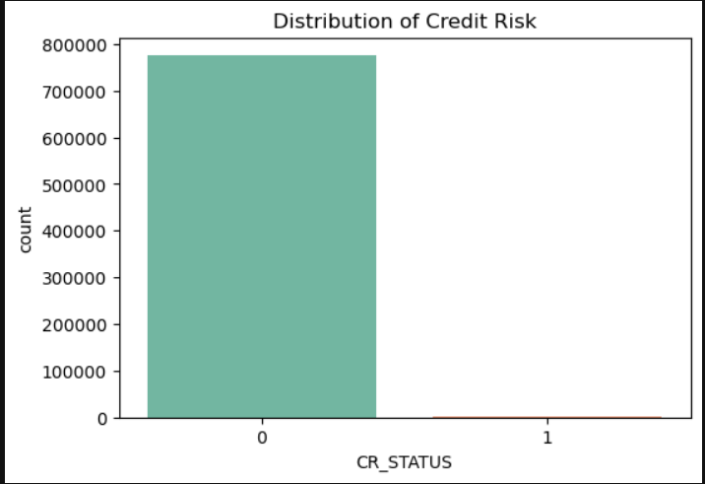
Key Insights from Credit Risk Distribution :
Highly Imbalanced Distribution:
The bar chart shows a highly imbalanced dataset where the majority of records belong to CR_STATUS = 0, while very few observations fall under CR_STATUS = 1.
Dominance of Non-Risk Cases:
Most individuals in the dataset are categorized as non-credit-risk customers, indicating that default or risky credit cases are relatively rare.
Low Representation of Risky Customers:
The number of records with CR_STATUS = 1 is extremely small compared to CR_STATUS = 0, suggesting that risky borrowers form only a tiny portion of the dataset.
Potential Class Imbalance Issue:
Such a strong imbalance between classes may cause machine learning models to become biased toward predicting the majority class.
Impact on Model Training:
To build an effective predictive model, techniques like resampling, class weighting, or SMOTE may be required to handle the imbalance and improve prediction of risky cases.

Slide 3
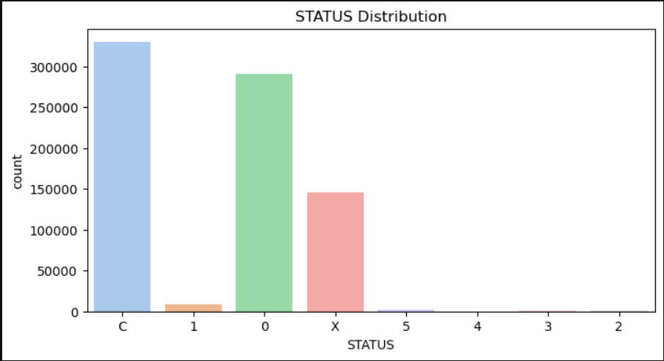
Key Insights from STATUS Distribution :
Dominance of Category ‘C’:
The chart shows that status ‘C’ has the highest number of records, indicating that most customers fall under this category compared to other status values.
Significant Presence of Status ‘0’:
The ‘0’ status category also has a large number of observations, making it the second most frequent category in the dataset.
Moderate Representation of Status ‘X’:
The ‘X’ category has a noticeable but smaller count compared to ‘C’ and ‘0’, suggesting a moderate presence in the dataset.
Rare Occurrence of Numeric Status Values:
Status values such as 1, 2, 3, 4, and 5 appear very rarely, indicating that these categories represent only a small portion of the data.
Impact on Analysis:
Since a few categories dominate the dataset, models or analysis may be biased toward major status groups, and rare categories might require special handling or grouping during preprocessing.

Slide 4
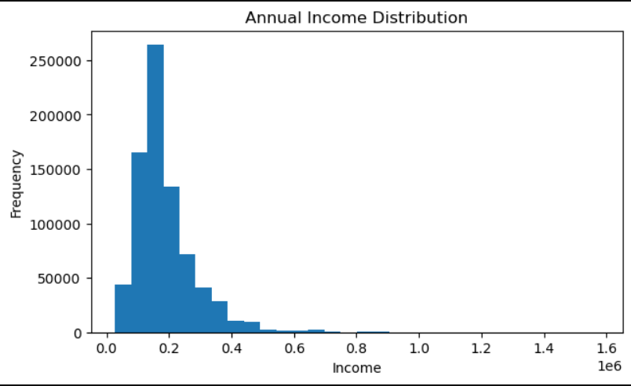
Key Insights from Annual Income Distribution :
Right-Skewed Distribution:
The histogram shows a positively skewed (right-skewed) distribution, where most individuals fall in the lower income range while a small number earn significantly higher incomes.
Concentration of Middle-Low Income Groups:
A large portion of the dataset is concentrated roughly between 100,000 and 250,000 income range, indicating that most customers belong to middle or lower-middle income groups.
Presence of High-Income Outliers:
The long tail extending toward higher income values (above 500,000 and up to around 1.5 million) suggests the presence of high-income outliers in the dataset.
Declining Frequency with Increasing Income:
As income increases, the number of individuals in those ranges gradually decreases, showing that higher income groups are relatively rare.
Impact on Analysis:
Due to skewness and extreme values, statistical measures like mean income may be influenced by high-income outliers, so techniques like log transformation or outlier handling may be useful for better modeling.

Slide 5
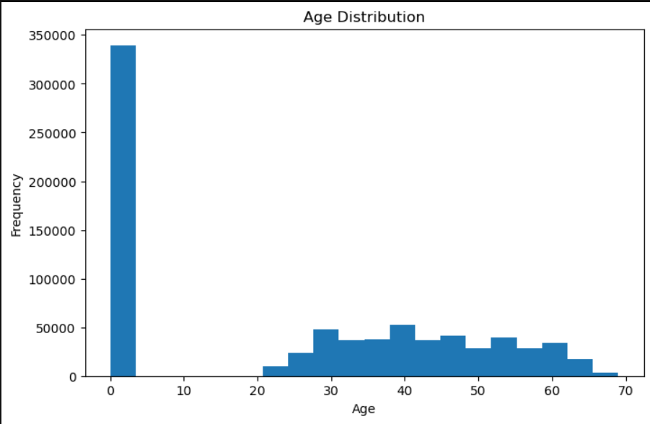
Key Insights from Age Distribution :
Presence of Invalid or Zero Age Values:
The histogram shows a large spike at age 0, indicating the presence of invalid or missing values that may have been recorded as zero in the dataset.
Majority of Customers are Adults:
Most individuals fall within the age range of approximately 25 to 60 years, suggesting that the dataset mainly consists of working-age adults.
Peak Concentration in Middle Age Group:
The highest frequency of records appears around the 30–45 age range, indicating that middle-aged individuals form the largest segment of the dataset.
Lower Representation of Younger and Older Groups:
Very few records exist for ages below 25 and above 65, showing that younger and senior populations are less represented.
Impact on Analysis:
The presence of age value 0 may distort statistical analysis, so data cleaning or removing invalid entries may be necessary before performing modeling or further analysis.

Slide 6
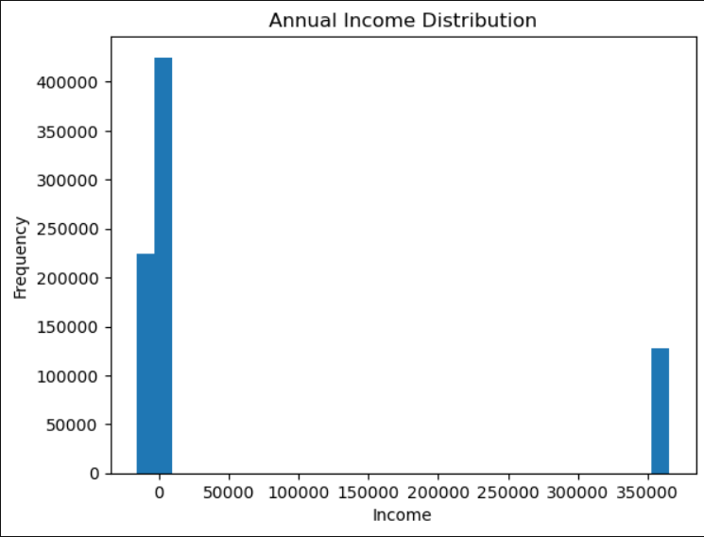
Key Insights from Annual Income Distribution :
Strong Concentration at Lower Income Levels:
The histogram shows that the majority of individuals are concentrated in the lower income range, indicating that most customers in the dataset earn relatively modest incomes.
Extreme Income Outlier Present:
There is a large spike around the very high income value (around 350,000+), suggesting the presence of extreme outliers that are far from the typical income range.
Highly Skewed Distribution:
The distribution appears highly right-skewed, where most observations lie in the lower range while only a few exist at extremely high income levels.
Possible Data Entry or Scaling Issue:
The isolated cluster of very high income values may indicate data inconsistencies, scaling issues, or incorrectly recorded income values.
Impact on Analysis:
Such extreme outliers can significantly affect statistical measures like the mean and variance, so outlier detection or normalization techniques may be necessary before building predictive models.

Slide 7
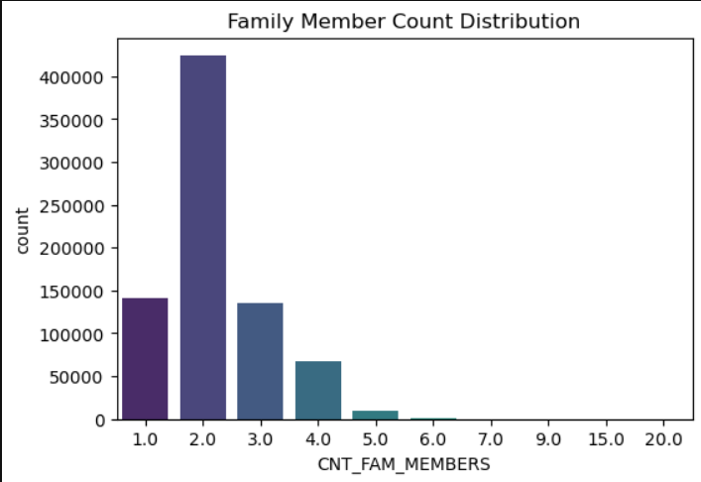
Key Insights from Family Member Count Distribution :
Dominance of Small Families:
The distribution shows that the majority of households consist of 2 family members, making it the most common family size in the dataset.
Moderate Presence of Medium-Sized Families:
Families with 3 to 4 members also appear frequently, indicating that medium-sized households form a significant portion of the data.
Lower Representation of Large Families:
Family sizes above 5 members are relatively rare, showing that large households are uncommon in the dataset.
Presence of Extreme Outliers:
A few records show unusually high family member counts such as 9, 15, and 20, which may represent data entry errors or exceptional cases.
Impact on Analysis:
Since most values fall between 1 and 4 family members, extreme values may need to be reviewed or capped to prevent them from affecting statistical analysis or predictive models.

Slide 8
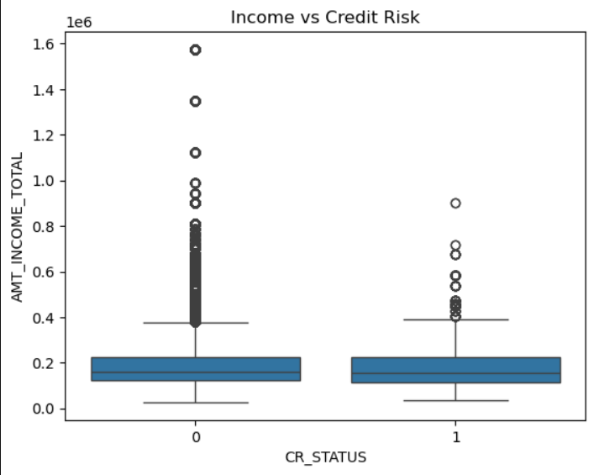
Key Insights from Income vs Credit Risk :
Similar Median Income Across Risk Groups:
The boxplot shows that the median income for both CR_STATUS = 0 and CR_STATUS = 1 is quite similar, indicating that income alone may not strongly differentiate between low-risk and high-risk customers.
Slightly Wider Income Spread in Non-Risk Group:
Customers with CR_STATUS = 0 (non-risk) show a slightly wider spread of income values, suggesting greater income variability among safer borrowers.
Presence of High-Income Outliers:
Both credit risk groups contain several high-income outliers, with some incomes exceeding 1 million, indicating that extreme income values exist in the dataset.
Overlap Between Risk and Non-Risk Groups:
There is significant overlap in the income ranges of both groups, meaning both risky and non-risky customers can fall within similar income brackets.
Impact on Analysis:
Since income distributions overlap heavily between the two groups, income alone may not be a strong predictor of credit risk, and additional features may be required for accurate credit risk modeling.

Slide 9
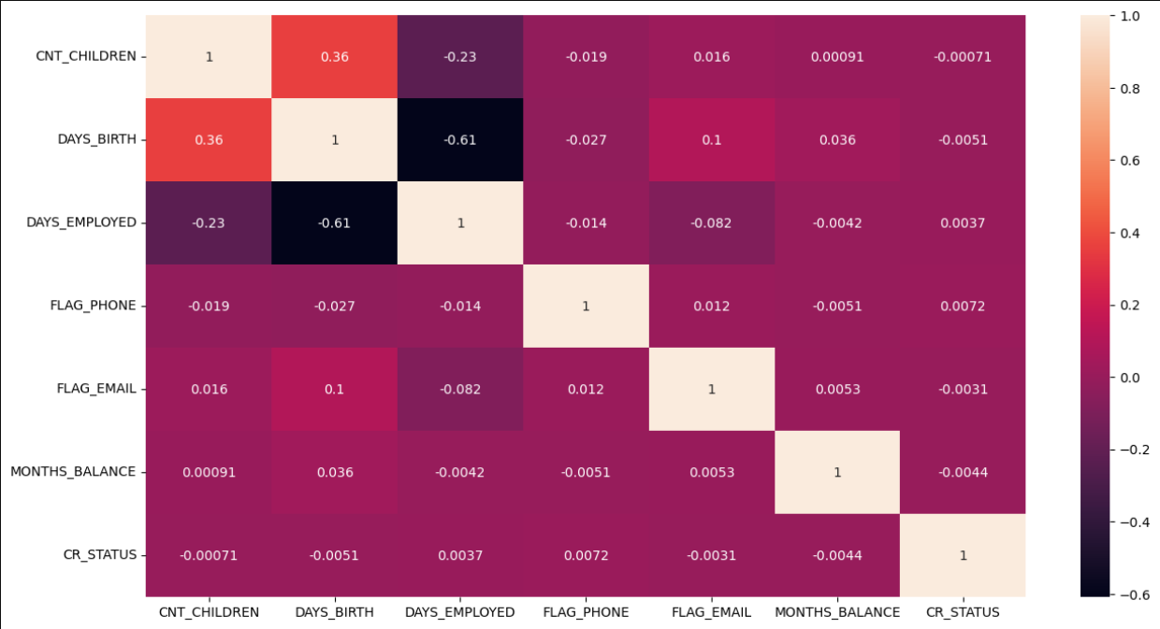

Slide 10
Key Insights from Correlation Heatmap :
Strong Negative Correlation between Age and Employment Days:
The heatmap shows a strong negative correlation (-0.61) between DAYS_BIRTH and DAYS_EMPLOYED, indicating that as age increases, the recorded employment days decrease due to the way these variables are represented.
Moderate Positive Relationship between Age and Number of Children:
There is a moderate positive correlation (0.36) between DAYS_BIRTH and CNT_CHILDREN, suggesting that older individuals tend to have slightly more children.
Weak Relationships Among Most Variables:
Most variables show very weak correlations close to zero, indicating that they are largely independent of each other.
Minimal Correlation with Credit Risk:
The CR_STATUS variable has almost zero correlation with other features, suggesting that these individual variables alone may not strongly explain credit risk.
Impact on Modeling:
Since correlations are generally low, credit risk prediction may require combining multiple features or using more complex models rather than relying on single-variable relationships.

Slide 11
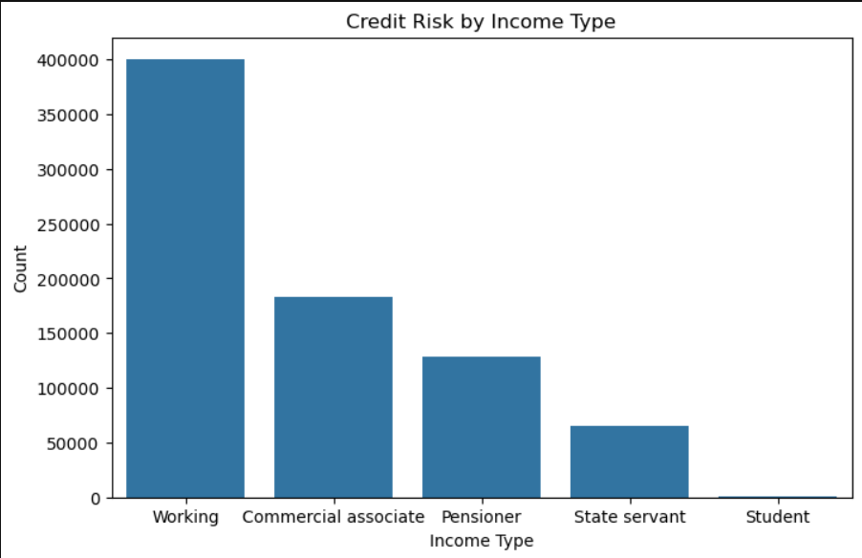
Key Insights from Credit Risk by Income Type :
Dominance of Working Professionals:
The chart shows that the majority of applicants belong to the “Working” income type, indicating that most individuals in the dataset are salaried employees.
Significant Representation of Commercial Associates:
The “Commercial associate” category is the second largest group, suggesting a considerable number of individuals engaged in business or commercial activities.
Moderate Presence of Pensioners:
The “Pensioner” category also forms a noticeable portion of the dataset, representing retired individuals who still participate in credit-related activities.
Lower Representation of State Servants:
Applicants categorized as “State servant” appear less frequently, indicating fewer government-employed individuals in the dataset compared to private sector workers.
Very Small Student Segment:
The “Student” category has the smallest count, suggesting that very few students are included in the credit dataset.
Impact on Analysis:
Since the dataset is heavily dominated by working professionals, credit risk models may primarily reflect patterns related to employed individuals rather than other income groups.

