Slide 1

Space Mission Analysis Report

Slide 2
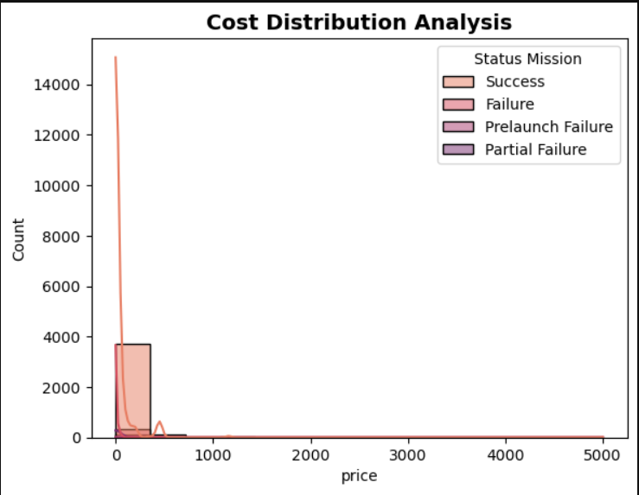
Key Insights from Price Distribution Histogram :
Skewed Distribution:
The histogram shows a highly right-skewed distribution, indicating that most listings fall into the lower price range while only a few have very high prices.
Concentration of Low Prices:
A majority of the properties are priced between 0–500, showing that the dataset is dominated by budget-friendly listings.
Presence of Outliers:
A long tail stretching up to 5000 suggests the existence of extreme high-price outliers, which can significantly influence statistical measures.
Rarity of High-Priced Listings:
Listings above 500 are very few, indicating that luxury or premium options are uncommon in this dataset.
Impact on Analysis:
Because of the skewness and outliers, metrics like the mean may not accurately represent typical prices, and transformations or outlier handling may be necessary before modeling.

Slide 3
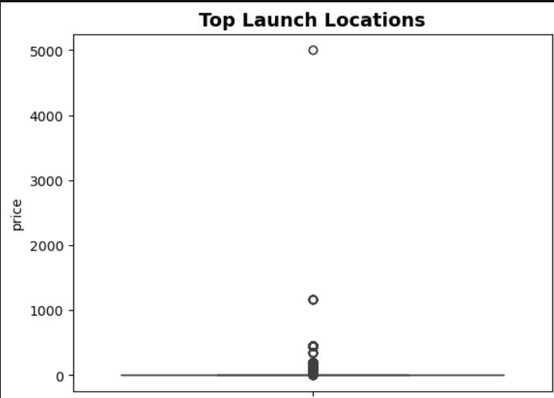
Key Insights from Top Launch Locations (Boxplot):
Majority of Prices Are Low:
Most listings fall within a very low price range, as shown by the tightly packed box at the bottom of the plot.
Presence of Extreme Outliers:
Several points extend far above the main cluster, including outliers around 500, 1200, and even 5000, indicating rare high-priced listings.
High Price Variation:
The large spread between the box and the distant outliers highlights significant price variability across locations.
Skewed Price Distribution:
The extended upper tail suggests a strong right skew, dominated by a few premium or exceptional listings.
Location Influence:
Since multiple outliers appear across top launch locations, it suggests that certain areas host premium-priced offerings compared to the rest.

Slide 4
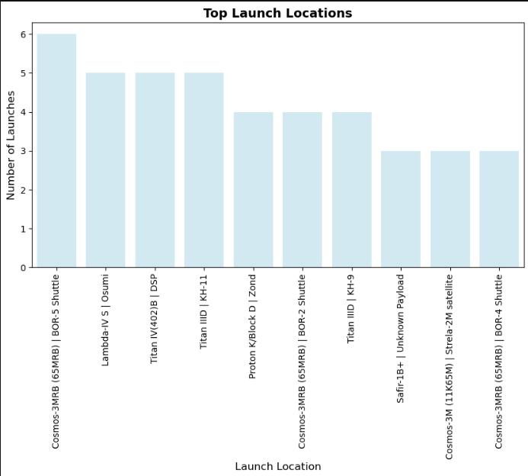
Key Insights from Top Launch Locations :
High Launch Concentration in Kazakhstan & Russia:
Most launches occur from Baikonur Cosmodrome (Kazakhstan) and multiple sites in Plesetsk Cosmodrome (Russia), indicating they are the dominant global launch hubs.
Baikonur Site 31/6 Leads the Chart:
Site 31/6 in Baikonur shows the highest number of launches, highlighting its major operational role.
Plesetsk Cosmodrome Shows Strong Activity:
Several Plesetsk sites (132/1, 43/4, 41/1, 132/2, 133/3, 43/3) appear consistently among the top locations, reflecting Russia’s dense launch infrastructure.
Global Diversity is Limited:
Only two non-Russian/Kazakh sites—Kennedy Space Center (USA) and ELA-2 (France)—appear in the top 10, showing limited global distribution among top launch locations.
Launch Frequency Varies Significantly:
While the top sites have over 200 launches, the lower-ranked ones show numbers around 120–140, indicating notable variation in site usage.

Slide 5
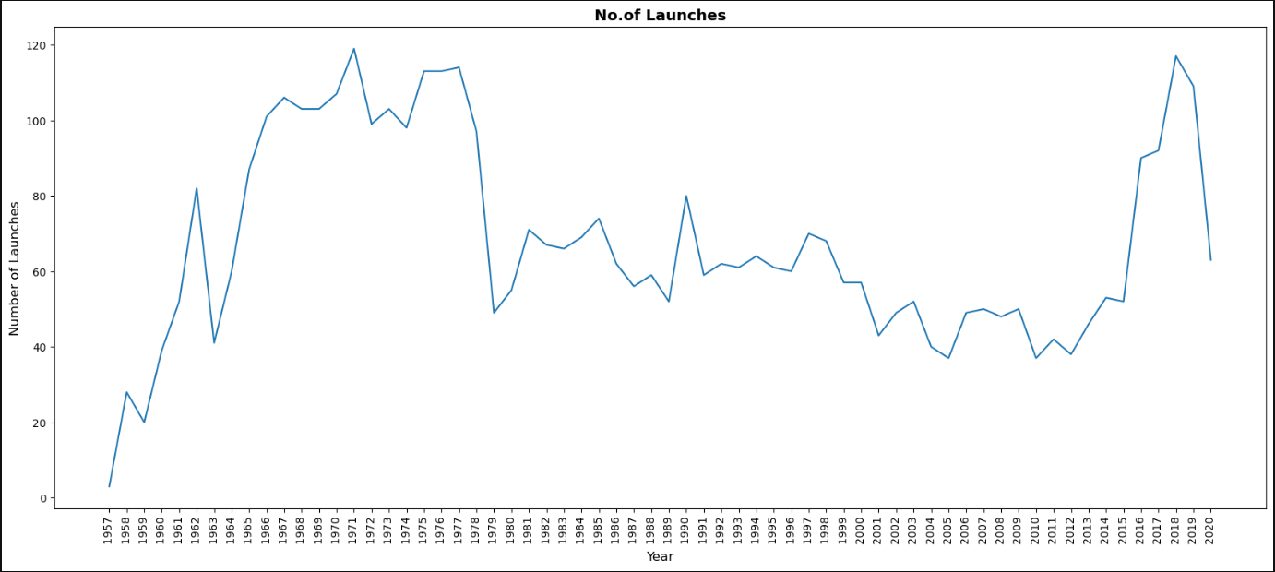

Slide 6
Key Insights from Launch Trends Over the Years :
Strong Early Growth Phase (1957–1965):
Launch activity increases sharply during the early space race as major nations push rapid advancements.
Peak Launch Era (1967–1976):
This period records the highest and most stable launch frequencies, consistently reaching 100–120 launches per year.
Sudden Decline After 1978:
A noticeable drop occurs post-1978, indicating reduced launch intensity due to geopolitical and programmatic changes.
Moderate and Stable Activity (1980–2010):
Launch numbers remain relatively steady between 40–80 annually, showing a balanced but less intense phase of global space operations.
Modern Revival in Launch Activity (2015–2020):
A sharp rise in launches appears after 2015, driven by commercial space growth, reusable rockets, and increased satellite deployment.
Final Drop in 2020:
A dip in the last year may be due to incomplete data or global events such as the pandemic affecting launch schedules.

Slide 7
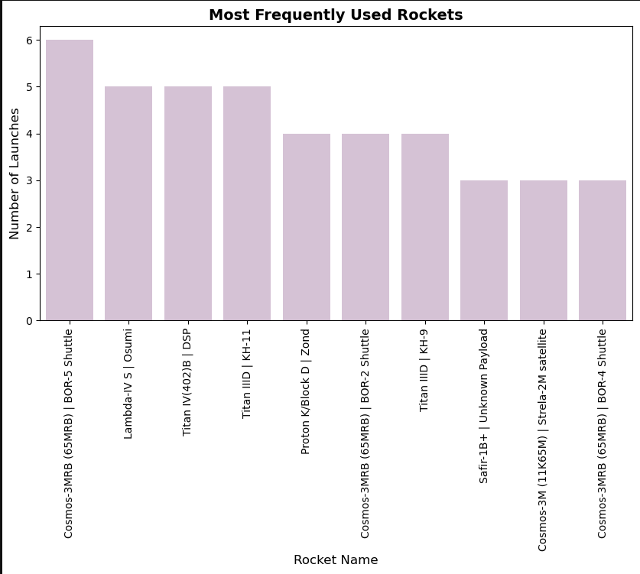
Key Insights from Most Frequently Used Rockets :
Cosmos-3MRB (65M-RB) | BOR-5 Shuttle Leads Usage:
This rocket combination has the highest number of launches, indicating strong reliability and repeated operational deployment.
Lambda-V, Titan Variants, and DSP Rockets Show Consistent Use:
Rockets like Lambda-V, Titan IV(402)B, and Titan IIID appear frequently, showing their importance in various mission types.
Moderate Usage for Proton-K and Titan III (KH-9):
These rockets fall in the mid-range with 4 launches each, suggesting balanced but not dominant use.
Limited Use of Several Other Rockets:
Models such as Safir-1B, Strela-2M, and Cosmos-3MRB (BOR-4 Shuttle) appear fewer times, indicating niche or mission-specific deployment.
Overall Trend Shows Mixed Rocket Diversity:
The chart reflects a wide variety of rockets being used, suggesting no single rocket fully dominates the entire mission landscape.

Slide 8
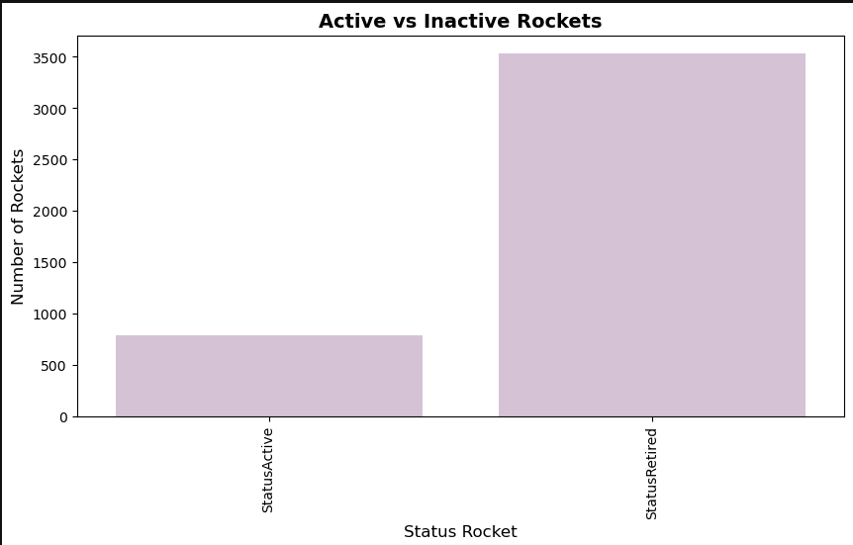
Key Insights from Active vs Inactive Rockets :
Retired Rockets Dominate the Dataset:
The majority of rockets in the dataset are retired, indicating that most launch vehicles are no longer in active service.
Very Few Rockets Remain Active:
Only a small portion of rockets are still operational, showing limited active fleet availability.
Historical Rockets Make Up Most of the Records:
The large retired count suggests the dataset spans many decades of spaceflight history.
Imbalance Highlights Technological Evolution:
Frequent retirement of older models reflects advancements in rocket design, efficiency, and mission reliability.
Modern Launch Capabilities Rely on Fewer Active Rockets:
The significantly lower number of active rockets indicates reliance on a small, modern set of launch vehicles.

Slide 9
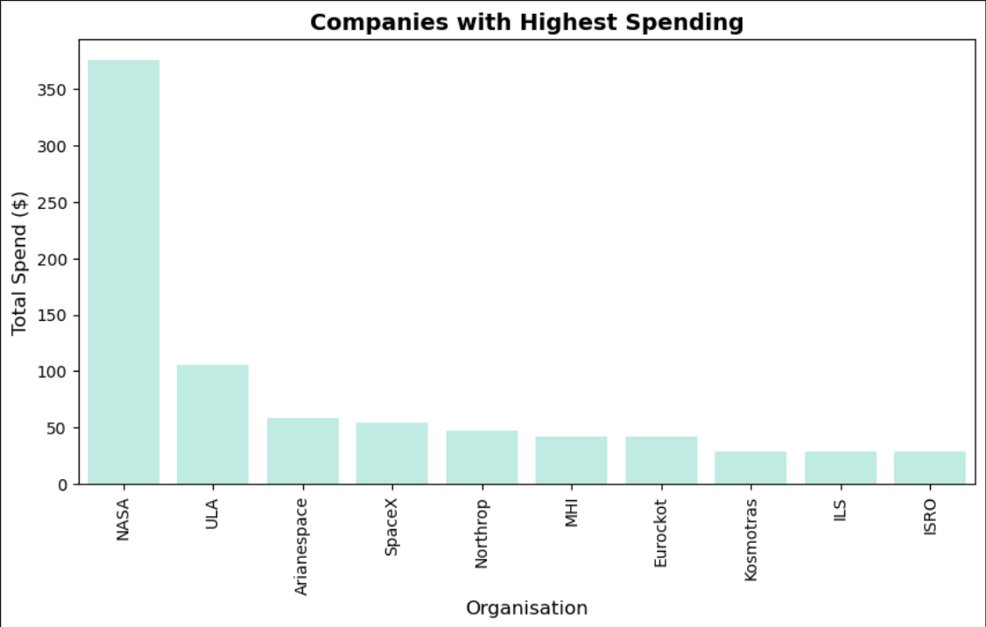
Key Insights from Companies with Highest Spending :
NASA Dominates Total Spending:
NASA’s expenditure is far ahead of all other organizations, showing its large-scale investment in space missions and technology.
ULA Holds a Strong Second Position:
United Launch Alliance shows significantly high spending, reflecting its major role in government and commercial launches.
Arianespace and SpaceX Show Moderate Spending:
Both organizations fall in the mid-tier, indicating a balanced but consistent investment pattern.
Several Companies Maintain Lower but Steady Expenditures:
Northrop, MHI, Eurockot, and Kosmotras show smaller yet stable spending levels, likely tied to focused mission portfolios.
ISRO Shows Efficient Low-Cost Operations:
Despite being at the lower end of spending, ISRO’s global reputation indicates high efficiency and cost-effective mission execution.
Overall Spending Distribution is Highly Skewed:
The gap between NASA and other organizations highlights differing scales of operation, budgets, and mission complexities.

Slide 10
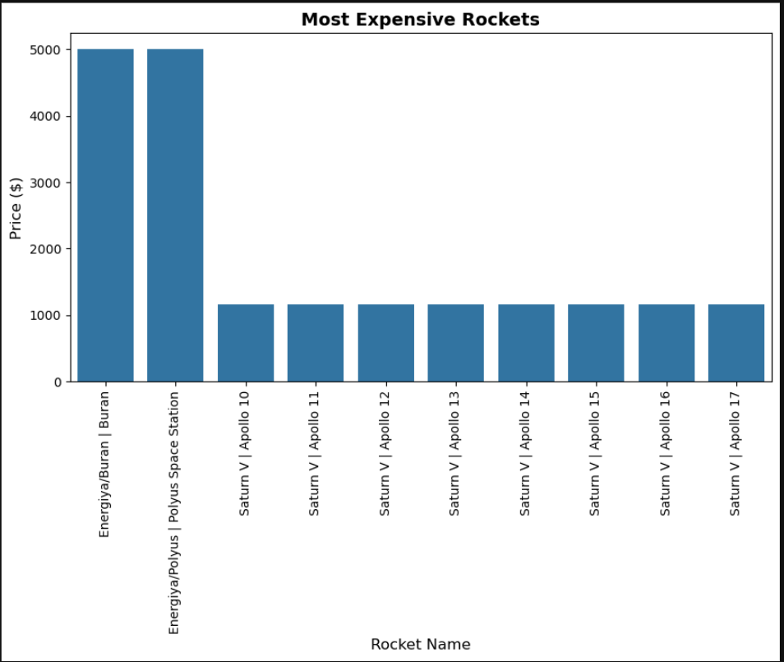
Key Insights from Most Expensive Rockets :
Energiya/Buran Leads as the Costliest Rocket System:
The Energiya/Buran program holds the highest expenditure, reflecting its massive scale and advanced engineering requirements.
Polyus Space Station Launch Vehicle Matches Buran in Cost:
Energiya/Polyus also reaches the top cost tier, showing the immense budget involved in Soviet-era heavy-lift developments.
Saturn V Missions Show Consistent High Costs:
All Saturn V rockets across Apollo missions (10 to 17) display very similar price levels, indicating standardized production and mission design.
Saturn V Costs Are High but Far Below Energiya:
While expensive, Saturn V rockets cost less than half of the Energiya launch systems, highlighting major differences in program budgets.
Cost Distribution is Highly Concentrated:
Only two rocket programs dominate the highest cost bracket, showing that extreme expenses occur in only a few flagship missions.
Apollo Mission Rockets Have Uniform Budget Patterns:
The consistent pricing across Apollo 10–17 suggests optimised manufacturing processes and similar mission payload requirements.

Slide 11
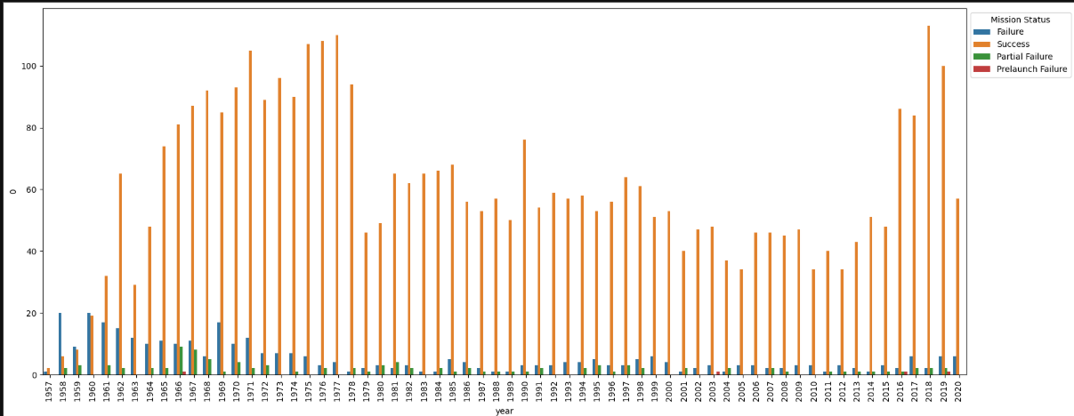

Slide 12
Key Insights from Yearly Mission Status Trends :
Success Missions Dominated Every Year:
The orange bars remain consistently higher than all other categories, proving strong reliability across decades.
Peak Success Era in the 1960s–1970s:
Success missions reached their highest levels during the space-race years, showing rapid technological advancement.
Decline in Total Launch Activity After the Late 1970s:
All mission categories drop sharply after 1978, marking a period of reduced global launch operations.
Failures and Partial Failures Decrease Over Time:
Both failure categories show a gradual decline, reflecting improved rocket design and mission planning.
Modern Growth in Successful Missions After 2015:
There is a fresh spike in successes post-2015, largely influenced by private companies and reusable rockets.
Pre-Launch Failures Stay Minimal:
The red bars are consistently the lowest, indicating rare cases of issues occurring before launch.
Mission Trends Become More Stable After 1990:
All mission outcomes show smoother, more predictable patterns, indicating matured spaceflight programs.
Explanation of Legends in the Graph :
Clear Categorization of Mission Outcomes:
The legend groups all mission results—Success, Failure, Partial Failure, and Pre-launch Failure—into distinct colors, making it easy to interpret the bars.
Color-Coding Enhances Comparison:
Each mission status is assigned a unique color, helping the viewer visually separate different outcomes even in crowded yearly bars.
Improves Readability of Multi-Category Data:
Since all four categories appear for each year, the legend ensures viewers can quickly identify which bar corresponds to which mission status.
Essential for Understanding Long-Term Trends:
Without the legend, it would be difficult to understand which category is rising, falling, or stabilizing across decades.
Supports Accurate Data Interpretation:
The legend prevents confusion by clearly mapping colors to outcomes, ensuring that the analysis remains accurate and user-friendly.

