Slide 1

Building CassieQ
http://paradoxical.io/slides/cassieq

Slide 2
What do we do?
Simple libraries
Simple containers
Easy to use, easy to deploy
Open source, because we love it

Slide 3
CassieQ
A distributed queue built on cassandra
paradoxical.io
https://github.com/paradoxical-io/cassieq

Slide 4
Why use queues?
Distribution of work
Decoupling producers/consumers
Reliability

Slide 5
Existing queues
ActiveMQ
RabbitMQ
MSMQ
Kafka
SQS
Azure Queue
others
Notes:
The common component of these queues is disk based storage. While they can be clustered or federated, and have master failovers, all these systems have some form of dedicated master and are disk bound for max queue size.

Slide 6
Advantage of a queue on c*
Highly available
Highly distributed
Massive intake
Masterless
Re-use existing data store/operational knowledge

Slide 7
But aren’t queues antipatterns?
Notes:
Aren’t queues an antipattern with cassandra? Technically they are

Slide 8
Issues with queues in c*
Modeling off deletes
Tombstones
Evenly distributing messages?
What is the partition key?
How to synchronize consumers?
Notes:
Some of those issues are due to tombstoning of messages, which is caused by modeling a queue off of deletes. Another issue how to evenly distribute your messages across partitions? In a queue, what would be the partition key? How do you prevent one node from handling all the load? And finally, how do you synchornize a queues consumers? If you have 10 consumers, you want to attempt to distribute work across those consumers, but if they all are pulling messages off a single partition and then deleting the message, they may all get the message.

Slide 9
Existing c* queues
Netflix Astyanax recipe
Cycled time based partitioning
Row based reader lock
Messages put into time shard ordered by insert time
Relies on deletes
Requires low gc_grace_seconds for fast compaction

Slide 10
Existing c* queues
Comcast CMB
Uses Redis as actual queue (cheating)
Queues are hashed to affine to same redis server
Cassandra is cold storage backing store
Random partitioning between 0 and 100

Slide 11
Missing features
Authentication
Authorization
Statistics
Simple deployment
Requirement on external infrastructure

Slide 12
CassieQ
HTTP(s) based API
No locking
Fixed size bucket partitioning
Leverages pointers (kafkaesque)
Message invisibility
Azure Queue/SQS inspired
Docker deployment
Authentication/authorization
Ideally once delivery
Best attempt at FIFO (not guaranteed)

Slide 13
Try it!
docker run –it -p 8080:8080 –p 8081:8081 \
paradoxical/cassieq dev

Slide 14
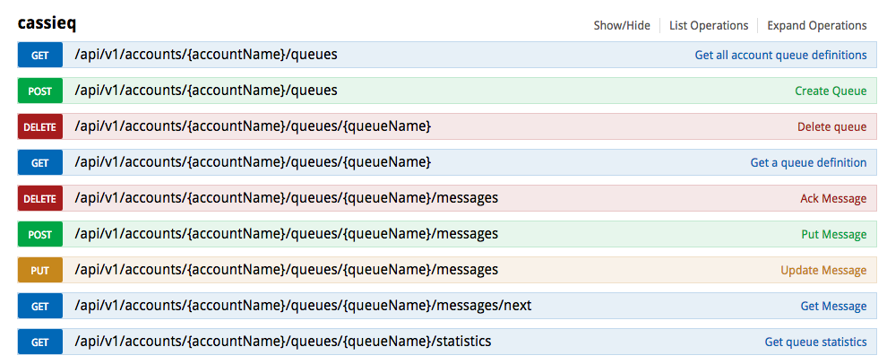
CassieQ API

Slide 15
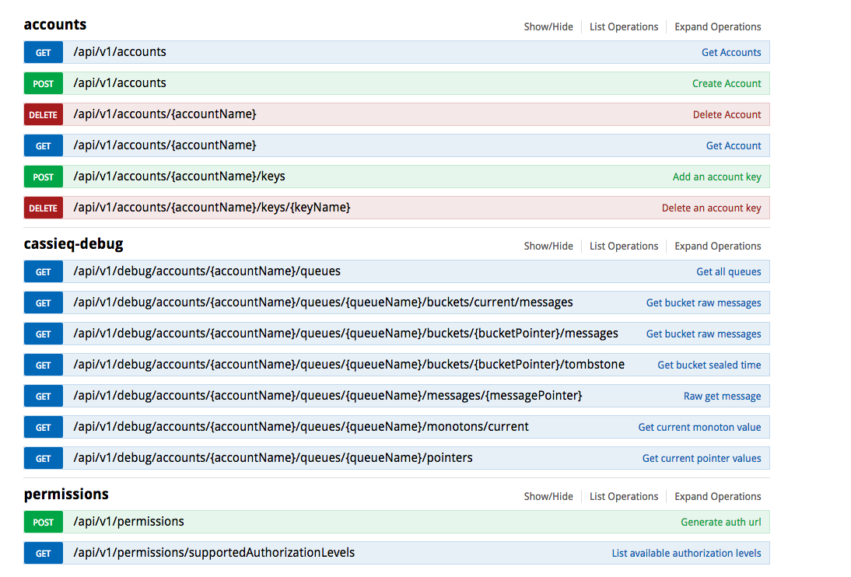

Slide 16
CassieQ workflow
Client is authorized on an account
Granular client authorization up to queue level
Client consumes message from queue with message lease (invisibility)
Gets pop receipt
Client acks message with pop receipt
If pop receipt not valid, lease expired
Client can update messages
Update message contents
Renew lease

Slide 17
SHOW ME THE CODE

Slide 18
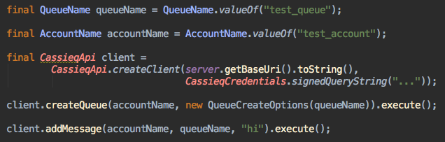

Slide 19
Lets dig inside
CassieQ internals

Slide 20
Schema
CREATE TABLE queue (
account_name text,
queuename text,
bucket_size int,
version int,
...
PRIMARY KEY (account_name, queuename)
);
CREATE TABLE message (
queueid text,
bucket_num bigint,
monoton bigint,
message text,
version int,
acked boolean,
next_visible_on timestamp,
delivery_count int,
tag text,
created_date timestamp,
updated_date timestamp,
PRIMARY KEY ((queueid, bucket_num), monoton)
);

Slide 21
CassieQ internals
Kafka part
Messages internally versioned
All atomic actions increment version
Append only
Zookeeper part:
ReaderPointer
Reads by bucket
“Strict” fifo, or random bucket read
Advances after able to consume message
InvisibilityPointer
Points to messages that are consumed but not acked (invisible)
RepairPointer
Watches buckets and repairs delayed writes

Slide 22
CassieQ buckets
Messages stored in fixed sized buckets
Deterministic when full
Easy to reason about
Messages given monotonic ID
CAS “id” table
Bucket # = monotonicId / bucketSize

Slide 23
Pointers to buckets
All 3 pointers point to monotonic id value
1 2 3 4 5
InvisPointer
ReaderPointer
RepairPointer

Slide 24
Buckets… complications
Once a monoton is generated, it is taken
If a message fails to insert the monoton is taken
Buckets are now partially filled!
How to resolve?
1 2 ? 4 5

Slide 25
When to move off a bucket?
All known messages in the bucket have been delivered at least once
All new messages being written in future buckets
Bucket 1
Bucket 2
1 2 ? 4 5 6
Message 3 missing
Reader

Slide 26
When to move off a bucket?
Tombstoning (not cassandra tombstoning, naming is hard!)
Bucket is sealed, no more writes
Reader tombstones bucket after its reached
Bucket 1
Bucket 2
1 2 ? 4 5 6 7 …
Tombstone
Message 3 missing
Reader @ bucket 2

Slide 27
When to move off a bucket?
Tombstoning enables us to detect delayed writes
Bucket 1
Bucket 2
1 2 ? 4 5 6 7 …
Tombstone
Message 3 missing
Reader @ bucket 2

Slide 28
Repairing Delayed Writes
Scenarios:
Message taking its time writing (still alive, but slow)
Message claimed monoton but is dead
Resolution:
Watch for tombstone in bucket
Wait for repair timeout (30 seconds)
If message shows up, republish
If not, finalize bucket and move to next bucket (message is dead)

Slide 29
Repairing Delayed Writes
Bucket 1
Bucket 2
1 2 ? 4 5 6 7 …
Tombstone
Message 3 missing
Reader @ bucket 2
Repair Pointer
@ bucket 1

Slide 30
wait 30 seconds…

Slide 31
Repairing Delayed Writes
Bucket 1
Bucket 2
Republished to end
1 2 3 4 5 6 7 …
Message 3
Showed up!
Tombstone
Reader @ bucket 2 +
Repair Pointer
@ bucket 1

Slide 32
Repairing Delayed Writes
Bucket 1
Bucket 2
Republished to end
1 2 3 4 5 6 7 …
Message 3
Showed up!
Tombstone
Reader @ bucket 2 +
Repair Pointer
@ bucket 2

Slide 33
Invisibility
and the unhappy path :(

Slide 34
What is invisibility?

Slide 35
A mechanism for message re-delivery
(in a stateless system)

Slide 36
The happy path
Client consumes message
Message is marked as “invisible” with a “re-visibility” timestamp
Client gets pop receipt encapsulating metadata (including version)
Client acks within timeframe
Message marked as consumed if version is the same

Slide 37
The unhappy path :(
Client doesn’t ack within timeframe
Message needs to be redelivered
Subsequent reads checks the invis pointer for visibility
If max delivers exceeded, push to optional DLQ
Else redeliver!

Slide 38
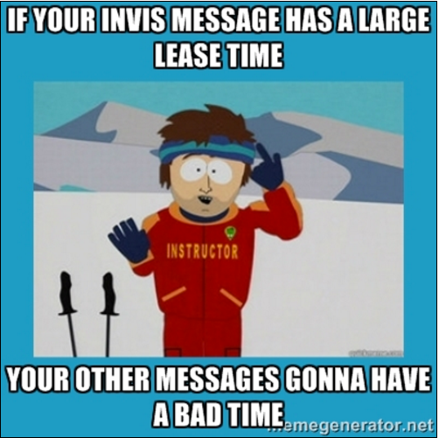
Long term invisibility is bad
InvisPointer WILL NOT move past a unacked message
Invisible messages can block other invisible messages
Possible to starve future messages

Slide 39
wait 30 weeks…

Slide 40
Long term invisibility is bad
InvisPointer WILL NOT move past a unacked message
Invisible messages can block other invisible messages
Possible to starve future messages

Slide 41
Questions?
or feedback/thoughts/visceral reactions
Contribute to the antipattern @ paradoxical.io
https://github.com/paradoxical-io/cassieq

