Slide 1
INTERNATIONAL INSTITUTE OF INFORMATION TECHNOLOGY, BANGALORE
MATHIQ
Presented By:
Aditi Singh (MT2023085) & Parag Dutt Sharma (MT2023095)

Slide 2
Project Description
MATHIQ is a system that translates natural language math problems into equations for accurate solutions using NLP techniques. It understands diverse mathematical scenarios, converting user-provided word problems into mathematical expressions for educational, practical, and analytical purposes. Enhancing problem-solving capabilities, MathIQ makes complex tasks easier through natural language processing.

Slide 3
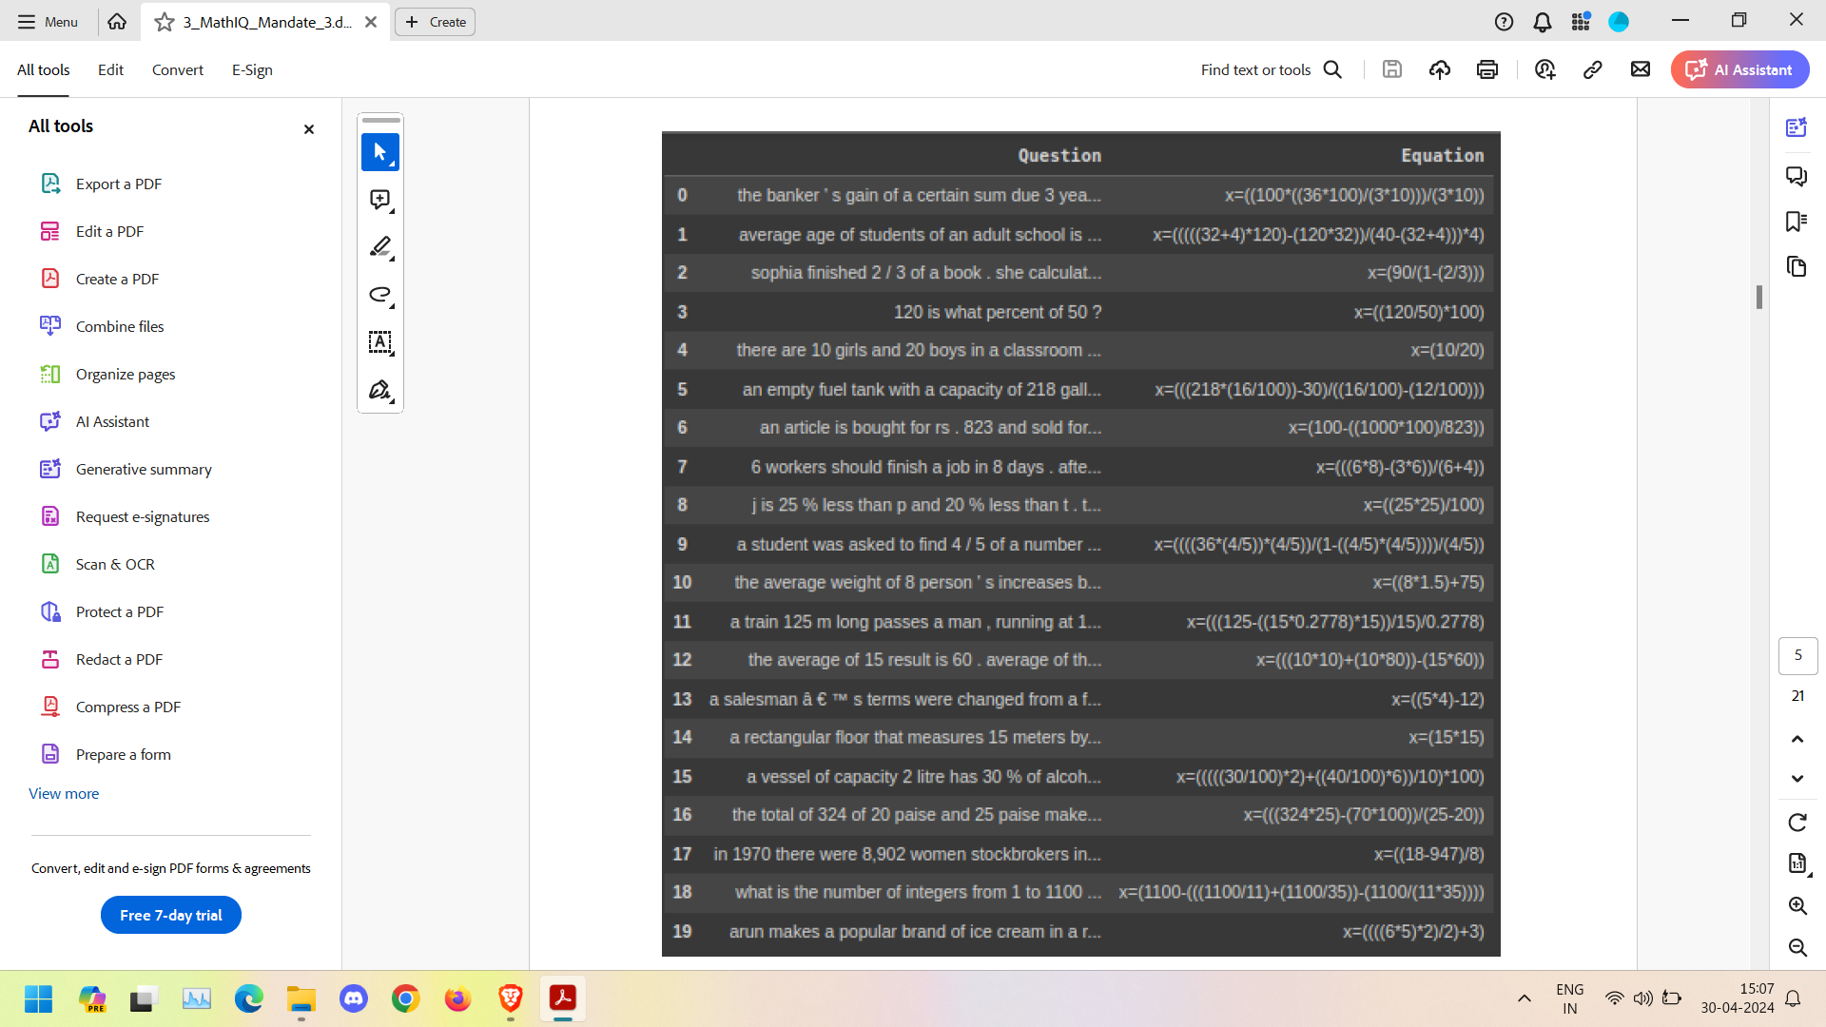
Dataset

Slide 4
Data Preprocessing
Following are the various methods we used for data preprocessing:
1.Lowercase Alphabets: To ensure uniformity by converting all characters to lowercase. This prevents inconsistencies in word treatment based on case, improving model generalization.
2.Padding Spaces and Removing Extra White Spaces: This ensures consistent spacing between words for effective tokenization, and enhances data cleanliness by removing unnecessary whitespaces.

Slide 5
3.Tokenization: It breaks down text into smaller units (words or subwords) for analysis. It also provides discrete elements for subsequent processing, facilitating feature extraction.
4.Converting to Tensor Sequences: This is essential for numerical representation in NLP models. It enables efficient processing by machine learning algorithms.
5.Zero Padding for Equalizing Sequence Lengths: Addresses challenges posed by sequences of varying lengths in model training, and ensures consistent input dimensions for neural networks by adding

Slide 6
6.Add integers for < start > and < end > tokens: Markers to indicate the beginning and end of sequences, aiding in sequence generation tasks. This ensures proper alignment and interpretation of input-output sequences during model training and inference.
7.Increasing Vocabulary Size of the Target: This will include additional words to avoid problems due to a short vocabulary size.
8.Train-Test Split (95 : 5): Splits the dataset into training and testing sets with a ratio of 95:5, respectively, for model evaluation.

Slide 7
Hyperparameters
• Number of Encoder-Decoder layers, 𝑁=4
• Embedding dimension of input/output, 𝑑𝑚𝑜𝑑𝑒𝑙=128
• Number of Self-Attention heads, ℎ=8
• Dropout Rate, 𝑃𝑑𝑟𝑜𝑝=0.1
• Size of each mini-batch = 64
• Epochs = 17

Slide 8
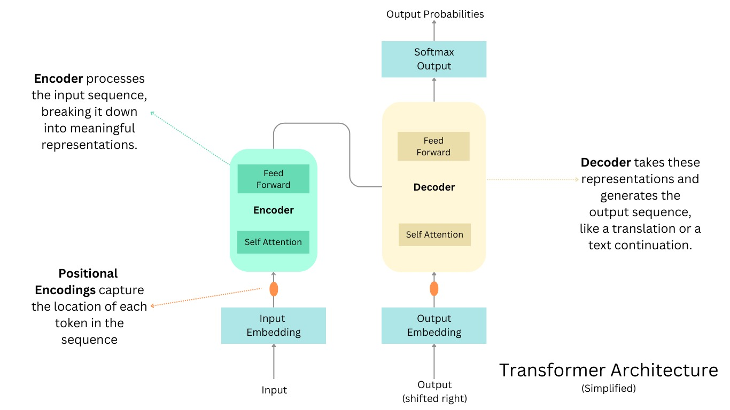
Transformer Model behind MATHIQ

Slide 9
Positional Encoding
Unlike Recurrent Neural Networks (RNNs) that process sequences step-by-step, the Transformer model treats each word in a sequence independently.
This is efficient but lacks the inherent ability to understand the order of words, which is crucial for tasks like translating sentences or, in this case, math word problems.

Slide 10
Masking (Padding Mask & Look Ahead Mask)
Padding Mask: The padding mask addresses the issue of variable sequence lengths in the data.
In real-world scenarios, math-worded problems can have different lengths.
To train the model efficiently, sequences are often padded with special tokens (e.g., zeros) to ensure a fixed length.
During training, the padding mask is applied to the attention weights calculated by the scaled dot-product attention mechanism. This prevents the model from paying attention to these padding tokens and focuses on the actual content of the problem.
Look-Ahead Mask (Decoder Only): The look-ahead mask is specific to the decoder part of the Transformer model.
In math word problems, the solution (expression) depends on the problem itself, not on future words in the solution being generated.
This structure prevents the decoder from attending to future words in the expression during generation.

Slide 11
Scaled Dot-Product Attention
Input Preparation: The Transformer blocks receive queries (encoder) or queries and keys (decoder) as input. These are vectors representing individual words or concepts.
Dot Product: The scaled dot-product attention calculates the compatibility score between each query and every key using a dot product operation. This score indicates how relevant a particular key (word in the problem or encoder output) is to the current query (word being processed in the decoder or encoder).
Scaling: The raw dot product values are scaled down by the square root of the key vector dimension. This helps prevent exploding gradients during training and improves the stability of the model.
For example, when translating the phrase "five apples plus three oranges," the attention might assign higher weights to "five" and "apples" for the query word "plus," reflecting their importance in calculating the sum.

Slide 12
Multi-Head Self Attention
Analyzes relationships between all tokens within the current sequence (encoder) or between the decoder's input and the encoder's output. This allows the model to understand how different parts of the problem and expression relate to each other.

Slide 13
Point-wise Feed Forward Neural Network
Introduces non-linearity and allows the model to learn more complex patterns beyond just attention.
The FFN is typically a simple multi-layer perceptron (MLP) with one or two hidden layers.
the FFN within the Transformer block can help the model learn intricate relationships between words beyond just their positional context.
For example, the FFN might learn that "plus" and "minus" have opposite meanings, even though they might be close together in the sentence.
This capability complements the Multi Head Self Attention mechanism, allowing the model to capture both long-range dependencies (through attention) and non-linear interactions between words (through FFNs).

Slide 14
Encoder
This is the first part of the Transformer model. It takes the input sequence (the math worded problem) as a series of tokens.
It stacks multiple TransformerEncoderLayer objects, where each layer performs:
Multi-head self-attention: Analyzes relationships between all words within the problem sentence to understand the context of each word.
Feed forward neural network (FFN): Introduces non-linearity to capture more complex relationships beyond just attention.

Slide 15
Decoder
This part of the model follows the encoder.
It takes two inputs:
The encoded representation of the problem from the encoder.
The target sequence (the mathematical expression) one token at a time (during training) or starts with a special start token (during prediction).

Slide 16
Decoder (Continued)
It stacks multiple TransformerDecoderLayer objects, where each layer performs:
Masked multi-head attention: Similar to self-attention but prevents the decoder from attending to future words in the generated expression (important for correct order).
Multi-head attention to the encoder output: Allows the decoder to attend to relevant parts of the encoded problem representation for generating each token in the expression.
FFN: Similar to the encoder's FFN.

Slide 17
Custom Schedule
It controls how the learning rate changes throughout the training process.
A fixed learning rate can be inefficient, and a custom schedule allows for adjustments based on specific needs.
A custom schedule can improve training speed and stability by adapting the learning rate based on the model's progress.

Slide 18
Optimizer
Optimizer: This is an algorithm that updates the weights of the Transformer model based on the calculated loss (error) during training.
Learning Rate: This hyperparameter controls the step size taken by the optimizer when updating the weights. A custom schedule defines how this learning rate changes.
Loss Object: This function calculates the difference between the model's predictions and the actual target expressions (mathematical expressions).

Slide 19
Performance Metric
Loss Function: This function, used during training, measures the discrepancy between the model's predicted expressions and the actual expressions.
Accuracy Function (Optional): While not essential for this specific task, the code might include an accuracy function to evaluate the model's performance on a separate validation set. Accuracy can be measured in terms of correctly generated expressions or character-level accuracy.

Slide 20
Train (Train Step)
Forward Pass: The model processes the batch through the encoder and decoder, generating a predicted expression.
Loss Calculation: The loss between the predicted and actual expression is calculated using the chosen loss function.
Backward Pass: The loss is backpropagated through the model.
Optimization: The optimizer (e.g., Adam) uses the gradients and the learning rate schedule to update the model's weights, aiming to minimize the loss.

Slide 21
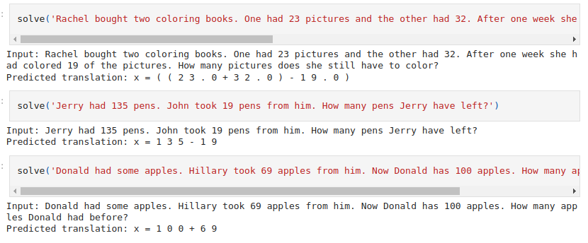
Screenshots

Slide 22
Thank You

