Slide 1

Traffic Accident Analysis & Modeling
Johnson Varghese
Parag Mehta
Ranjeet Singh Rawat

Slide 2
Project Overview
Organization: National Highway Traffic Safety Administration, USA
Problem statement: Deaths due to traffic accidents increased 7.2% in 2015 over 2014. This project aims to analyze the data from highway accidents and identify the causes of the increase and help find ways to prevent these deaths.
Data Source: Fatality Analysis Reporting System (FARS) that has data on fatal traffic accidents since 1975
Deliverables:
Insights into the data using visualization tools
Model to predict the number of fatalities and injury severity in accidents

Slide 3
Key Data files
Approach
Merge the data
Identify data errors/outliers
Draw trends / inferences / clusters
Shortlist features for model
Create and refine model
Present inferences
Publish model
Key Questions to be answered:
Time pattern of accidents
Impact of weather conditions
Impact of distractions
Impact of impairments
Impact of drink and drugs
Impact of safety equipment
Accident (52)
Vehicle (102)
Person (68)
Distractions (4)
Impairments (4)
Factors (4)
Vision (4)
:
:
Notes:
Accident: # vehicles involved, # people involved, location, date and time, nature of accident, weather conditions, time taken for emergency services, fatalities
Vehicle: one row for each vehicle involved, # occupants, type of vehicle, make & model, hazardous goods, gross weight, speed at accident, driver licence and previous penalty details
Person: one row for each person involved, age, sex, nature of injuries, usage of restraints/air bags, alcohol/drug details
Distractions: e.g. mobile, eat/drink, audio/video
Impairments: e.g. depression, handicap, fatigue
Factors: pre existing defects or maintenance issues with vehicle that could have caused crash
Vision: Obstruction to the driver’s vision e.g. trees, glare, fog, unclean windshield

Slide 4
Approach followed
40 years of data available: 1975 to 2015
Each member took up 10 years of data to analyze
In the first phase, only descriptive analysis was done
Programming Language: R
Visualization tool: Tableau
Model building was done in the second phase
Programming Language: R
Algorithm: Decision tree

Slide 5
Challenges in data collation
Only 3 data files available for all 10 years – Accident, Vehicle, Person
Many features got added or deleted over the years, needed to identify the common features e.g. in accident data file, only 42 features were common to all 10 years, from a max of 55
Interpretation of some of the feature codes had changed over years e.g. In the feature WEATHER, the code of 6 earlier stood for “Rain and Fog”. Now it stands for “Severe Crosswinds”
Interpretations of some codes is very ambiguous e.g. Most harmful event feature has a code called “Motor Vehicle in Transport”
Value of None in many cases e.g. Crash factors feature has 95% of values as ‘None’

Slide 6
Key Statistics
Total # of accidents from 2006 to 2015: 324710
# of fatalities in this period: 355262
# of vehicles involved: 484462
# of motorists involved: 770151
# of pedestrians/cyclists involved: 60022
# of motorist deaths: 299534
# of pedestrian deaths: 55728
68% of vehicles had 1 occupant, 20% had 2, 6% had 3, 3% had 4 and 1.4% had 5 occupants

Slide 7
Key Statistics
Total # of accidents from 1995 to 2005: 416359
# of fatalities in this period:465489
# of vehicles involved: 635712
# of motorists involved: 572850
# of pedestrians/cyclists involved: 73436
# of motorist deaths: 185207
# of pedestrian deaths: 43812
66% of vehicles had 1 occupant, 22% had 2, 8% had 3, 3% had 3 and 1.4% had 5 occupants

Slide 8
Key Insights
The highest number of accidents and fatalities occur in Texas, California and Florida
The most number of accidents in a week occur during the nights of Fri-Sat and Sat-Sun
The highest number of accidents occur in August and the lowest in Feb
Most accidents occur on State Highways compared to other type of roads (US Highways, Interstate etc)
Roads having most accidents: I-10, I-95, I-40
Close to half (48%) of accidents happen in daylight
Over 80% accidents happen in clear weather

Slide 9
Key Insights
To determine safety levels of various types of vehicles, we used a metric called deaths/vehicle (deaths per vehicle involved in accident):
Chevrolet, Ford, Honda, Toyota are the brands most involved in accidents (desc order of number of deaths) having a death/vehicle ratio of 0.64, 0.58, 0.76 and 0.61 respectively
Death/vehicle ratio of different body types (desc order of number of deaths): 4 door sedan – 0.69, motorcycle – 0.98, standard pickup – 0.51, compact utility – 0.59, 2 door sedan – 0.77, truck – 0.16
Statistics related to ownership of the accident vehicle
In 55% of cases, the driver was the owner of the vehicle leading to 58% of deaths
In 28% of cases, the driver was not the owner of the vehicle leading to 32% of deaths
In 10.65% of cases, the vehicle was company owned leading to 4.65% of deaths

Slide 10
Key Insights
No drunk drivers were involved in 68% of accidents
However in the case of drunk drivers, death/vehicle ratio was much higher at 0.91 as compared to 0.54 in the case of non drunk drivers
38% of those not drinking were killed vs 68% of those drinking
83% of the drivers had valid permanent licenses, 4.3% were not licensed and 5.3% had suspended licenses
Deaths/vehicle ratio was 0.6, 0.83 and 0.81 respectively
83.5% of the drivers are non commercial license holders
Deaths/ vehicle ratio was 0.67 for non commercial vs 0.36 for commercial drivers
Deployment of airbags shows inverse correlation with injury severity
Fatal injuries are higher when airbags are deployed and No Injury is higher when they are not deployed

Slide 11
Key Insights
60% of those involved in accidents were drivers, 32% were passengers, 6% pedestrians and less than 1% bicyclists
Statistics related to seating position in the vehicle:
47% of drivers involved in accidents were killed
32% of front right seat occupants involved in accidents were killed
27% of 2nd row left seat occupants were killed
23% of 2nd row right seat occupants were killed
66% of persons involved in accidents are male
Most of the accidents involve people in the 20-30 age group
69% of those killed in accidents were White, 11% were Black

Slide 12
Key Insights
Usage of lap and shoulder belts shows a direct correlation with injury severity
When these are used, No Injury is higher and when they are not used, Fatal Injury is higher
When victims were not transported to hospital, both No Injury and Fatal Injury are very high, implying either that there was no need to take them to hospital or they were already dead
60% of victims could be saved when evacuated by air compared to 59% by ground, implying almost no difference

Slide 13
Model: # of FATALITIES
Aim: to predict the number of deaths in a vehicle that meets with an accident
Data file: VEHICLE
Algorithm: Decision Tree
Response variable: DEATHS
Predictor variables: BODY_TYP, DR_DRINK , DR_ZIP, GVWR, CARGO_BT , L_STATE, OWNER, TRAV_SP, L_STATUS
Accuracy: 69%

Slide 14
Model: INJURY SEVERITY
Aim: to predict the injury severity of a person who meets with an accident
Data file: PERSON
Algorithm: Decision Tree
Response variable: INJ_SEV
Predictor variables: ALC_RES, REST_USE, BODY_TYP, AIR_BAG, SEAT_POS, PER_TYP, AGE, MAKE, STATE, LOCATION, DRUGS, SEX
Accuracy: 62%

Slide 15
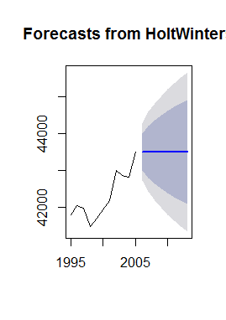
Forecast: # Annual accidents of next 8 years
Aim: Simple time series forecasting of annual accidents for next 8 years (2006-2013)
Data file: Accident
Method: Time Series
The forecasted fatalities for 2006 is about 43499 fatalities, with a 95% prediction interval of (42739, 44260.62).

Slide 16
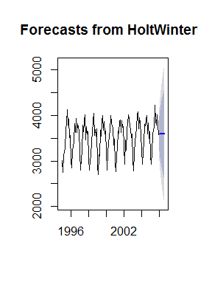
Forecast: # Monthly accidents of next 8 Months
Aim: Simple time series forecasting of annual accidents for next 8 months
Factor: Seasonality
Data file: Accident
Method: Time Series
forecasted fatalities for Jan 2006 is about 3595 fatalities, with a 95% prediction interval of (3011.235, 4176.960).

Slide 17
APPENDIX

Slide 18
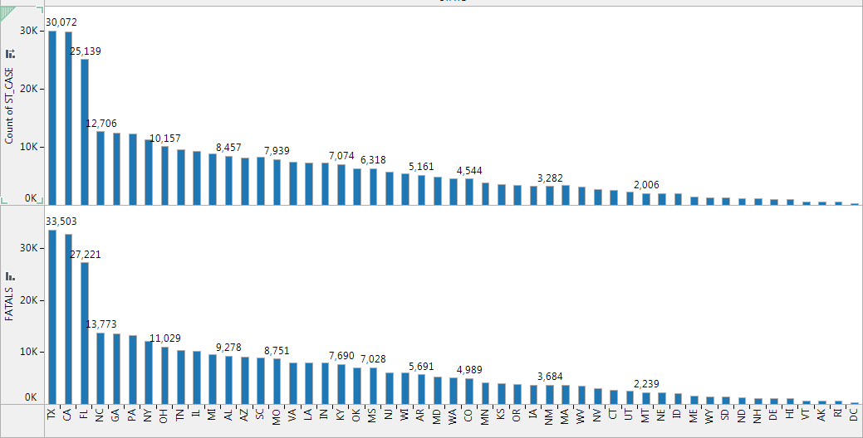

Slide 19
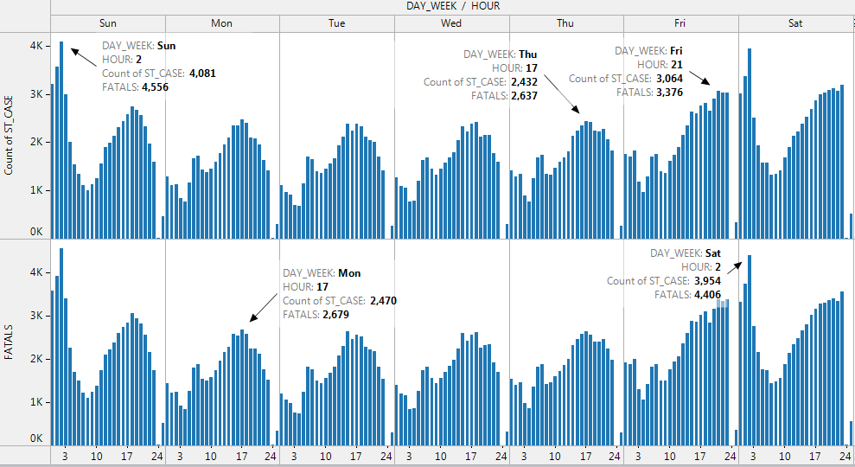

Slide 20
Danger Days

Slide 21
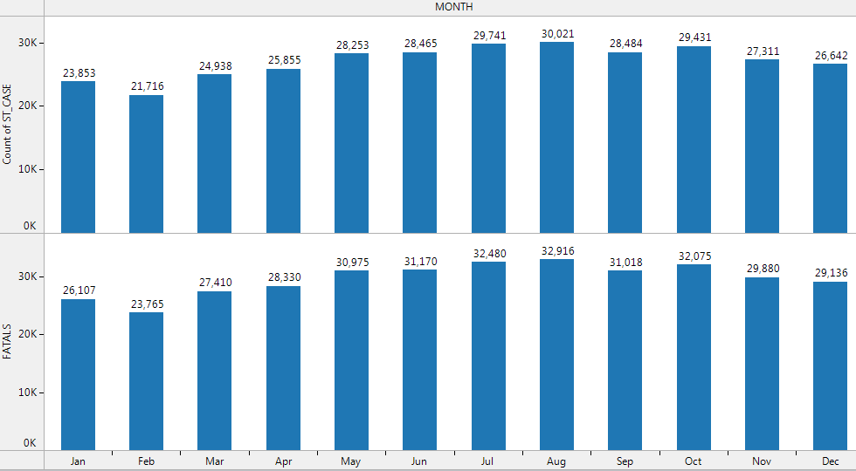

Slide 22
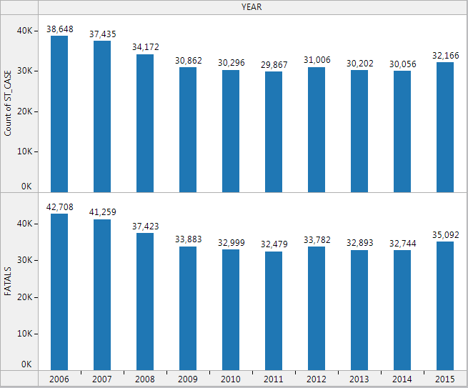

Slide 23
Accident Trends – 10 years

Slide 24
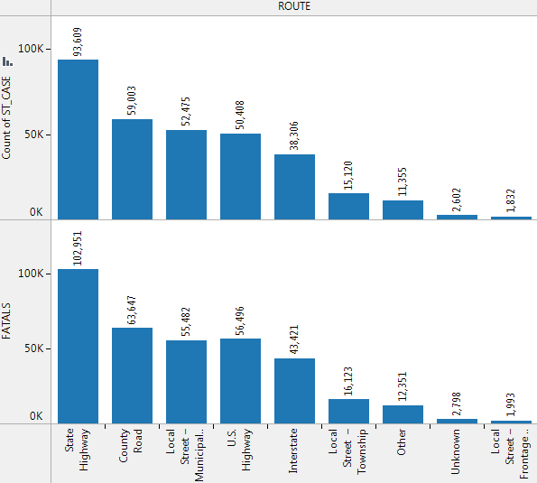

Slide 25
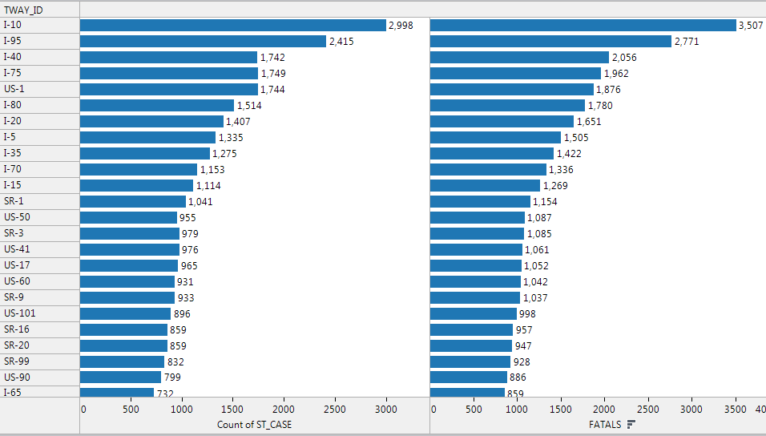

Slide 26
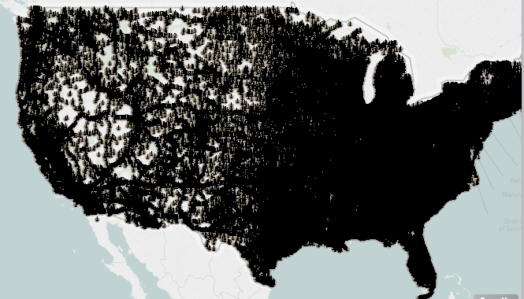

Slide 27
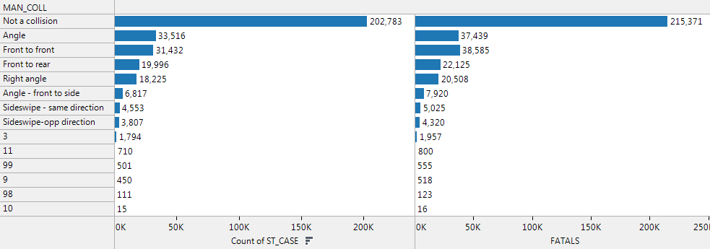

Slide 28
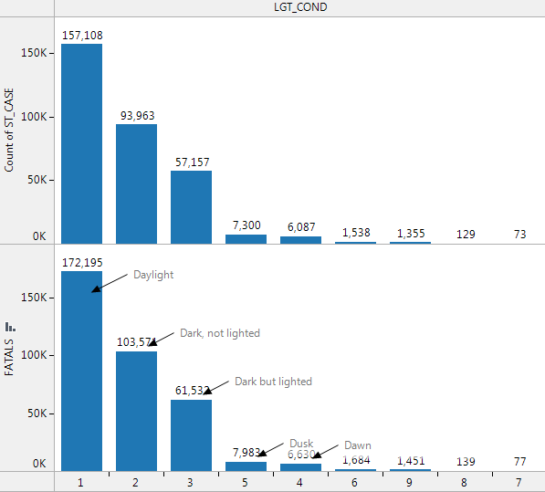

Slide 29
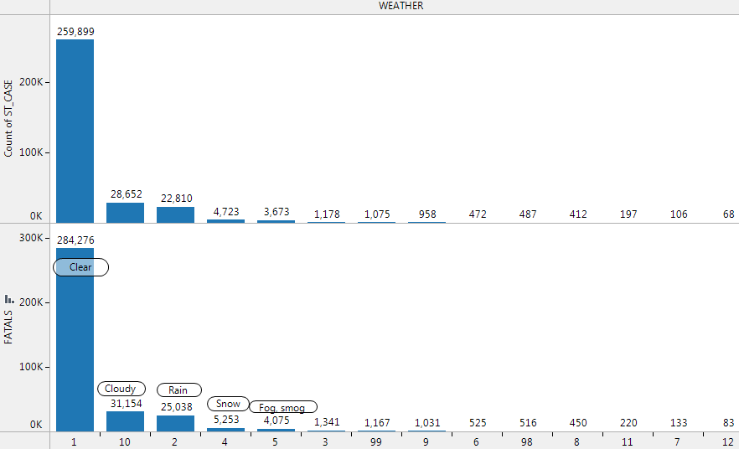

Slide 30
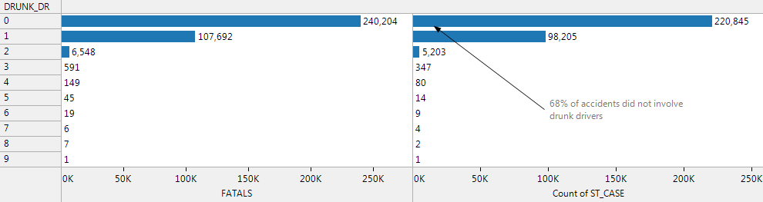
No drunk drivers were involved in 68% of accidents

Slide 31
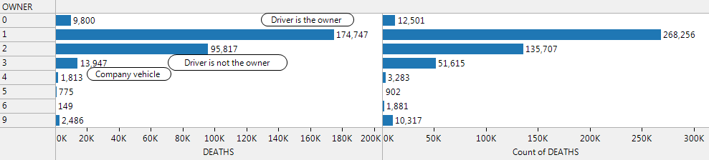

Slide 32
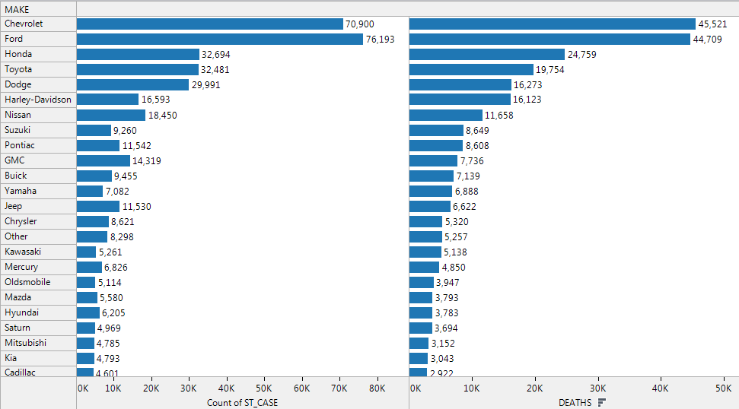

Slide 33
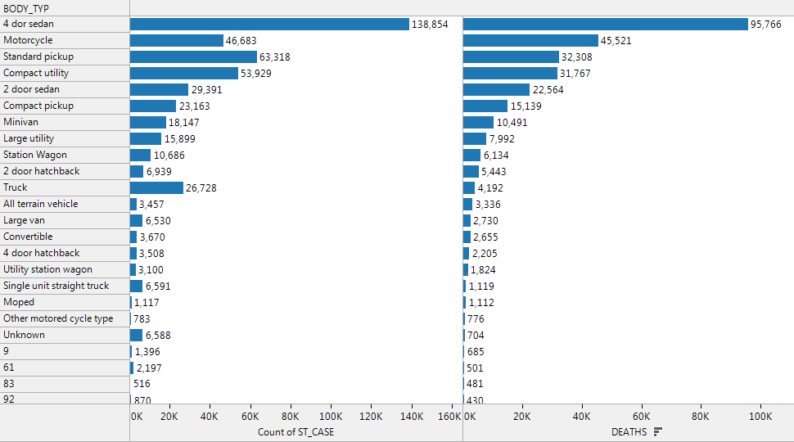

Slide 34
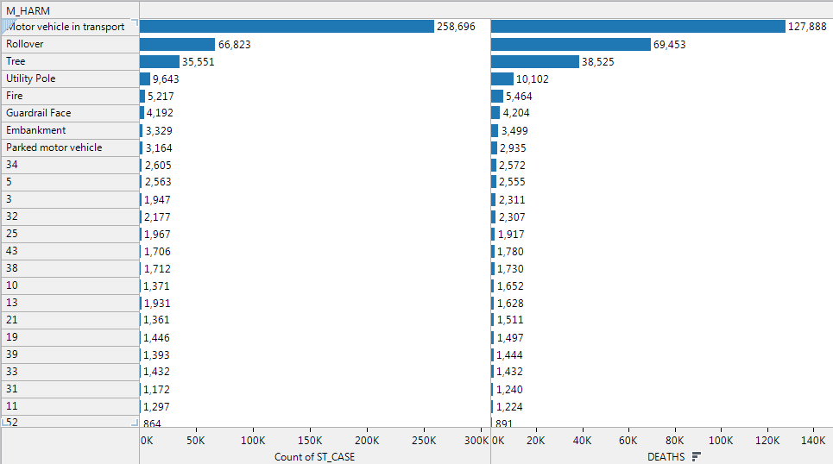

Slide 35
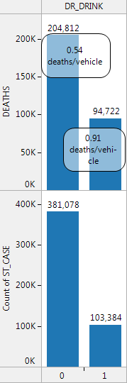
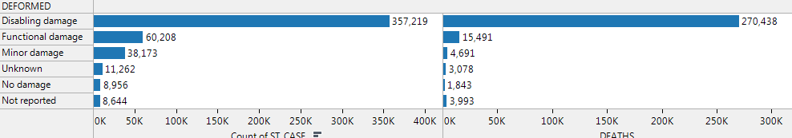

Slide 36
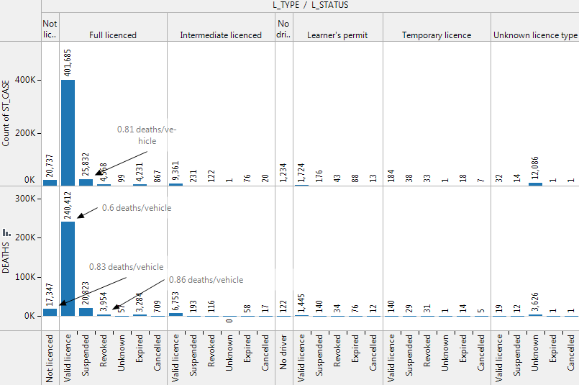

Slide 37
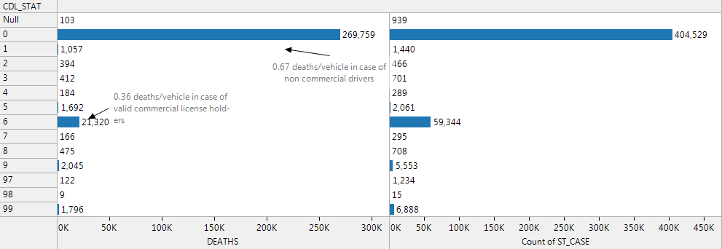
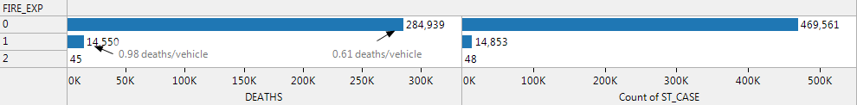

Slide 38
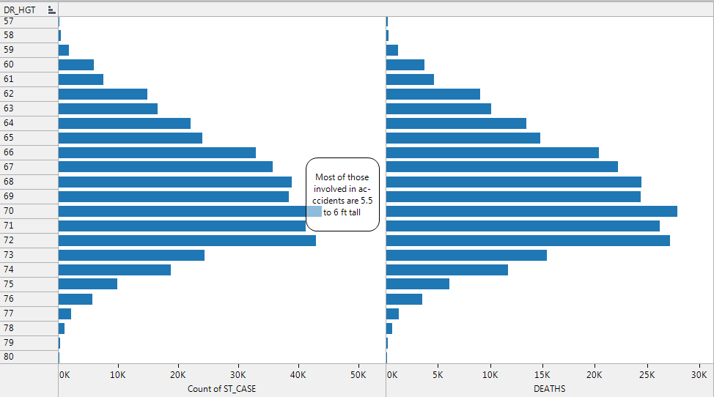

Slide 39
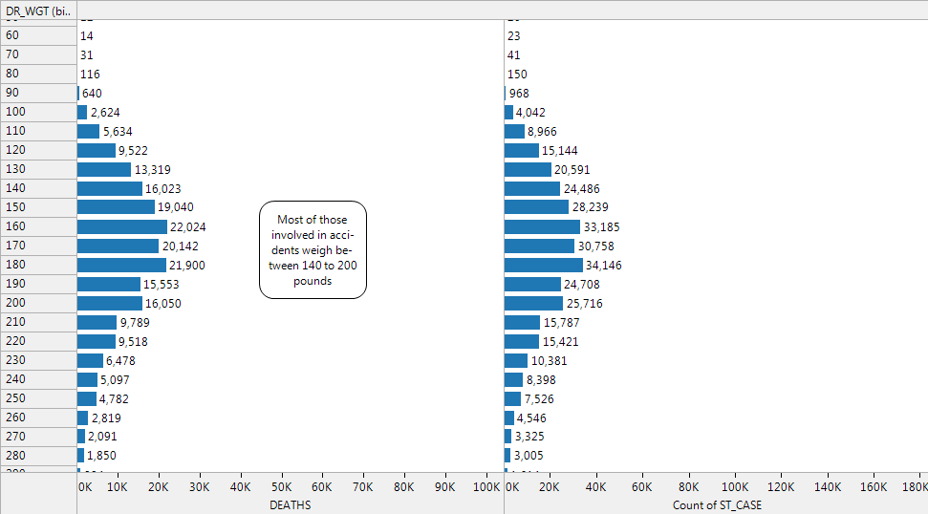

Slide 40
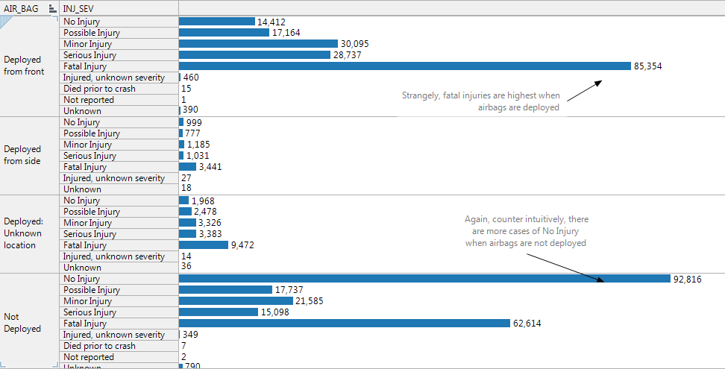

Slide 41
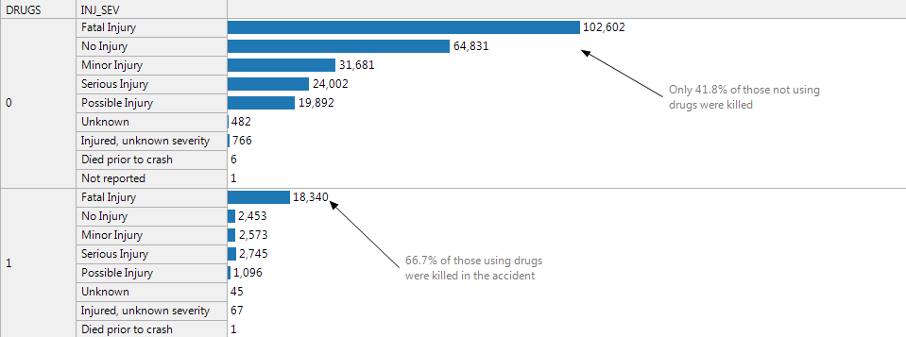

Slide 42
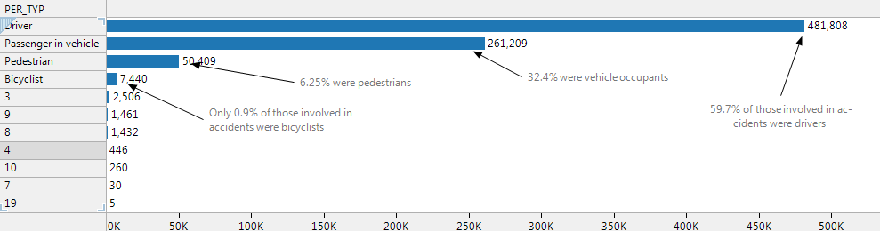

Slide 43
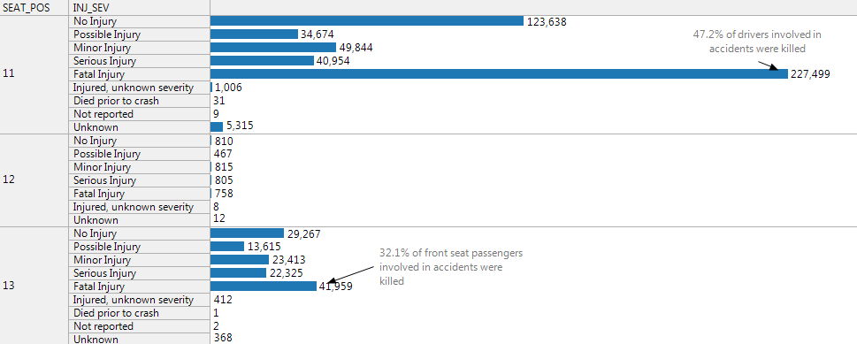
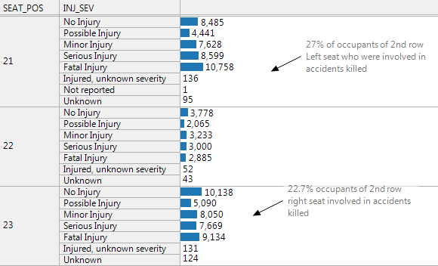

Slide 44
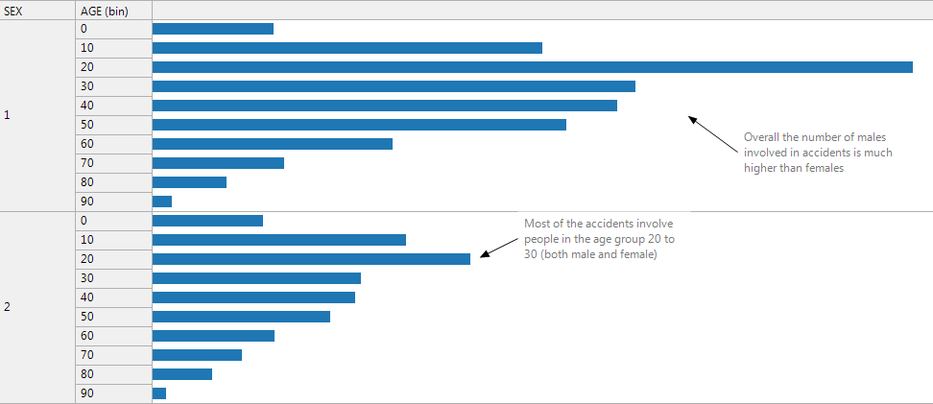

Slide 45
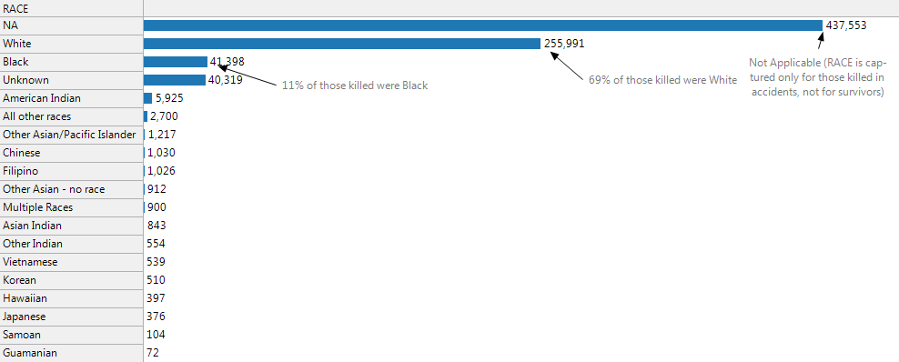

Slide 46
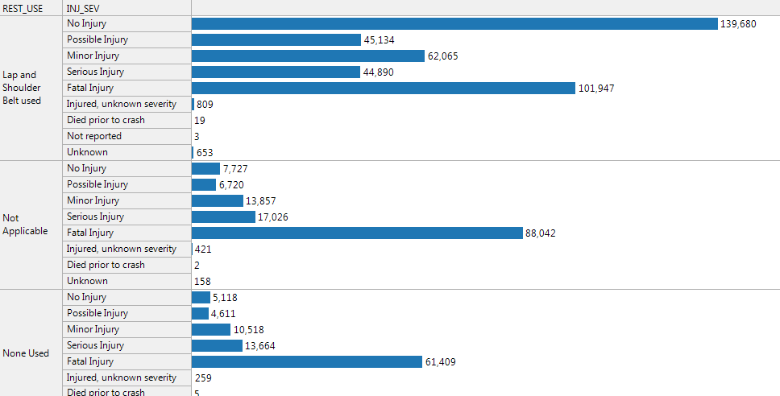
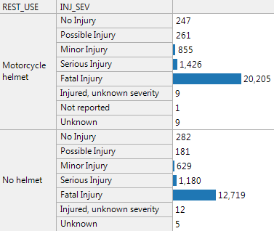

Slide 47
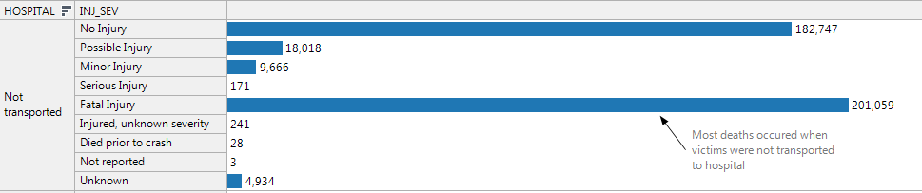
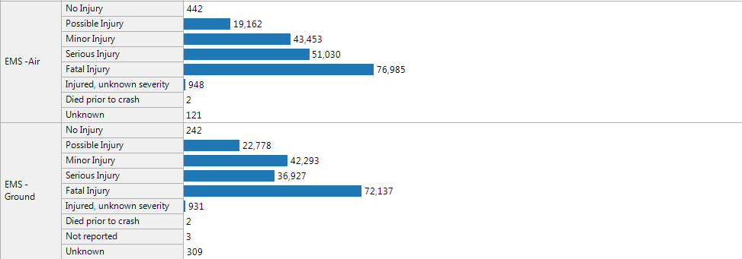

Slide 48



