Slide 1
The Block Breaker Game
Guide :Prof. G. D. Bhutkar
Name: Parag Sharad Godbole
Division: SY_CS_A
Batch: B2
Roll No: 78
GR No: 11910443

Slide 2
Content
Introduction
Problem Statement and Objective of Project
Domain, Technology and Tools
Literature Review
Outcome
Result
Future Scope
Reference

Slide 3
Introduction
Breakout is an arcade game originally developed by Steve Wozniak, Nolan Bushnell in 1976.
The object of brick breaker is to break the bricks that are distributed around the top of the game screen.
The bricks get broken after coming in contact with a ball that bounces around the screen.
At the bottom is a paddle that in the classic game moves based on user input.
The user has to make sure the ball bounces off the paddle without going off the bottom of the screen.

Slide 4
Problem Statement and Project Objectives
Problem Statement :
To build the block breaker game in java.
Project Objectives :
The main objective is to give fun to users.
It might be helpful for relieving the stress.

Slide 5
Domain, Technology and Tools
Domain : Game Development
Technology :
I am using Java Swing for building the game.
Swing is a GUI widget toolkit for Java.
It is part of Oracle's Java Foundation Classes (JFC) – and providing a graphical user interface (GUI) for Java programs.
Tools : Visual Studio Code IDE

Slide 6
Literature Review
Link:
https://geekrodion.medium.com/breakout-game-with-javascript-react-and-svg-c8c62a3d30c6
Author: Rodion Chachura
Tools used: JavaScript, React, and SVG(Scalable Vector Graphics)
About:
In the project, he utilized functional, immutable programming, React Hooks, SVG rendering, and basics of game development.

Slide 7
Literature Review Cont...
Link:
https://sites.google.com/site/blockbreakeer/home
Author: Bugra Gökdogan, Cagkan Tastekin, Levent Aydin
Tools: SVG,Javascipt
About:
Created 5 different cases namely PlayGames, ViewHelp, ChangeSetting, ViewHighScore and LoadGame.
then write code separately for each case in different files.
called all files in main file.

Slide 8
Outcomes
I want to learn java.
To get good knowledge about Game Development domain.
Get used to with different algorithms and toolkits for game development present in java.

Slide 9
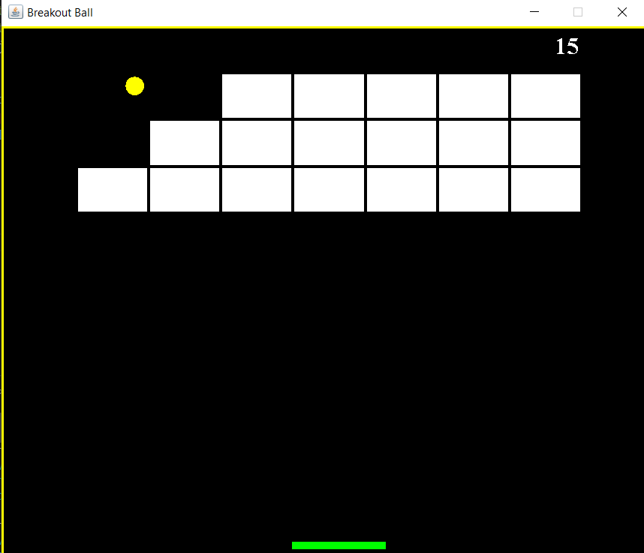
Result

Slide 10
Future Scope
In future, we can add sound, more complex arrangement of bricks.
Also we can make double or triple hit bricks.
In addition to that we can also deploy the whole project onto either web application or mobile application.

Slide 11
References
https://sites.google.com/site/blockbreakeer/home
http://www.cs.columbia.edu/~sedwards/classes/2015/4840/designs/breakout.pdf
https://zetcode.com/javagames/breakout/
https://www.javatpoint.com/java-swing

Slide 12
Thank You

