Slide 1
Predicting the best venues to visit in Bengaluru to experience the Nightlife

Slide 2
Finding the Best Venue for outings is always a complex issue…….
Bengaluru city is well known for its nightlife. Thousands of Bengalurians look for escape venues on Friday nights and weekends. However, finding the best venues for hangouts is a conundrum, given the plethora of choices available.
This Data Analytics project intends to help make better choices by clustering similar venues based on three parameters: Rating, Price, and the number of likes.

Slide 3
Data Acquisition:
Foursquare DataBase was used to collect necessary data for the analysis. Two end points were used to get the data:
Venue Categories:
Description: Returns a hierarchical list of categories applied to venues.
2. Venue Details:
Description: Gives the full details about a venue including location, tips, and categories.

Slide 4
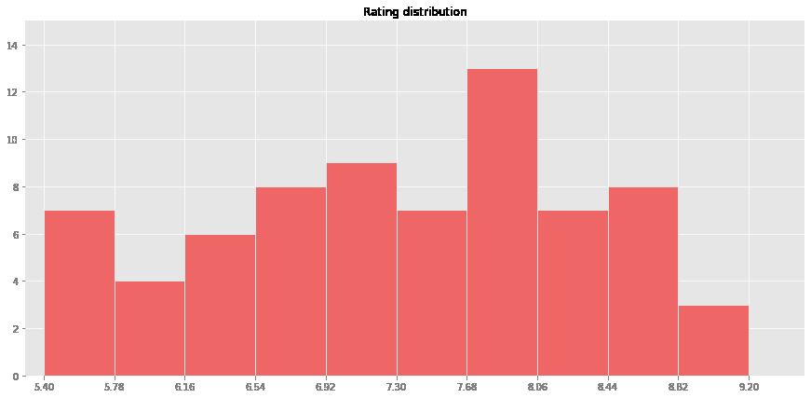
Exploratory Data Analysis:
1. Rating Distribution:

Slide 5
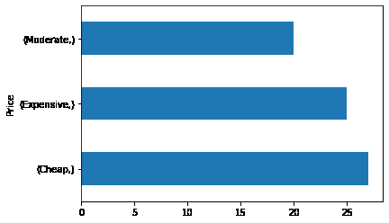
2. Price Distribution :

Slide 6
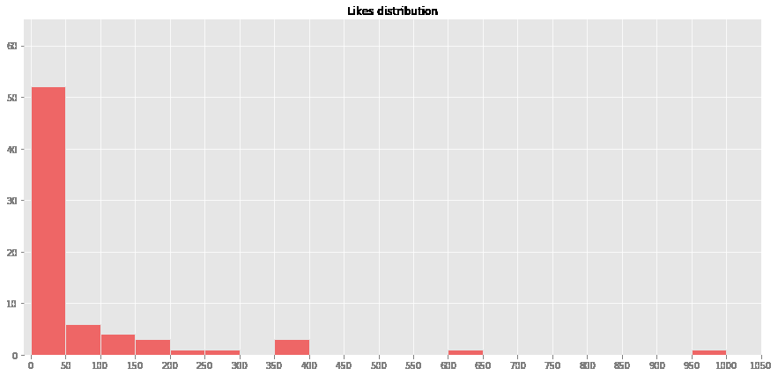
3. Like counts Distribution :

Slide 7
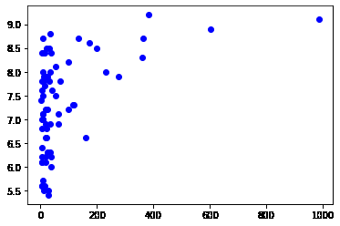
4. Likes counts Vs. Rating

Slide 8
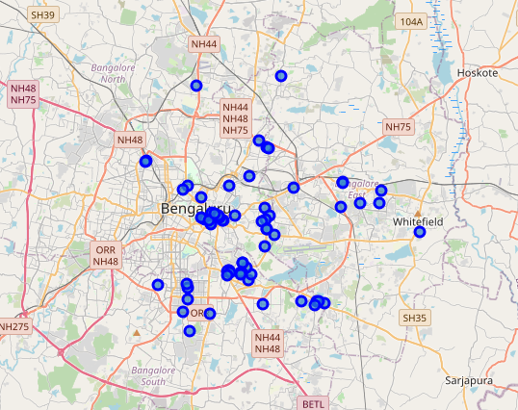
Venues on Map :

Slide 9
Clustering Model:
The Kmeans clustering algorithm from the sci-kit learn library was used to cluster the venues into different groups.
The number of clusters based on the following assumption:
1. Under the pricing column, the venues fall under Cheap, Moderate, and Expensive.
2. Under the Rating column, the venues fall under: Bad, Decent, and Good.
3. From high-level permutation and combinations, we can have 3*3 = 9 possibilities.

Slide 10
Results:
On analyzing the type of venues in each cluster based on the three metrics, I labeled each cluster as follows:
Cluster 0: ‘Moderate, good but not well known’
2. Cluster 1: ‘Cheap and Decent’
3. Cluster 2: ‘Expensive and Decent’
4. Cluster 3:’Expensive, Excellent, and Very well known’
5. Cluster 4: ‘Moderate, Good, and well known’
6. Cluster 5: ‘Moderate and Bad’
7. Cluster 6: ‘Expensive, good, and well known’
8. Cluster 7: ‘Cheap and bad’
9. Cluster 8:’Expensive, bad, and not well known’

Slide 11
Conclusion :
From the above analysis, I was able to sort venues based on these three metrics: Price, Rating, and likes. This analysis could be used to select the most appropriate venue for an outing based on preferences. It also forms a basis for the recommendation system.

