Slide 1
COMPARING UNSUPERVISED LEARNING METHODS FOR HIGH DIMENSIONAL DATA.
By:
PARAG DHERE
APURVA WANKHADE
SONIA SHAH
SURRAM ANUGNA

Slide 2
CLUSTERING
Clustering is one of the most important unsupervised learning method, which deals with finding a structure in a collection of unlabeled data.
Hence, clusters are collection of objects which are “similar” between them and are “dissimilar” to the objects belonging to other clusters.

Slide 3





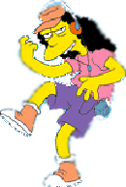






Clustering:
John's Family
School Employees
Females
Males

Slide 4
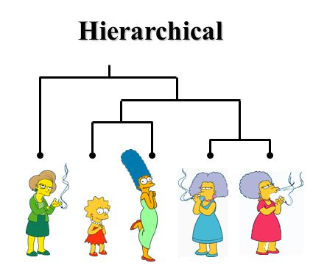
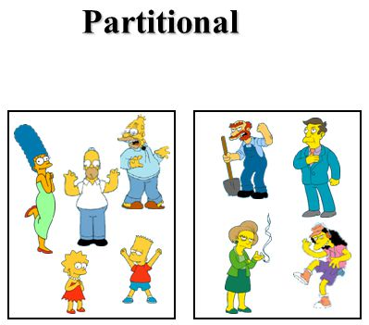
Types of Clusters:
It constructs various partitions & evaluate by some criterion.
It creates a hierarchical decomposition of the set of objects using some criterion

Slide 5
Methods
Partitional
- K-means clustering
Hierarchical clustering
-Agglomerative (Bottom-up)
Spectral clustering

Slide 6
DATASETS
IRIS IDENTIFICATION
Instances:150
Attributes: 4
GLASS IDENTIFICATION
Instances:214
Attributes: 10
- YEAST IDENTIFICATION
Instances:1484
Attributes: 9

Slide 7
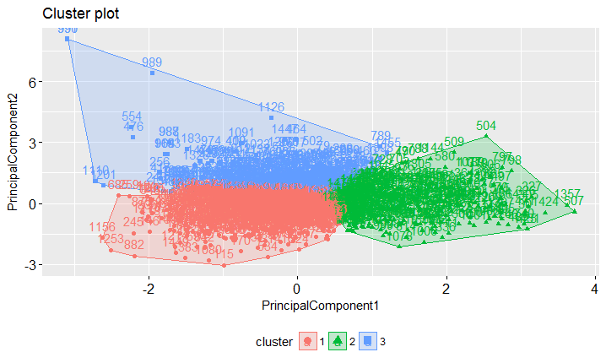
IRIS IDENTIFICATION

Slide 8
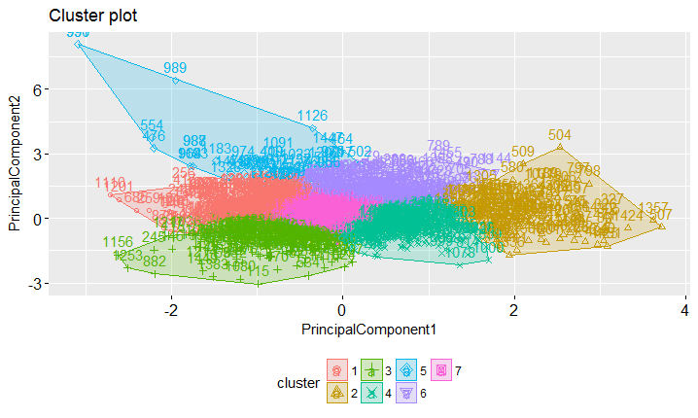
GLASS IDENTIFICATION

Slide 9
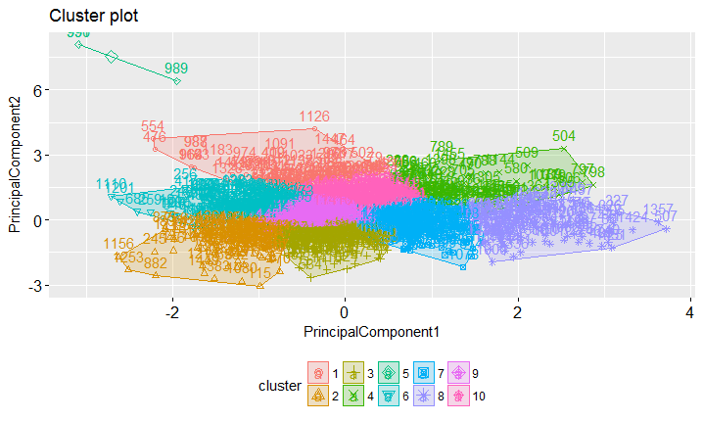
YEAST IDENTIFICATION

Slide 10
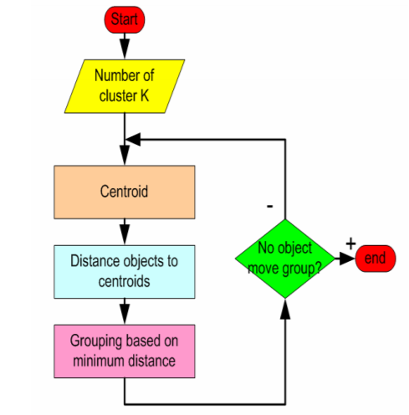
K-Means
Works with numeric data only
Select a number (K) of cluster centers (at random)
Assign every item to its nearest cluster center (e.g. using Euclidean distance)
Move each cluster center to the mean of its assigned items
Repeat steps 2,3 until convergence (change in cluster assignments less than a threshold)
The centroid is (typically) the mean of the points in the cluster.

Slide 11
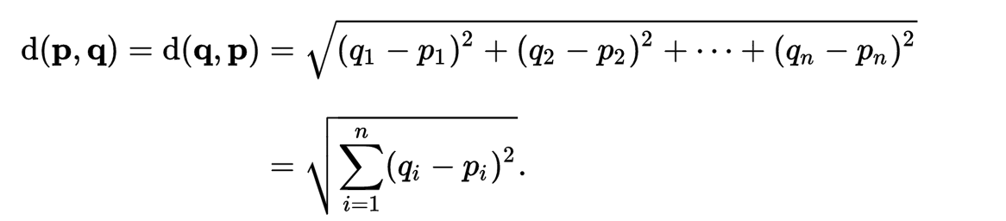
Euclidean Distance:
The Euclidean distance or Euclidean metric is the distance between two points in Euclidean space

Slide 12
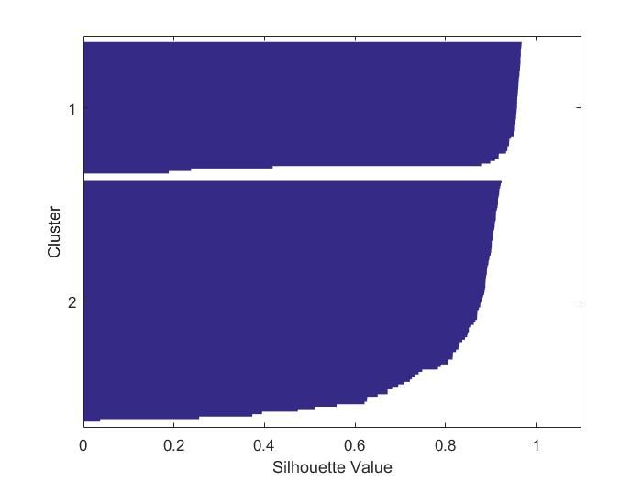
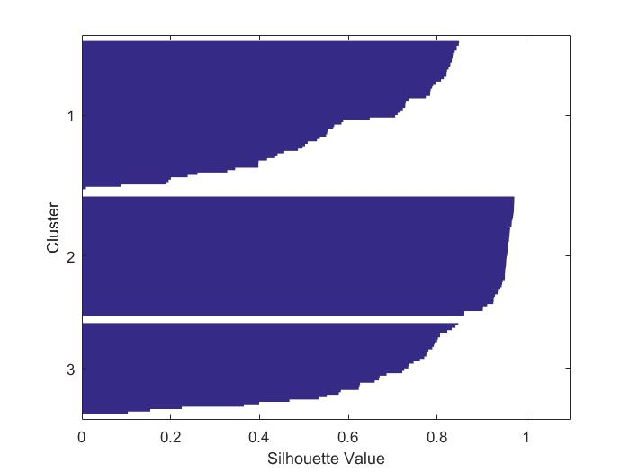
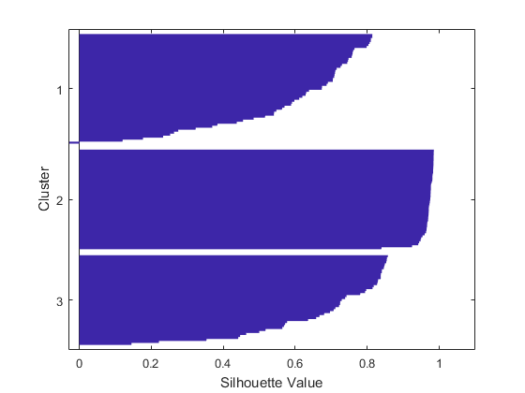
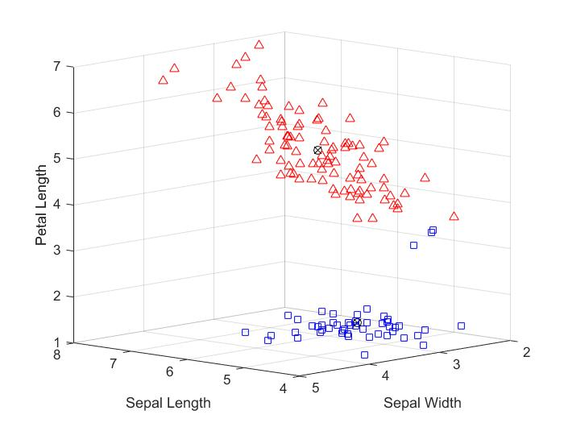
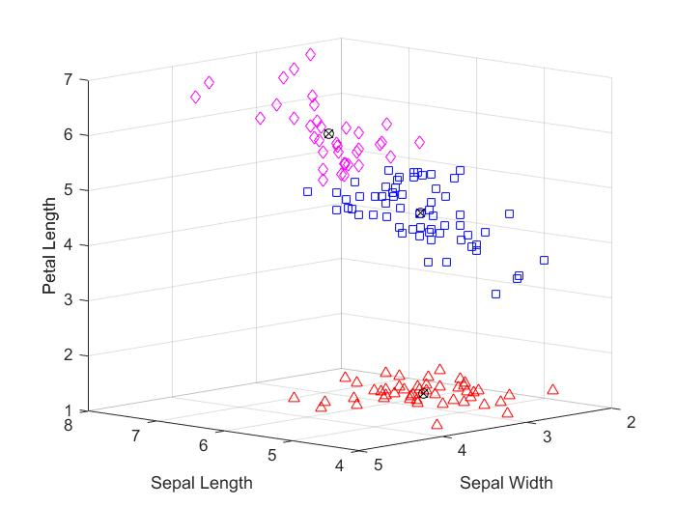
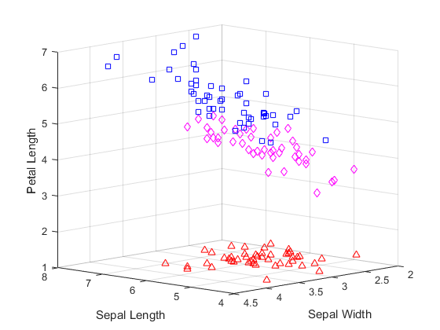
Centroids: IRIS

Slide 13
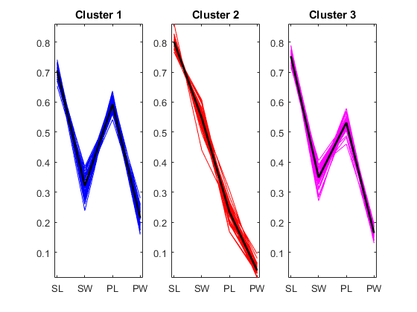

Slide 14
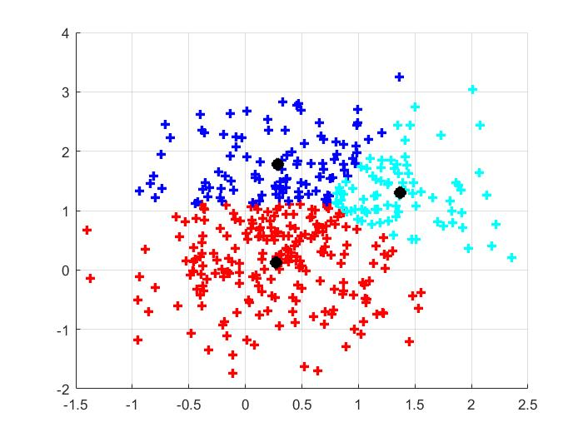
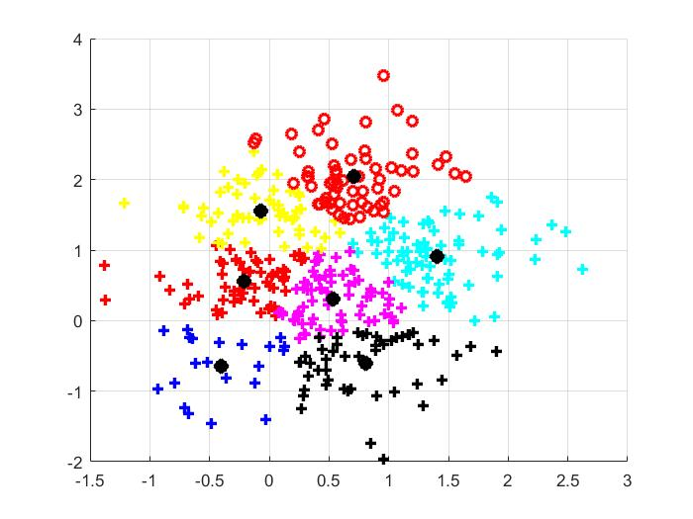
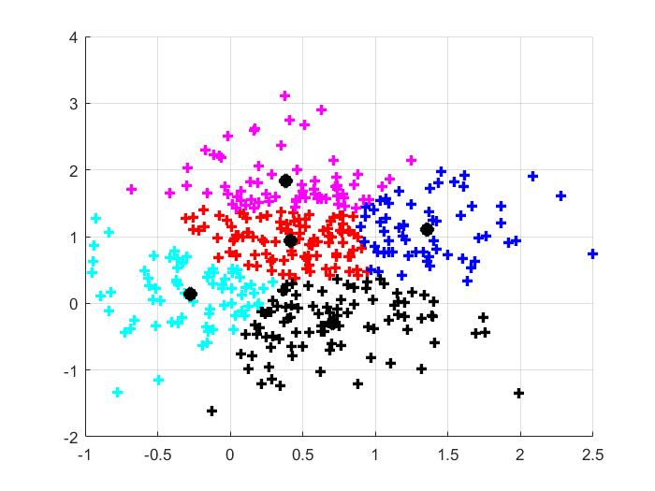
GLASS
3,2
7,9
5,5

Slide 15
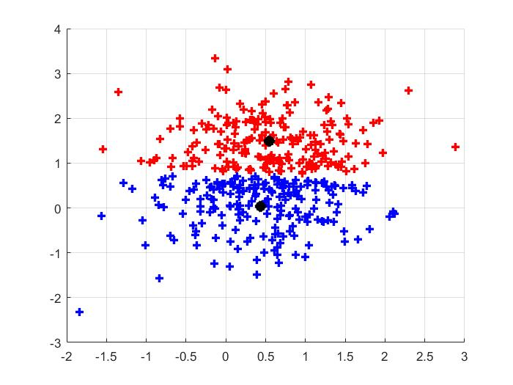
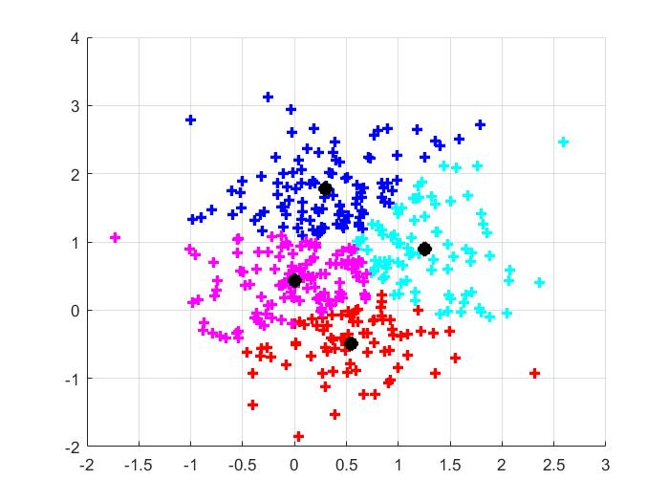
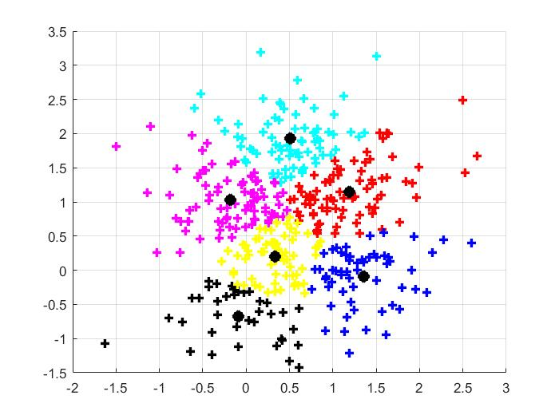
YEAST
2,1
4,6
6,8

Slide 16
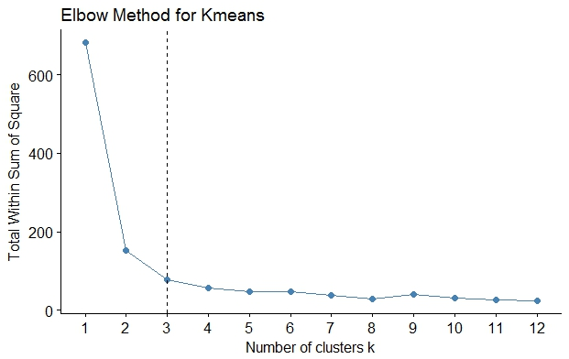
ELBOW METHOD: Iris Identification

Slide 17
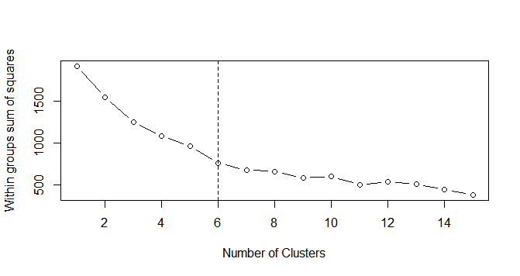
Glass Identification:

Slide 18
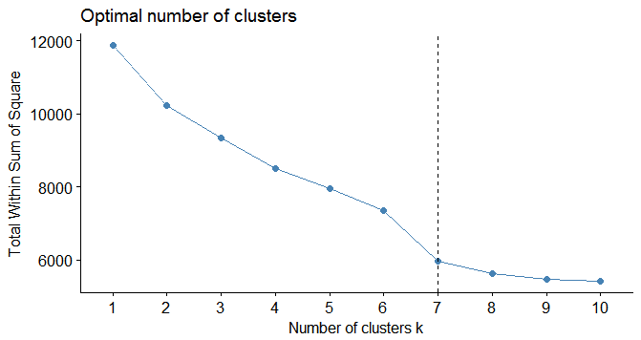
Yeast Identification:

Slide 19
Hierarchical Clustering:
Produces a set of growing clusters organized as a hierarchical tree
Can be visualized as a dendrogram
A tree-like diagram that records the sequences of merges or splits
Types:
Agglomerative
Divisive

Slide 20
Agglomerative Algorithm:
Basic algorithm
Compute the distance matrix between the input data points
Let each data point be a cluster
Repeat
Merge the two closest clusters
Update the distance matrix
Until only a single cluster remains
Key operation is the computation of the distance between two clusters

Slide 21
Closest Pair of Clusters
Many Variants to Defining Closest Pair of Clusters
SINGLE-LINK
Distance of the “Closest” points.
COMPLETE-LINK
Distance of the “Furthest” points.
AVERAGE-LINK
Average distance between pairs of Elements.

Slide 22
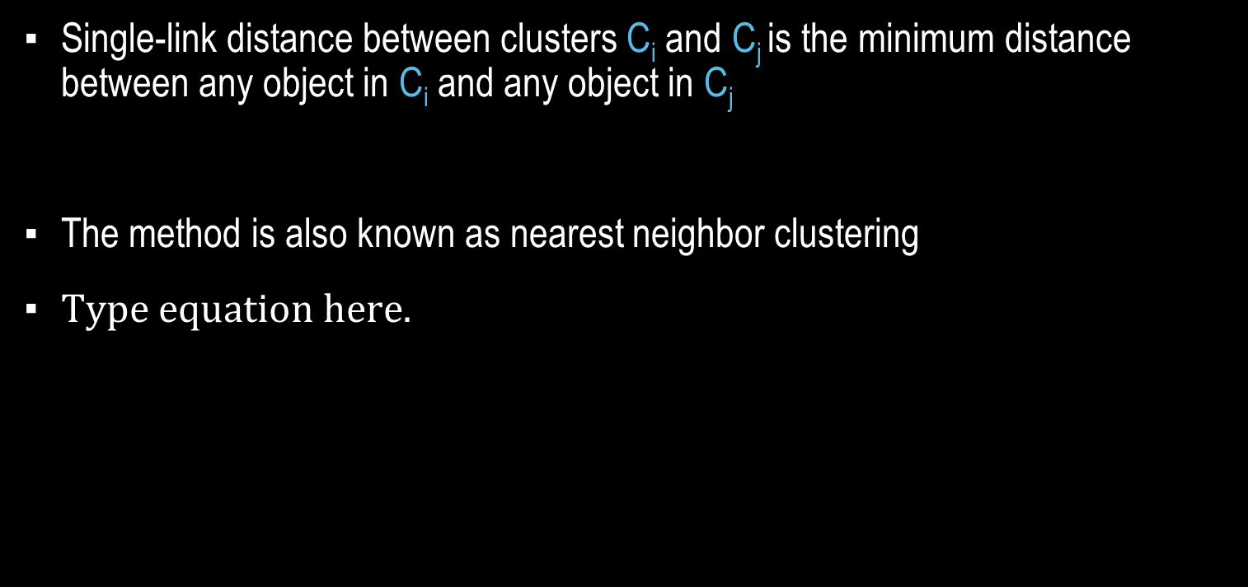
Single-link clustering
Single-link distance between clusters C_{i} and C_{j} is the minimum distance between any object in C_{i} and any object in C_{j}
The method is also known as nearest neighbor clustering

Slide 23
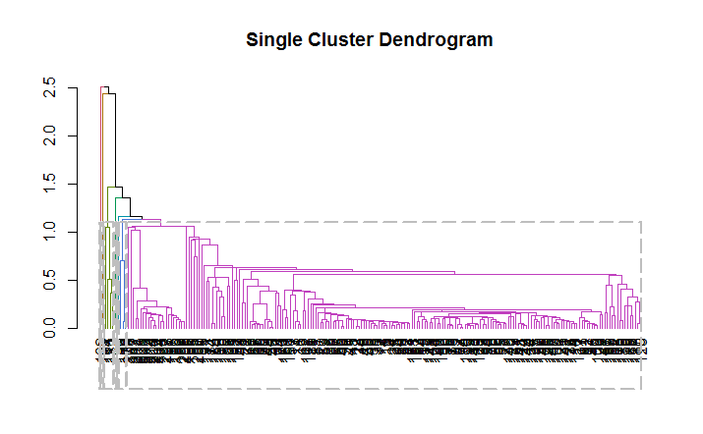
IRIS Dataset:

Slide 24
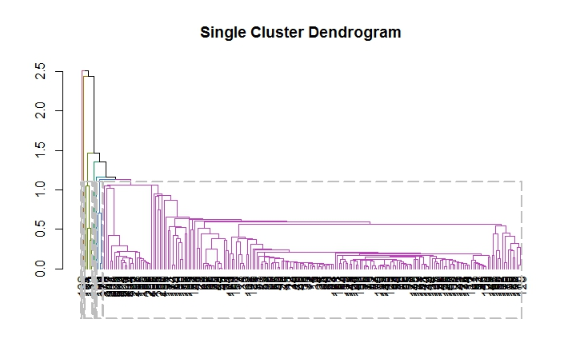
GLASS Dataset:

Slide 25
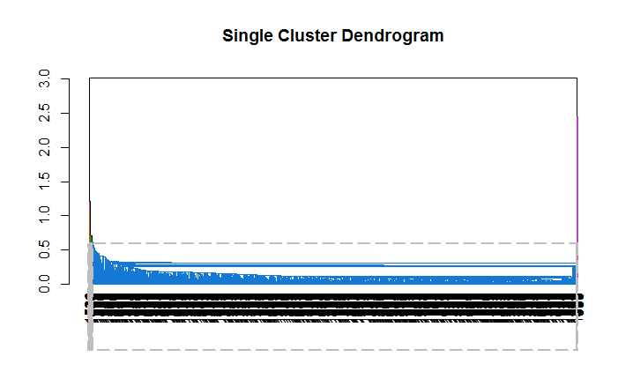
YEAST Dataset:

Slide 26
Complete-linkage clustering
Complete-link distance between clusters C_{i} and C_{j} is the maximum distance between any object in C_{i} and any object in C_{j}
The method is also known as farthest neighbor clustering

Slide 27
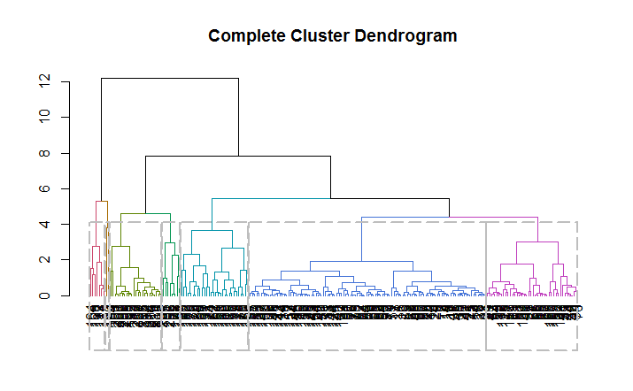
IRIS:

Slide 28
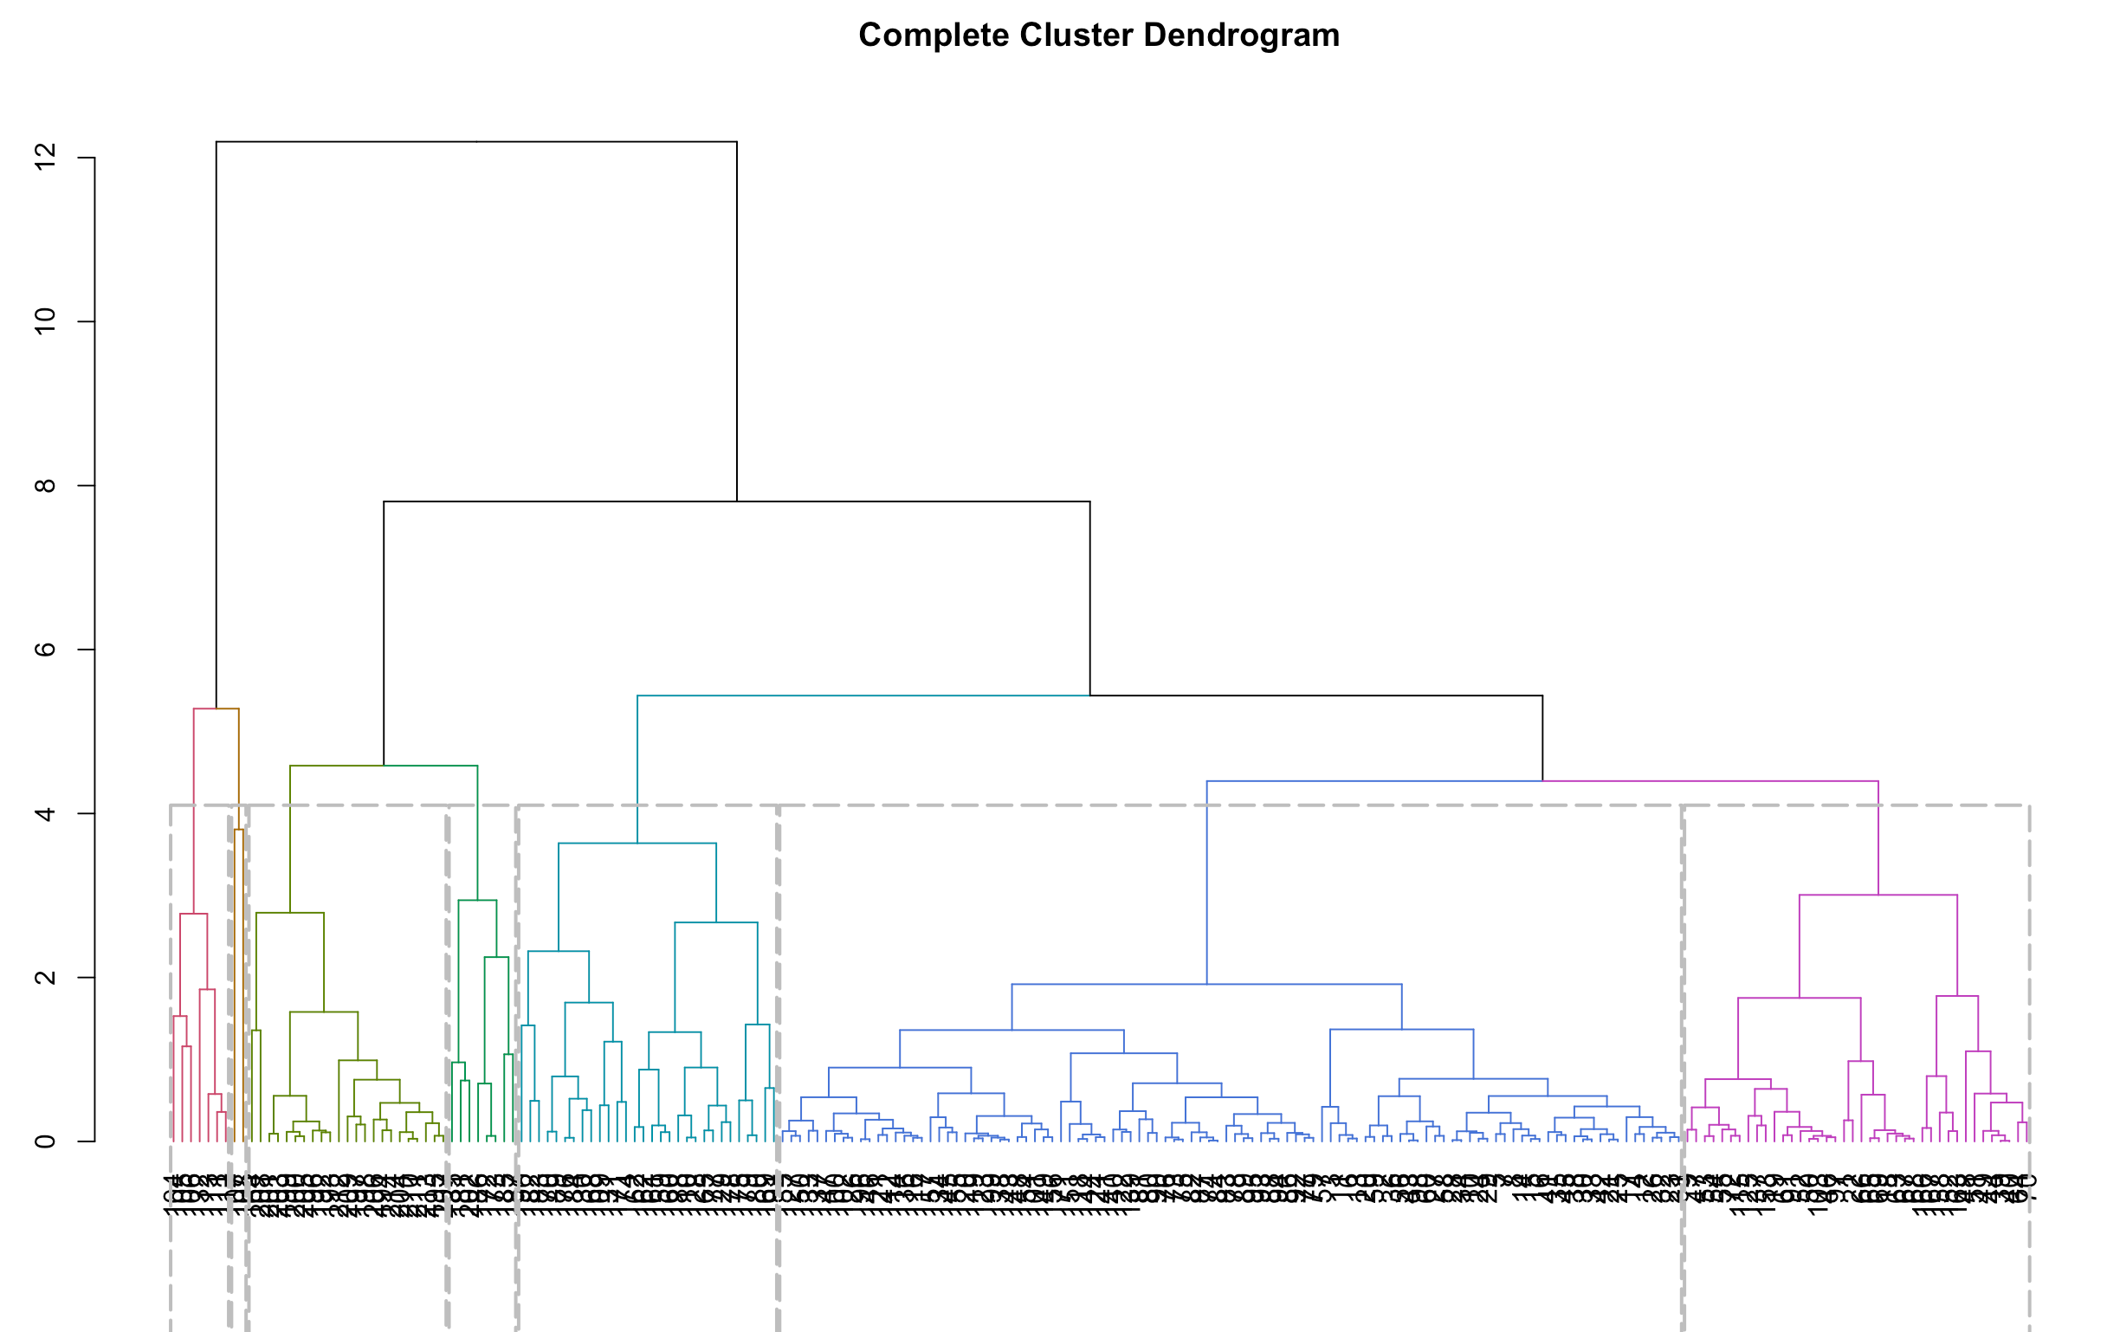
Glass:

Slide 29
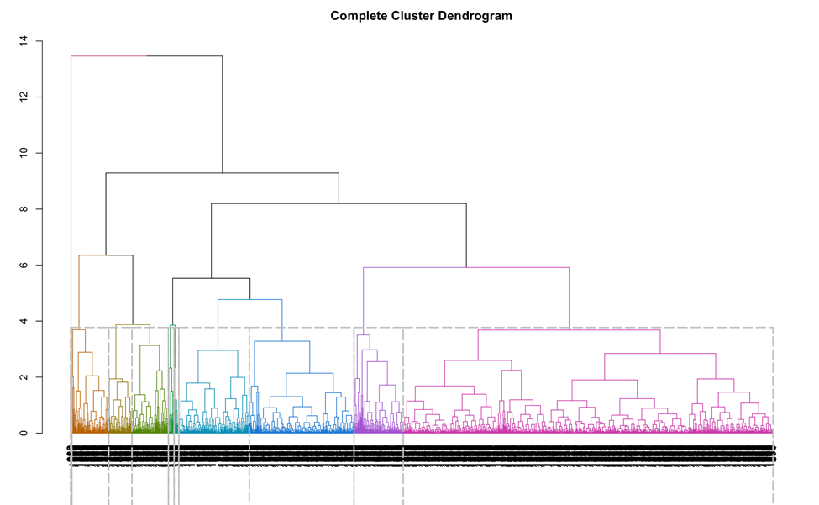
Yeast:

Slide 30
Average-linkage Clustering
Group average distance between clusters C_{i} and C_{j} is the average distance between any object in C_{i} and any object in C_{j}

Slide 31
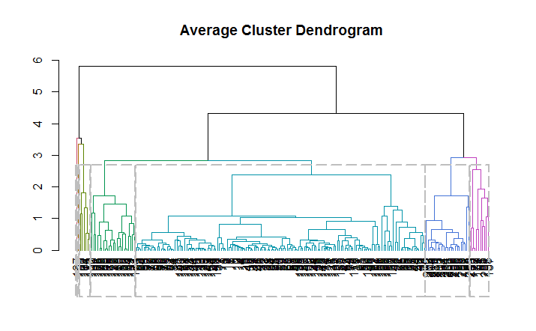
IRIS:

Slide 32
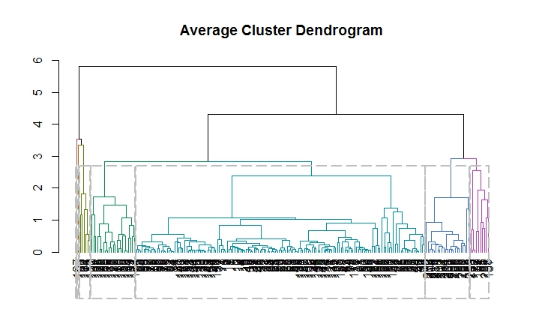
Glass:

Slide 33
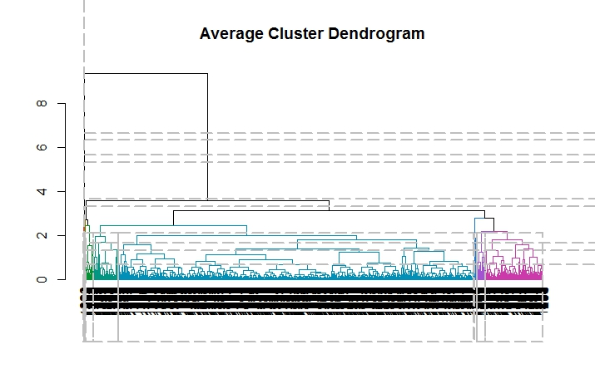
Yeast:

Slide 34
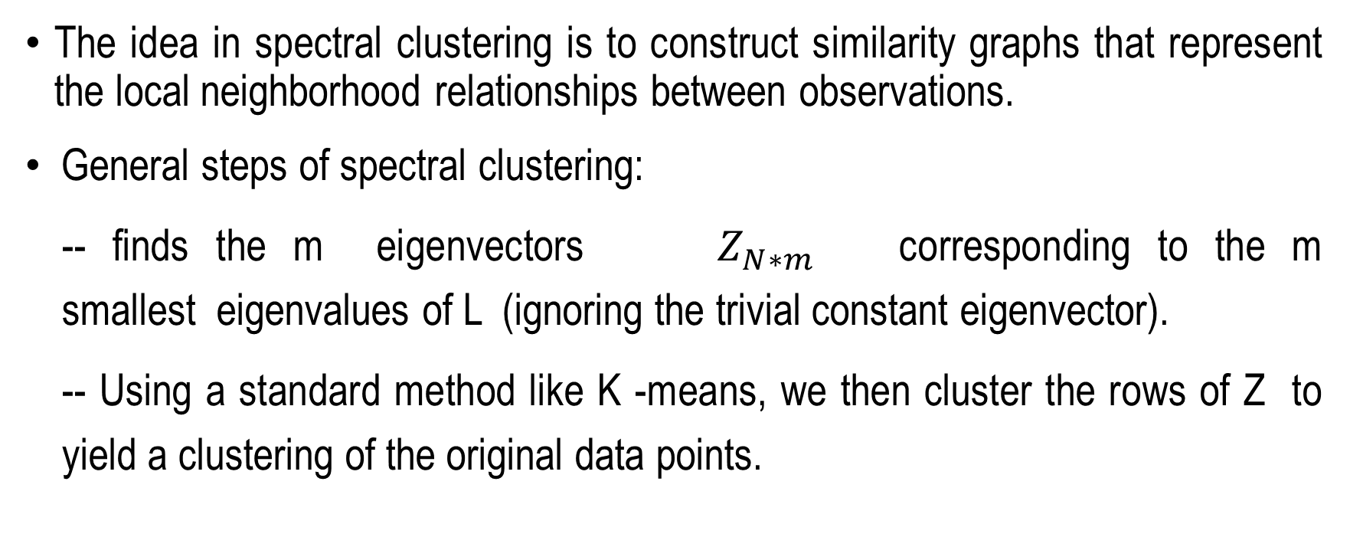
Spectral clustering
The idea in spectral clustering is to construct similarity graphs that represent the local neighborhood relationships between observations.
General steps of spectral clustering:
-- finds the m eigenvectors $Z_{N∗m}$ corresponding to the m smallest eigenvalues of L (ignoring the trivial constant eigenvector).
-- Using a standard method like K -means, we then cluster the rows of Z to yield a clustering of the original data points.

Slide 35

Algorithm:
Obtain data representation in the low-dimensional space that can be easily clustered
Use k eigenvectors (k chosen by user)
Directly compute k-way partitioning
Experimentally has been seen to be “better
project your data into R^(n)
define an Affinity matrix , using a Gaussian Kernel or say just an Adjacency matrix (i.e. )
construct the Graph Laplacian from A (i.e. decide on a normalization)
$$A_{i,j}=δ_{i,j}$$

Slide 36
Continued…
Project your data into R^(n)
define an Affinity matrix , using a Gaussian Kernel or say just an Adjacency matrix (i.e.
construct the Graph Laplacian from A (i.e. decide on a normalization)
solve an Eigenvalue problem (or a Generalized Eigenvalue problem )
select k eigenvectors corresponding to the k lowest (or highest) eigenvalues , to define a k-dimensional subspace
form clusters in this subspace using, say, k-means

Slide 37
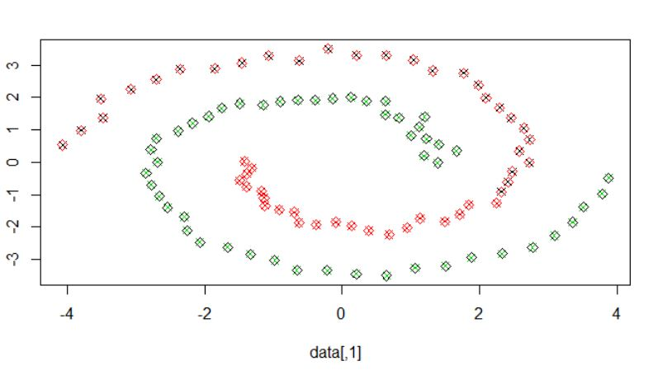
IRIS:

Slide 38
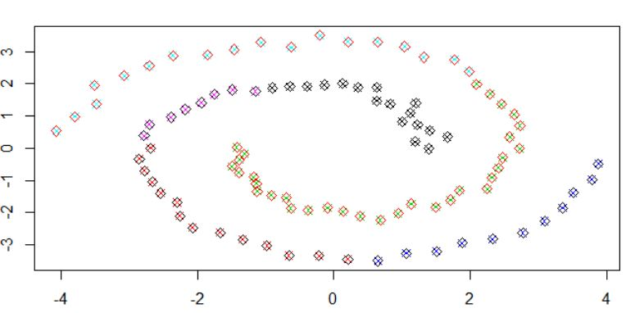
GLASS:

Slide 39
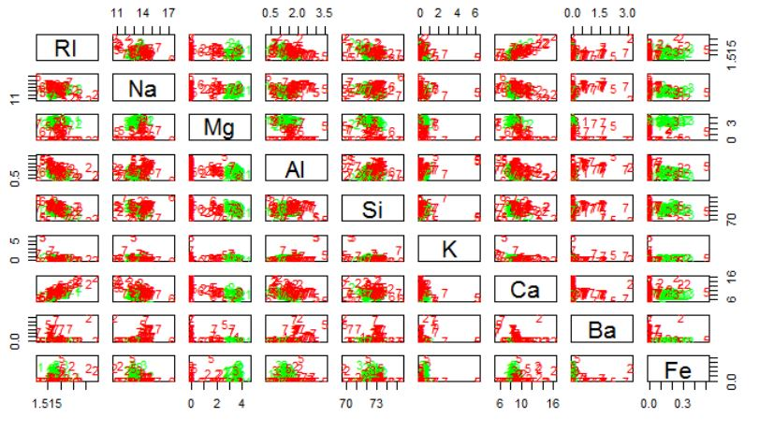
Glass Grid Graph:

Slide 40
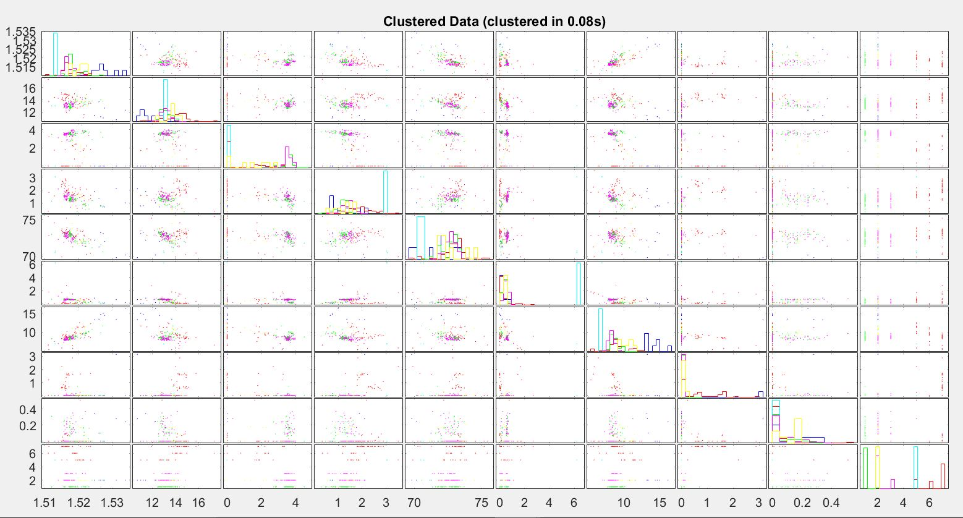
Glass Cluster grid

Slide 41
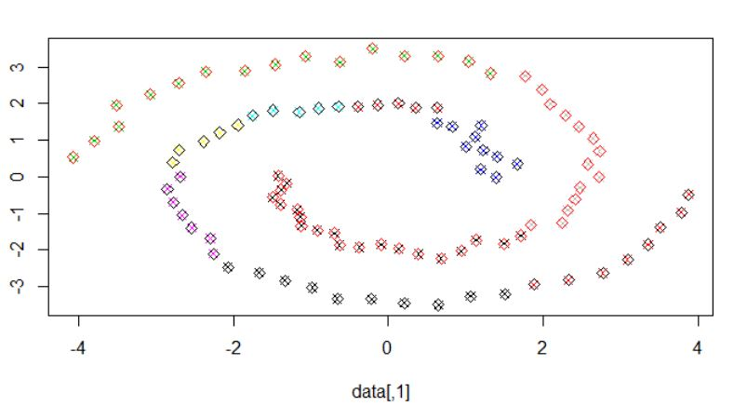
Yeast:

Slide 42
Issues:
Choice of k, the number of clusters
Choice of scaling factor
Realistically, search over and pick value that gives the tightest clusters
Choice of clustering method

Slide 43
Cluster Evaluation:
The quality of a clustering is very hard to evaluate because
We do not know the correct clusters
Some methods are used:
User inspection
Study centroids, and spreads
Rules from a decision tree.
For text documents, one can read some documents in clusters.

Slide 44
Cluster Evaluation: Evaluation Based On Internal Information
Intra-cluster cohesion (compactness):
Cohesion measures how near the data points in a cluster are to the cluster centroid.
Sum of squared error (SSE) is a commonly used measure.
Inter-cluster separation (isolation):
Separation means that different cluster centroids should be far away from one another.
In most applications, expert judgments are still the key

Slide 45
Results:
Accuracy
Error Rate

Slide 46
Accuracy
Dataset | K-means Accuracy(%) | Hierarchical clustering Accuracy(%) | Spectral Clustering Accuracy(%)
Iris | 87.987 | 84 | 51.93
Glass | 76.8 | 81.91 | 59.76
Yeast | 67.231 | 47 | 43.83

Slide 47
Error Rate

Slide 48
HIERARCHICAL CLUSTERING:
DATASETS | SINGLE | COMPLETE | AVEREAGE
IRIS | 8.67 | 9.33 | 6
GLASS | 22.47 | 21.91 | 19.66
YEAST | 65.63 | 62.5 | 62.5

Slide 49
SPECTRAL CLUSTERING:
DATASETS | ERROR RATES
IRIS | 42
GLASS | 62
YEAST | 72.75

Slide 50
Conclusion:
The three Algorithms are compared as:
- The Size of Dataset
- No. of Clusters
- Type of Datasets
- Type of Software’s
The performance of k-means & Spectral algorithm is better than Hierarchical clustering algorithm.
K-means and Spectral have less accuracy.
Partitional Algorithm is recommended for Huge Dataset(better result).
Hierarchical clustering is recommended for Small Datasets.

Slide 51
References:
Mihael Ankerst, Markus M. Breunig, Hans-Peter Kriegel (2012),OPTICS: Ordering Points To Identify the Clustering Structure. In Proceedings of, the International Conference on Management of Data, SIGMOD , volume 28(2) of SIGMOD Record, pages 4960, Philadelphia, PA.USA, 13 June 1996.ACM Press .
Rakesh Agrawal, Johannes Gehrke, Dimitrios Gunopulos, and Prabhakar Raghavan Automatic Subspace lustering of High Dimensional Data for Data Mining Applications. SIGMOD In Proceedings of the International Conference on Management of Data, (), volume 27(2) of SIGMOD Record, pages 94105, Seattle,WA, USA, 14 June 1998. ACM Press.
Michael R. Anderberg. M. 1973. Cluster Analysis and Applications. Academic Press New York.
www.wikipedia.com

Slide 52
Thank You!!

