Slide 1
Natural Language Processing
By- Parag Sharma

Slide 2
NLP is…

Slide 3
: NLP
Natural Language Processing
A field of Computer Science concerned with the
interaction between computer and humans(language)
Wikipedia:
https://en.wikipedia.org/wiki/Natural_language_processing

Slide 4
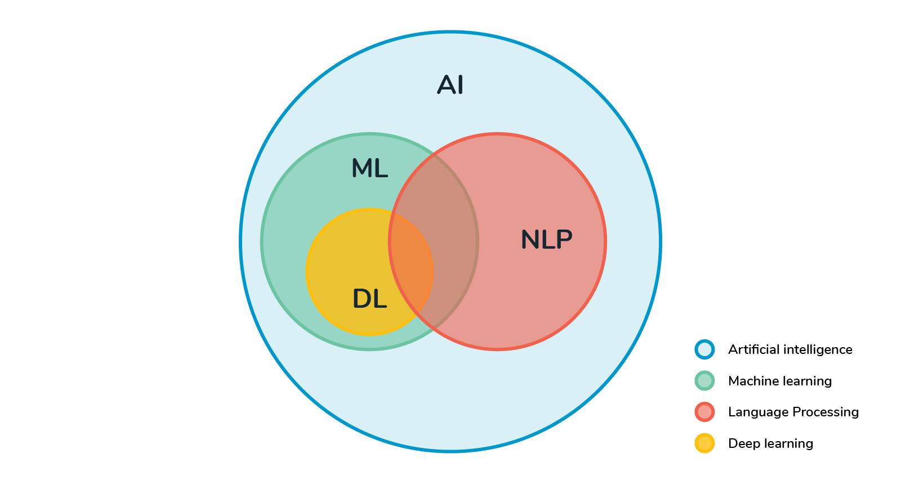
Where does NLP exist ?
.

Slide 5
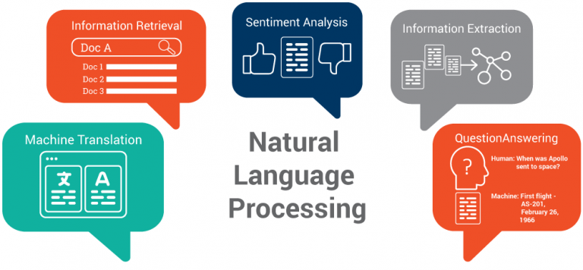
Why NLP ?

Slide 6
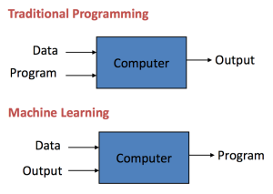
But let’s first learn what Machine Learning is …

Slide 7
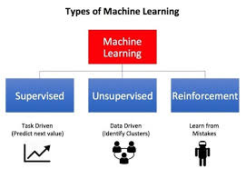

Slide 8
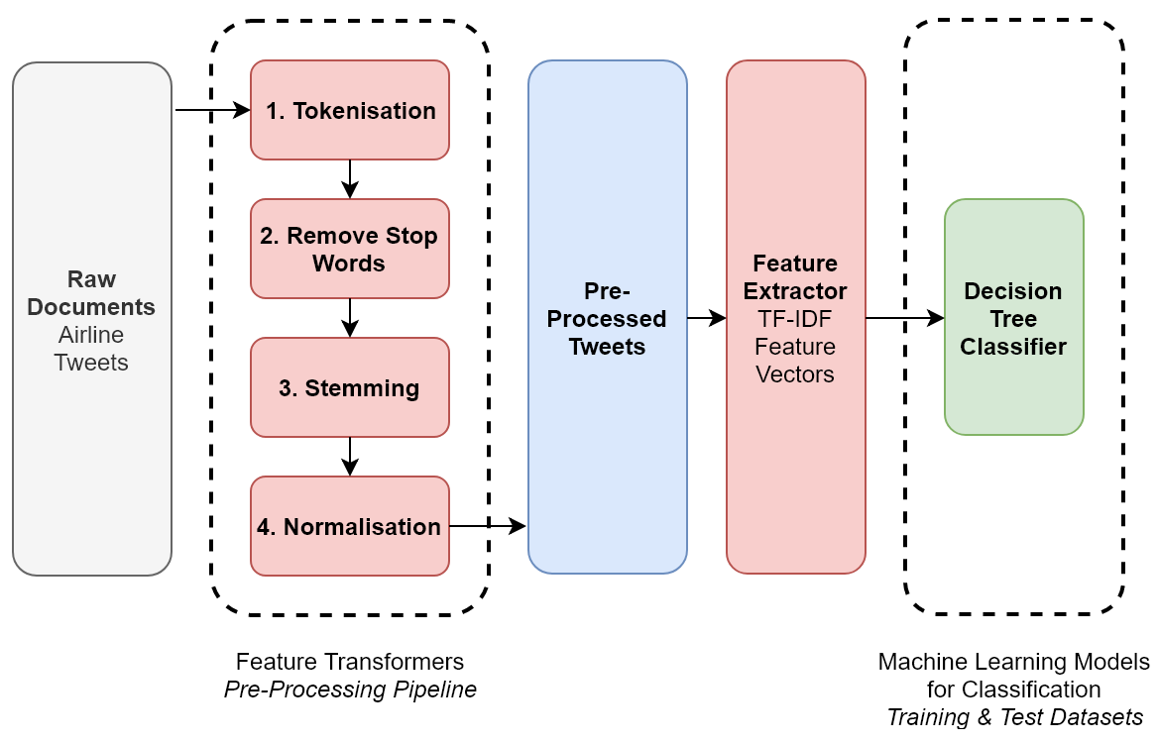
Coming Back to NLP:

Slide 9
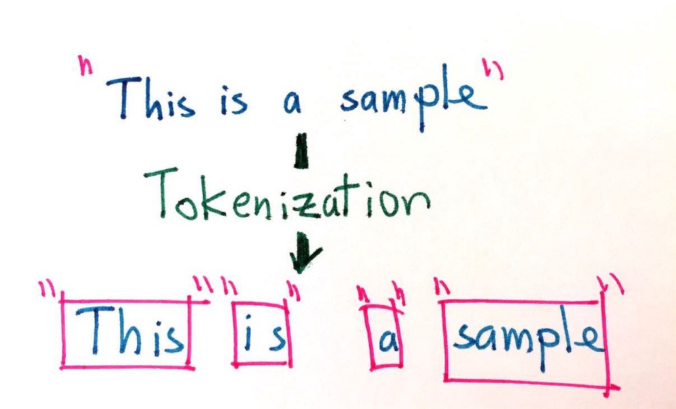
Tokenization:

Slide 10
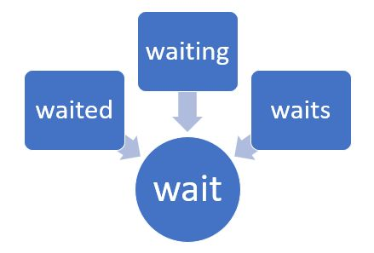
Stemming:

Slide 11
But ?
Wait !!!
How will a computer understand a human language?
Since Computer understands 0’s and 1’s.
For this reason our text data must be converted
into vectors.

Slide 12
Text to Vectors:
Bag of Words (BOW)
N-grams BOW
TF-IDF
Avg W2V
TF-IDF W2V

Slide 13
After Converting Data into Vectors, depending
Upon the task we use machine learning algorithms.
Following one are common in practice:
Naïve Bayes for text classification.(Base line model mostly)
Markov Models
SVM
Neural Networks/ Deep Learning

Slide 14
Thank you

