Slide 1
Problem Statement

Slide 2
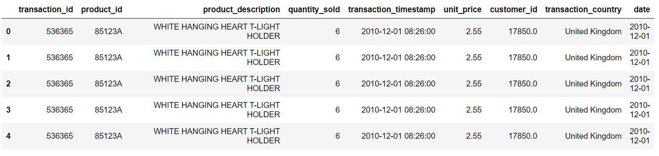
Data Merge for data merge I’ve changed column’s name after that I’ve used pd.merge() function to merge two dataset The main motto for merging two data set is to extract insight from them data = pd.merge(left = data, right= data1[['transaction_timestamp','date']],how='left', on ='transaction_timestamp')

Slide 3
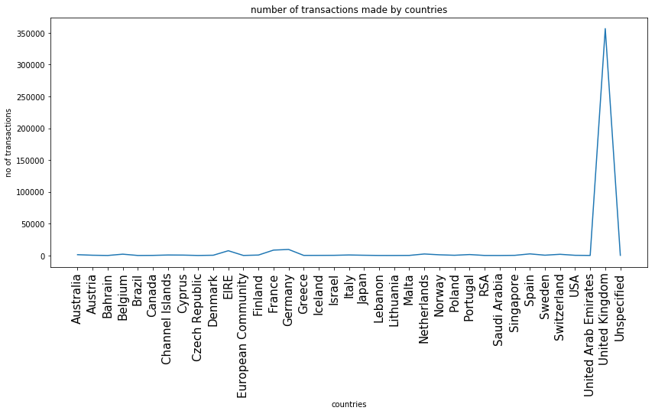
Number Of Transaction Made By Countries Below shown is a Graph where we can see United Kingdom has made most of the transaction

Slide 4
Handling Missing Value data.dropna(axis=0, subset = ['customer_id'], inplace = True) check_null = pd.DataFrame(data = data.isnull().sum()).T.rename(index={0:'null_values'}) check_null = check_null.append(pd.DataFrame(data= data.isnull().sum()/data.shape[0] *100).T.rename(index={0:'null_values%'})) check_null

Slide 5
Cancel Transaction 2.21% transaction were canceled by the customers

Slide 6
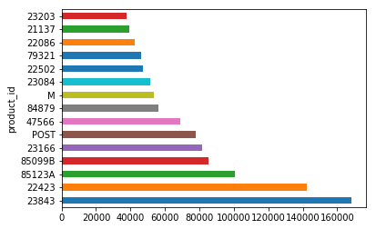
Highest Product sale From below graph we can avoid out of stock situation eg. As from below shown graph we can say that product_id(23843) sale most of the time compare to product_id(23203) Conclusion we can conclude, if we want to avoid an out of stock situation then we have to order this type of product product_id(23843) in huge quantity

Slide 7
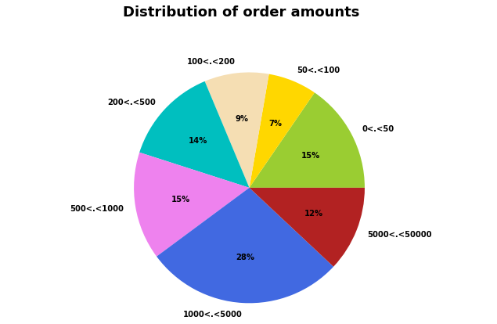
Distribution Of Order Amount From below pie chart we can say that people mostly buy this type of range(1000<.<5000)product Conclusion We can conclude that 28% people buy this range(1000<.5000) product

Slide 8
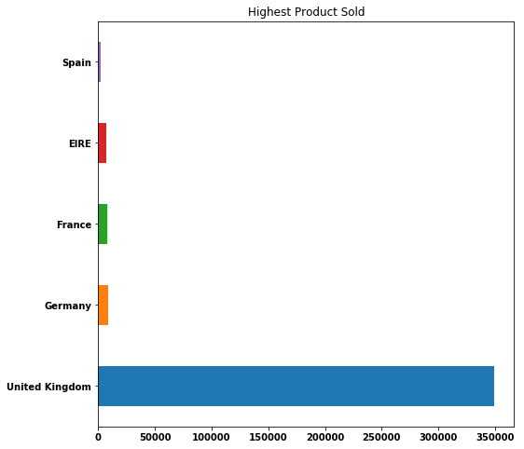
Transaction Made By Country From below shown graph we can see the highest transaction made by United Kingdom in transaction_country column Conclusion we can conclude that , we can sale highest product in these country

Slide 9
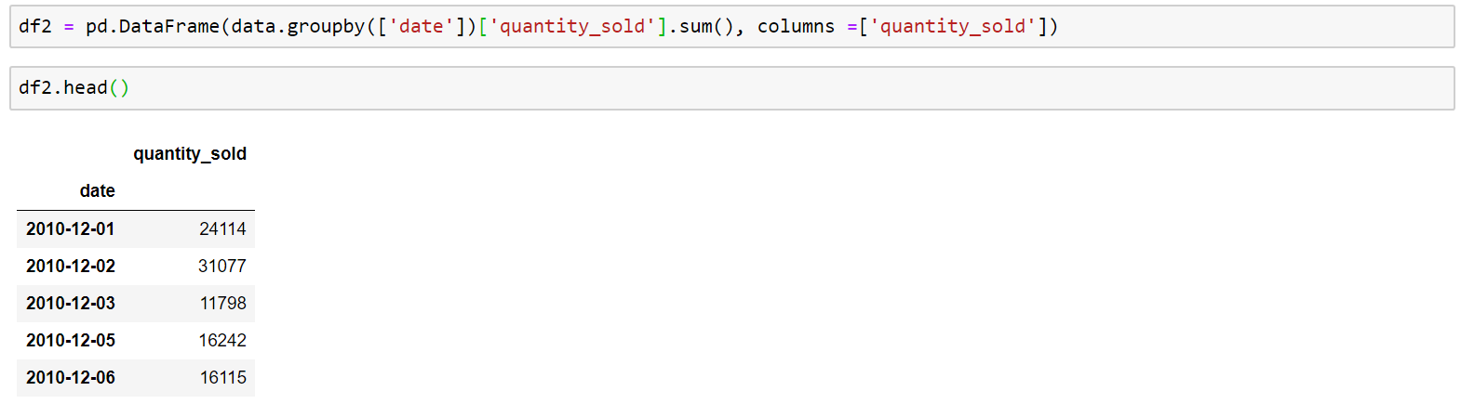
Quantity Over Time we used “date” and “quantity_sold” columns to see quantity sold over time

Slide 10
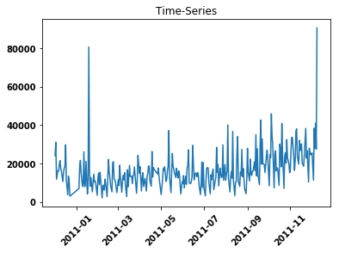
Performance From below graph we can say that company’s performance was increasing day by day we can conclude that company’s performance increases and at some time it is stationary but does not decrease at any point of time given Conclusion we can use time series forecasting for prediction

Slide 11
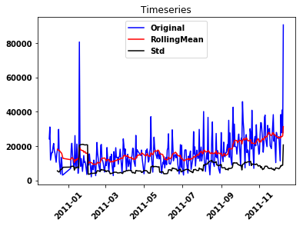
Stationary test

Slide 12
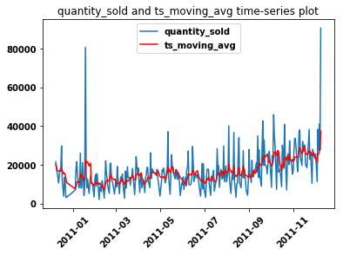
Transformation Plot

Slide 13
Thank You Parag chache

