Slide 1
Survey on COVID-19 Impacts
Education, Social Life, and Mental Health of Students

Slide 2
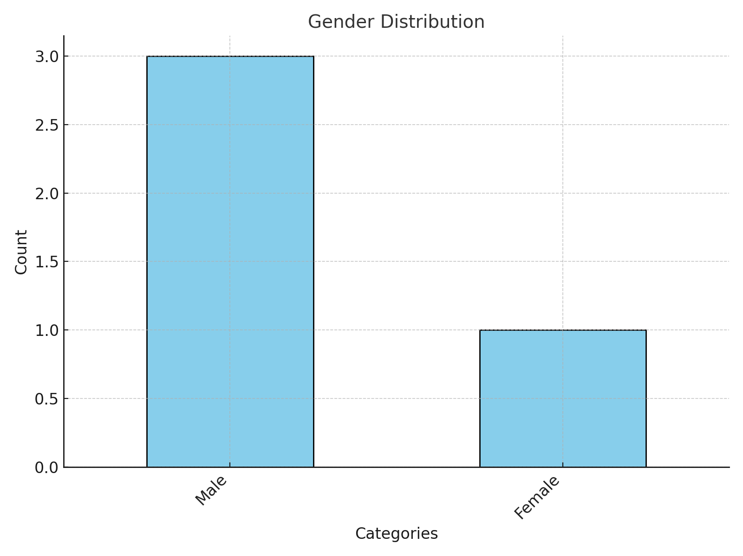
Gender Distribution Wise

Slide 3
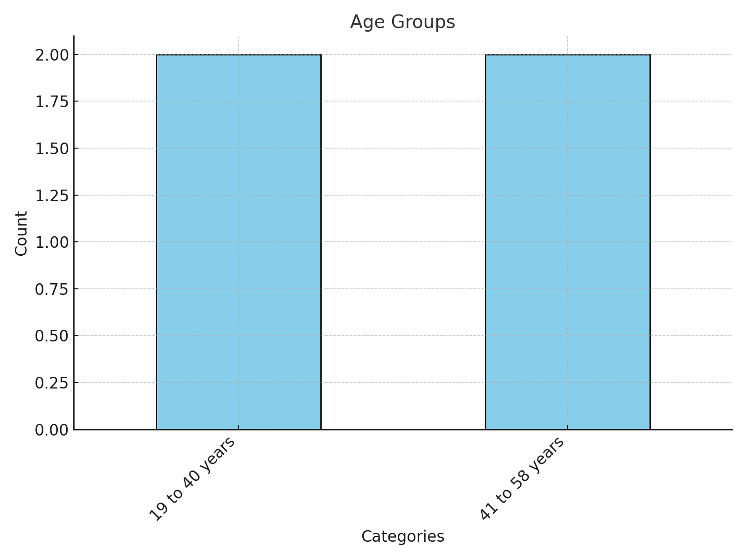
Age groups wise

Slide 4
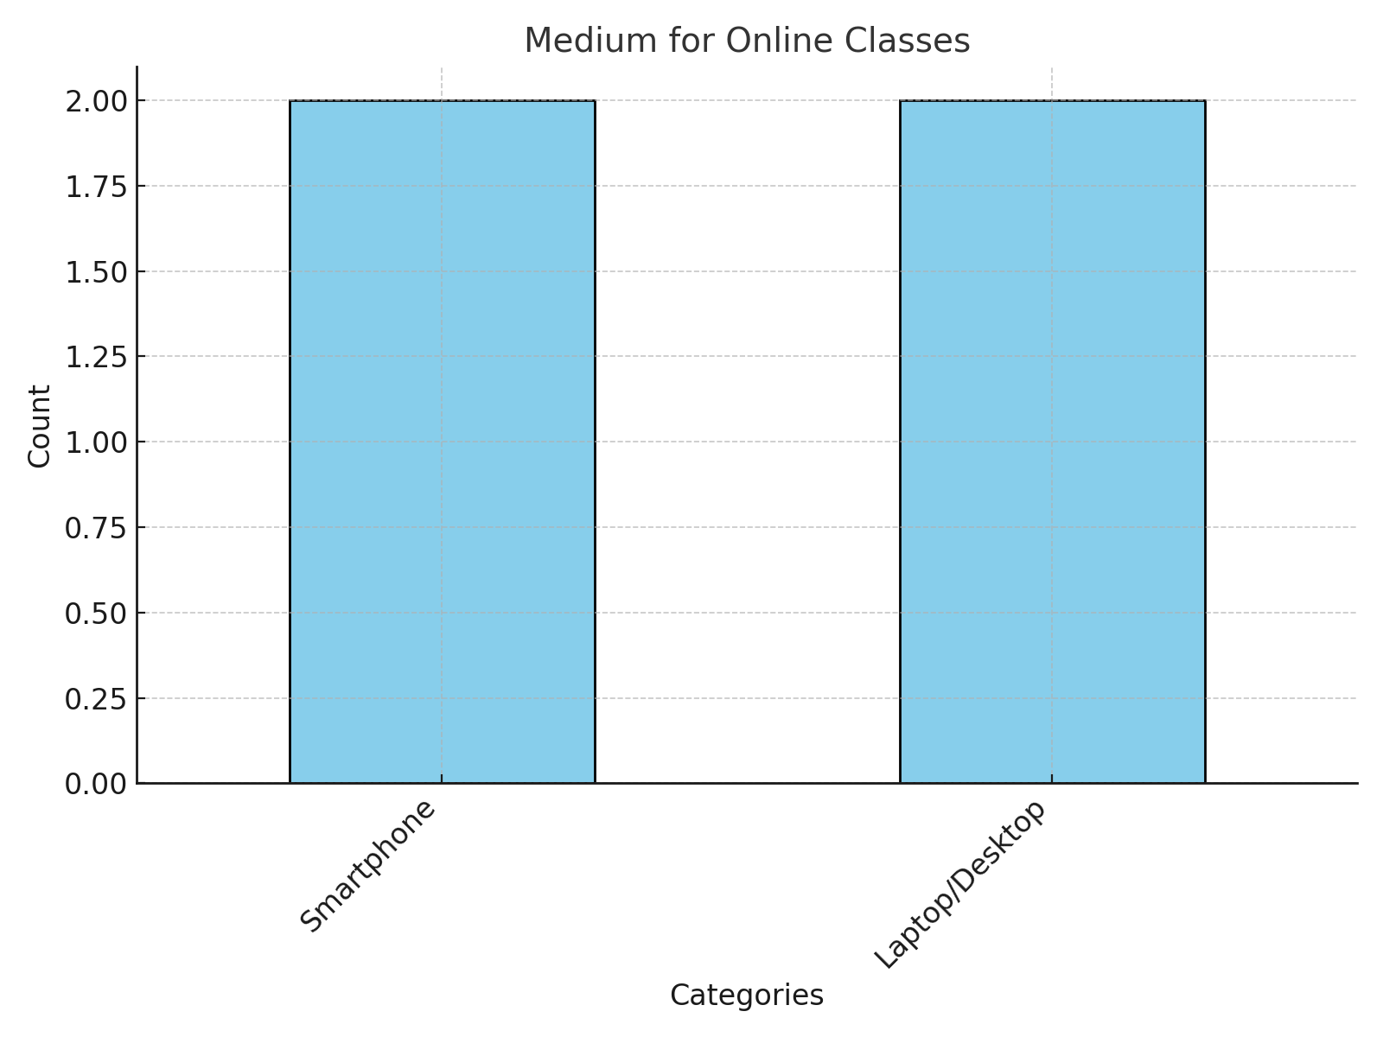
Medium Wise

Slide 5
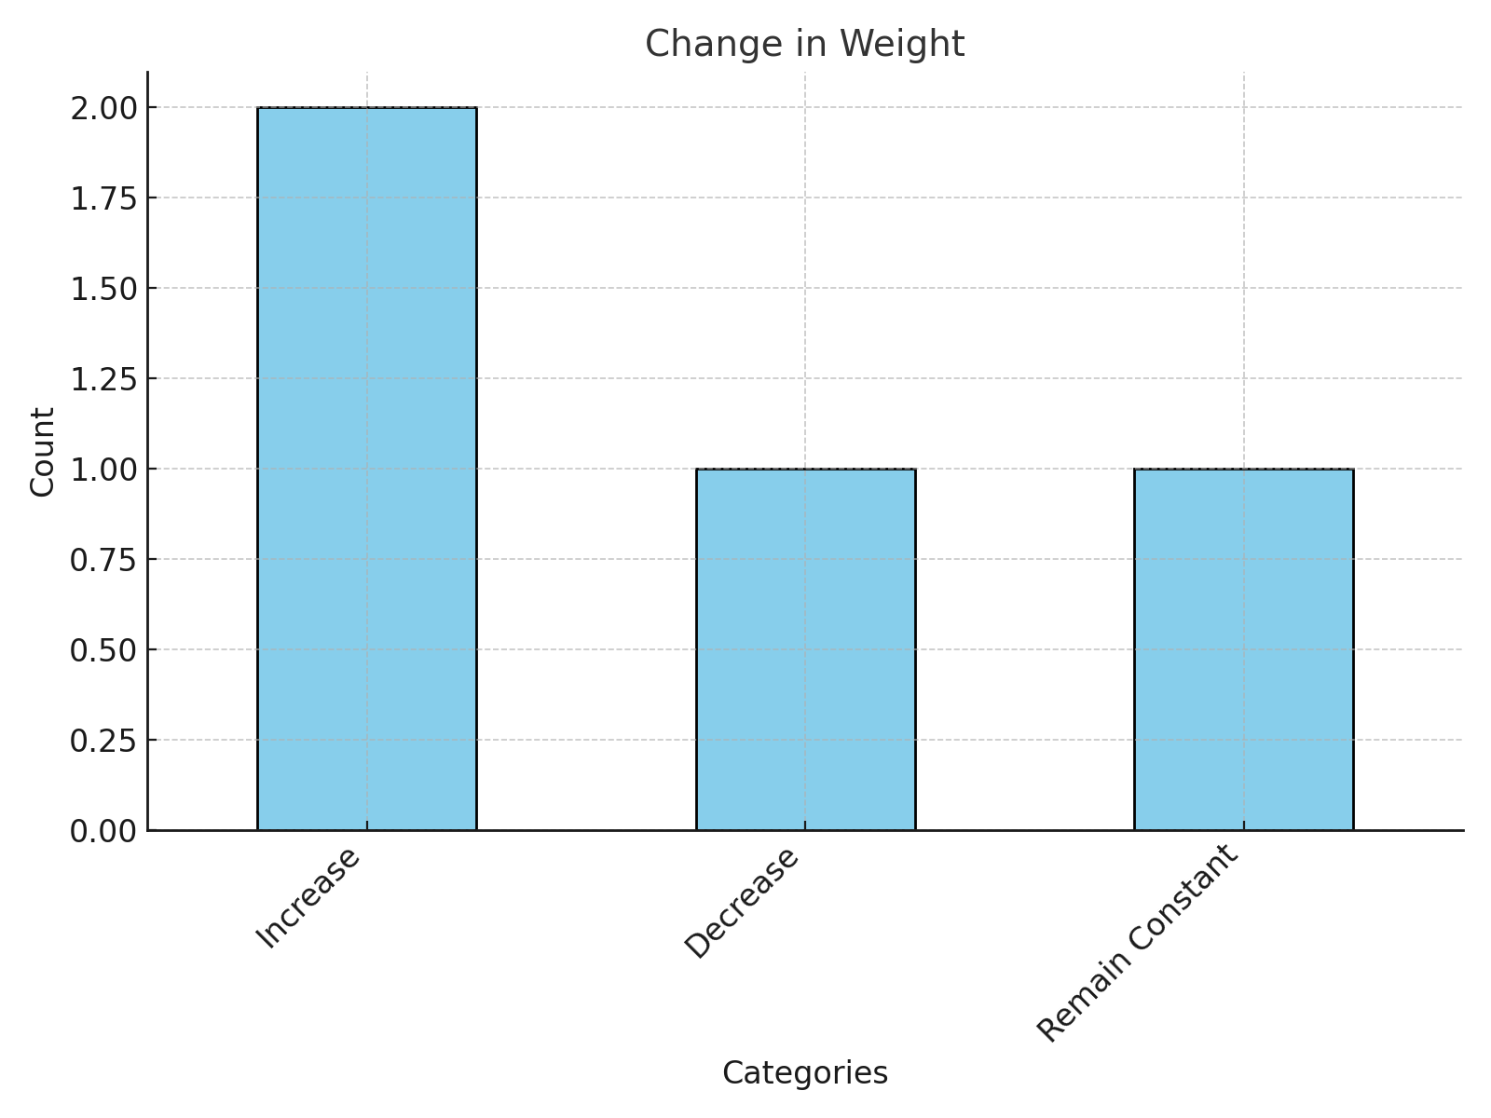
Affect on Weight

Slide 6
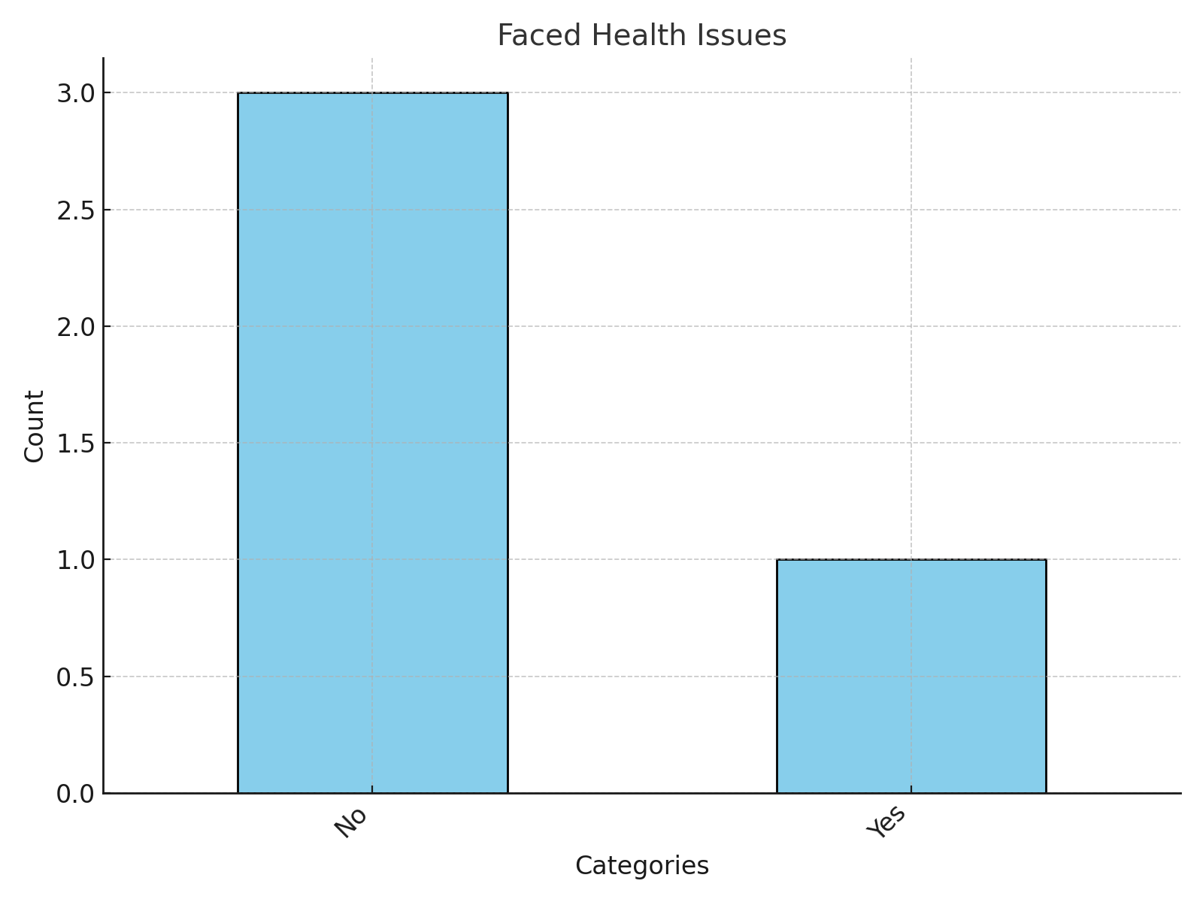
Health Issues wise

Slide 7
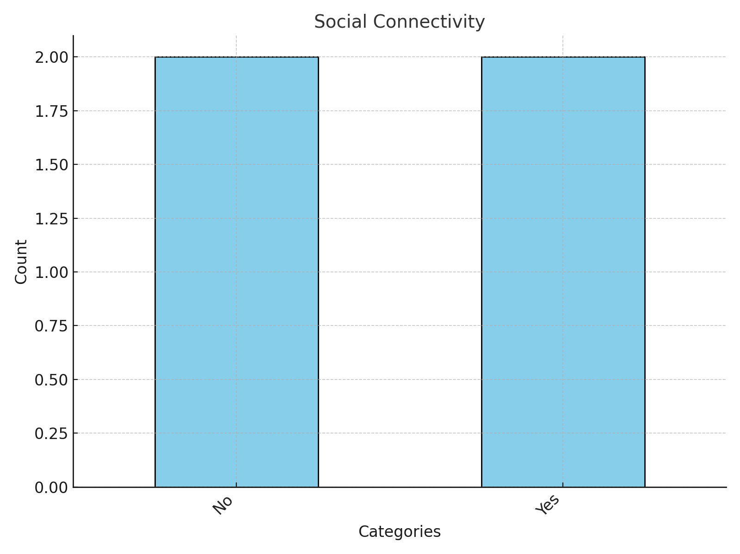
Social Connect

Slide 8
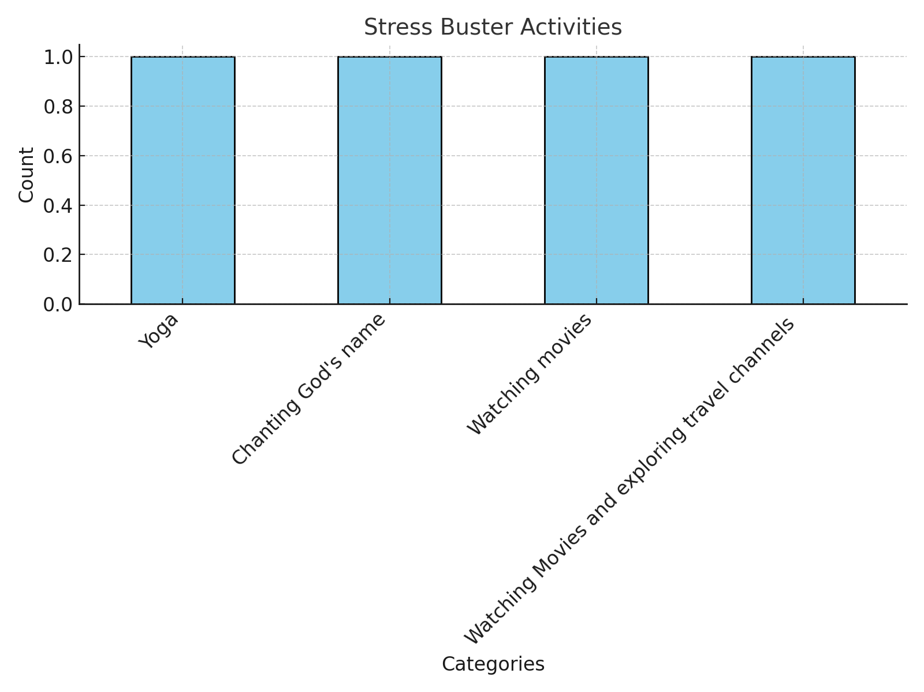
Stress Buster wise

