Slide 1
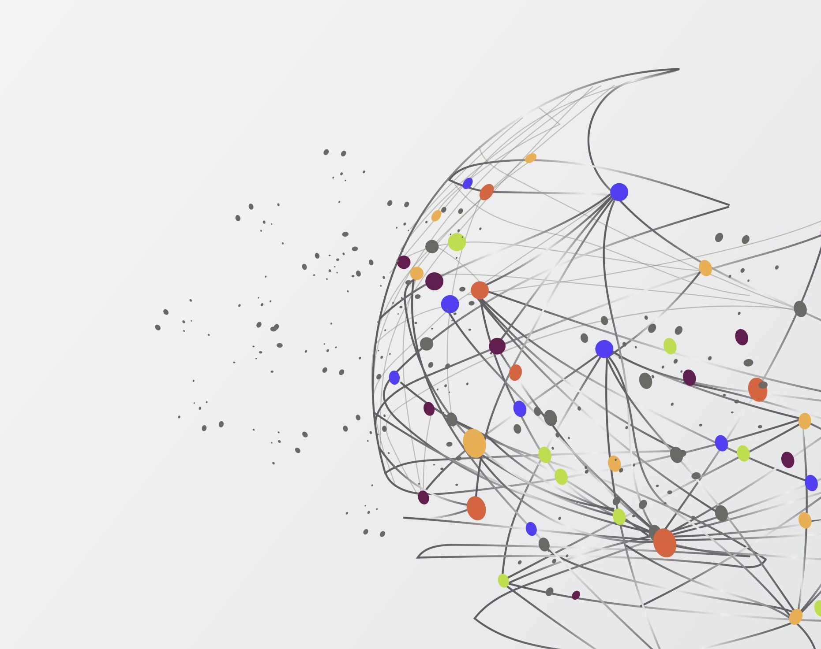
Data Science
From Data to Actionable Business Insight

Slide 2
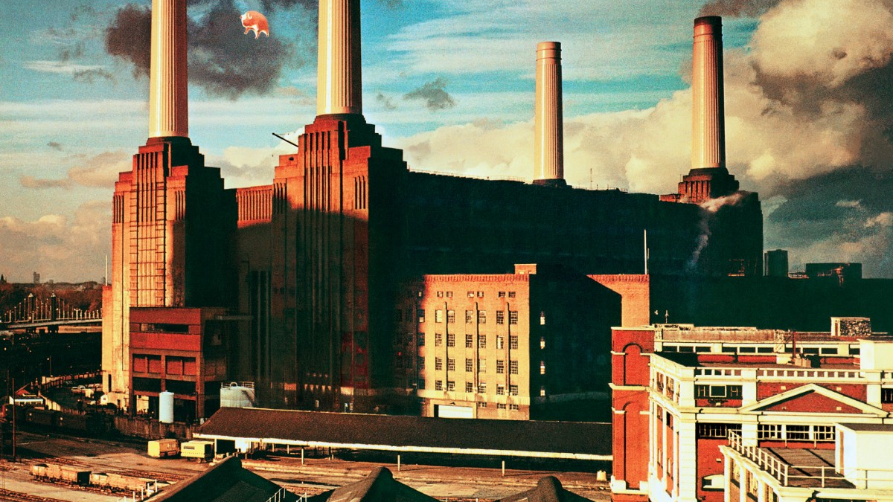
Industrial Revolution

Slide 3








Industrial Revolution
Industry 4.0
IoT – Internet of things
Cyber Security,
Cloud Computing,
Augmented Reality
Blockchain
Industry 3.0
Computers
Automation
Electronics
Industry 2.0
Industry 1.0
Mass Production, Assembly Line manufacturing,
AC / DC power supply
Steam Power, mechanization, power looms

Slide 4
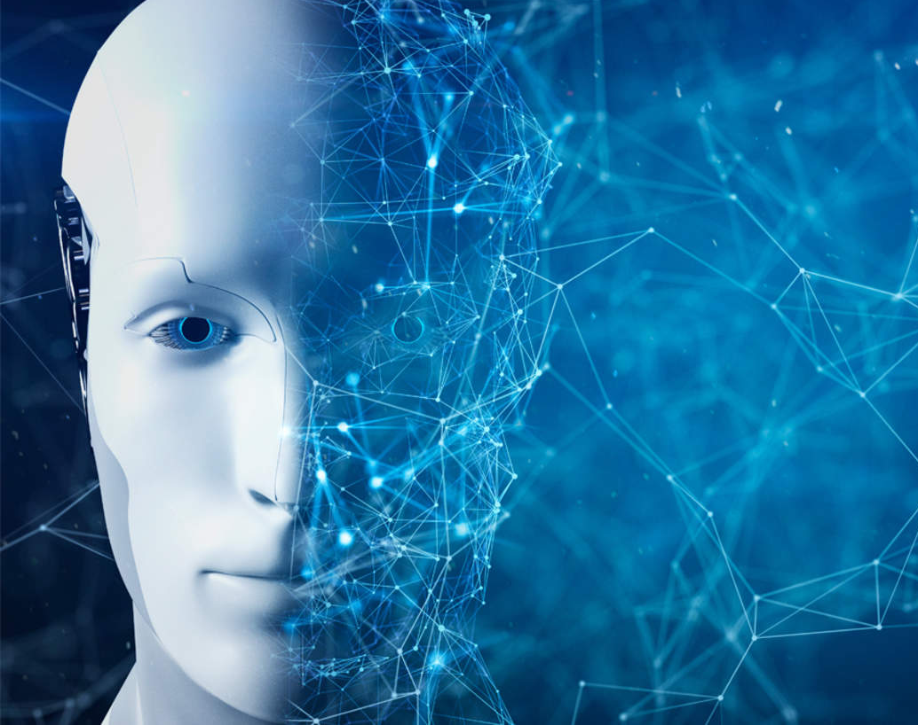
Welcome to the Data

Slide 5
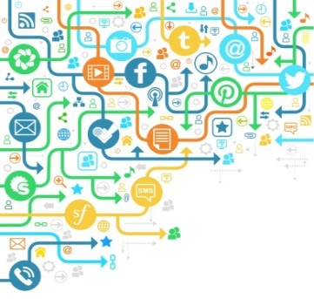
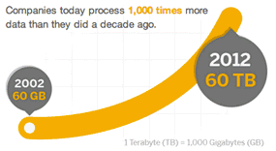

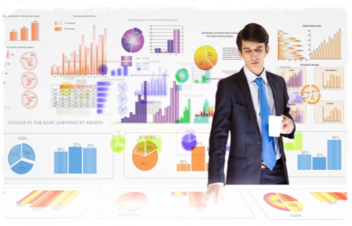

What is Data Science?
Discovering & communicating patterns and insights in data which are beyond the obvious
Why Business Analytics ?
Gain competitive advantage
Synchronize financial & operational strategy
Increase revenues
Tackle regulatory reform
Realize cost efficiency
Manage risk
Improve decision making
The Journey from Data to Business Value
Leading to
Data
Explosion
Multiple Data Sources (Structured & Unstructured)
What action to be taken for profits to increase?
Descriptive
What is this quarters contribution margin?
Generate actionable insights & Dollar-Value
Data
Prescriptive
Inquisitive
What will be our sales volume in the next quarter?
Why has this quarters sales gone down?
Predictive

Slide 6
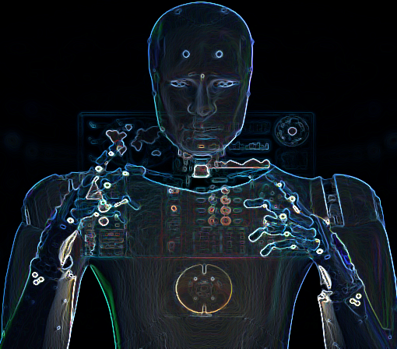
Age of iNetlligent Machines
Machine Learning
Artificial Intelligence
Enable computers to perform Tasks without explicit programming.
Science of developing machines to Think and Act like humans.
Deep Learning
Subset of machine learning comprising of advanced Deep layered Artificial Neural Networks

Slide 7
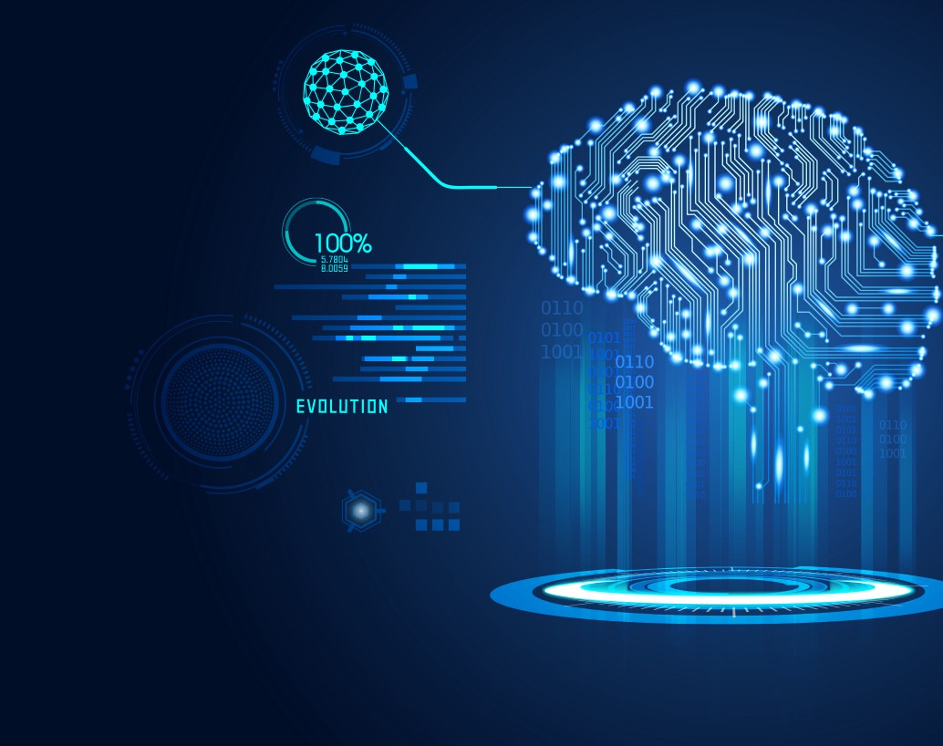
What it means to be a Data Scientist

Slide 8
Curiosity + Quest for Leaning New Frontiers
Yet another programmer ?
Yet another Statistician ?
Yet another Business SME ?
Answer is NO !!!
We need Sherlock Holmes
Solve Business Problems

Slide 9

Applications

Slide 10

Current Industry Applications
Sentiment Analysis of Twitter data
Prediction of Ratings based on product feedback
Classify best fit resume based on Job description
Social Media analysis of a company
Predicting author of a document
Natural Language Processing
Prediction of Share Values
Housing price prediction
Fraud detection in a claim transaction
Supermarket recommendation of products
Identify duplicate records in multiple database using Machine Learning techniques
Event Prediction
Prediction of image tags
Product recommendations based on an input image
Language models to provide near human level Essay writing
Deep Learning

Slide 11
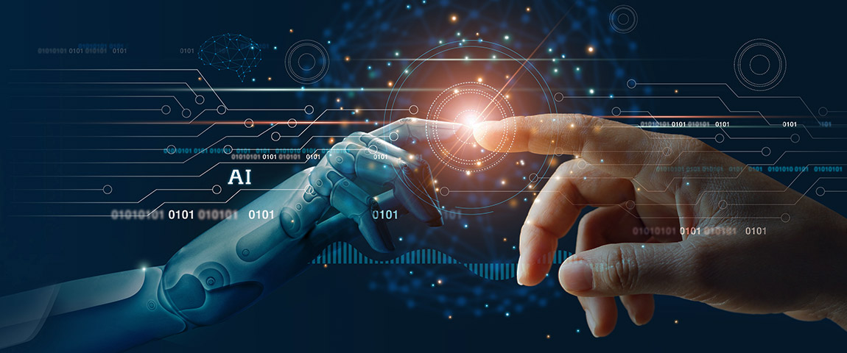
Market your skills
Maintain GitHub Repository
Arrange GitHub repo of solved Kaggle Datasets
Kaggle Profile
Solve min. 20 Data sets of Image & Text Processing

Slide 12
Thank You

