Slide 1
Singular Value Decomposition
Introduction

Slide 2
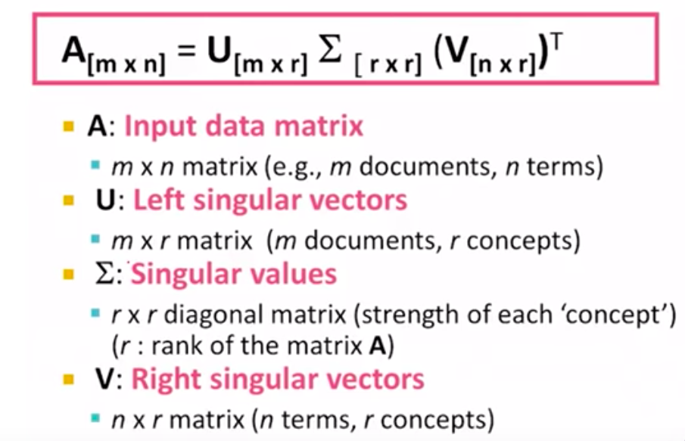
Singular Value Decomposition

Slide 3
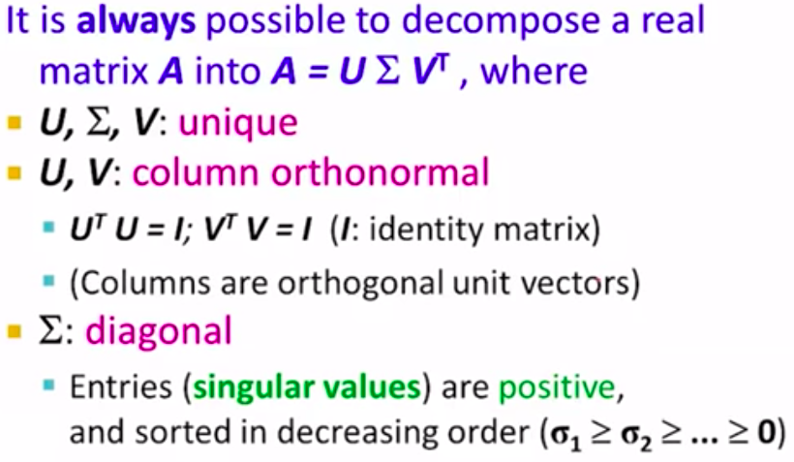
Singular Value Decomposition

Slide 4
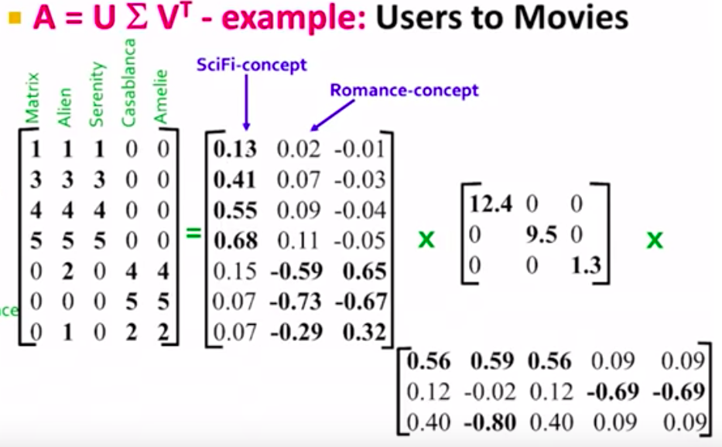
Singular Value Decomposition

Slide 5
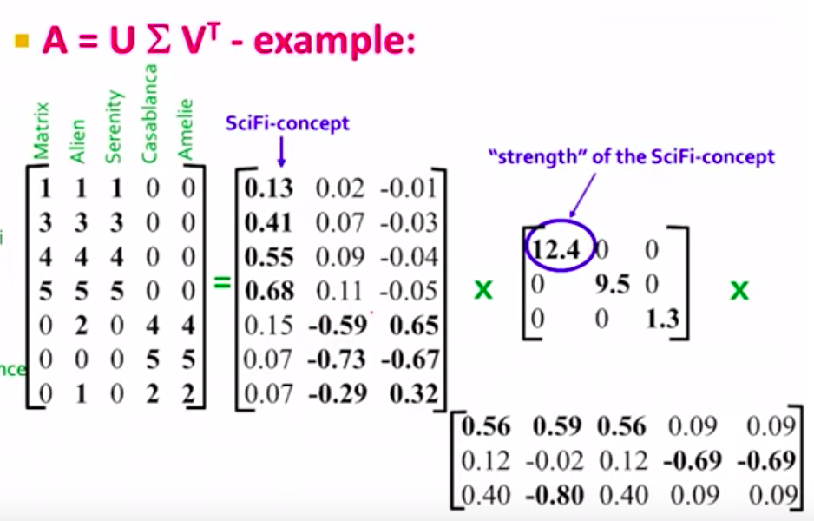
Singular Value Decomposition

Slide 6
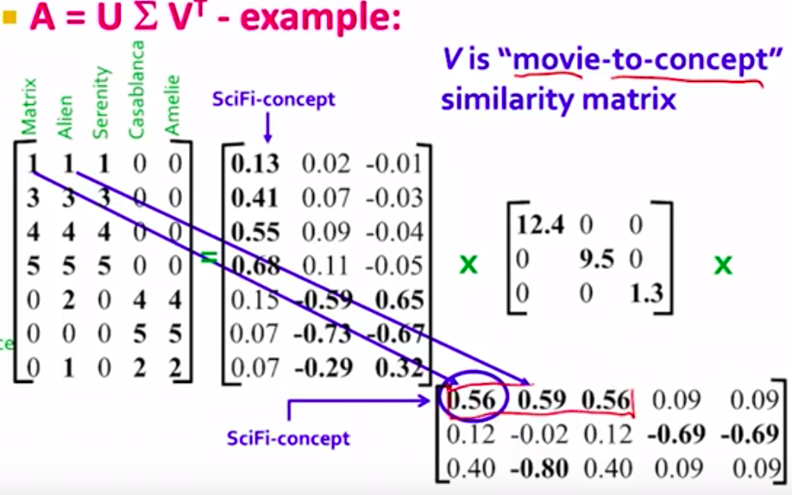
Singular Value Decomposition

Slide 7
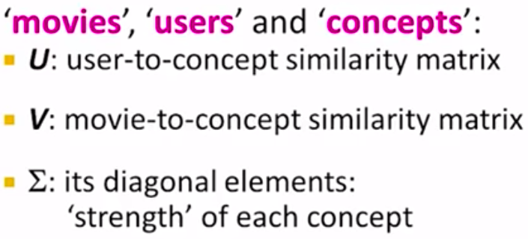
Singular Value Decomposition

Slide 8
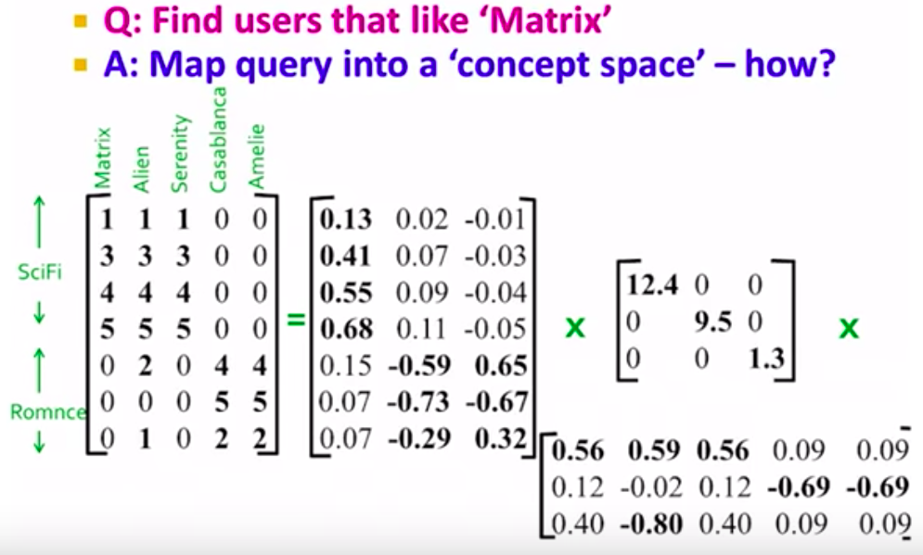
Singular Value Decomposition

Slide 9
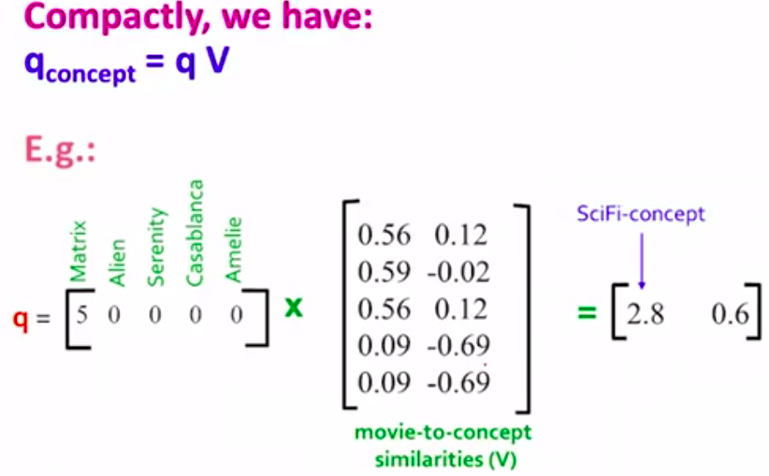
Singular Value Decomposition

Slide 10
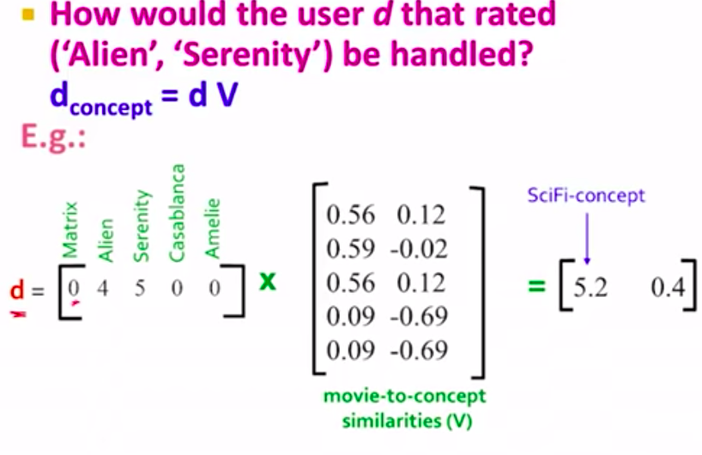
Singular Value Decomposition

Slide 11
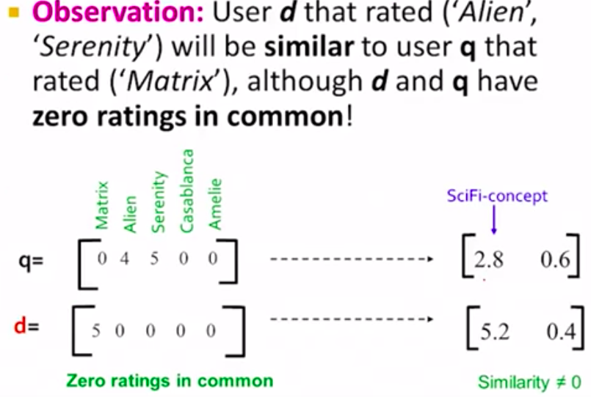
Singular Value Decomposition

