Slide 1
Linear correlation and linear regression

Slide 2
Scatter Plots of Data with Various Correlation Coefficients
Y
Y
Y
X
X
X
r = -1
r = -.6
r = 0
Y
Y
Y
X
X
X
r = +1
r = +.3
r = 0

Slide 3
Linear Correlation
Linear relationships
Curvilinear relationships
Y
Y
X
X
Y
Y
X
X

Slide 4
Linear Correlation
Strong relationships
Weak relationships
Y
Y
X
X
Y
Y
X
X

Slide 5
Linear Correlation
No relationship
Y
X
Y
X

Slide 6
Linear regression
In correlation, the two variables are treated as equals. In regression, one variable is considered independent (=predictor) variable (X) and the other the dependent (=outcome) variable Y.

Slide 7
What is “Linear”?
Remember this:
Y=mX+B?
m
B

Slide 8
What’s Slope?
A slope of 2 means that every 1-unit change in X yields a 2-unit change in Y.

Slide 9
Prediction
If you know something about X, this knowledge helps you predict something about Y. (Sound familiar?…sound like conditional probabilities?)

Slide 10
Regression equation…
Expected value of y at a given level of x=

Slide 11
Predicted value for an individual…
y_{i}= α + β*x_{i} + random error_{i}
Fixed – exactly on the line
Follows a normal distribution

Slide 12
Assumptions (or the fine print)
Linear regression assumes that…
1. The relationship between X and Y is linear
2. Y is distributed normally at each value of X
3. The variance of Y at every value of X is the same (homogeneity of variances)
4. The observations are independent

Slide 13
The standard error of Y given X is the average variability around the regression line at any given value of X. It is assumed to be equal at all values of X.
Sy/x
Sy/x
Sy/x
Sy/x
Sy/x
Sy/x

Slide 14
Regression Picture
y_{i}
C
A
B
y
B
A
C
y_{i}
*Least squares estimation gave us the line (β) that minimized C²
x
R²=SSreg/SStotal
A² B² C²
SS_{total}
Total squared distance of observations from naïve mean of y
Total variation
SS_{reg}
Distance from regression line to naïve mean of y
Variability due to x (regression)
SS_{residual}
Variance around the regression line
Additional variability not explained by x—what least squares method aims to minimize

Slide 15
Multiple Linear Regression
More than one predictor…
E(y)= α + β₁*X + β₂ *W + β₃ *Z…
Each regression coefficient is the amount of change in the outcome variable that would be expected per one-unit change of the predictor, if all other variables in the model were held constant.

Slide 16
Residual Analysis for Linearity
Y
Y
x
x
residuals
x
x
residuals
Not Linear
✓
Linear

Slide 17
Residual Analysis for Homoscedasticity
Y
Y
x
x
residuals
x
x
residuals
✓
Non-constant variance
Constant variance

Slide 18
Residual Analysis for Independence
Not Independent
✓
Independent
residuals
X
residuals
X
residuals
X

Slide 19
Other types of multivariate regression
Multiple linear regression is for normally distributed outcomes
Logistic regression is for binary outcomes

Slide 20
Common multivariate regression models.
Outcome (dependent variable) | Example outcome variable | Appropriate multivariate regression model | Example equation | What do the coefficients give you?
Continuous | Blood pressure | Linear regression | blood pressure (mmHg) = α + βsalt*salt consumption (tsp/day) + βage*age (years) + βsmoker*ever smoker (yes=1/no=0) | slopes—tells you how much the outcome variable increases for every 1-unit increase in each predictor.
Binary | High blood pressure (yes/no) | Logistic regression | ln (odds of high blood pressure) = α + βsalt*salt consumption (tsp/day) + βage*age (years) + βsmoker*ever smoker (yes=1/no=0) | odds ratios—tells you how much the odds of the outcome increase for every 1-unit increase in each predictor.

Slide 21
Multivariate regression pitfalls
Multi-collinearity
Residual confounding
Overfitting

Slide 22
Multicollinearity
Multicollinearity arises when two variables that measure the same thing or similar things (e.g., weight and BMI) are both included in a multiple regression model; they will, in effect, cancel each other out and generally destroy your model.
Model building and diagnostics are tricky business!

Slide 23
Residual confounding
You cannot completely wipe out confounding simply by adjusting for variables in multiple regression unless variables are measured with zero error (which is usually impossible).
Example: meat eating and mortality

Slide 24
Overfitting
In multivariate modeling, you can get highly significant but meaningless results if you put too many predictors in the model.
The model is fit perfectly to the quirks of your particular sample, but has no predictive ability in a new sample.

Slide 25
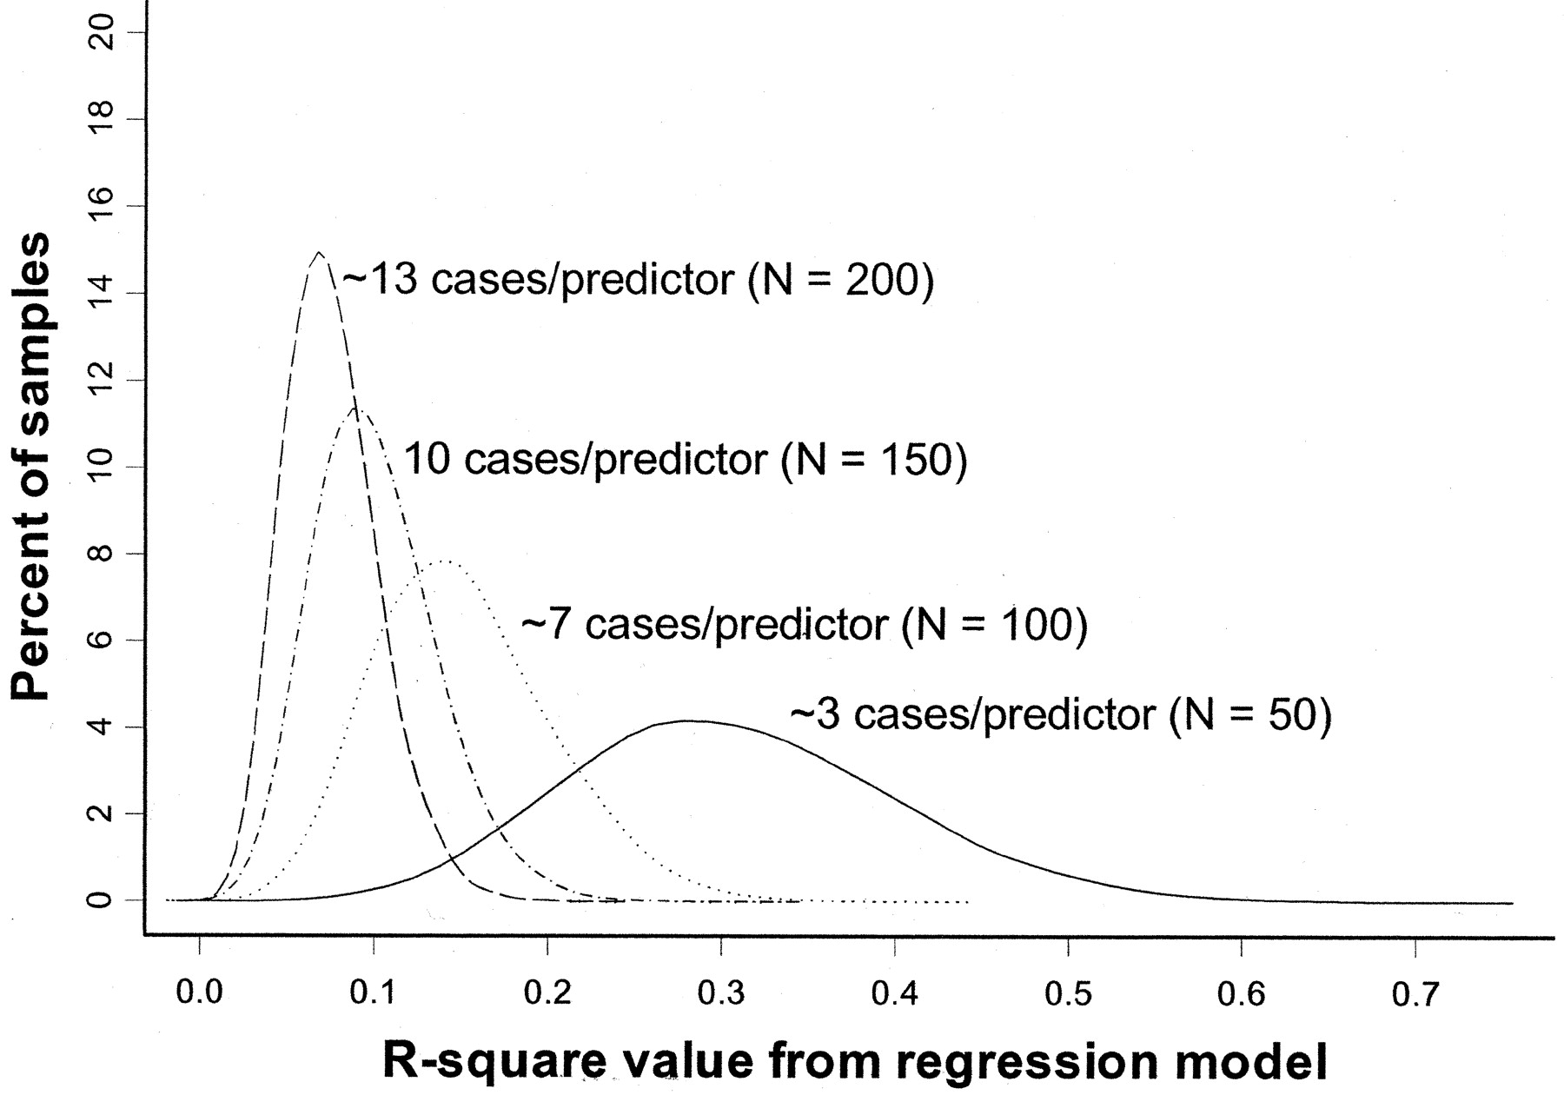
Overfitting
Rule of thumb: You need at least 10 subjects for each additional predictor variable in the multivariate regression model.
Pure noise variables still produce good R² values if the model is overfitted. The distribution of R² values from a series of simulated regression models containing only noise variables.
(Figure 1 from: Babyak, MA. What You See May Not Be What You Get: A Brief, Nontechnical Introduction to Overfitting in Regression-Type Models. Psychosomatic Medicine 66:411-421 (2004).)

Slide 26
Review of statistical tests
The following table gives the appropriate choice of a statistical test or measure of association for various types of data (outcome variables and predictor variables) by study design.
e.g., blood pressure= pounds + age + treatment (1/0)
Continuous outcome
Continuous predictors
Binary predictor

