Slide 1
OPEN SYSTEM CALL
PARAG DUDEJA
20234757030

Slide 2
Open
Open is the first step to access data in a file.
Usage:
fd = open (pathname, flags, mode);
where flags indicate the type of open (reading or writing) and mode gives the permissions if the file is being created. It returns an integer called the user file descriptor. Other file operations use the file descriptor returned by open.

Slide 3
Use of flags
If the specified file does not exist, it may optionally (if O_CREAT is specified in flags) be created by open().
The argument flags must include one of the following access modes: O_RDONLY, O_WRONLY, or O_RDWR.
These request opening the file read-only, write-only, or read/write, respectively.
The file creation flags are
O_CLOEXEC, O_CREAT, O_DIRECTORY, O_EXCL, O_NOCTTY, O_NOFOLLOW, O_TMPFILE, and O_TRUNC.

Slide 4
Mode
mode applies only to future accesses of the newly created file; the open() call that creates a read-only file may well return a read/write file descriptor.
The following symbolic constants are provided for mode:
S_IRWXU 00700 user (file owner) has read, write, andexecute permission
S_IRUSR 00400 user has read permission
S_IWUSR 00200 user has write permission
S_IXUSR 00100 user has execute permission
And many more (https://man7.org/linux/man-pages/man2/open.2.html)

Slide 5
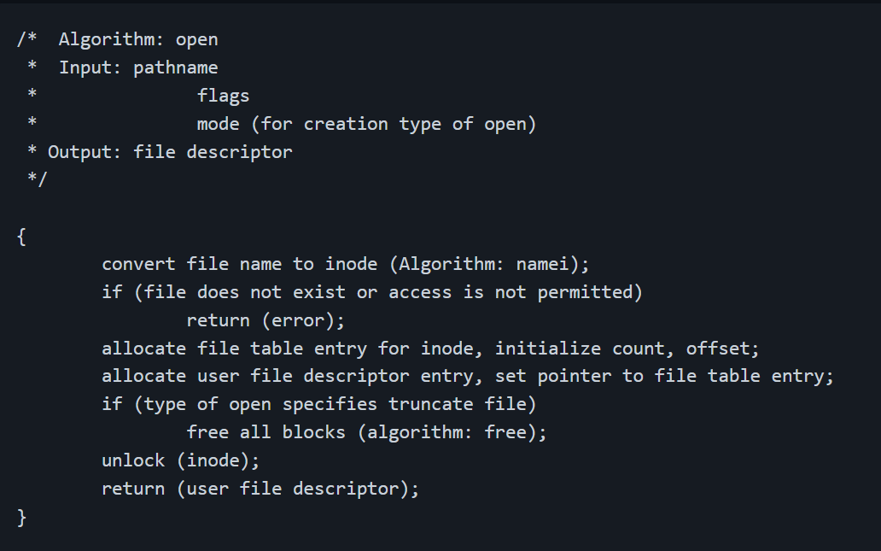
Algorithm

Slide 6
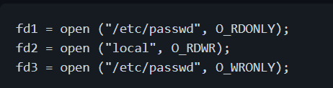
Example

Slide 7
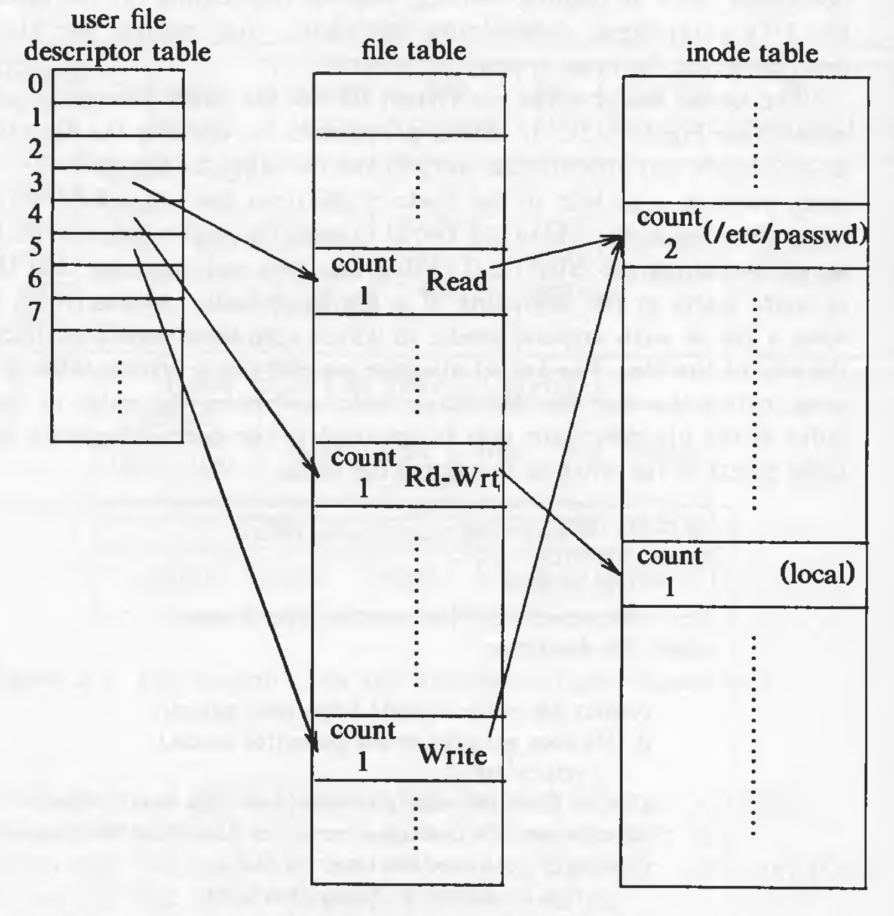

Slide 8

Process B

Slide 9
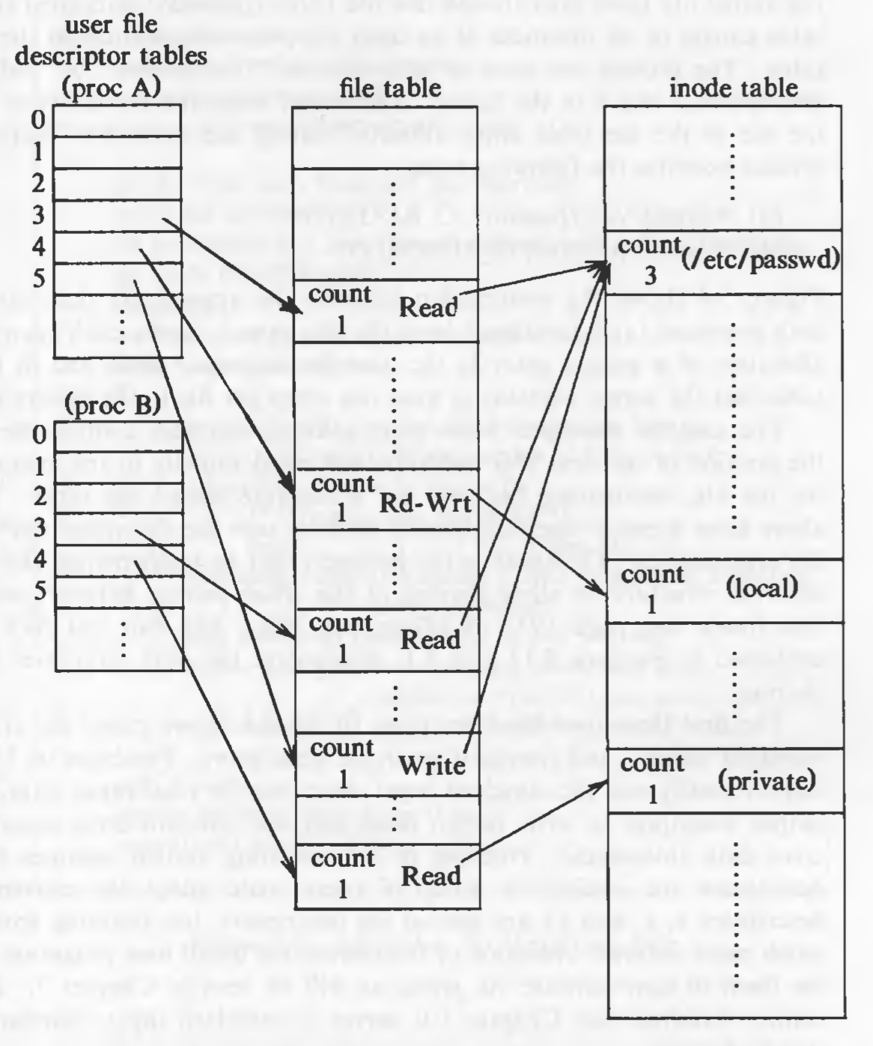

Slide 10
BIBILIOGRAPHY
Linux Manual Page(https://man7.org/linux/man-pages/man2/open.2.html)
Maurice J. Bach, Design of the UNIX Operating System, Prentice Hall, 1986

