Slide 1



HOSTELITES
By- NAMAN AGARWAL (1BM18CS057), NIMIT SAJAL (1BM18CS063) ,
PARAG GATTANI (1BM18CS067),Rutazeet Ritik rout(1bm18cs151)

Slide 2
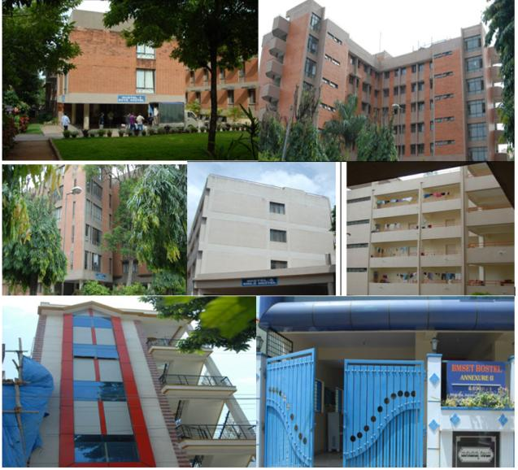
INDEX
Introduction and Objective
Proposed System
Hardware and Software Requirements
ER Diagram and Schema Diagram
Architecture
Login Page
Account Details
Home Page
Events
Feed
Facilities
Bank
Help
Food
Buy/Sell
Result and Conclusion
Future Enhancement

Slide 3
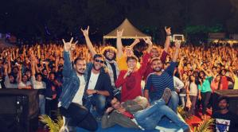

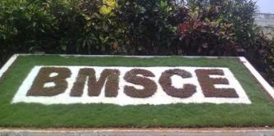
INTRODUCTION
Aim
To create a Web-Portal which provides a platform for the B.M.S.C.E Hostilities to get to know about the Hostels and for them to always be updated about the activities happening and participate in them.
Introduction
We have made a fully functional and interactive Web-Portal for the B.M.S.C.E Hostilities that creates a platform that enables the students to know about the Hostels and full fill their basic needs, all at the comfort of their rooms. This website also provides better interaction between the management and the students, and also among students and the neighbourhood shopkeeper.

Slide 4
OBJECTIVE
To provide students information about the canteens and the mess, their menus and their timings on the go.
To increase student participation in the activities taking place in the hostels by making them aware of the upcoming activities, host events and provide their valuable feedbacks on the events.
To allows better interaction between the management and the students, by enabling the hostilities to decide menu, request facilities or report facilities provided by the hostel management.
To ease up the process of settlement of the fresher's by connecting them directly to the venders and individual sellers.
To constantly updated contact information of all the hostel personal, bank information and emergency contacts on a same portal.
To enable the canteen owners to modify their items and the vendors to sell essential products on the website directly.

Slide 5
PROPOSED SYSTEM
Our project aims for the ease and comfortability of students by providing them a platform where they can get or sell things.
It also aims on increasing the quality of food and facilities available to them.
It also helps in the interaction of students with seniors and juniors by participating in physical and academic or technical events hosted by students only, which indeed make students responsible for hosting and managing events.

Slide 6

HARDWARE AND SOFTWARE REQUIREMENTS
Hardware Requirements:
A PC with the following or greater specifications:
Intel Core i3 (5th gen or higher)
4 GB RAM
500 GB Hard Drive
A stable internet connection (2Mbps or higher).
Software Requirements:
Operating system :- Windows 8 or Above
Technologies :- HTML, CSS, JavaScript, PHP, My SQL
Browser :- Google Chrome/Microsoft Edge / Mozilla Firefox

Slide 7
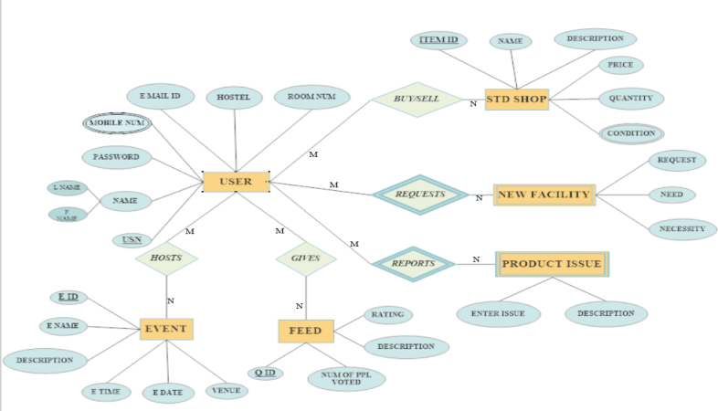
ER DIAGRAM

Slide 8
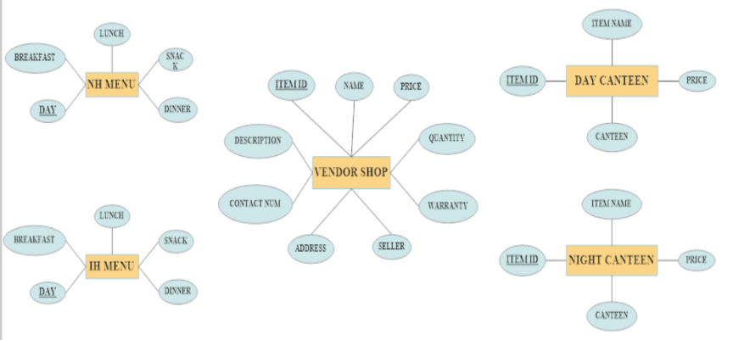

Slide 9
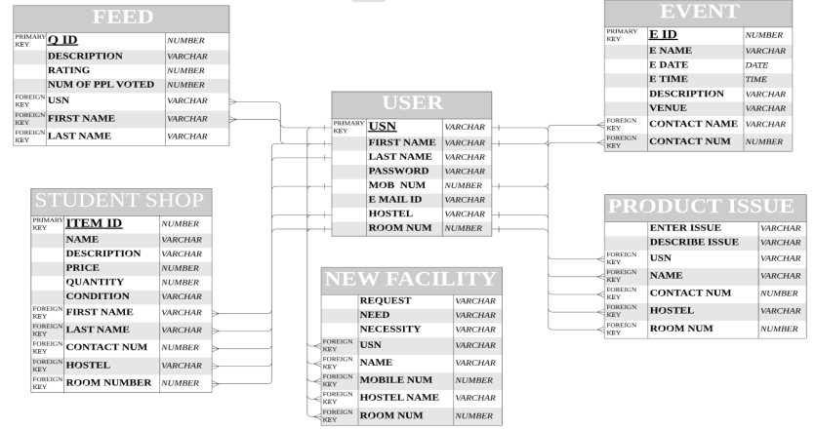
SCHEMA DIAGRAM

Slide 10
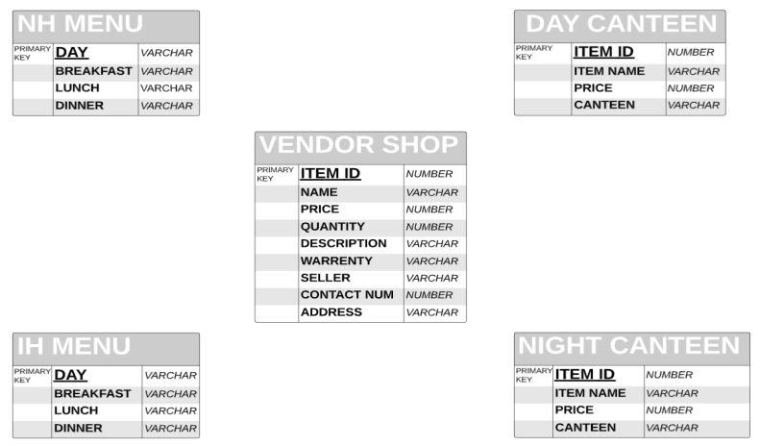

Slide 11
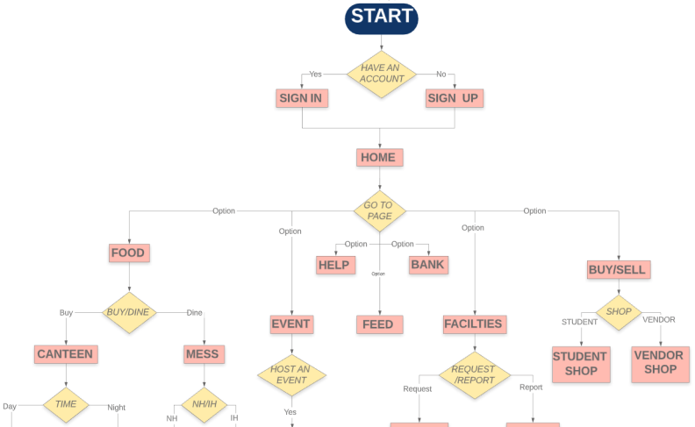
ARCHITECTURE

Slide 12
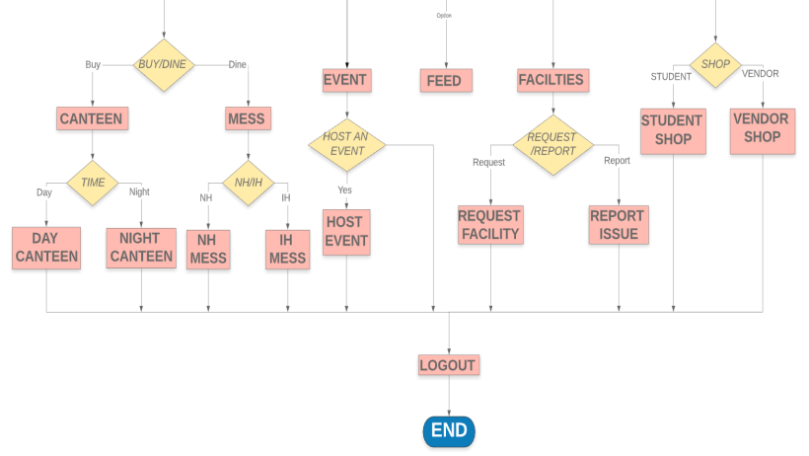

Slide 13
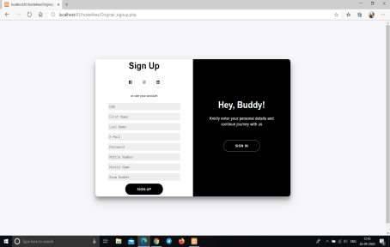
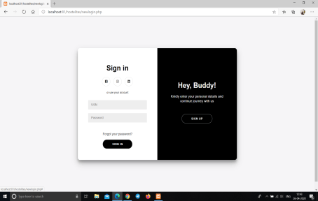
LOGIN PAGE
Sign-In / Sign-Up Screen
Our Sign-In and Sign-Up page heavily uses collapsible tables along with CSS, JavaScript and PHP to create new users as well as authenticate the existing users and log them in the home page.
SIGN - UP
SIGN - IN

Slide 14
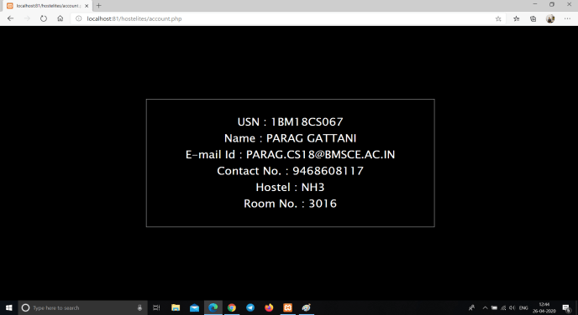
ACCOUNT DETAILS
Our account details page gives the user information of the current user after it has been authenticated by the login procedure.

Slide 15
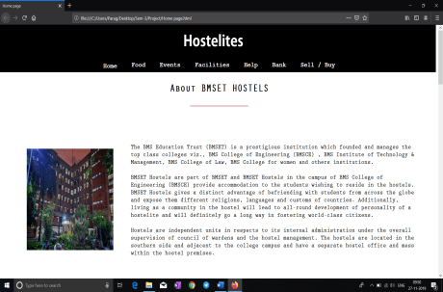
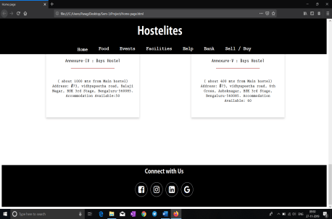
HOME PAGE
Our homepage shows the basic details of all the inside campus as well as outside campus of B.M.S. Hostels as well as the details of each building under hostel department.

Slide 16
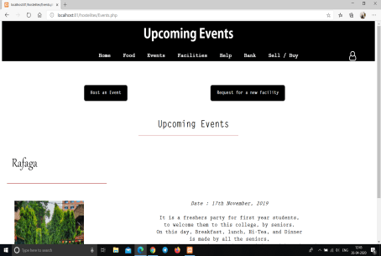
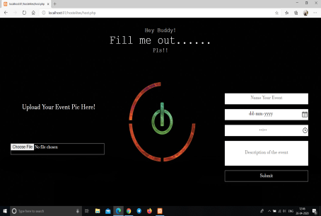
EVENTS
Our events page shows all the upcoming events that are being organized by the hostel committee as well as a few details about them.
The events page has option to host event available to the administrator where they can add the name, date and time of the event and describe the event.
EVENTS
HOST EVENT

Slide 17
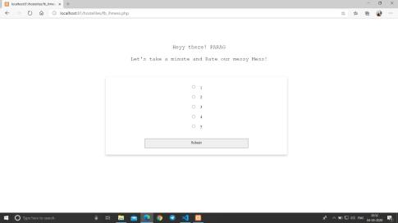
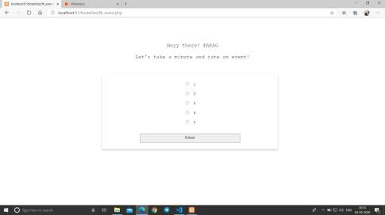
FEEDBACK
Our feedback page takes the feedback of events, food items in the mess from the hostilities in the form of rating and conveys it to the administration.
EVENT FEEDBACK
FOOD FEEDBACK

Slide 18
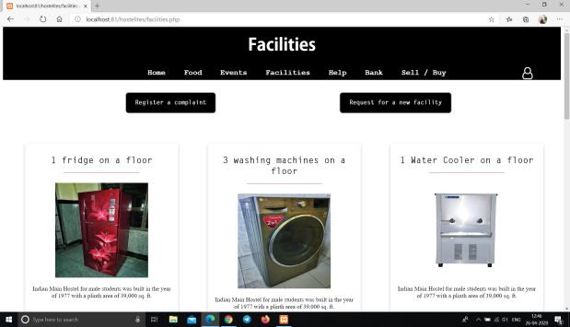
FACILITIES
Our facilities page displays the different facilities readily available for students to use in the hostel.
The student can request for a new facility or they can register a complaint of an existing facility.
FACILITY

Slide 19
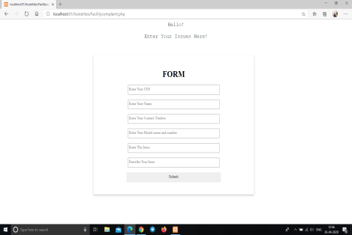
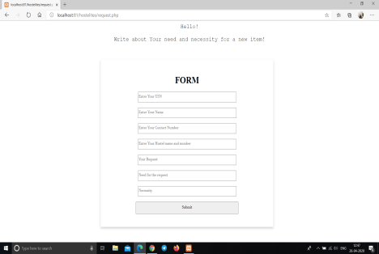
REQUEST FOR A NEW FACILITY
REGISTER A COMPLAIN

Slide 20
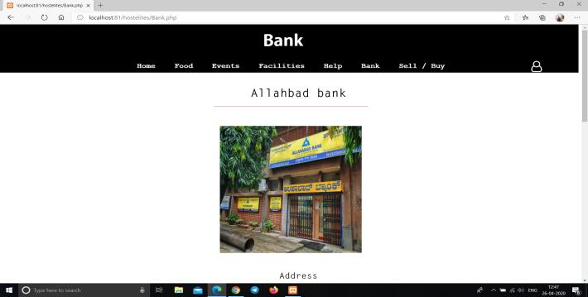
BANK
Our bank page shows the details for the in campus Allahabad bank such as IFSCE code, Bank timings etc.

Slide 21
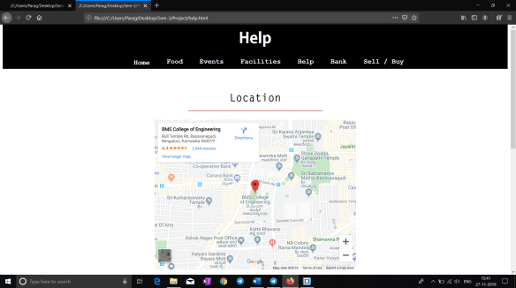
HELP PAGE
Our help page is integrated with Google Maps and it displays a link for the Google Maps of the hostel as well as displays the telephone numbers of all the wardens with the functionality of calling them from the website itself.

Slide 22
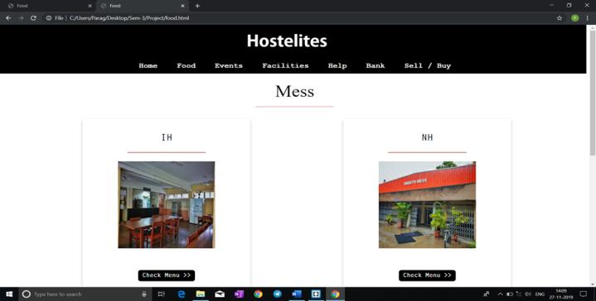
FOOD
Our food page displays the menu of each day of International Mess as well as the National Mess and the various canteens in the hostel vicinity.
HOSTEL MESS

Slide 23
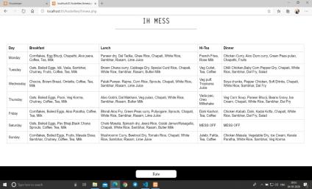
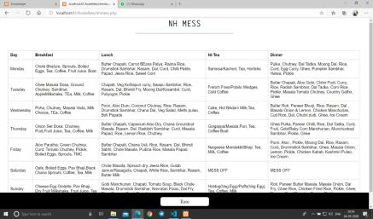
IH MESS
NH MESS

Slide 24
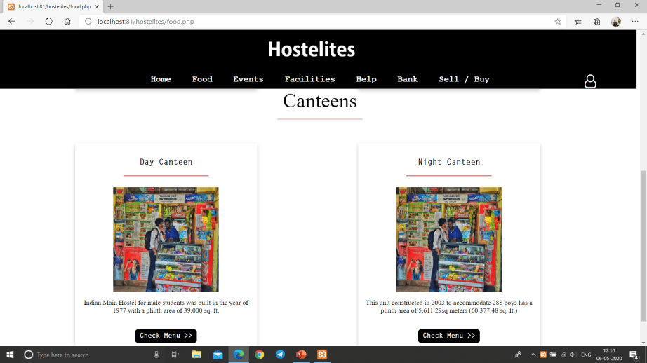
HOSTEL CANTEENS

Slide 25
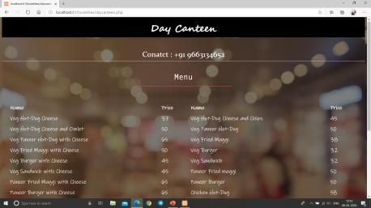
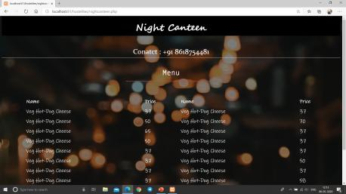
DAY CANTEEN
NIGHT CANTEEN

Slide 26
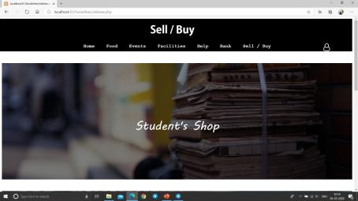
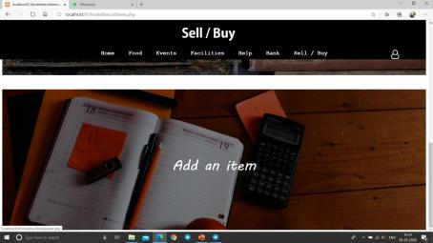
BUY/SELL
Our buy/sell page has an array of used as well as new items available for the user to buy with add to cart, remove from cart as well as view cart and clear cart functionalities.
SELL ITEM
SHOP

Slide 27
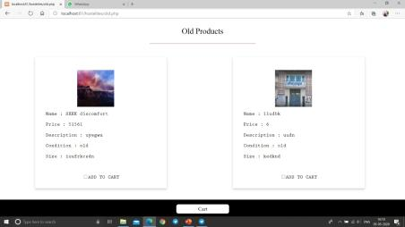
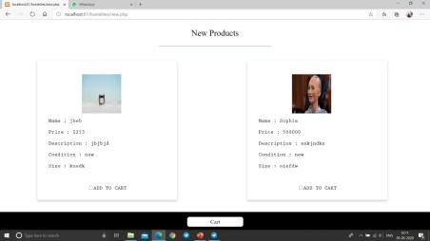
NEW PRODUCT
OLD PRODUCT

Slide 28
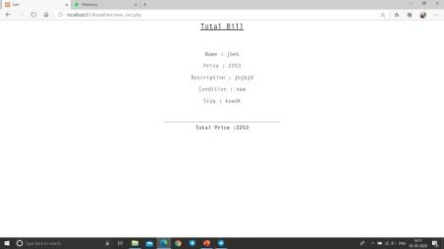
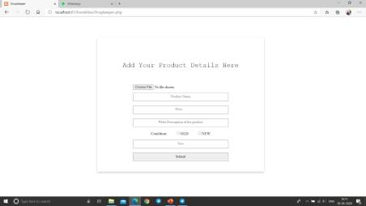
CART
ADD ITEM

Slide 29
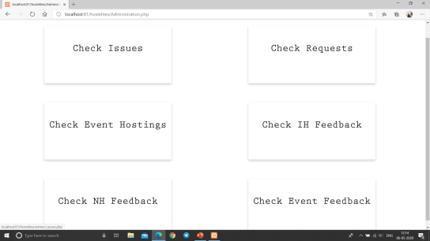
ADMINISTRATION
In this page administration can login and check for issues, requests for facilities, events being hosted by students and the feedback of IH and NH mess and events feedback, that are submitted or reported by students.
ADMINISTRATION

Slide 30
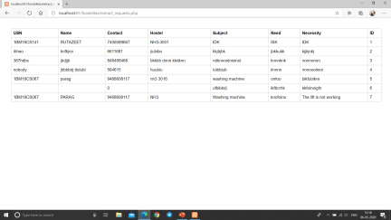
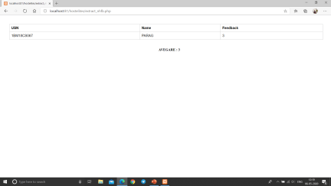
Requests
NH MESS FEEDBACK

Slide 31
RESULT AND CONCLUSION
We have made a fully functional and interactive Web-Portal for the B.M.S.C.E Hostilities that creates a platform that enables them to know about the Hostels.
Our project is extremely beneficial for fresher's as it allows them to get acquainted with the hostel and feel it as their second home.
Our portal even allows the hostilities to easily communicate with the hostel management and provide them with their valuable suggestions.
Our portal also increases the participation among the residents, where they can buy and sell their items, hosts events, give feedbacks on the events and also decide menu, all in the comfort of their own room.
Our portal even allows the vendors to sell their goods using this portal and also allows the canteen owners to modify their items.

Slide 32
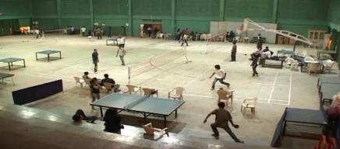
FUTURE ENHANCEMENT
Allow parents to see their wards daily attendance.
Provide real time FAQ and community post for better interactions among the juniors and the seniors.
Connect the neighbourhood food courts and allow delivery of those items.
Create play mates to play sports or do other activities together allowing better interactions among students and allowing them to make new friends and pursue their hobby.

Slide 33
THANK YOU

