Slide 1
whoami
Application Security and Crypto Auditing
Open source security researcher since 2013
  Many CVEs from side-channels to RCE
CDO, Paragon Initiative Enterprises since 2015
  https://paragonie.com
Scott Arciszewski
  Ar as in art, cis as in scissors, zew as zoo, ski as in skiis
Twitter: @CiPHPerCoder
Github: sarciszewski, paragonie-scott

Slide 2
Building Defensible Solutions to Weird Problems

Slide 3
The Meta Problem
“Don’t roll your own crypto!” - Everyone
  That isn’t helpful advice when the problem you’re trying to solve is weird
  If a solution isn’t available, you have to (on some level) roll your own crypto to solve the problem
  That doesn’t mean be totally reckless
    Use experts’ recommendations where you can

Slide 4
TL;DW
Understanding cryptography is extremely useful, even if you’re solving totally unorthodox problems
If you’re solving orthodox problems, just use TLS (in transit) or libsodium (at rest) and save yourself the headache of novel protocol analysis
If you aren’t immediately sure if your problem is unorthodox:
  Watch the entire talk, OR
  Consult with cryptography specialists
Your most important document is your threat model

Slide 5
Rules of Engagement
Always use authenticated encryption
Crypto coding standards
  https://cryptocoding.net/index.php/Coding_rules
  https://paragonie.com/b/5icowx2WfyrzWIvL
Use getrandom(2) or /dev/urandom
  Never /dev/random, random.org, LCG, MT19937
Demo code: https://github.com/paragonie/bsidesorl-2017
Code examples are in PHP, but the concepts are generally applicable to any stack

Slide 6
Process
Create a threat model
  What security properties are you trying to assure?
  What attacks can be attempted?
  How should your application tolerate failure?
Re-use orthodox solutions where possible
Fill in any remaining gaps in your threat model with a well-reasoned solution
  Don’t reason by Lego!
  http://www.cryptofails.com/post/121201011592/reasoning-by-lego-the-wrong-way-to-think-about

Slide 7
Orthodox Solutions (Libsodium)
Shared-key cryptography
  Encryption: crypto_secrebox
  Authentication: crypto_auth
  Password hashing / key derivation: crypto_pwhash
Public-key cryptography
  Encryption: crypto_box
  Authentication: crypto_sign
  Key exchange: crypto_kx

Slide 8
Orthodox Solutions (Legacy)
Shared-key cryptography
  Encryption
    AES-256-CTR + HMAC-SHA-256 (Encrypt-then-MAC)
  Authentication
    HMAC-SHA-256
  Password hashing
    Bcrypt with a cost factor >= 10
  Key derivation
    PBKDF2-SHA256 with 100,000+ rounds

Slide 9
Orthodox Solutions (Legacy Pt. 2)
Public-key cryptography
  Encryption
    KEM+DEM
    KEM: RSA-OAEP with e=65537 and MGF1+SHA256
    DEM: AES-256-CTR + HMAC-SHA-256 (Encrypt-then-MAC)
  Authentication
    RSASSA-PSS with e=65537 and MGF1+SHA256, or
    RFC 6979 (Deterministic ECDSA) over secr1p256 (NIST P-256)
  Key exchange
    ECDH over secr1p256 (NIST P-256)

Slide 10
For reasons that should be obvious,
our example code uses libsodium.
Unless regulations prevent you from using libsodium, you definitely should.

Slide 11
Example Problem 1
You’re running a website whose primary audience is privacy-sensitive
You don’t want to store users’ IP addresses
  It would be a fundamental violation of trust
  It might expose them to increased risk of doxing
However, you want basic analytics of how your website is used

Slide 12
Possible (but Incomplete) Solutions
Encrypt the IP address
  Under what key?
  Encryption is reversible
    Get the key, you now have true IP addresses
Hash the IP address
  Limited number of possible inputs (2³² for IPv4)
  Cryptographic hash functions are fast
  Enumeration attacks are trivial

Slide 13
Anonymous IP Logging
Store a random key, valid for only 24 hours
Use shared-key authentication (crypto_auth):
  H(“127.0.0.1”, k₂₀₁₇₀₄₀₇) → 930e48c5...9e6ad1e2
  H(“192.168.0.37”, k₂₀₁₇₀₄₀₇) → ea6b08d2...338d340e
  H(“127.0.0.1”, k₂₀₁₇₀₄₀₈) → 37c71110...15f03c8b
  H(“192.168.0.37”, k₂₀₁₇₀₄₀₈) → 15f03c8b...c096679d
Wipe the old key for good hygiene (zero-fill the file before unlinking; this is useless for solid-state drives)
Example included in our demo code

Slide 14
Weird Problem #2: Electric Boogaloo
You’re storing properly secured password hashes (bcrypt, Argon2) with a per-user salt
Client requests the ability to detect/block accounts with duplicate passwords
Some reasons why they might want this:
  Detect fake accounts ran by lazy criminals that reuse passwords
  Local regulations (mandatory, non-negotiable)

Slide 15
Bad Solutions
Encrypt the password under a secret key
  This is morally equivalent to plaintext storage
  Using semantically secure encryption makes duplication detection an O(n) operation
  Incentivizes developers to use insecure
  encryption to optimize detection
Just store an unsalted cryptographic hash
  Totally undermines the security of your slow,
  salted password hash
  See also: Yahoo!

Slide 16
Securely Detect Duplicate Passwords
Store a second password hash alongside the one used to validate users’ passwords
Instead of a per-user salt, use a static string
Increase the cost factor to make this second password hash less attractive to password crackers:
  Bcrypt: Increase the cost factor by 2 (or more)
  Argon2: double the memory cost, add 1 round
Demo code (uses Argon2i)

Slide 17
Weird Problem #3
Searchable, encrypted database fields
You’ll likely encounter this problem at some point in your career (if you haven’t already)
Three parts:
  “We need to store sensitive info (e.g. SSNs).”
  – business goals
  “We need to encrypt this information.”
  – the security industry, common sense, etc.
  “We need to be able to search our database quickly for these values.” – the development team

Slide 18
Searchable Encryption
Can the database decrypt values?
  If yes, can an attacker armed with SQL Injection?
Are we using secure encryption?
  Indistinguishable from random noise
  Ciphertexts have integrity protection
  e.g. AES-GCM, XSalsa20-Poly1305
Can we avoid reading/decrypting every record?

Slide 19
Academic Solutions
Homomorphic encryption
  e.g. lattices, unpadded RSA
  Featured in encrypted database products
Doesn’t provide indistinguishability from line noise
  Even with a noise factor, you have an observable structure that can be exploited
Doesn’t provide ciphertext integrity
  Chosen-ciphertext attacks without any barriers

Slide 20
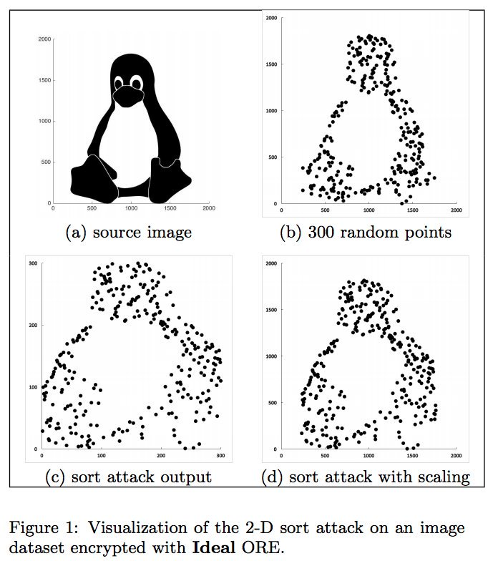
Academic Solutions, cont’d.
Order Revealing Encryption (ORE)
  https://eprint.iacr.org/2016/786.pdf

Slide 21

Academic Solutions Summarized
Experimental designs are too interesting.
We want boring cryptography.

Slide 22
Toward Practical Searchable Database Record Encryption
Let’s revisit our ground rules:
  Always use authenticated encryption
Use two columns (and two keys):
  One for the ciphertext
    crypto_secretbox (XSalsa20-Poly1305)
    AES-GCM
    AES-CTR + HMAC-SHA-256 (Encrypt then MAC)
  One for a blind index used for fast searching

Slide 23
Toward Practical Searchable Database Record Encryption
Blind index algorithm decision:
  If we have high-entropy inputs, we can just use shared-key authentication (crypto_auth, which uses HMAC)
  If we have low-entropy inputs (SSNs, phone numbers), we must use a password hashing function (and our second key becomes a salt)
We can use the blind index (HMAC/Argon2 output) in our SELECT queries, but the actual result is stored in the database encrypted
Demo

Slide 24
Real-World Searchable Encryption
Use crypto_secretbox() to store encrypted data
Use crypto_auth() or crypto_pwhash() to store an separate column (called a blind index) to be used in SELECT queries
  SELECT * FROM people WHERE ssn_blindindex = $1
  $plaintextSSN = \Sodium\crypto_secretbox_open(
  $encryptedSSN,
  $nonce,
  $key
  );
No crazy homomorphic schemes
Known primitives; easy to reason about

Slide 25
Limitations of Blind Indexing
This only works for exact-match lookups.
  What if you need separate case-insensitive and case-sensitive search capability?
  What if you need to be able to search based on a subset of data?
    First three letters, common prefixes?
The general solution to the above limitation is to create a separate index column for each use-case.
  It may be worthwhile to truncate the indexes and use them as a bloom filter rather than exact search, depending on your use case.

Slide 26
Recap
Anonymous IP logging
  HMAC with a daily random authentication key
Duplicate Password Detection
  Second password hash (e.g. Argon2) with a static salt but higher cost
Encrypted Database Search
  Authenticated encryption
  Blind index (HMAC or Argon2)
No crazy homebrew primitives
No experimental academic designs!

Slide 27
Questions?
Demo code is at https://github.com/paragonie/bsidesorl-2017

