Slide 1
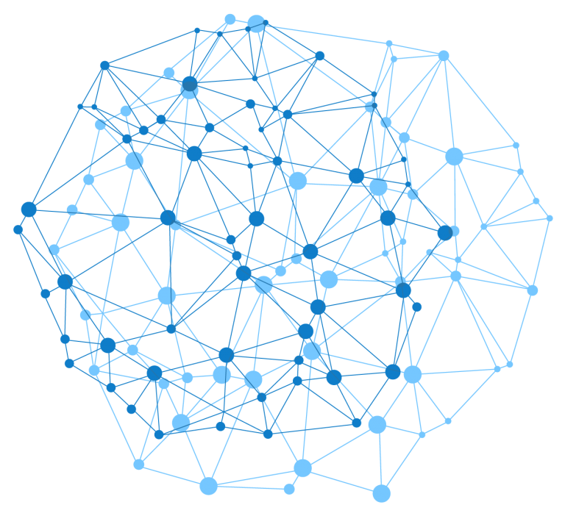

Presentation
on
Paragraph Segmentation Using Semi-Supervised Deep Clustering Network
Under the guidance of Prof. Zeyd Boukhers
Presented by
Vidyasagar Aithal Radhakrishna
Soujanya Basangari
Toralben Arvindbhai Davara
Varuni Gururaja
Sai Manasa Tanniru

Slide 2







Agenda
3. Pre-Processing
Description about the data preparation before sending it to our model.
4. Methodolgy
Description about our model, training phase and evaluation of trained model.
2. Data Generation
A short description of methodology involved in generating a large data tp train our model.
5. Results and Evaluation
Discussion on the results achieved by our model on the different set of test data.
1. Introduction
A brief introduction about our application. Problem statement? How can it be tackled? Design of our model to solve the problem?
6. User Interface
A small demonstration of our website application.

Slide 3
Introduction
PDF is one of the most popular and powerful electronic document formats
Extracting information from the PDF document is a tricky job
A huge number of applications are available online to extract the content. But the variety is so confusing and there is no clear winner
Deep Learning techniques are booming nowadays and could be used to solve numerous problems
Our application is developed on semi-supervised model combined with clustering technique
End result is the clustered data, which will be used to get the segmented paragraphs in an oredered manner

Slide 4
Data Generation
Metadata records from ArXiv On Kaggle2 (1.7 million articles in JSON format)
1000 Pdfs with 200 paragraphs, headers, and footnotes each
CSV files are generated parallelly, containing each lines of pdfs with
respective labels
Scraped webpages to create large set of pdfs (Unlabelled data)
Starting line of paragraph as 1
Rest lines of paragraph as 2
Header and footer as 3

Slide 5
Pre-Processing
Feature extraction is done using PyMuPDF
Along with the each line of text the layout information of the line are also derived using the PyMuPDF.
From the extracted features, we also derive a few more features by the method of transormation.
All together around 26 handcrafted features are extracted.
A few of the examples are as follows: Ishorizontaltab, isenddot, isstartnumber, etc.

Slide 6

Methodology
X_{i}
X_{i}
Latent features
Inputs
Reconstruction
Z_{i}
Encoder
Decoder
Clustering
Techniques
fθ(.)
gθ(.)
Architecture of Clustering using autoencoder

Slide 7
Methodolgy
Training Process
Training process involves two phases in our application as follows:
Phase 1 – Pre-train model with labeled dataset
Phase 2-Two step process
Step 1: Train model with both datasets without true labels(labeled and unlabeled)
Step 2: Train using only labeled dataset until the desired accuracy score is obtained
The accuracy achieved on our trained model is 0.99

Slide 8
Results & Evaluation
 | Accuracy | Precision | Recall | F-score
Using Kmeans
Set1 | 0.84 | 0.84 | 0.839 | 0.84
Set2 | 0.85 | 0.85 | 0.84 | 0.84
Set3 | 0.81 | 0.81 | 0.81 | 0.81
Using Gaussian mixture model
Set1 | 0.83 | 0.835 | 0.839 | 0.835
Set2 | 0.84 | 0.84 | 0.84 | 0.83
Set3 | 0.78 | 0.78 | 0.78 | 0.79

Slide 9

User Interface
User
Autoencoder
Kmeans
Input as PDF
Web Page
Preprocessing
Request
Response
features
Model Prediction
Model saved to hdf5 and .pkl files
Returns segmented paragraphs
Clustered labels
Segmentation Unit

Slide 10
For your Attention
Thank You

