Slide 1
Finastra Platform Shared Services
Grafana Cloud BU-Aligned Architecture: Observability Pod
Date: May, 2026

Slide 2
Deliverable Overview
Deliverable Purpose
Supported Outcomes
Key Questions Answered in this Document
Evaluate existing Grafana Cloud stack management framework originally established in Pattern 005
Establish a clear separation between two distinct boundaries:
The View Stack (BU Level) serves as the Operational Boundary.
The Product Label serves as the Security Boundary.
Design Pattern 006 without compromising the enterprise-grade security guarantees that Pattern 005 established.
Consolidate an ecosystem of more than one hundred per-product stacks into approximately five to six BU-aligned stacks (Lending, Payment).
Design High-Level Target State Architecture including control plane, telemetry ingestion tier, and Grafana Cloud boundary that compose the BU-aligned model.
Design BU-Aligned Org Structure and introduce naming convention: Product ID tier is replaced by the Business Unit tier.
What is the purpose of evolving the Grafana Cloud stack management framework?
What were the key characteristics of the original framework established in Pattern 005?
What does the shift to a business unit–aligned stack model involve?
Why is the organization moving away from a per-product stack model?
What are the benefits of reducing the number of stacks from over 100 to 5-6?
What will be proper boundaries for the different environments within stack?
This document summarizes the strategic evolution Grafana Cloud stack management framework originally established in Pattern 005 and introduces a deliberate architectural shift to Business Unit aligned stack model consolidating an ecosystem of more than one hundred per-product stacks into approximately five to six BU-aligned stacks.

Slide 3

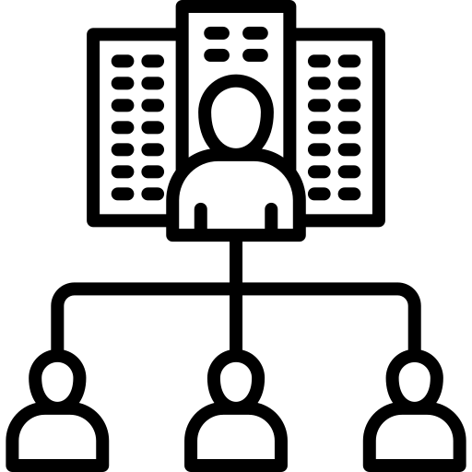
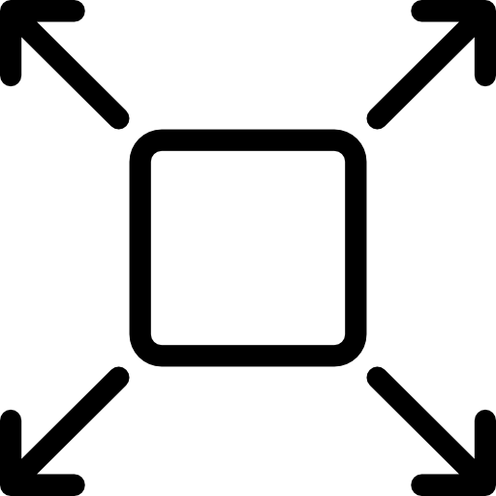


Observability Solution
Next-Gen Developer Portal
Core Personas
Service Portal
Orchestration
Delivery and Integration
Developer Portal
Services Catalog
Developer Portal
Access Controls
Standardized CI/CD and GitOps
Secure Image and Artifact Management
Automated Testing Services
Event & Infrastructure Integration
Finastra
Lending
Landing Zone
Payments
Platform
Integration
Universal Banking
Cloud-Native Networking
Identity, Access, and Secrets Management
Policy-as-Code Security Enforcement
Runtime Protection & Platform Hardening
Services
Coordination
External Partners
Observability and FinOps
Fintech Partner
Request
Partner Integration Orchestration
Unified Telemetry (Metric, Logs, Traces)
BU Dashboards & Reliability Monitoring
Centralized Alerting & Incident Response
Cost Transparency & FinOps Optimization
Implementation Partner
Response
Governance, Policy and Compliance
API Provider
Services Lifecycle
Management
Policy-as-Code Governance
Compliance Automation & Audit
Change Control & Governance
Configuration & Drift Management
Customers
Global
One-Stop Platform Provisioning
AI Lab
National
Developer
Productivity Assistants
Business Self-Service AI Development
Developer Self-Service AI Development
AI
Marketplace
Regional
Community
Guiding
Principles
Cloud Agnostic
Global Guardrails,
Local Autonomy
FO and FFDC Extensions
Multi-Sided Ecosystem Growth
Marketplace
Driven Experience
Legend
Deliverable Scope
Future Execution Focus

Slide 4
EXECUTIVE SUMMARY
Where We Are. Where We're Going.
Pattern 006 evolves the Grafana Cloud framework established by Pattern 005.
WHERE WE STARTED
WHERE WE STRUGGLE
WHERE WE'RE GOING
Pattern 005
100+ Stacks
Pattern 006
Single Finastra org (4 → 1 consolidation). Per-product stack model. GitOps + Terraform foundation.
Operational sprawl, asset duplication, identity sprawl, no cross-tier views, fragmented multi-region visibility.
5–6 BU-aligned stacks. Same enterprise security via LBAC + RBAC. Native cross-tier + Single Pane of Glass.
The shift is structural, not regressive - enterprise-grade security is fully preserved.
5 / 17

Slide 5
THE PROBLEM
Why Per-Product Stacks Don't Scale
Pattern 005 served us well. At scale, its implementation choice has produced architectural debt.
100+
0
4
N×
Per-product stacks to maintain
Cross-tier views possible
Stacks SRE accesses for Pay2Go
Dashboard sync burden per change
FIVE DIMENSIONS OF ARCHITECTURAL DEBT
1
Operational Overhead
Patching, upgrading, auditing 100+ stateful stacks
2
Asset Duplication
Every dashboard improvement requires 100+ coordinated deployments
3
Identity Sprawl
SREs maintain role assignments across dozens of isolated boundaries
4
Siloed Observability
Cross-tier (Dev→Stage→Prod) views structurally impossible
5
Fragmented Multi-Region
Pay2Go SREs context-switch across 4 stacks for a global view
Consolidating at the BU level mitigates blast radius while unlocking material operational gains.
6 / 17

Slide 6
THE ARCHITECTURAL INSIGHT
Two Boundaries, One Architecture
What makes BU-level consolidation safe is a deliberate separation between two distinct boundaries.
OPERATIONAL BOUNDARY
SECURITY BOUNDARY
The Stack (BU Level)
The Label & Folder (Product Level)
AZR-C03-LEND-0001
{product="laserpro"}
WHERE
WHERE
SRE operations are anchored
Dashboards are shared
BU-level governance lives
Alertmanager runs
Product teams are isolated
RBAC scopes folder access
LBAC filters queries at runtime
Query engine enforces — not policy
Same enterprise-grade security as Pattern 005. The change is structural, not regressive.
7 / 17

Slide 7
HOW IT WORKS
Personas, Ingestion, Isolation, Billing
Four mechanisms that make BU-level consolidation safe, secure, and cost-attributable
① PERSONAS — Who Uses Pattern 006
② GRAFANA ALLOY — Label Enforcement at Edge
👤
Developer
Sees only their product's data — folder-scoped
"No labels = no entry"
LBAC: {product="laserpro"}
👥
DevOps / SRE
Cross-product within BU — incident correlation
INJECTS MANDATORY LABELS:
LBAC: {product=~"a|b"}
bu
product
env
region
💼
BU Owner
Cost showback & chargeback visibility
Telemetry without these labels is rejected at the collector — guaranteeing 100% attribution
Filtered: billing folder
③ LBAC + RBAC — Replaces Physical Stack Boundaries
④ PER-PRODUCT BILLING — Without Per-Stack
RBAC
LBAC
grafanacloud_usage{product="laserpro"}
Folder-level access
Query-engine filter
Controls which folders a user can SEE in the UI. LoanIQ folder hidden from LaserPro team.
Filters DATA at PromQL/LogQL execution. LaserPro queries cannot return LoanIQ data — period.
FILTERS BY PRODUCT LABEL:
Active series
Log volume
Trace spans
count
GB/month
count
Physical separation traded for query-engine enforcement — same security guarantee
10 products in 1 stack — each product's cost still accurately attributable to its P&L
8 / 17

Slide 8
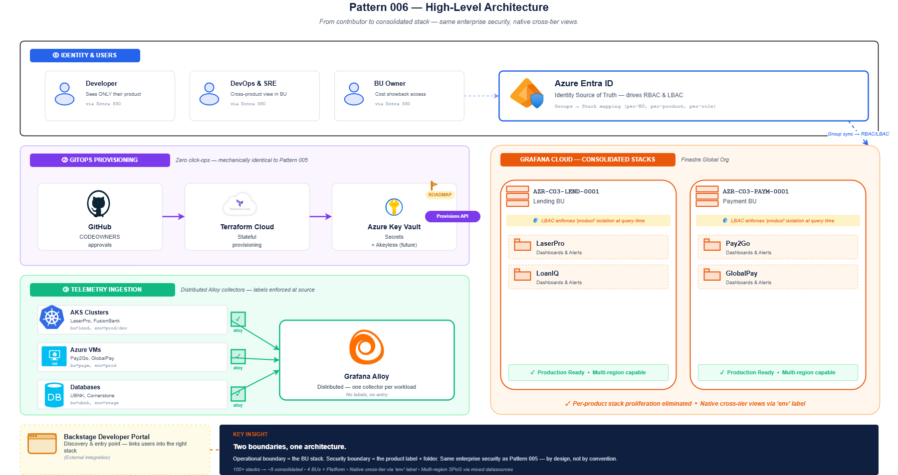
ARCHITECTURE OVERVIEW
High-Level Architecture
End-to-end view: Users & Identity → GitOps → Telemetry → BU-Aligned Grafana Cloud Stacks
KEY TAKEAWAYS
Single Finastra Org
Inherited from Pattern 005's 4→1 consolidation
GitOps Everywhere
Zero click-ops, full Terraform automation
Label Enforcement
Alloy injects bu, product, env, region at edge
5-6 BU Stacks
Replace 100+ per-product stacks
Backstage Entry
Discovery via developer portal
9 / 17

Slide 9
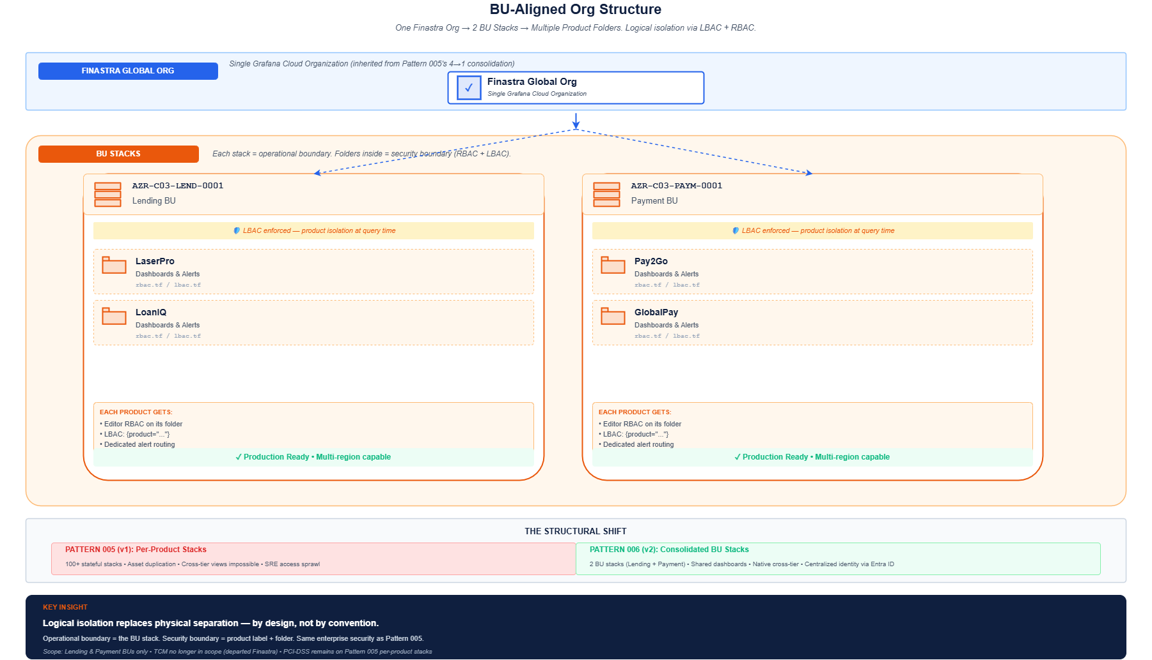
STRUCTURE
BU-Aligned Org Structure
Five Business Units. Multiple product folders. Logical isolation replaces physical separation.
KEY TAKEAWAYS
2 BU Stacks
Lending, Payment
Product Folders
Logical isolation within each stack
Multi-Region Support
Regional stacks where required
Editor RBAC
Teams retain self-service per folder
Pattern 005 Carve-Outs
PCI-DSS workloads stay isolated
Pattern 006 • SPS-2000 • Finastra Observability Pod
10 / 17

Slide 10
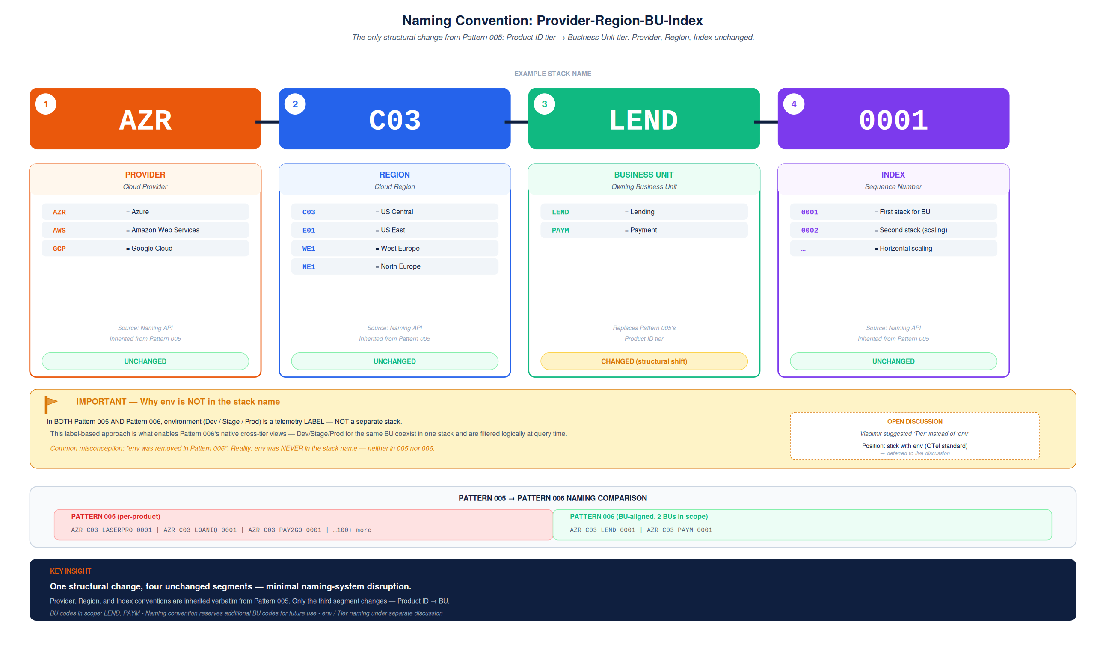
NAMING
Naming Convention
Precisely one structural change from Pattern 005: Product ID tier → Business Unit tier.
KEY TAKEAWAYS
Provider Unchanged
AZR, AWS, GCP — Naming API
Region Unchanged
C03, E01, WE1, NE1
BU Replaces Product ID
LEND, PAYM
Index Unchanged
Supports horizontal scaling
env is a Label
Never in stack name (005 or 006)
11 / 17

Slide 11
ACCESS CONTROL
Identity-to-Stack Mapping
Worked example - Jane, a LaserPro engineer in the Lending BU.
KEY TAKEAWAYS
Entra ID = Truth
Inherited from Pattern 005
Auto-Provisioning
RBAC + LBAC from group memberships
Jane Sees Only LaserPro
LoanIQ folder hidden by RBAC
LBAC at Query Time
Cannot see LoanIQ data — structurally
SRE Variant
Multi-product access via single group
12 / 17

Slide 12
MULTI-REGION
Region as a Dimension
Single Pane of Glass - LoanIQ (single-region) vs Pay2Go (multi-region) side by side.
KEY TAKEAWAYS
Region in 2 Places
Stack name (hosting) + label (filter)
LoanIQ: 1 Stack
US-only, region as dropdown filter
Pay2Go: 2 Stacks
US + EU due to GDPR
Mixed Datasources
Unified dashboard across regions
Data Residency
Raw user data stays regional
13 / 17

Slide 13
ALERT ISOLATION
Hardened Alertmanager Flow
Four guardrails make cross-tenant alert suppression structurally impossible in a shared stack.
KEY TAKEAWAYS
Family Isolation
alert_family label gates inhibition
Identity Matching
equal: [namespace, cluster, name]
Jira vs OnCall
Routing separation enforced
GitOps Enforcement
Unlabeled rules rejected at PR
By Design
Not by convention — structurally
14 / 17

Slide 14
GITOPS
GitOps Management Flow
Zero click-ops - mechanically identical to Pattern 005. Contributor → GitHub → Terraform → Grafana Cloud.
KEY TAKEAWAYS
Same as Pattern 005
Mechanically identical flow
Auditable
Every change = PR + CODEOWNER approval
Standardized
Same workflow for all BUs
Self-Service
Teams operate within the rails
Idempotent
Re-runs produce zero drift
15 / 17

Slide 15
MIGRATION PATH
Five-Phase Adoption Strategy
Zero-disruption rollout. Old and new stacks coexist. Rollback possible through Phase 3.
KEY TAKEAWAYS
Phase 0: Preparation
Week 0 — alignment & sandbox
Phase 1: Provision
Weeks 1-2 — new stacks empty
Phase 2: Dual-Write
Weeks 3-6 — Alloy writes to both
Phase 3: Migrate
Weeks 7-10 — last rollback point
Phase 4: Deprecate
Week 11+ — 60-day grace
16 / 17

Slide 16
THE BOTTOM LINE
Pattern 006 Sets Finastra Up to Scale
95%
1 policy
Native
fewer stacks
for SRE multi-product
cross-tier views
From 100+ to 5–6 BU stacks
vs. dozens of mappings before
Dev/Stage/Prod overlay possible
STAKEHOLDER FEEDBACK — RESOLVED
Q1
✓
Q2
✓
Q3
✓
Q4
✓
Which stack will I access?
Multi-region Single Pane of Glass?
Region — label or boundary?
Alertmanager in shared stack?
NEXT STEPS
1. Review of design with Vladimir Babichev 2. Alignment call with Enterprise Monitoring 3. Iterate, finalize by June 30
Questions, please.

