Slide 1
Front-end Web Design
Lecture 1

Slide 2
Content
Course requirements
Purpose of course
Introduction to HTML.
Common tags

Slide 3
Course requirements
Govher Yarashova
Web Design and Programming
17 weeks: 17 lectures, 17 seminars, 17 practices
[Midterm*35+Assignment*25+Final*40]/100
Submit your work online in IUHD portal
I will not share ppt until next lecture
You need a notebook and it’s your choice to write or not, but I will check it

Slide 4

What is HTML?
HTML is short for Hyper Text Markup Language.
A language for describing web-pages using ordinary text.
HTML is not a complex programming language.
Hypertext is simply a piece of text that works as a link.
Markup Language is a way of writing layout information within documents.

Slide 5
What is HTML?
Every web page is actually an HTML file.
Each HTML file is just a plain-text file, but with a .html file extension instead of .txt, and is made up of many HTML tags as well as the content for a web page.

Slide 6
HTML Tags
HTML tags are the hidden keywords within a web page that define how your web browser must format and display the content.
The most important benefits of knowing tags are:
You can use tags the editor does not support.
You can read the code of other people's pages, and "borrow" the cool effects.
You can do the work yourself, when the editor simply refuses to create the effects you want.

Slide 7
A Simple HTML Document
<!DOCTYPE html> <html> <head> <title>Page Title</title> </head> <body> <h1>My First Heading</h1> <p>My first paragraph.</p> </body> </html>

Slide 8
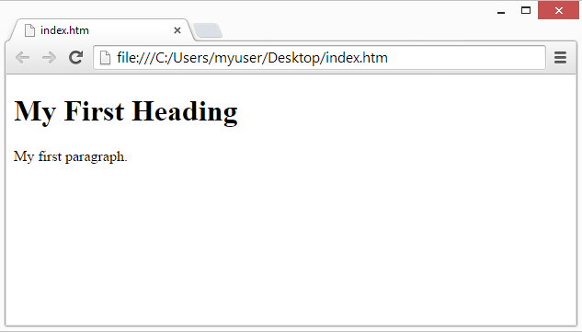

Slide 9
Anatomy of a tags
HTML tags are element names surrounded by angle brackets:
<tagname> content goes here...</tagname>
HTML tags normally come in pairs like <p> and </p>
The first tag in a pair is the start tag, the second tag is the end tag
The end tag is written like the start tag, but with a forward slash inserted before the tag name

Slide 10
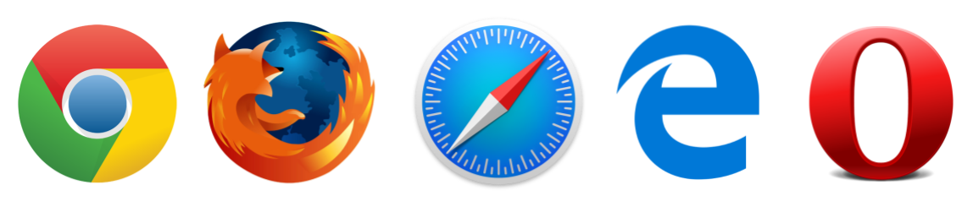
Web Browsers
The purpose of a web browser (Chrome, IE, Firefox, Safari) is to read HTML documents and display them.
The browser does not display the HTML tags, but uses them to determine how to display the document

Slide 11
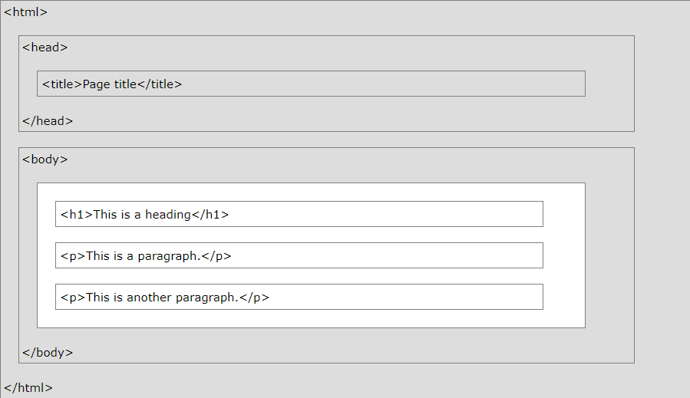

Slide 12
Document type declaration
All HTML documents must start with a document type declaration: <!DOCTYPE html>.
The HTML document itself begins with <html> and ends with </html>.
The visible part of the HTML document is between <body> and </body>.
The <!DOCTYPE> Declaration
The <!DOCTYPE> declaration represents the document type, and helps browsers to display web pages correctly.
It must only appear once, at the top of the page (before any HTML tags).
The <!DOCTYPE> declaration is not case sensitive.

Slide 13
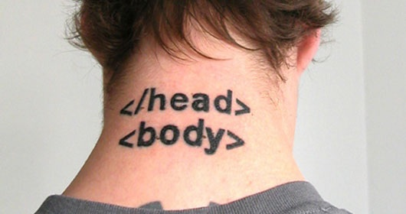

Slide 14
HTML Headings
Headings are defined with the <h1> to <h6> tags.
<h1> defines the most important heading. <h6> defines the least important heading.
Example
<h1>This is heading 1</h1> <h2>This is heading 2</h2> <h3>This is heading 3</h3> <h4>This is heading 4</h4> <h5>This is heading 5</h5> <h6>This is heading 6</h6>

Slide 15
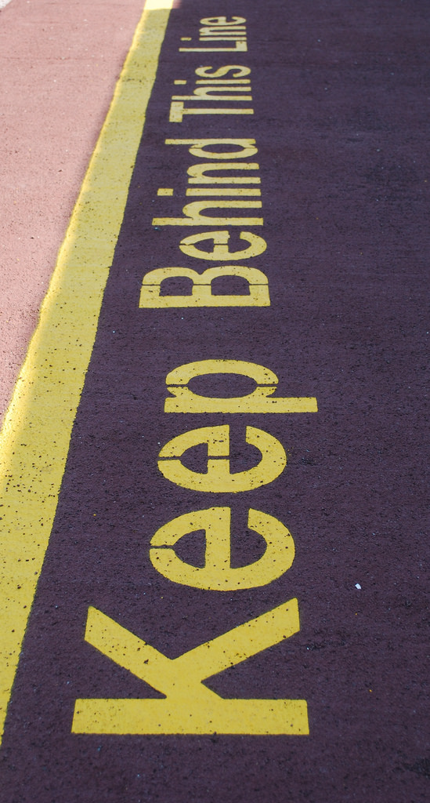
Empty HTML Elements
Empty HTML Elements
HTML elements with no content are called empty elements.
The <hr> tag displayed as a horizontal rule.
The <hr> element is used to separate content (or define a change) in an HTML page:
<h1>This is heading 1</h1> <p>This is some blah blah blah.</p> <hr> <h2>This is heading 2</h2> <p>This is some other blah blah blah.</p> <hr>

Slide 16
HTML Paragraphs
The HTML <p> element defines a paragraph:
You cannot be sure how HTML will be displayed.
Large or small screens, and resized windows will create different results.
With HTML, you cannot change the output by adding extra spaces or extra lines in your HTML code.
The browser will remove any extra spaces and extra lines when the page is displayed.

Slide 17
HTML paragraph
<p>This paragraph contains a lot of lines in the source code, but the browser ignores it. </p>
<p> This paragraph
contains a lot of
spaces in the source code,
but the browser ignores it.
</p>

Slide 18
HTML Line Breaks
The HTML <br> element defines a line break.
Use <br> if you want a line break (a new line) without starting a new paragraph:
Example
<p>This is<br>a paragraph<br>with line breaks.</p>
The <br> tag is an empty tag, which means that it has no end tag.

Slide 19
The Poem Problem
<p> My Bonnie lies over the ocean.
My Bonnie lies over the sea.
My Bonnie lies over the ocean.
Oh, bring back my Bonnie to me.</p>

Slide 20
The HTML <pre> Element
The HTML <pre> element defines preformatted text.
The text inside a <pre> element is displayed in a fixed-width font (usually Courier), and it preserves both spaces and line breaks:
Example
<pre>
My Bonnie lies over the ocean.
My Bonnie lies over the sea.
My Bonnie lies over the ocean.
Oh, bring back my Bonnie to me.</pre>

Slide 21
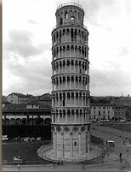
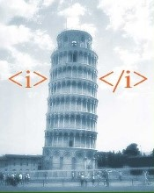

Slide 22
<b>text</b> | writes text as bold
<i>text</i> | writes text in italics
<u>text</u> | writes underlined text
<sub>_{text}</sub> | lowers text and makes it smaller
<sup>^{text}</sup> | lifts text and makes it smaller
<strike>text</strike> or <del>text</del> | strikes a line through the text
<tt>text</tt> | writes text as on a classic typewriter
<pre>text</pre> | writes text exactly as it is, including spaces.
<em>text</em> | usually makes text italic
<strong>text<strong> | usually makes text bold

Slide 23
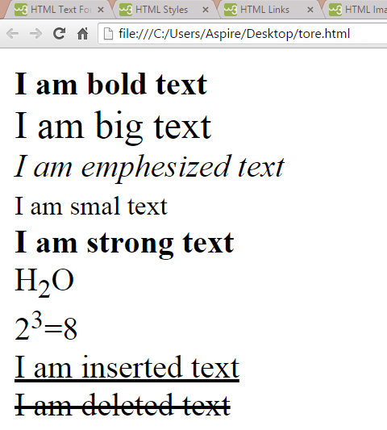
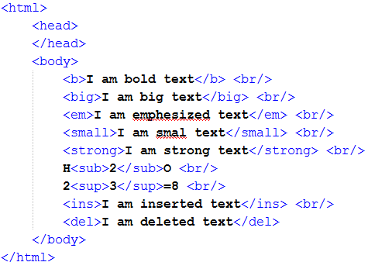

Slide 24

Image
In HTML, images are defined with the <img> tag.
The <img> tag is empty, it contains attributes only, and does not have a closing tag.
<img src=“source”>

Slide 25

HTML Links
HTML links are hyperlinks.
You can click on a link and jump to another document.
A link does not have to be text. It can be an image or any other HTML element.
<a href="url">link text</a>

Slide 26
Next lecture
HTML attributes
Colors
Lists
Tables
Forms

