Slide 1

Frameset Element
Nested Framesets

Slide 2
Introduction
All of the Web pages we present have the ability to link to other pages, but can display only one page at a time. Frames allow a Web developer to display more than one XHTML document in the browser simultaneously.
HTML frames are used to divide your browser window into multiple sections where each section can load a separate HTML document. A collection of frames in the browser window is known as a frameset. The window is divided into frames in a similar way the tables are organized: into rows and columns.

Slide 3
Introduction
Two tags are used to make frame documents: <frameset> and <frame>. <noframes> tags can be used to provide alternative content for non-frames browsers.
A frameset is simply a collection of frames that occupy the browser's window. Column and row definition attributes for the <frameset> tag let you define the number and initial sizes for the columns and rows of frames. The <frame> tag defines what document--HTML or otherwise--initially goes into the frame, and is where you may give the frame a name to use for hypertext link targets.

Slide 4
Creating Frames
To use frames on a page we use <frameset> tag instead of <body> tag. The <frameset> tag defines, how to divide the window into frames. The rows attribute of <frameset> tag defines horizontal frames and cols attribute defines vertical frames. Each frame is indicated by <frame> tag and it defines which HTML document shall open into the frame.

Slide 5
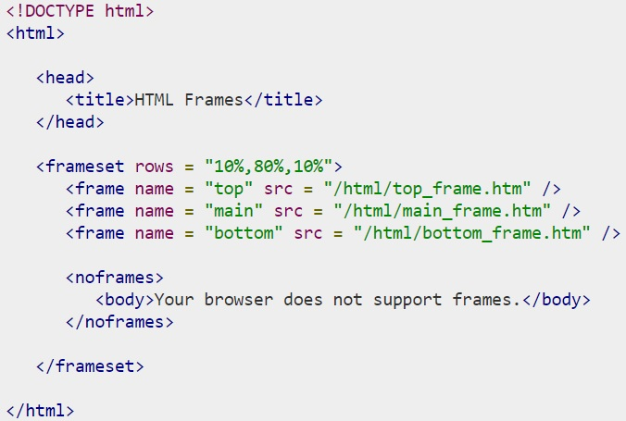
Following is the example to create three horizontal frames

Slide 6
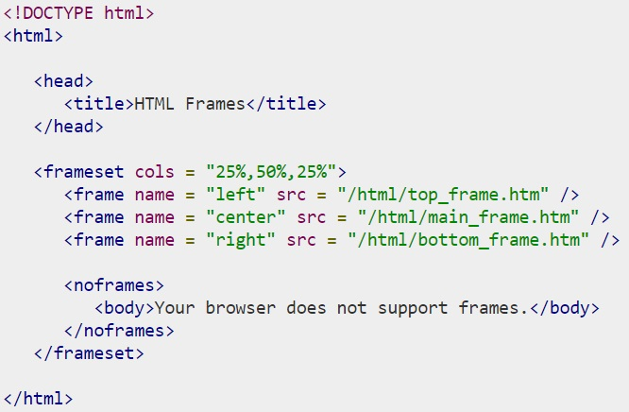
Let's put the above example as follows, here we replaced rows attribute by cols and changed their width. This will create all the three frames vertically

Slide 7
Element <noframes>
Not all browsers support frames. HTML provides the <noframes> element to enable HTML document designers to specify alternative content to a frameset for browsers that do not support frames
<noframes>
<body>
Your browser does not support frames.
</body>
</noframes>

Slide 8
The <frameset> Tag Attributes: Cols
Specifies how many columns are contained in the frameset and the size of each column. You can specify the width of each column in one of the four ways −
Absolute values in pixels. For example, to create three vertical frames, use cols = "100, 500, 100".
A percentage of the browser window. For example, to create three vertical frames, use cols = "10%, 80%, 10%".
Using a wildcard symbol. For example, to create three vertical frames, use cols = "10%, *, 10%". In this case wildcard takes remainder of the window.
As relative widths of the browser window. For example, to create three vertical frames, use cols = "3*, 2*, 1*". This is an alternative to percentages. You can use relative widths of the browser window. Here the window is divided into sixths: the first column takes up half of the window, the second takes one third, and the third takes one sixth

Slide 9
The <frameset> Tag Attributes: Rows
This attribute works just like the cols attribute and takes the same values, but it is used to specify the rows in the frameset. For example, to create two horizontal frames, use rows = "10%, 90%". You can specify the height of each row in the same way as explained above for columns.
The <frameset> Tag Attributes: border
This attribute specifies the width of the border of each frame in pixels. For example, border = "5". A value of zero means no border.

Slide 10
The <frameset> Tag Attributes: frameborder
This attribute specifies whether a three-dimensional border should be displayed between frames. This attribute takes value either 1 (yes) or 0 (no). For example frameborder = "0" specifies no border.
The <frameset> Tag Attributes: framespacing
This attribute specifies the amount of space between frames in a frameset. This can take any integer value. For example framespacing = "10" means there should be 10 pixels spacing between each frames.

Slide 11
The <frame> Tag Attributes: scr
This attribute is used to give the file name that should be loaded in the frame. Its value can be any URL. For example, src = "/html/top_frame.htm" will load an HTML file available in html directory.
The <frame> Tag Attributes: name
This attribute allows you to give a name to a frame. It is used to indicate which frame a document should be loaded into. This is especially important when you want to create links in one frame that load pages into an another frame, in which case the second frame needs a name to identify itself as the target of the link.

Slide 12
The <frame> Tag Attributes: frameborder
This attribute specifies whether or not the borders of that frame are shown; it overrides the value given in the frameborder attribute on the <frameset> tag if one is given, and this can take values either 1 (yes) or 0 (no).
The <frame> Tag Attributes: marginwidth
This attribute allows you to specify the width of the space between the left and right of the frame's borders and the frame's content. The value is given in pixels. For example marginwidth = "10".

Slide 13
The <frame> Tag Attributes: marginheight
This attribute allows you to specify the height of the space between the top and bottom of the frame's borders and its contents. The value is given in pixels. For example marginheight = "10".
The <frame> Tag Attributes: noresize
By default, you can resize any frame by clicking and dragging on the borders of a frame. The noresize attribute prevents a user from being able to resize the frame. For example noresize = "noresize".

Slide 14
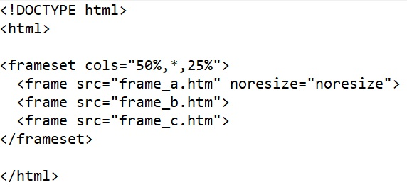
The <frame> Tag Attributes: noresize

Slide 15
The <frame> Tag Attributes: scrolling
This attribute controls the appearance of the scrollbars that appear on the frame. This takes values either "yes", "no" or "auto". For example scrolling = "no" means it should not have scroll bars.
The <frame> Tag Attributes: longdesc
This attribute allows you to provide a link to another page containing a long description of the contents of the frame. For example longdesc = "framedescription.htm"

Slide 16
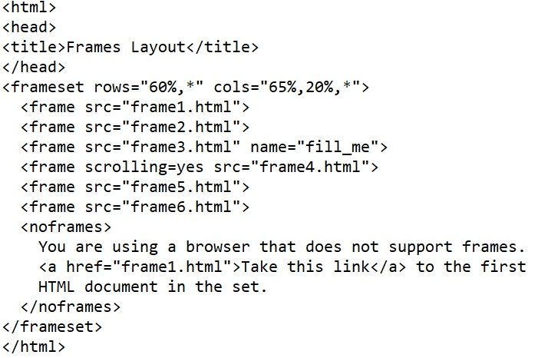
The <frame> Tag Attributes: scrolling

Slide 17
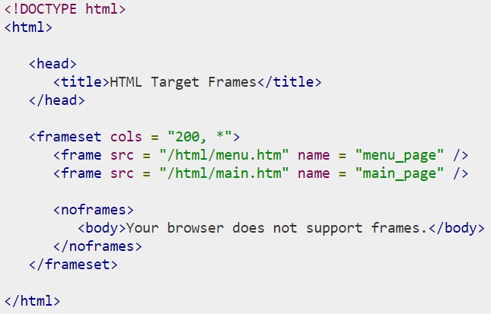
Frame's name and target attributes

Slide 18
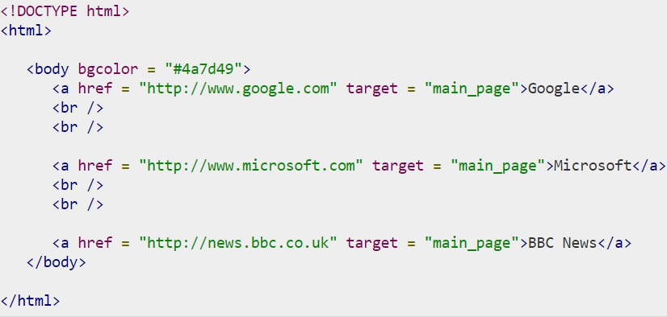
Main page background color

Slide 19
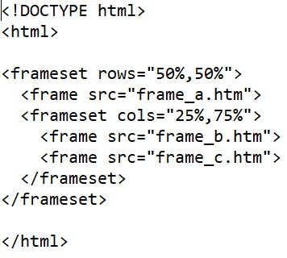
Mixed Framesets

Slide 20
Nested Framesets
You can achieve more complex layouts by using nested <frameset> tags. Any frame within a frameset can contain another frameset.
For example, shows a layout of two columns, the first with two rows and the second with three rows. This is created by nesting two <frameset> tags with row specifications within a top-level <frameset> that specifies the columns

Slide 21
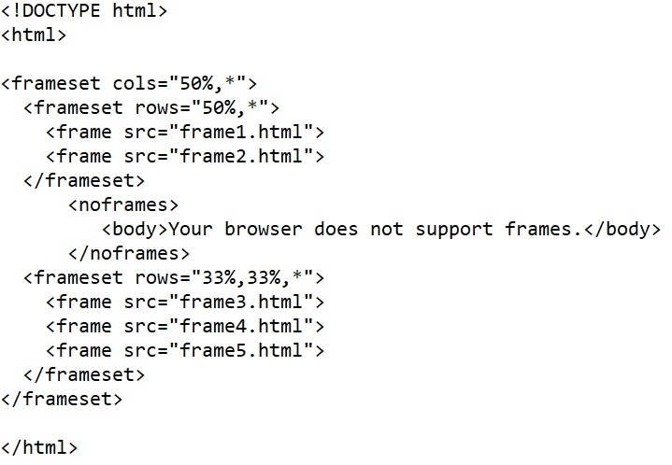
Nested Famesets

Slide 22
















Framesets can be nested
True
False

Slide 23



Attributes which define the framesets
Cols, borders
Cols, rows
Src,borders

Slide 24

How is called the frame within a frameset which can contain another frameset?
Horizontal frameset
Mixed frameset
Nested frameset

Slide 25

This attribute is used to give the file name that should be loaded in the frame
link
scr
name

Slide 26

The tag which is used to provide alternative content for non-frames browsers.
<noframe>
<frame>
<frameset>

Slide 27
Insert a framed Web page, with the first
frame extending 300 pixels across the page
from left side

Slide 28
Insert web source to the 3rd vertical frame

Slide 29
Insert an image to the 2nd horizontal frame

Slide 30
Create mixed frameset with different bg colors

Slide 31
Insert a mixed frameset
with a source and name

Slide 32
ANSWERS

Slide 33
Framesets can be nested
True

Slide 34
Attributes which define the framesets
Cols, rows

Slide 35
How is called the frame within a frameset which can contain another frameset?
Nested frameset

Slide 36
This attribute is used to give the file name that should be loaded in the frame
scr

Slide 37
The tag which is used to provide alternative content for non-frames browsers.
<noframe>

Slide 38
Insert a framed Web page, with the first
frame extending 300 pixels across the page
from left side
<frameset cols =“300,*>………..</frameset>

Slide 39
Insert web source to the 3rd vertical frame
<frameset cols = "25%,50%,25%">
<frame name = "left" />
<frame name = "center" />
<frame name = "right" src = “web.html" />
</frameset>

Slide 40
Insert an image to the 2nd horizontal frame
<frameset rows = “20%,60%,20%">
<frame name = "top"/>
<frame name = "main" src = “main.jpg”/>
<frame name = "bottom"/>
</frameset>

Slide 41
Create mixed frameset with different bg colors
<frameset rows="50%,50%">
<frame src="frame_bg.html">
<frameset cols="25%,75%">
<frame src="frame_bg1.html">
<frame src="frame_bg2.html">
</frameset>

Slide 42
Insert a mixed frameset with a source and name
<frameset rows = "30%,*">
<frame src="m.jpg" name = "hello"/>
<frameset cols = "150,*">
<frame src="frame_bg1.html" name = "nav"/>
<frame src="art.html" name = "sign"/>
</frameset>

Slide 43

Thanks for your attention!

